Slide 1
Multi-AP coordination over Fibre
Date: 2023-06-25
Authors:
Name | Affiliation | Address | Phone | Email
Tony Zeng | Huawei |  |  | tony.zengyan@huawei.com
Xuming Wu
Yanchun Li

Slide 2
Introduction
Throughput enhancement is not the only driven factor for service operator to evolve the in-premises network
  High-end XR continually grows
  3D naked eye display provides 3D imaging and multiple view angles
QoE is becoming the key factor for Wi-Fi deployment
  Latency: industrial application, cloud gaming, XR, etc.
  Green: green ICT, ICT enables green digitalization
  Others: connectivity, etc.
UHR matches the needs to solve the QoE problems
  Traditionally, IEEE 802.11 is mainly focusing on air interface
ITU-T SG15 Q3 is working on defining in-premises fibre communication protocol (G.fin series recommendation & G.p2pf) for Fibre-to-the-room (FTTR) scenario for full Wi-Fi coverage

Slide 3
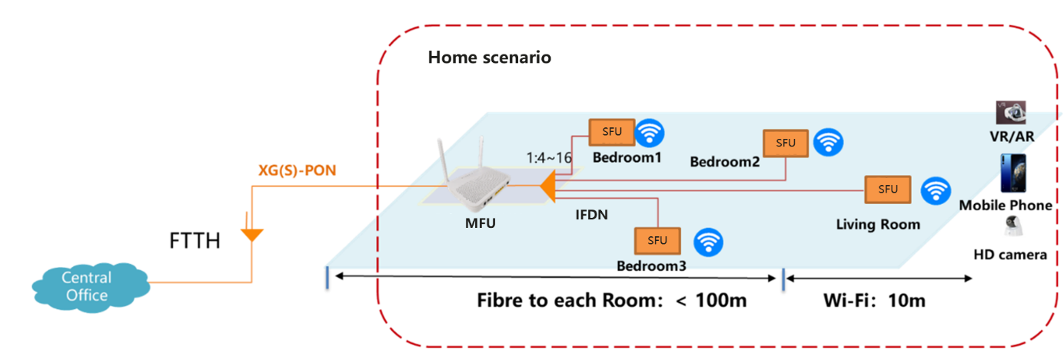
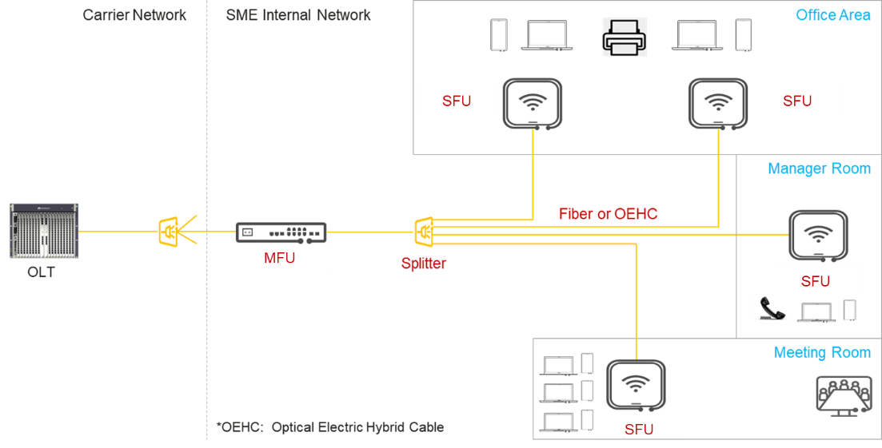
Fibre-to-The-Room (FTTR)
Home scenario
Business scenario
Home scenario
  P2MP fibre topology for scalability, direct link
  Symmetric rate (2.5/10Gbps), stable & reliable connection, extremely low latency, etc.
Business scenario (live broadcasting, smart office, etc.)
  Dense connection (32 APs), long range@1km, remote power feed,
  Super uplink, low/guaranteed latency, east-west streaming, seamless roaming, etc.
Omdia forecasts 7 million system set of FTTR will be deployed in China by 2023

Slide 4
The framework of FTTR
Management Entities
Network Entities
The availability of Wi-Fi interfaces is important for fibre link to help network coordination
Main Fibre Unit (MFU)
Secondary Fibre Unit (SFU)
Control plane: Centralized fibre-wireless coordination
  Identify service flow and differentiate the service QoS
  MFU dynamically collects the Wi-Fi and network relevant information such as data buffer, link status, etc.
  The MFU controller does analysis and makes decision
  The decision is sent to each SFU through the fibre network

Slide 5
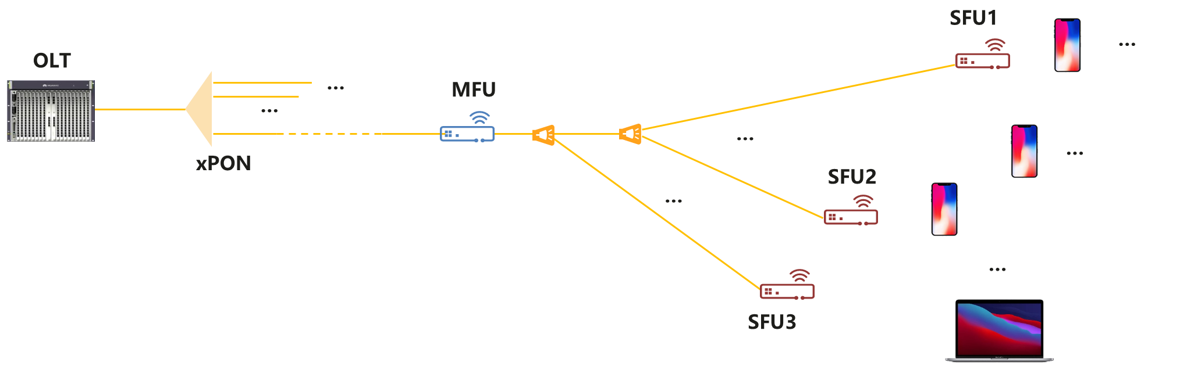
Differences between FTTR Coordination and UHR Coordination
Optical Line Terminal
Multi-AP coordination over fibre link
Multi-AP coordination through air interface
Fibre link should be a complement way for multi-AP coordination
  Guaranteed low latency channel for control message exchange in PHY and DLL
  Deterministic data delivery via TDMA in uplink and TDM broadcasting in downlink
  Tree topology, in which controller is set in MFU
  High throughput backhauling over fibre, best for Co-BF & Joint transmission
  Nature high synchronization over fibre network (OOK modulation over 2.5G/10G)

Slide 6
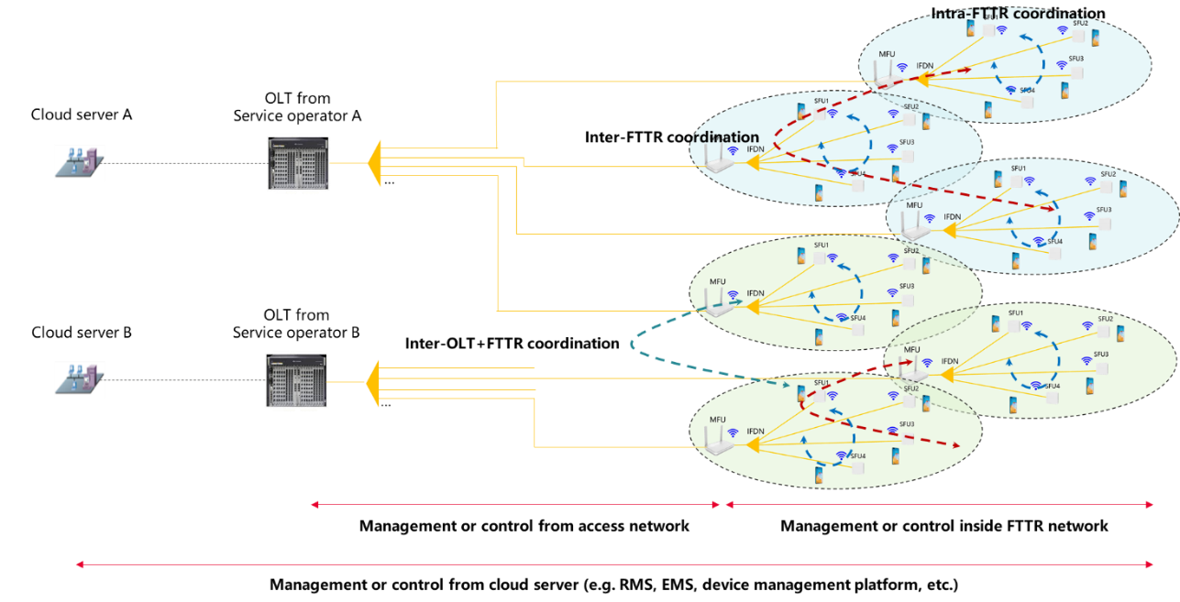
Neighbor coordination in optical access network
③
②
①
To enable global coordination through a E2E network
  Additional controller in central office -> Real-time coordination message exchanging:
  ① under the same PON port
  ② between different PON port of same OLT
  ③ between different PON port of different OLT

Slide 7
Summary
Multi-AP coordination over fibre can be a complementary way as that over air interface:
  We suggest 802.11 (e.g. UHR) can specify the multi-AP coordination control interface for fibre backhaul case

Slide 8
References
[1] 11-22-1083-01-0wng-next-generation-sg-formation
[2] ITU-T G.9940 High speed fibre-based in-premises transceivers – system architecture
[3] ITU-T GSTP-FTTR Use cases and requirements of fibre-to-the-room (FTTR)
[4] ITU-T G.suppl.78 Use case and requirements of fibre-to-the-room for small business applications

