Slide 1
Multi-AP Simulations: framework and Joint Transmission results
Date:

Slide 2
Introduction
Various contributions have presented Joint Transmission (JT) simulation results
  e.g., [1, 2], [4, 5], [6 7]
Simulation methodology, simulation parameters and scenarios vary for the different submissions
  Details in Appendix
We believe simulation scenarios should inherently reflect the realities of in-home deployment
  Analysis that is too abstract or statistical is of limited value

Slide 3
Goal of the submission
Discuss and present topologies relevant for JT
Present initial simulation results using such topologies
Align simulation conditions and simulation results with the UHR project goals
Focusing on residential case

Slide 4
Considerations for residential JT
JT is most likely to be deployed inside a single residence
  All APs under “common control”
  Multiple backhaul options may be available
APs should be strategically placed to maximize coverage
  Allow the network to fall back to current mesh/extender topology when JT is not used
  Specifically, APs in close proximity or excessive number of APs should be avoided
AP configurations (e.g., #antennas) should reflect typical in-home scenarios
  Unlikely to have multiple high-end APs deployed

Slide 5
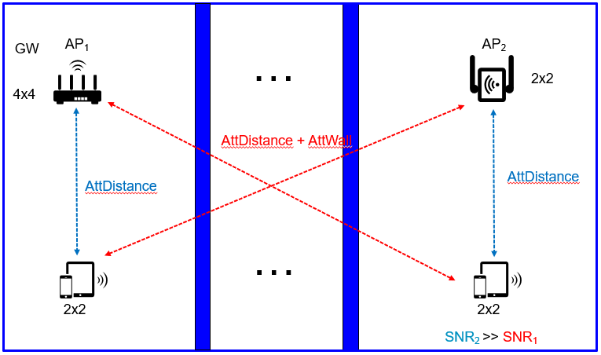
Topology 1: Extender (“Heterogenous APs”)
Typical scenario: one “main” AP and one (or more) “extender” APs
APs with different configurations
  Main AP may be 4x4
  “Extender” APs have lower configurations (e.g., 2x2)
APs in different rooms
  (multiple) wall attenuation
  Asymmetric Rx signal strength
  is typical

Slide 6
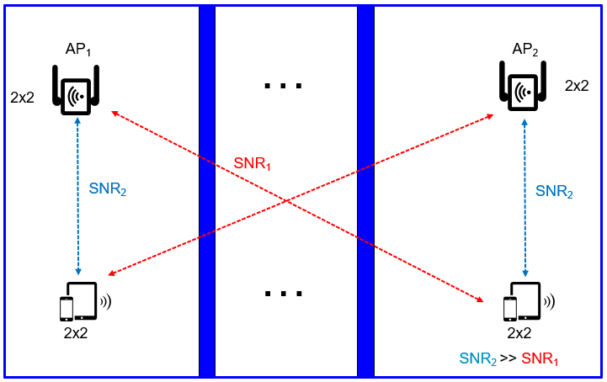
Topology 2: Mesh (“Homogeneous APs”)
All APs have the same configuration
  2x2 is commonly used
APs are separated
  Maybe closer than in Extender scenario
  Asymmetric Rx signal
  strength is typical
Number of APs may be
higher than two

Slide 7
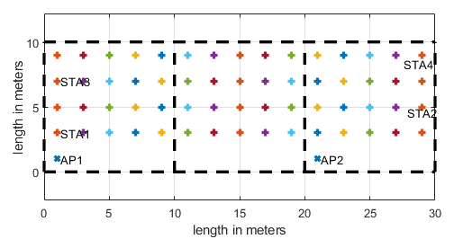
Simulation setup
Evaluate throughput compared to 802.11be
  Aligned with KPIs in UHR PAR
  Compare with the best legacy mode (BF, MU-MIMO)
Residential scenario based on [8]
  Three 10m x 10m rooms, 5dB wall loss
  AP1 in “room 1”, AP2 in “room 3”
  4 STAs total
Topologies:
  Extender: AP1 4x4, AP2 2x2
  Mesh AP1 2x2, AP2 2x2
Impairments or backhaul overhead not considered yet

Slide 8
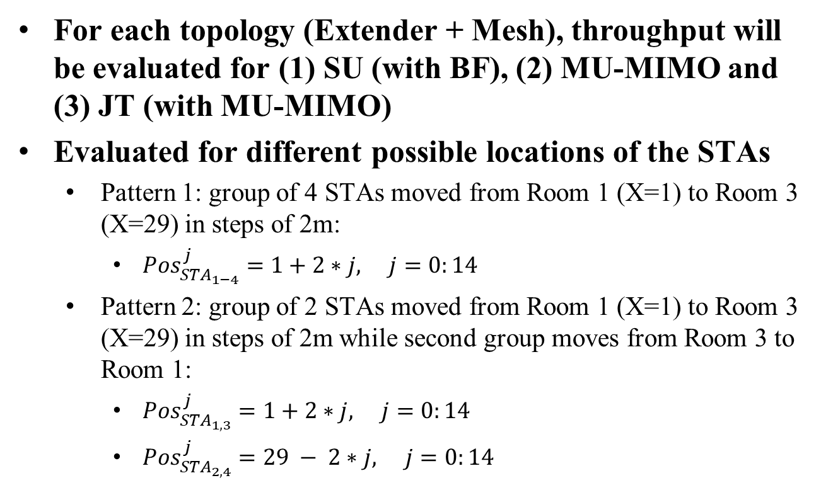
Simulation setup (2)
For each topology (Extender + Mesh), throughput will be evaluated for (1) SU (with BF), (2) MU-MIMO and (3) JT (with MU-MIMO)
Evaluated for different possible locations of the STAs
  Pattern 1: group of 4 STAs moved from Room 1 (X=1) to Room 3 (X=29) in steps of 2m:
    ${Pos}_{{STA}_{1−4}}^{j}=1+2∗j, j=0:14$
  Pattern 2: group of 2 STAs moved from Room 1 (X=1) to Room 3 (X=29) in steps of 2m while second group moves from Room 3 to Room 1:
    ${Pos}_{{STA}_{1,3}}^{j}=1+2∗j, j=0:14$
    ${Pos}_{{STA}_{2,4}}^{j}=29 − 2∗j, j=0:14$

Slide 9
Simulation parameters
Parameter | Value
TX/RX Antennas | 4/2
APs/STAs | 2/4 (2 STAs per AP)
Spatial streams | 1 or 2 (optimized)
Bandwidth | 160 MHz
AP TX Power | 24 dBm
Channel model | D NLOS [8]
MCS | 0-13 (optimized)
Frequency | 5.25GHz
GI | 1.6µs
TX/RX SNR | 41dB/43dB
Channel aging/Doppler | 1.2km/h, 6Hz
BF quantization | ideal
Precoder type | SVD (SU), MMSE (MU)
Sounding interval | 100ms (SU), 10ms (MU)
Overhead | Sounding and MAC overhead not considered
SU time allocation | 25% for each STA
MU allocation | 4 STAs served by one AP

Slide 10
Heterogenous Topology – legacy Beamforming
SU with BF
  “Best AP” selected
  4 STAS served simultaneously, TDMA between STAs, 25% transmit time per STA
  Identical for both movement patterns

Slide 11
Heterogenous Topology – legacy MU MIMO
Movement pattern 1 (4 STAs moving in same direction)
Movement pattern 2 (2 groups of 2 STAs moving in opposite directions)

Slide 12
Heterogenous Topology – Joint Transmission
Movement pattern 1 (4 STAs moving in same direction)
Movement pattern 2 (2 groups of 2 STAs moving in opposite directions)

Slide 13
Extender Topology:
Comparison BF, MU-MIMO, JT
Rate per STA vs. x axis position
Rainer Strobel, MaxLinear

Slide 14
Homogenous Topology – legacy Beamforming
SU with BF
  Best AP selected
  4 STAS served simultaneously, TDMA between STAs, 25% transmit time per STA

Slide 15
Mesh Topology – legacy MU MIMO
Movement pattern 1 (4 STAs moving in same direction)
Movement pattern 2 (2 groups of 2 STAs moving in opposite directions)

Slide 16
Mesh Topology – Joint Transmission
Movement pattern 1 (4 STAs moving in same direction)
Movement pattern 2 (2 groups of 2 STAs moving in opposite directions)

Slide 17
Mesh Topology:
Comparison BF, MU-MIMO, JT
Rate per STA vs. x axis position
Rainer Strobel, MaxLinear

Slide 18
Conclusions
We evaluated performance of JT vs. different “legacy” transmission schemes (BF, MU-MIMO)
We believe correctly capturing the characteristics of in-home topologies is important to understand the value of this technology
JT can provide benefits, but strongly dependent on STA locations and network topology
Complexity and impact from backhaul need to be considered still

Slide 19
References
[1] “Spatial Reuse in Coordinated M-AP for UHR”, IEEE 802.11-23/0058r0
[2] “On Joint C-SR and C-OFDMA M-AP Transmission”, IEEE 802.11-20/1399r2
[3] “Simulation Scenarios” IEEE 802.11-14/0980r16
[4] “Joint Transmission for UHR – Additional Results”, IEEE 802.11-23/0243r0
[5] “Joint Transmission for UHR –A Refresher and New Results”, IEEE 802.11-22/2188r0
[6]“System Level Simulation of Co-BF and Joint Tx”, IEEE 802.11-22/1821r0
[7]“Recap on Coordinated Spatial Reuse Operation”, IEEE 802.11-22/1822r0
[8] “TGax Simulation Scenarios”, IEEE 802.11-14/0621r3, Simone Merlin, etc.
[9] “Consideration of Industrial Automation Scenarios”, IEEE 802.11-23/0815r0, 2023-05
[10] Kosuke Aio (Sony Corporation), “Consideration on Multi-AP Home Mesh Scenario,” 20/0032r0, January 2020.
[11] Dmitry Akhmetov (Intel) et. al. “Multi-AP coordination for spatial reuse”, IEEE802.11-20/0107r1

Slide 20
Appendix

Slide 21
Example Movement Patterns
STAs move in the same direction
  All STAs in the same room (worst case for joint transmission)
STAs move in opposite directions
  Large SNR difference between STAs (worst case for MU MIMO)

Slide 22
Simulation Scenarios
[1, 2] is based on 11ax [8] enterprise scenario
[6, 7] uses [10], based on 11ax [8] residential scenario
[4, 5] uses a generic SNR model, based on channel SNR and the attenuation between the AP-STA links
Conclusion:
  11ax [8] residential and enterprise scenario are a good baseline
    Is the channel attenuation assumption valid?
    Are the residential room sizes reasonable (e.g., [11] uses different parameters)
  A simplified model (as in [4, 5]) may be derived from that
  The 11ax scenarios can be extend (e.g., as proposed in [9]) for other use cases

Slide 23
Parameter Table (from references [2, 5, 7])
Parameter | Value | Parameter | Value
TX/RX Antennas | 4/2 [5] 4/1 [7] | Phase offset | 0-180 [5]
APs/STAs | 2-3/4-6 [5], 2-3/2-3 [7], 4/8 [2] | TX SNR | 38dB [5]
Spatial streams | Opt. [5], 1 [7] | Channel aging | -30dBc [5]
Bandwidth | 80MHz [2, 5, 7] | Doppler | 0Hz [7]
Channel model | [5]11nD [7] D NLOS as in [10] [2] from [8] | BF quantization | 9/7 [6, 7]
MCS | 0-11 [7], 0-9 [2] | Precoder type | ZF [5], SVD-MMSE [7]
AP/STA TX power/dBm | 21/15 [7] 20/x [2] | Sounding interval | 100ms [7]
Frequency | 5.18GHz [7] | Noise figure | 7dB [2]
GI | 0.8µs [7]

Slide 24
Simulation Result Presentation
Throughput CDF used in [1, 2, 3, 6, 7]
  System level simulations
Gain vs. channel SNR used in [4, 5]
  2-dimensional data (channel SNR and attenuation between channels)
Conclusion:
  The UHR goal of Rate-vs.-range improvement fits best to a result presentation of
    data rate coverage in the served area
    Or an equivalent mapping to channel SNR
Rainer Strobel, MaxLinear

