Slide 1
Multi-BSS Network Simulation with ns-3: A Status Update
Date: 2023-07-11
Authors:

Slide 2
Abstract
An annual update on the status of the WiFi module in the open-source network simulator ns-3 (www.nsnam.org) managed by U. Washington FUNLab (https://wp.ece.uw.edu/funlab/); focus on the advancements made in terms of
new features added to protocol stack implementations tracking .11ax/.11be as well as enabling use of AI/ML models
improvements to simulation run-time as a function of multi-BSS network size as well as PHY/MAC cross-layer complexity resulting from focus on HE
Acknowledgement: ns-3 WiFi Working Group corporate members - Cisco, Intel, Apple and Max Linear – and academic collaborators, whose support contributes to the ongoing enhancements of ns-3 802.11.

Slide 3
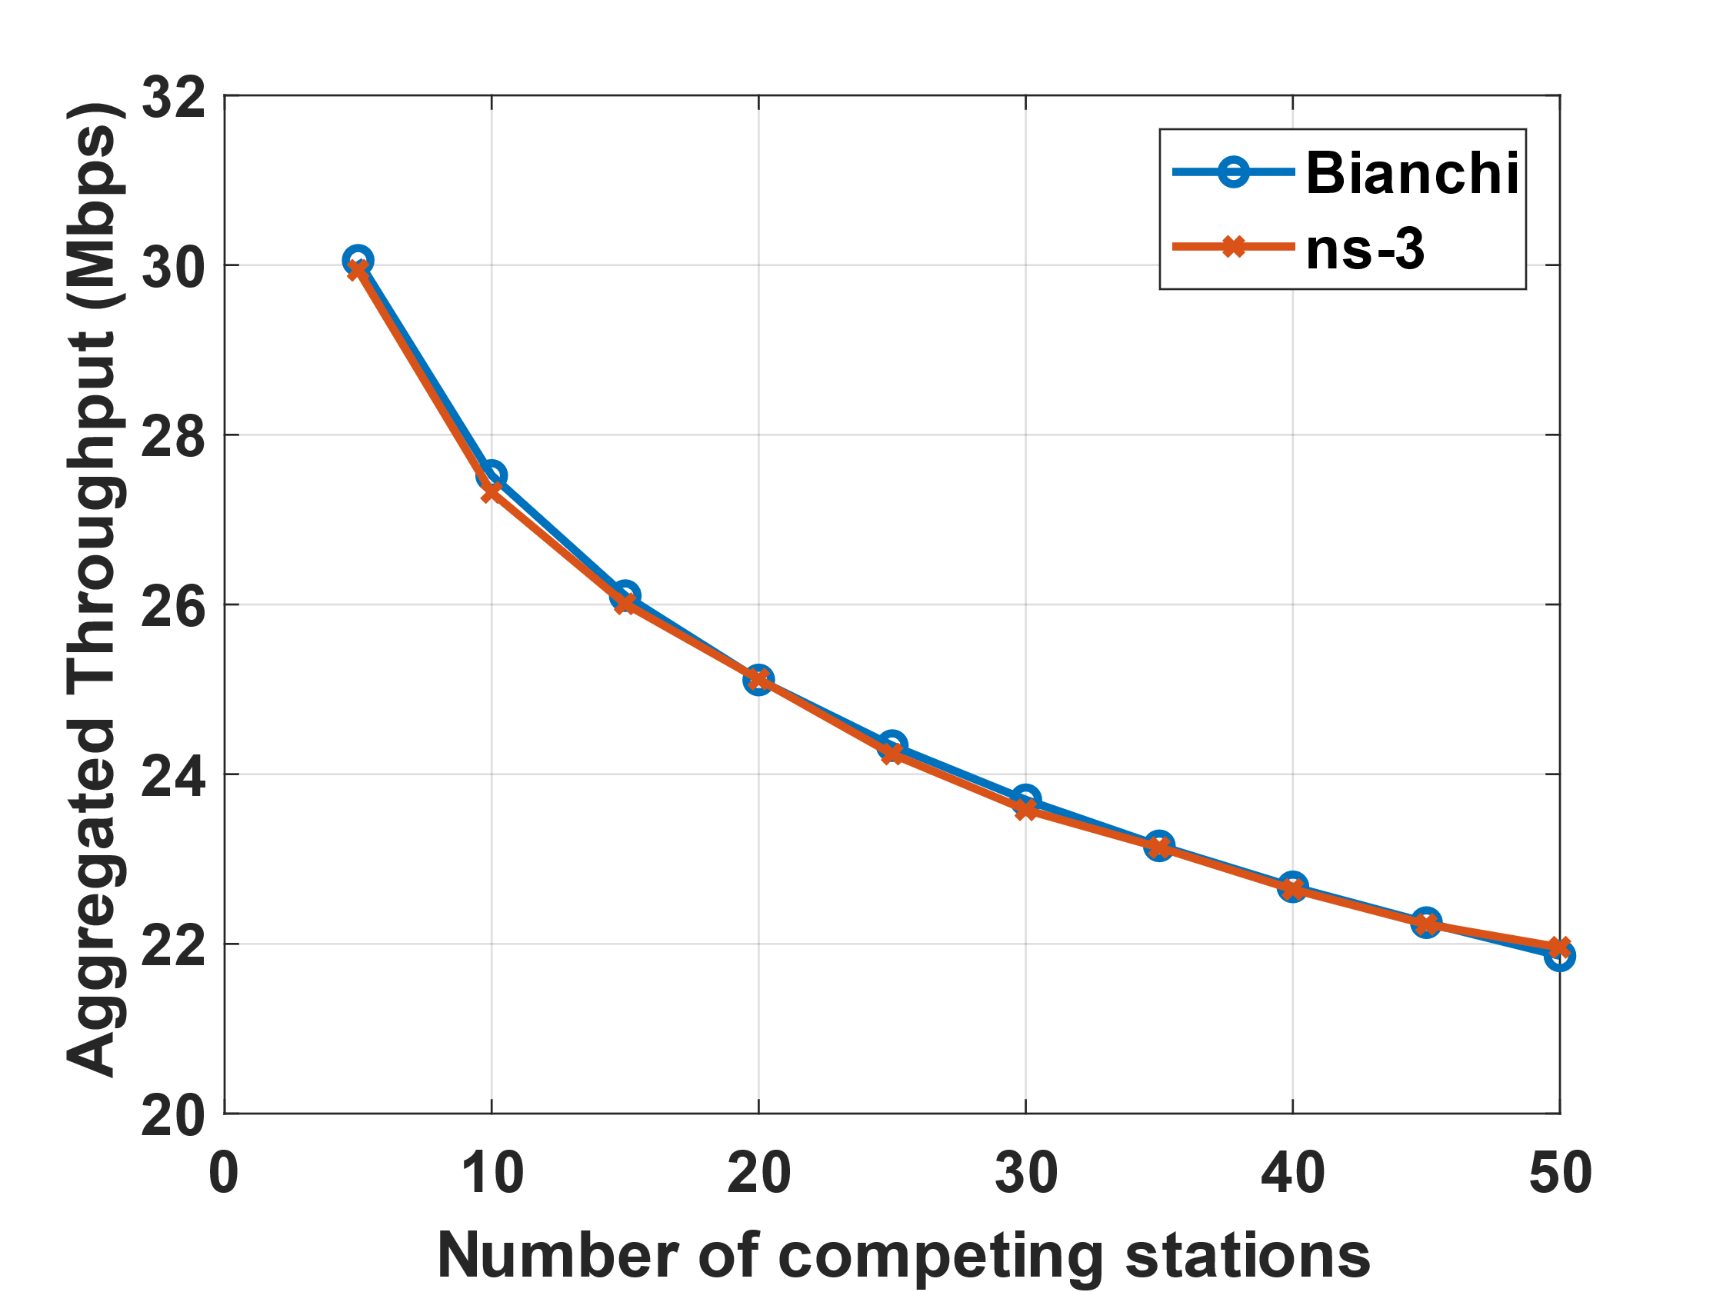
Throughput : Single-BSS .11ax
Benchmark DCF model under saturated traffic, single BSS: Bianchi [1]
ns-3 simulations (src/wifi/examples/wifi-bianchi.cc) used to validate simulator against analysis
ns-3 Simulation: 5 to 50 nodes, infrastructure network, MCS4
STAs uniformly distributed on a circle;
No successful multiple Txmissions!

Slide 4
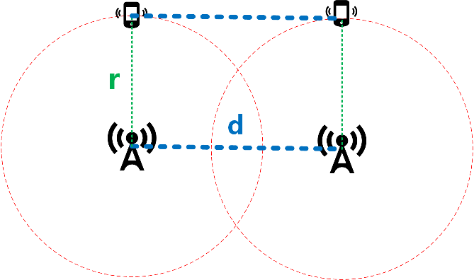
Throughput : Multi-BSS .11ax
Axis:
AP1 (0, 0) AP2 (d, 0)
STAs (0, r) STAs (d, r)
2 Overlapping BSS [2]:
Parameters d (inter-BSS distance), r (BSS transmission range) → different SINR
Variable # STA per BSS, ALL at same location
CCA threshold: -82 dBm, TX power: 20 dBm
CCA Range: 30 meters
Log distance path loss (PL) model
Uplink traffic only
interference
AP1
AP2
CCA Range = 30 m
SINR = $\frac{P_{rx}}{(P_{int}+Noise)}$
MCS | PER = 0.01
0 | 4.58 dB
2 | 10.53 dB
4 | 17.31 dB
6 | 23.35 dB
8 | 29.24 dB
$$P_{rx}=P_{tx} −PL\left(r\right)$$
$P_{int}=P_{tx} −PL(\sqrt{r^{2}+d^{2}}$)
SINR required for target PER, packet size 1500 bytes

Slide 5
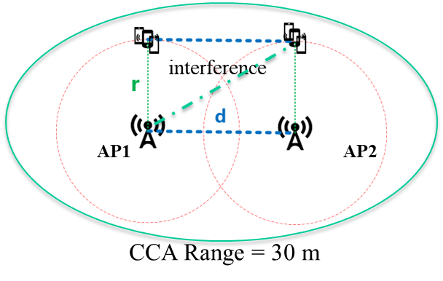
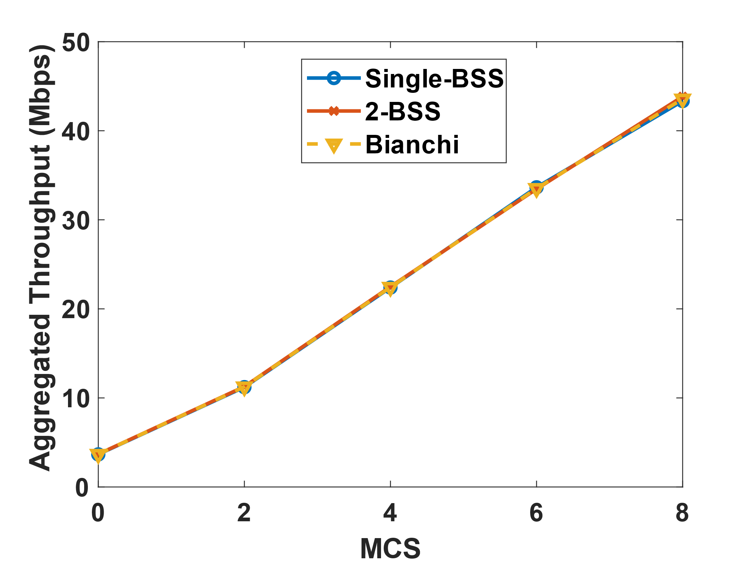
Throughput – Multi-BSS .11ax
Case 1: Two BSS T’put equiv. one large BSS
Setup: Total 50 STAs (25 STAs in each BSS)
r = 8m, d = 5m, $\sqrt{r^{2}+d^{2}}$ = 9.5m, SINR = 2 dB
SINR = 2 dB → No successful simult. transmissions for ALL MCS
ALL nodes within a carrier sensing range of 30 m (i.e., can sense each other)
2 BSS ~ One larger cell
Results:
Parameters | Value
$$P_{rx}$$ | -61.6 dBm
$$P_{in}$$ | -64.6 dBm
Noise | -128 dBm
SINR | 2 dB
Results validated against Bianchi model predictions
Example Codes: https://gitlab.com/haoyinyh/ns-3-dev/-/tree/multibss

Slide 6
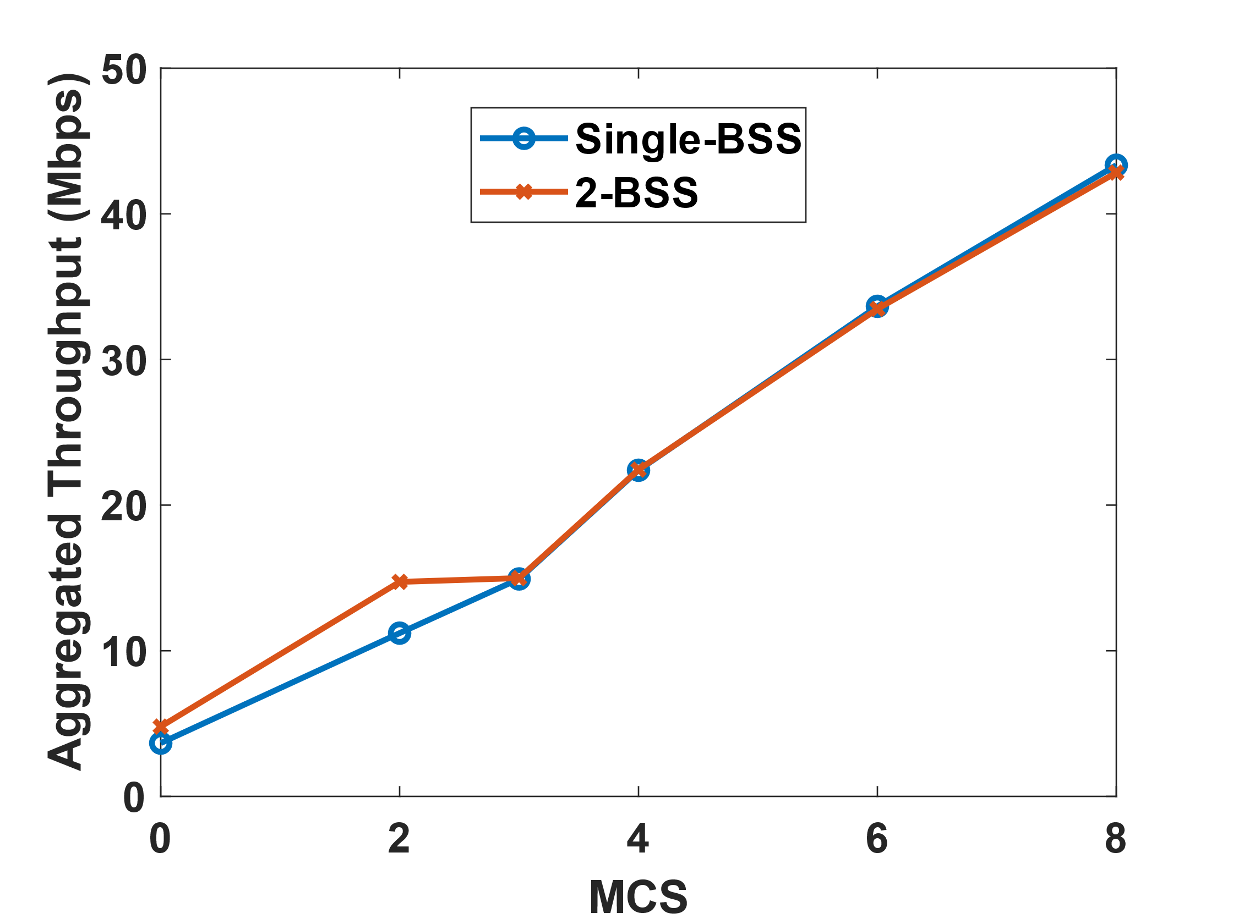
Throughput – Multi-BSS .11ax
Case 2: Successful Simultaneous transmission @ low MCSs
Setup: Total 50 STAs (25 STAs in each BSS)
r = 10m, d = 20m, $\sqrt{r^{2}+d^{2}}$ = 22.3m, SINR = 12 dB
SINR = 12 dB → Can support successful simult. transmission at MCS 0/1/2
ALL nodes within a carrier sensing range of 30 m (i.e., can sense each other)
Expectation: 2 BSS has larger throughput in MCS 0/1/2 than one large cell
Results:
Parameters | Value
$$P_{rx}$$ | -65 dBm
$$P_{in}$$ | -77.2 dBm
Noise | -128 dBm
SINR | 12 dB
Successful simultaneous transmission happens when MCS < 3
→ multi-BSS throughput is
larger when MCS < 3
Large single BSS throughput validated against the Bianchi model (similar to Case 1)

Slide 7
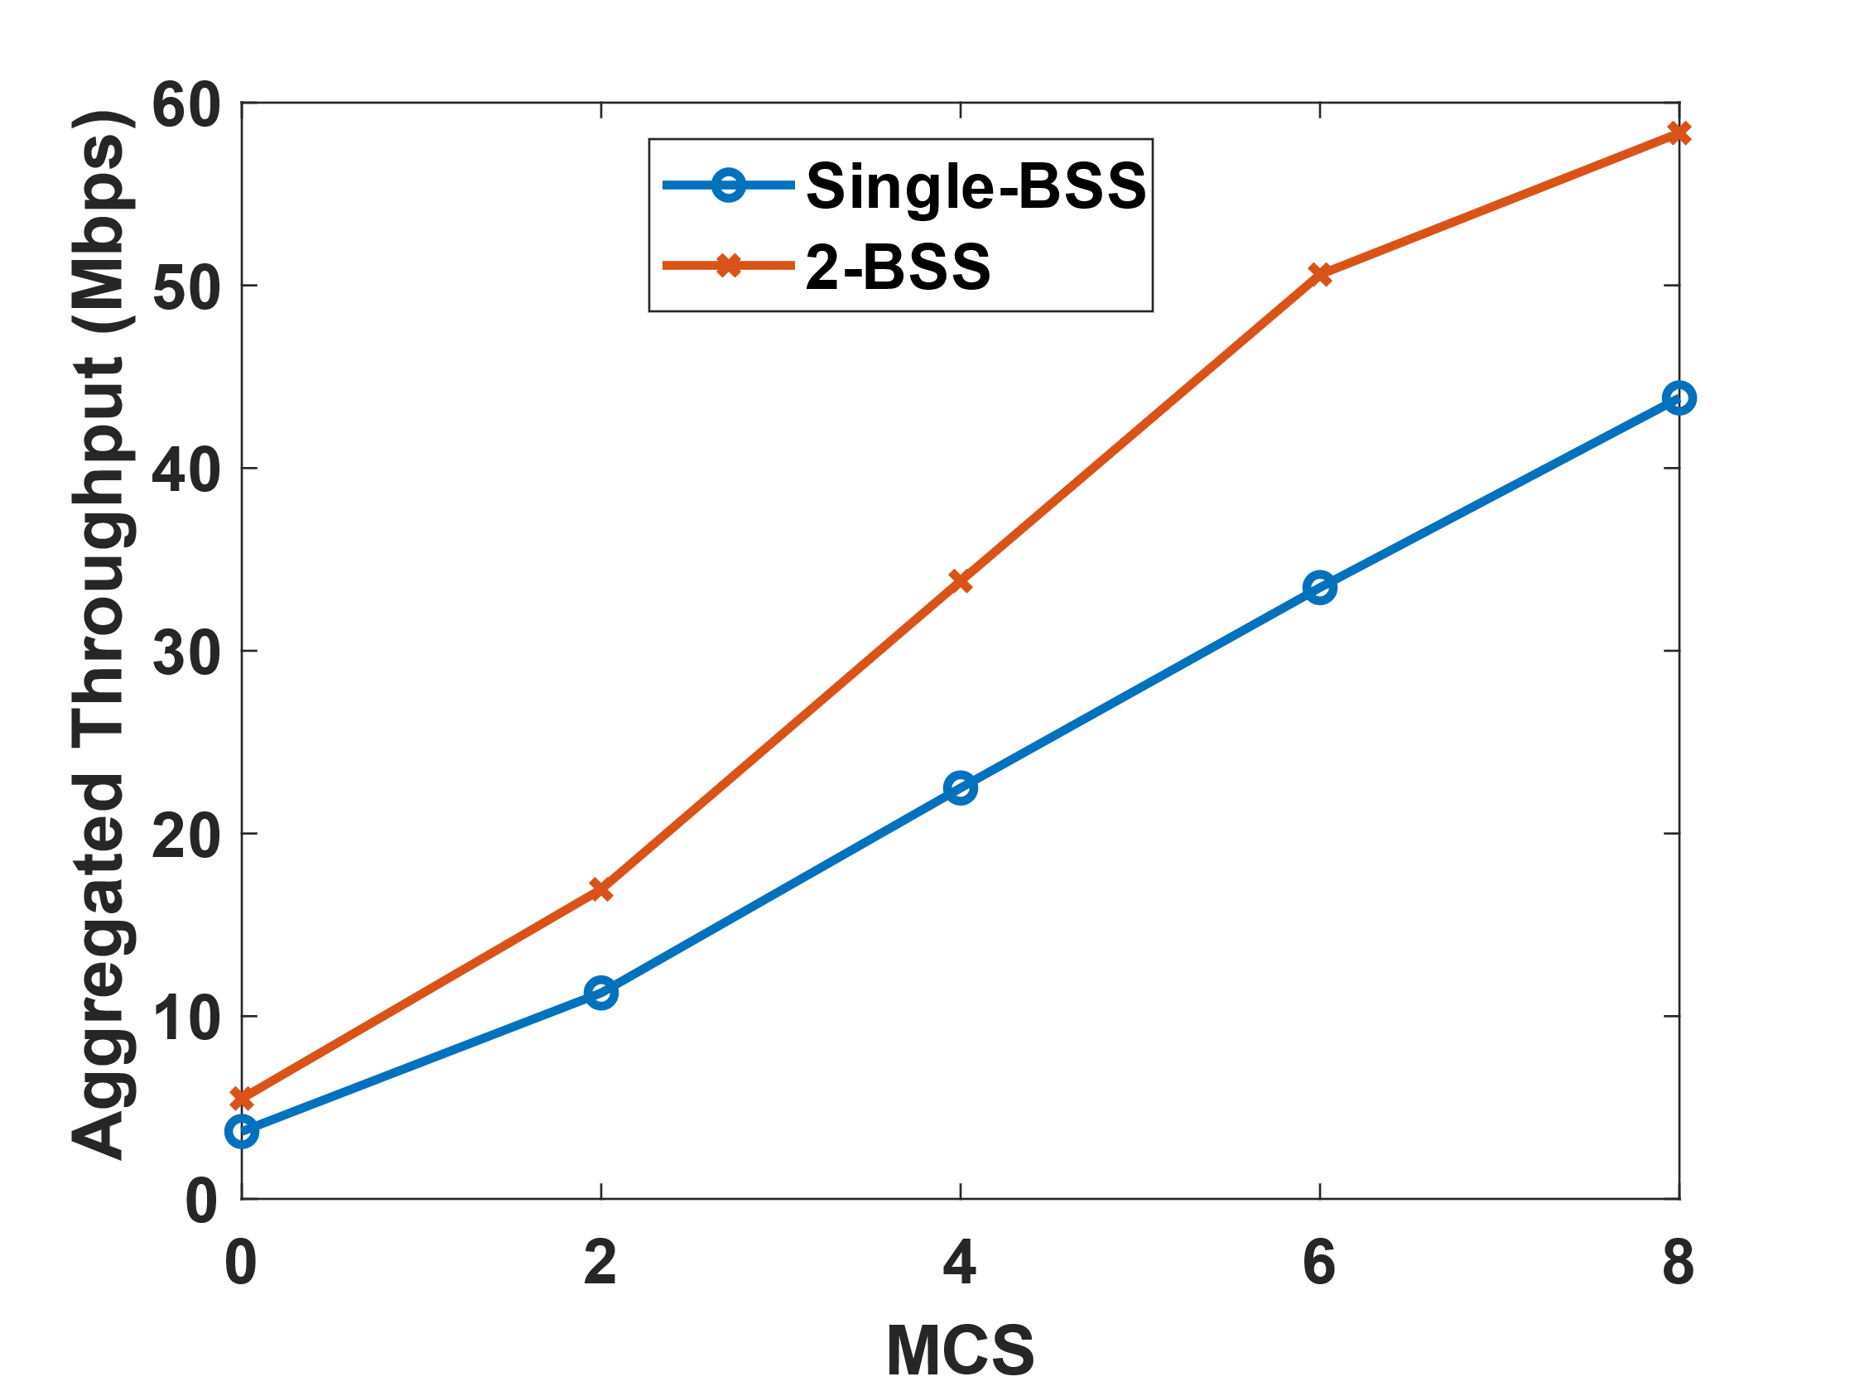
Throughput – Multi-BSS .11ax
Case 3: Successful Simultaneous transmission @ all MCSs
Setup: Total 50 STAs (25 STAs in each BSS)
r = 3m, d = 20m, $\sqrt{r^{2}+d^{2}}$ = 20.3m, SINR = 28.9 dB
SINR = 28.9 dB → Can support successful simult. transmission at all MCSs
ALL nodes within a carrier sensing range of 30 m (i.e., can sense each other)
Expectation: 2 BSS has larger throughput for all MCSs than one large cell
Results:
Parameters | Value
$$P_{rx}$$ | -46.7 dBm
$$P_{in}$$ | -75 dBm
Noise | -128 dBm
SINR | 28.9 dB
Successful simultaneous transmission happens for all MCSs → multi-BSS throughput is UNIFORMLY larger
Large single BSS throughput validated against the Bianchi model (similar to Case 1)
Can we adjust universal CCA threshold over all BSSs to gain FURTHER from successful simultaneous transmission?

Slide 8
Changing CCA-PD: Simple 2-BSS case
CCA -79 dBm, range 25m
r
d
r
STA1
AP1
CCA -76 dBm, range 20m
AP 2
STA2
CCA -82 dBm, range 30m
At STA1
r = 5 m, d=20 m, $P_{tx}$ = 20 dBm
Log distance propagation model
$P_{rx1}(STA2)=P_{tx}(STA2) −PL(r$+d+r) = -82 dBm
$$PL\left(dis\right)=L_{0}+10∗n ∗\log_{10}{(\frac{dis}{d_{0}})}$$
$P_{rx1}(AP2)=P_{tx}(AP2) −PL(r$+d) = -79 dBm
n: the path loss distance exponent, n=3.5
$d_{0}$: reference distance, $d_{0}=1 m$
$L_{0}$: path loss at reference distance (dB), $L_{0}$ = 50
At AP1
$P_{rx1}(STA2)=P_{tx}(STA2) −PL(r$+d) = -79 dBm
$P_{rx1}(AP2)=P_{tx}(AP2) −PL($d) = -76 dBm
Interference from STA2 at AP1: SINR(AP1) = $\frac{P_{rx}(STA1)}{(P_{rx} (STA2)+Noise)}$ = 24 dB
Interference from AP2 at AP1: SINR(AP1) = $\frac{P_{rx}(STA1)}{(P_{rx} (AP2)+Noise)}$ = 21 dB

Slide 9
Changing CCA-PD: Simple 2- BSS case
r
d
r
STA1
AP1
AP 2
STA2
$$P_{rx1}\left(STA2\right)=−82 dBm$$
$P_{rx1}(STA2)=$-79 $dBm$
$$P_{rx1}\left(AP2\right)=−79dBm$$
$P_{rx1}(AP2)=$-76 $dBm$
Change CCA thresholds:
Case1: 2-BSS all within the CCA range
Case2: 2-BSS, STA1 can’t hear STA2
Case3: 2-BSS, STA1 can’t hear Network2
Case4: 2-BSS, Network 1 and 2 can’t hear each other
Packet error rate for different MCSs and SINR
(CCA <= -82 dBm)
(-82<CCA<= -79 dBm)
(-79<CCA<= -76 dBm)
(CCA > -76 dBm)
MCS | $$P_{e}(24 dB)$$ | $$P_{e}(21 dB)$$
0-4 | 0 | 0
5 | 0 | 0.27
6 | 0.001 | 0.99
7 | 0.05 | 1
8 | 1 | 1
SINR(AP1) = $\frac{P_{rx}(STA1)}{(P_{rx} (STA2)+Noise)}$ = 24 dB: STA1 collides with STA2 at AP1
SINR(AP1) = $\frac{P_{rx}(STA1)}{(P_{rx} (AP2)+Noise)}$ = 21 dB: STA1 collides with AP2 (ACK) at AP1

Slide 10
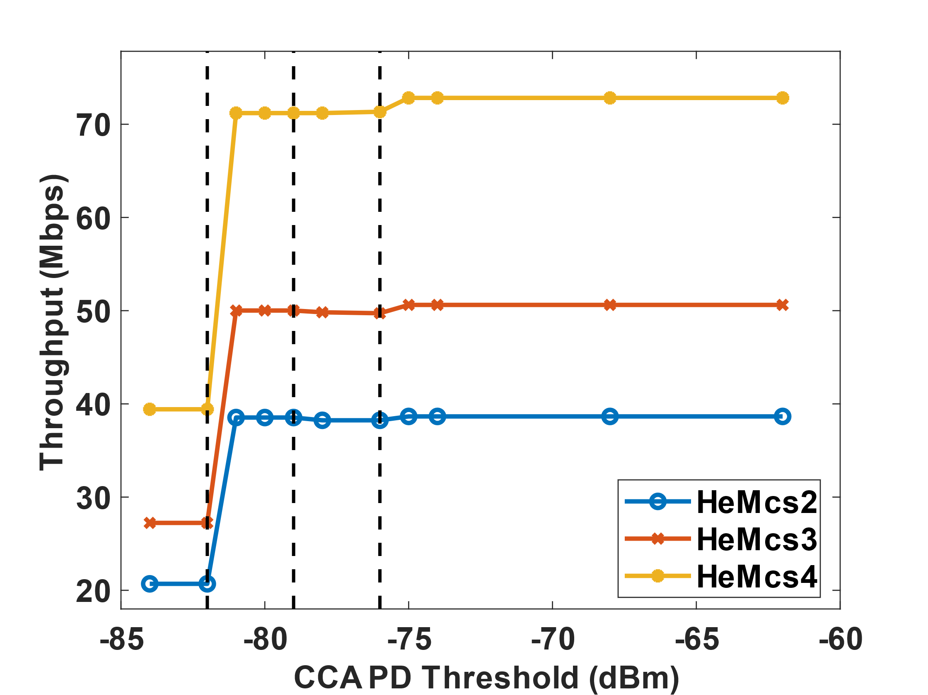
Throughput Simulation Results
Traffic:
UL Only, 2 Nodes (one AP ,one STA) in each network
MCS | $$P_{e}(24 dB)$$ | $$P_{e}(21 dB)$$
0-4 | 0 | 0
5 | 0 | 0.27
6 | 0.001 | 0.99
7 | 0.05 | 1
8 | 1 | 1
Packet error rate for
different MCSs and SINR
MCS | Single BSS | CCA <= -82 | CCA > -76 | 2*Single BSS
2 | 19.3 | 20.7 | 38.7 | 38.6
3 | 25.3 | 27.2 | 50.6 | 50.6
4 | 36.4 | 39.4 | 72.8 | 72.8
STA1 and STA2 can have two successful simultaneous transmission at MCS 0-4
As CCA threshold increases → throughput increases
After the CCA > -76 dBm: two networks can’t hear each other, and aggregate throughput is doubled compared with single BSS

Slide 11
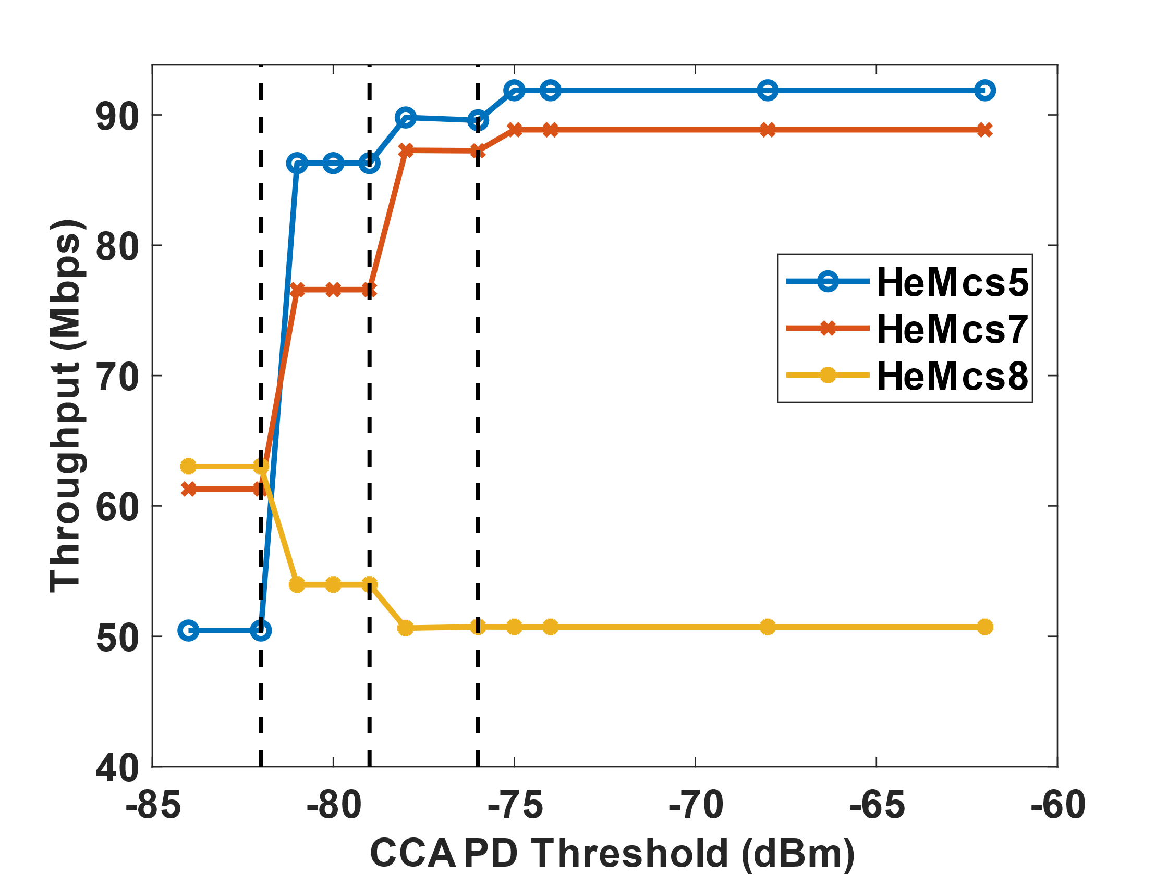
Throughput Simulation Results
Traffic:
UL Only, 2 Nodes (one AP ,one STA) in each network
MCS | $$P_{e}(24 dB)$$ | $$P_{e}(21 dB)$$
0-4 | 0 | 0
5 | 0 | 0.27
7 | 0.05 | 1
8 | 1 | 1
Packet error rate for
different MCSs and SINR
MCS | Single BSS | CCA <= -82 | CCA > -76 | 2*Single BSS
5 | 46.3 | 50.4 | 91.9 | 92.6
7 | 51.4 | 61.2 | 88.9 | 102.8
8 | 56.1 | 63.0 | 50.7 | 112.2
STA1 and STA2 will see errors when two network have simultaneous transmission
→ For MCS 5-7, error rate is low when two STAs transmit, throughput increases as CCA increases but < 2x single network t’put
→ For MCS8, two STAs can’t have any simultaneous transmission. As CCA increases, hidden terminals occur and leads to large throughput drop!

Slide 12
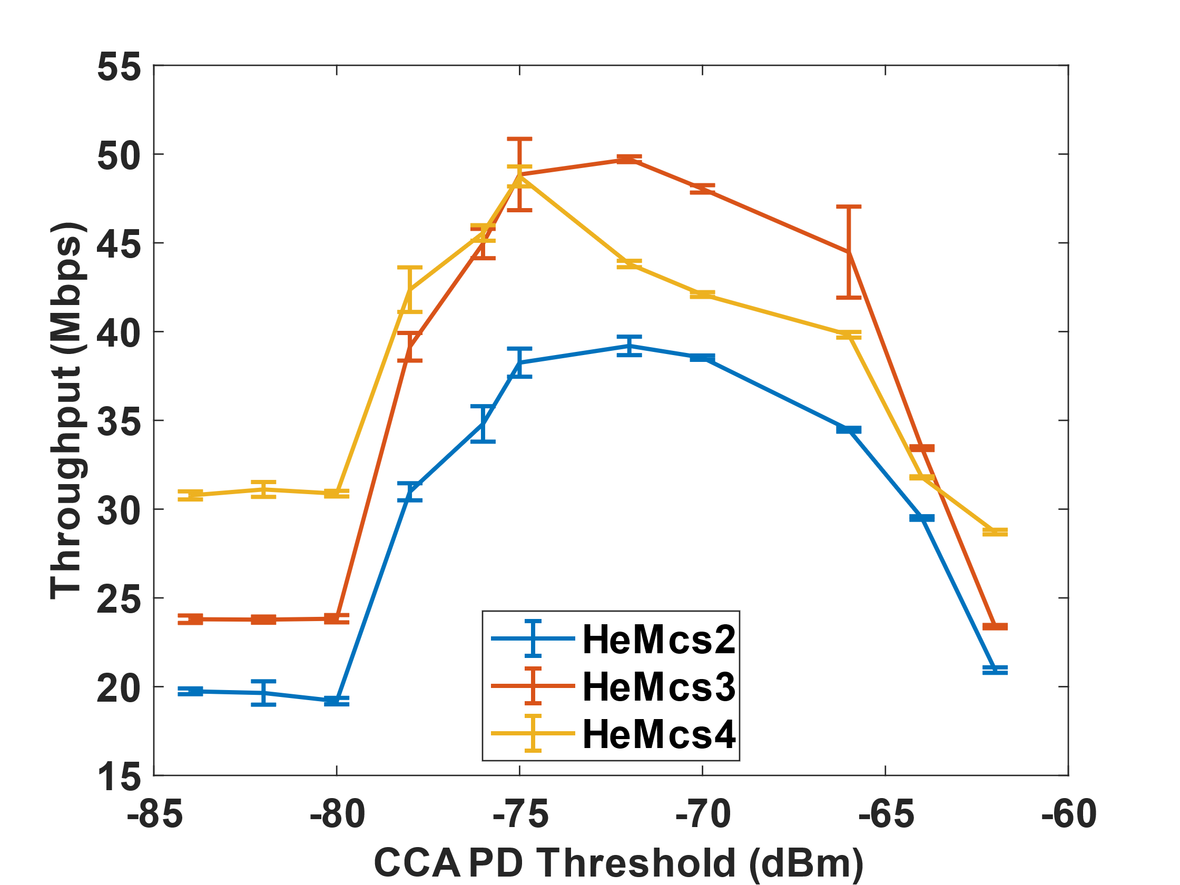
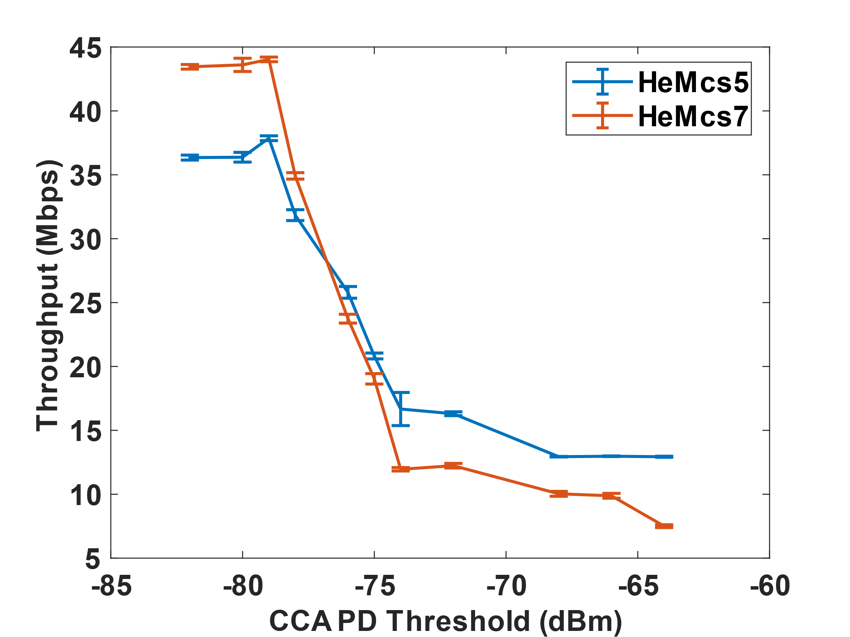
More complex cases: nSTA > 2
More stations (nSTA = 10), distributed on a circle, r = 5m, d = 20m, 𝑃_𝑡𝑥 = 20 dBm:
→ Different interference level: -82 dBm < $P_{rx1}$ < -69 dBm
Optimization of CCA: trade-off between hidden and exposed terminals
As MCS increases, optimal throughput achieved @ lower CCA threshold since it requires a higher SINR for success
CCA -79 dBm, range 25m
CCA -76 dBm, range 20m
r
d
r
AP1
AP2
CCA -82 dBm, range 30m
Analysis in [4] to find the optimal CCA threshold for a homogeneous network with constant link distances.
See analysis in [3] for optimal CCA threshold for a homogeneous network with constant link distances.

Slide 13
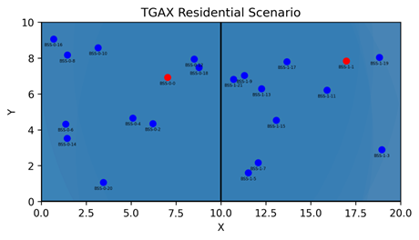
ns-3 Rx Decoding Summary (1)
Single node transmission:
No Drop
Multiple STAs/BSSs and everyone can hear each other
Synchronous Collision During Preamble: Collisions due to same backoff window count. Drop occurs in the first 4 us of HE preamble
36 us
HE Preamble
Data
HE Preamble
Data

Slide 14
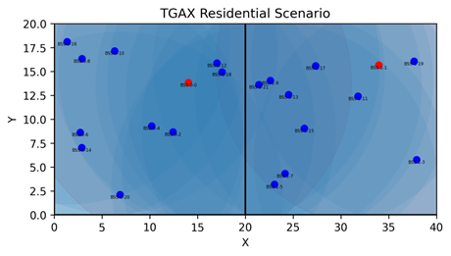
ns-3 Rx Decoding Summary (2)
3. Multiple BSSs and not everyone can hear each other
Asynchronous Collisions During HE Preamble: Collisions due to nodes outside of CCA range. Collision occurs after first 4 us of the signal reception and before the end of HE preamble (36 us)
Asynchronous Collisions During Payload: Collisions due to nodes outside of CCA range. Collision occurs after HE preamble (36 us). CRC fail
HE Preamble
Data
HE Preamble
Data
HE Preamble
Data
HE Preamble
Data

Slide 15
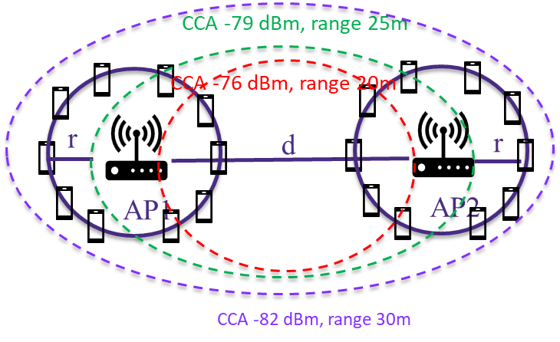
ns-3 Labels: PHY Reception Failure Cases
Results: For 2 BSSs, the failure/success probability vs PD threshold
nSTA=10 Per BSS
AMPDU disabled
r = 5 m, d=20 m, $P_{tx}$ = 20 dBm, same log distance pathloss model
For MCS = 4
Percentage: Failed Simultaneous Tx over Total Simultaneous Tx
CCA (dBm) | CCA Range (m) | Total Tx | Total Simult Tx (% over Total Tx) | Failed Simult Tx (% over Total Simult Tx) | Intra-BSS Success (% over Total Simult Tx) | Inter-BSS Success (% over Total Simult Tx) | Data Collision During HE Preamble (% over Total Simult Tx) | Data Collision During Payload (% over Total Simult Tx) | Aggregated Throughput (Mbps)
-82 | 30 | 84529 | 24039 (28%) | 16783 (69.81%) | 0 | 7256 (30.18%) | 16743 (69.65%) | 0 | 28.11
-78 | 24 | 84775 | 24474 (28%) | 16604 (67.84%) | 0 | 7870 (32.15%) | 16267 (66.46%) | 307 (1.25%) | 28.35
-74 | 18 | 119333 | 65261 (54%) | 23224 (35.58%) | 0 | 42035 (64.41%) | 19095 (29.25%) | 4100 (6.28%) | 40.27
-70 | 14 | 91541 | 31943 (34%) | 9609 (30.08%) | 0 | 22334 (69.91%) | 7876 (24.64%) | 1707 (5.34%) | 27.73
-66 | 11 | 90704 | 29019 (31%) | 6514 (22.44%) | 0 | 22505 (77.55%) | 6049 (20.82%) | 446 (1.53%) | 26.06
-62 | 8 | 96185 | 41874 (43%) | 19790 (47.26%) | 31 (0.07%) | 22053 (52.66%) | 10244 (24.44%) | 9231 (22.04%) | 20.84
*in this table - small amount of PHY reception failure such as "TXING“ happen due to beacon + data collisions not accounted for

Slide 16
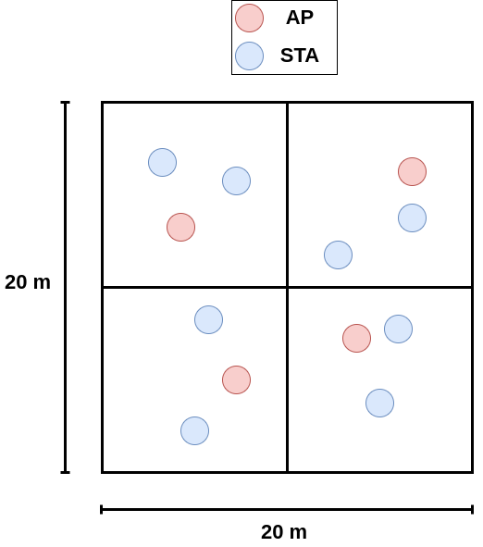
802.11ax TGax Residential Scenario [4]
Each apartment - square with dim. X m. by X m.
All STAs associate with AP in its own apartment/cell
AP and STAs are randomly distributed in the square
TGax defined pathloss for this scenario:
Consider mixed traffic types
VR/AR burst traffic: ns-3 VR traffic model [5]
CBR traffic as background
Distance to AP | MCS | Distance to AP | MCS
< 11 m | 11 | 27 m | 6
12 m | 10 | 29 m | 5
13 m | 9 | 31 m | 4
18 m | 8 | 42 m | 3
26 m | 7 | 52 m | 2
Auto MCS Allocation:
For each STA, fix MCS based on the distance to the AP
Choose the MCS that achieves less than 1% PER

Slide 17
VR/AR Gaming Scenario
15 m
VR/AR delay and throughput requirements [6]
Parameters for other nodes [7]
Use Cases | E2E Delay Requirement | Bandwidth
VR/AR Real-time Video Streaming | <5ms@50% <10ms@95% <100ms@99.99% | ~50Mbps@4K
Simulation Setup Parameters | Default value
Traffic type | UL traffic
Traffic Rate | CBR1.5 Mbps
Packet size | 1500 Byte per MPDU
15 m
BSS1
BSS2
Example Setup
4 BSSs co-channel (80 MHz)
AP and STA randomly distributed in 15m x 15m square (each apartment)
AP & STA TX Power: 12 dBm
TGax indoor pathloss model
One VR Node in BSS-1:
VR Traffic Rate: ≈50Mbps, 62000 bytes, interval 10 ms [8]
Background Traffic: Per-Node UL CBR 1.5 Mbps
Total Number of STAs per BSS: 4, Auto MCS
change CCA PD on BSS1, CCA on other BSSs is constant: -82 dBm
Simulation duration: 100 s
BSS3
BSS4
TGax Residential Scenario
Can we adjust CCA PD in BSS1 to
Fulfill the latency constraint & data rate for VR
Maximize aggregate throughput of network

Slide 18
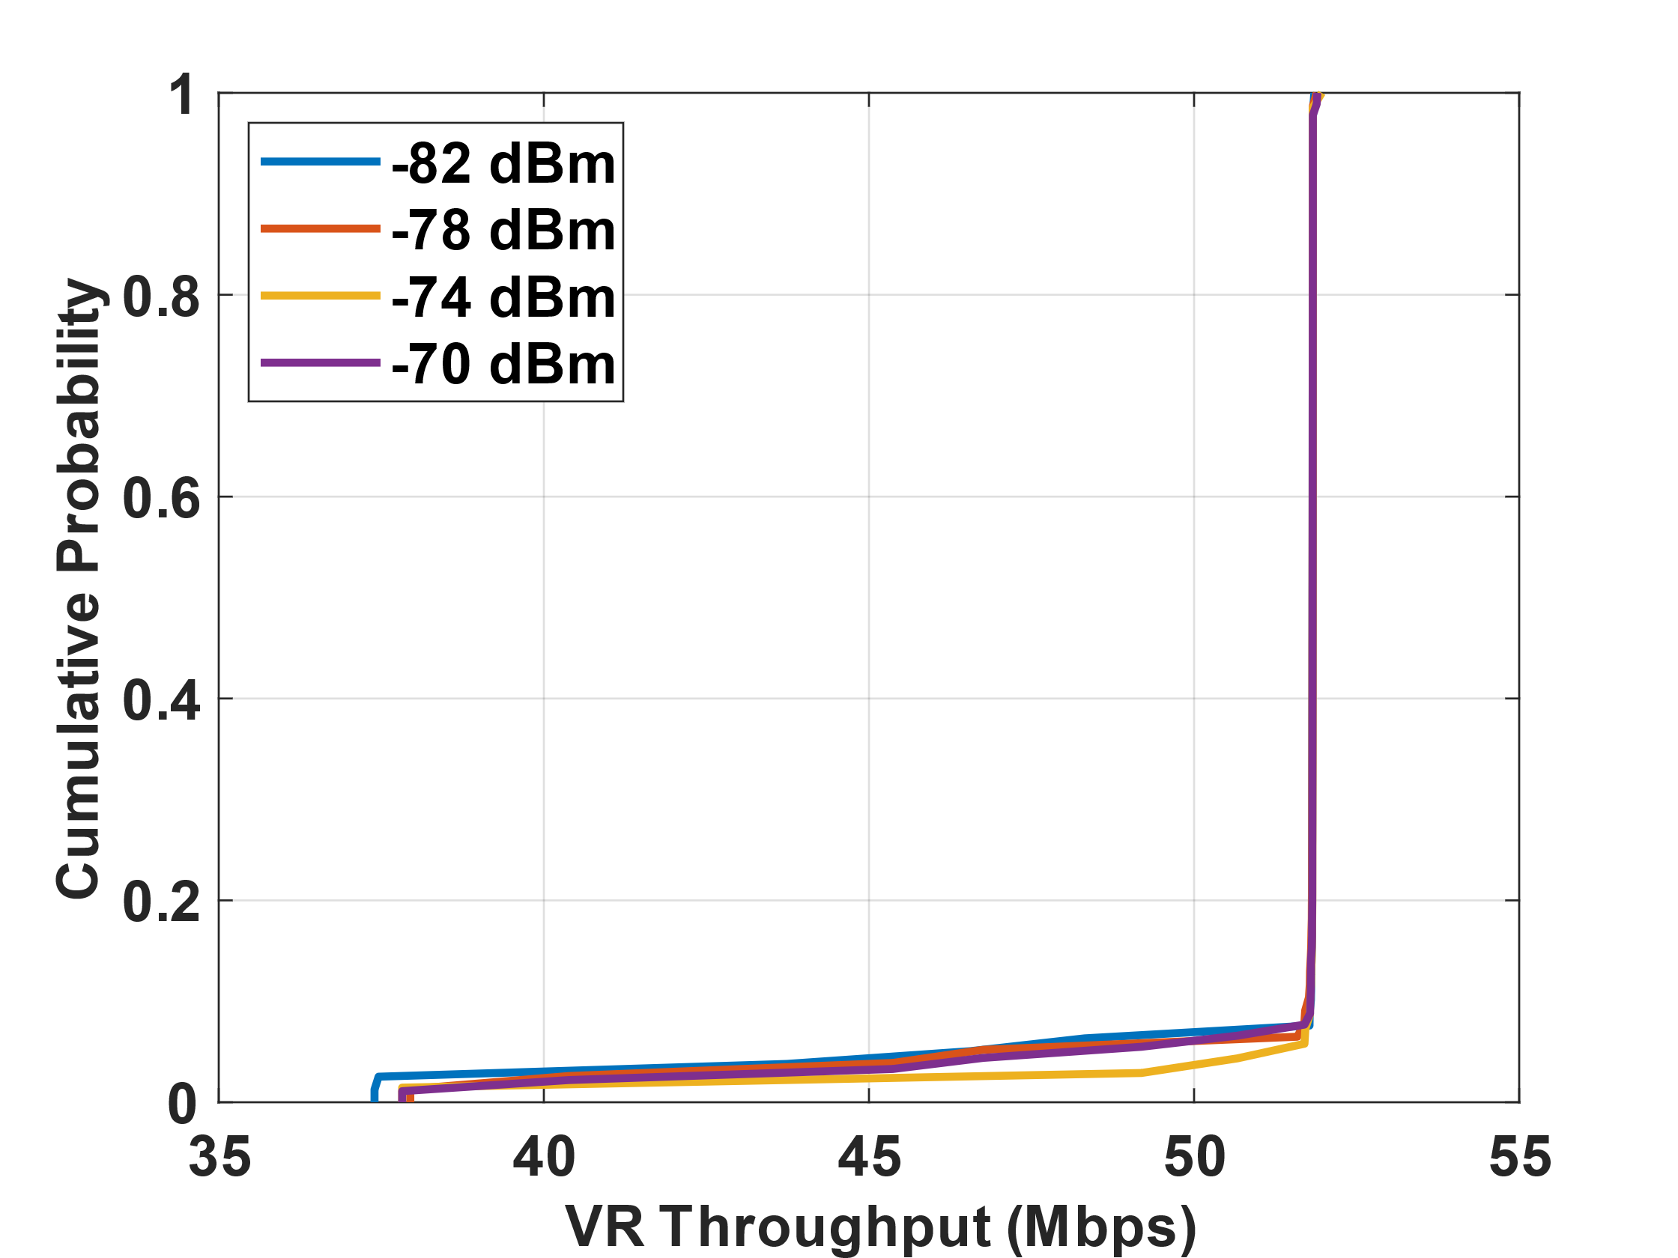
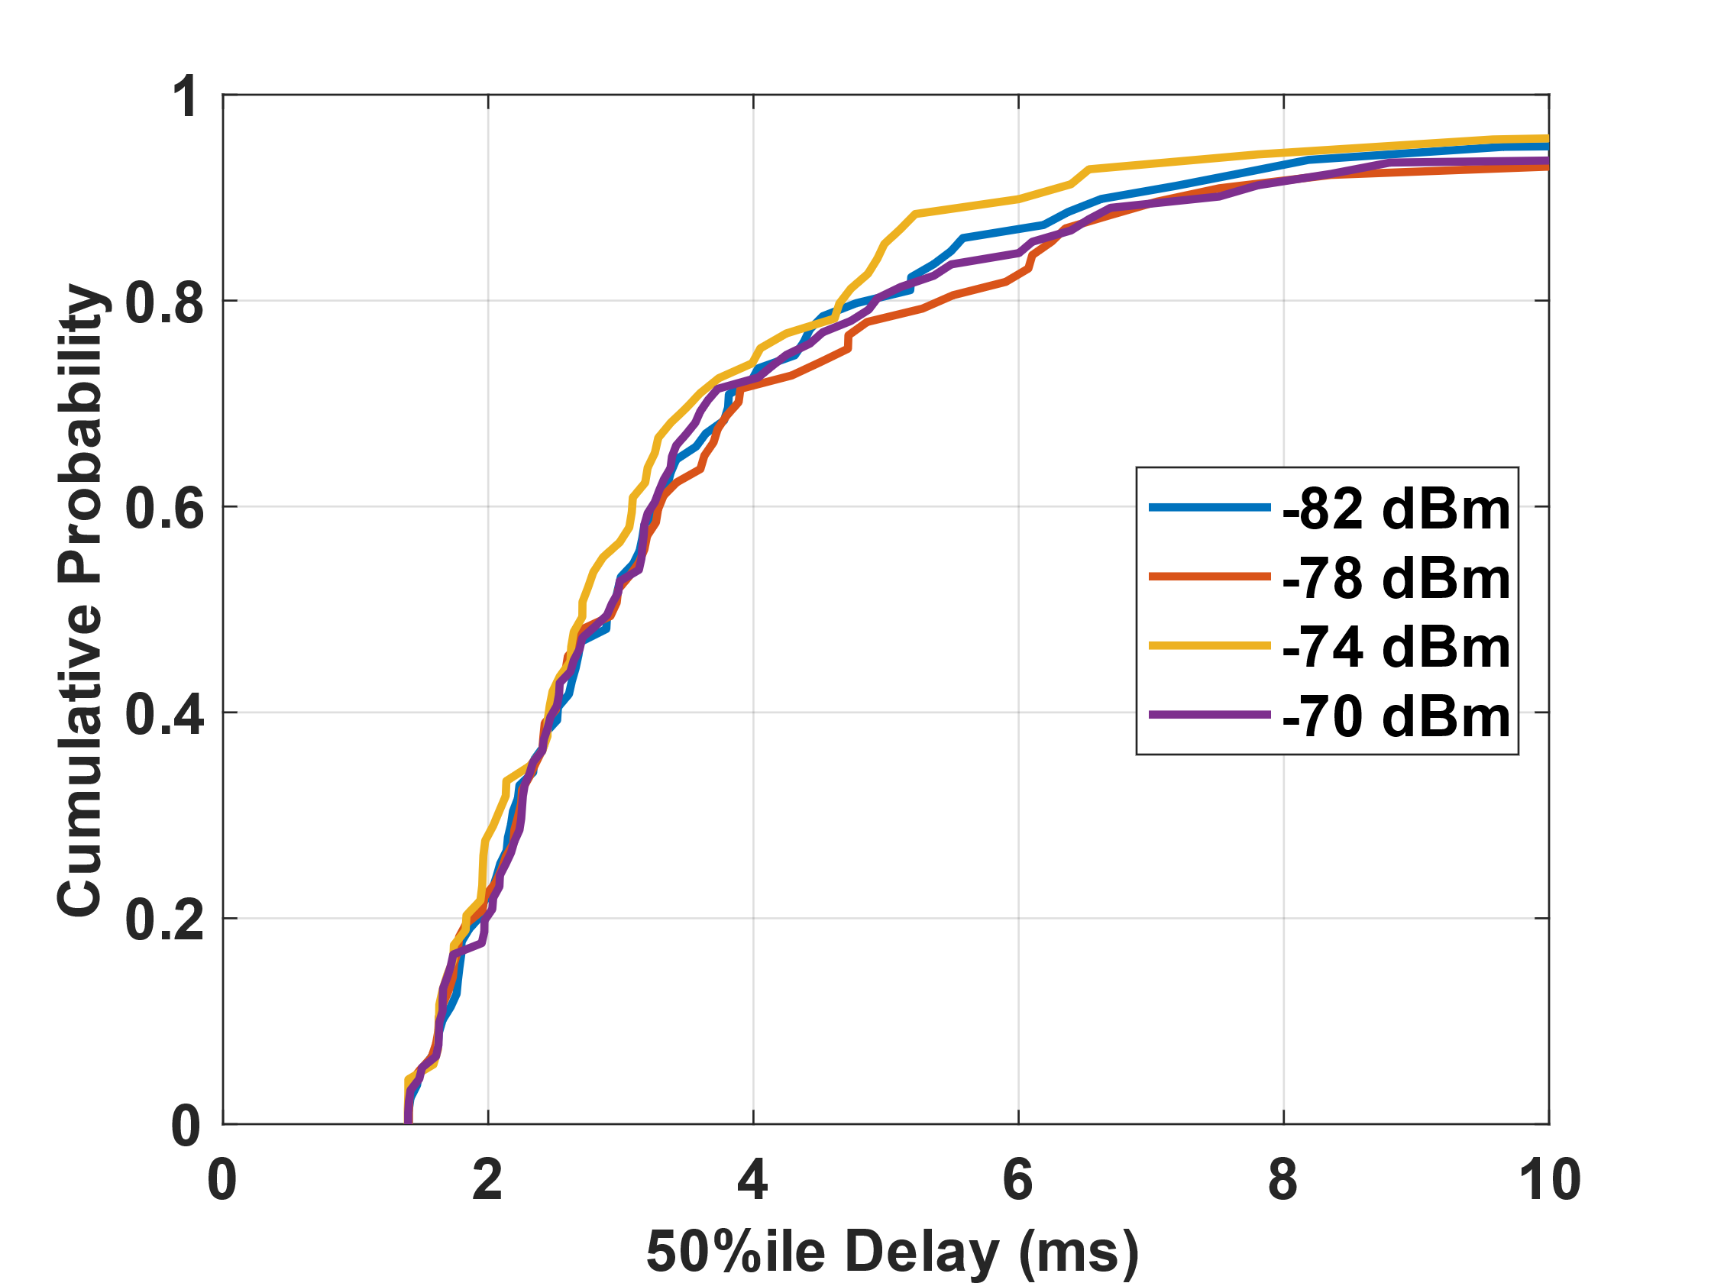
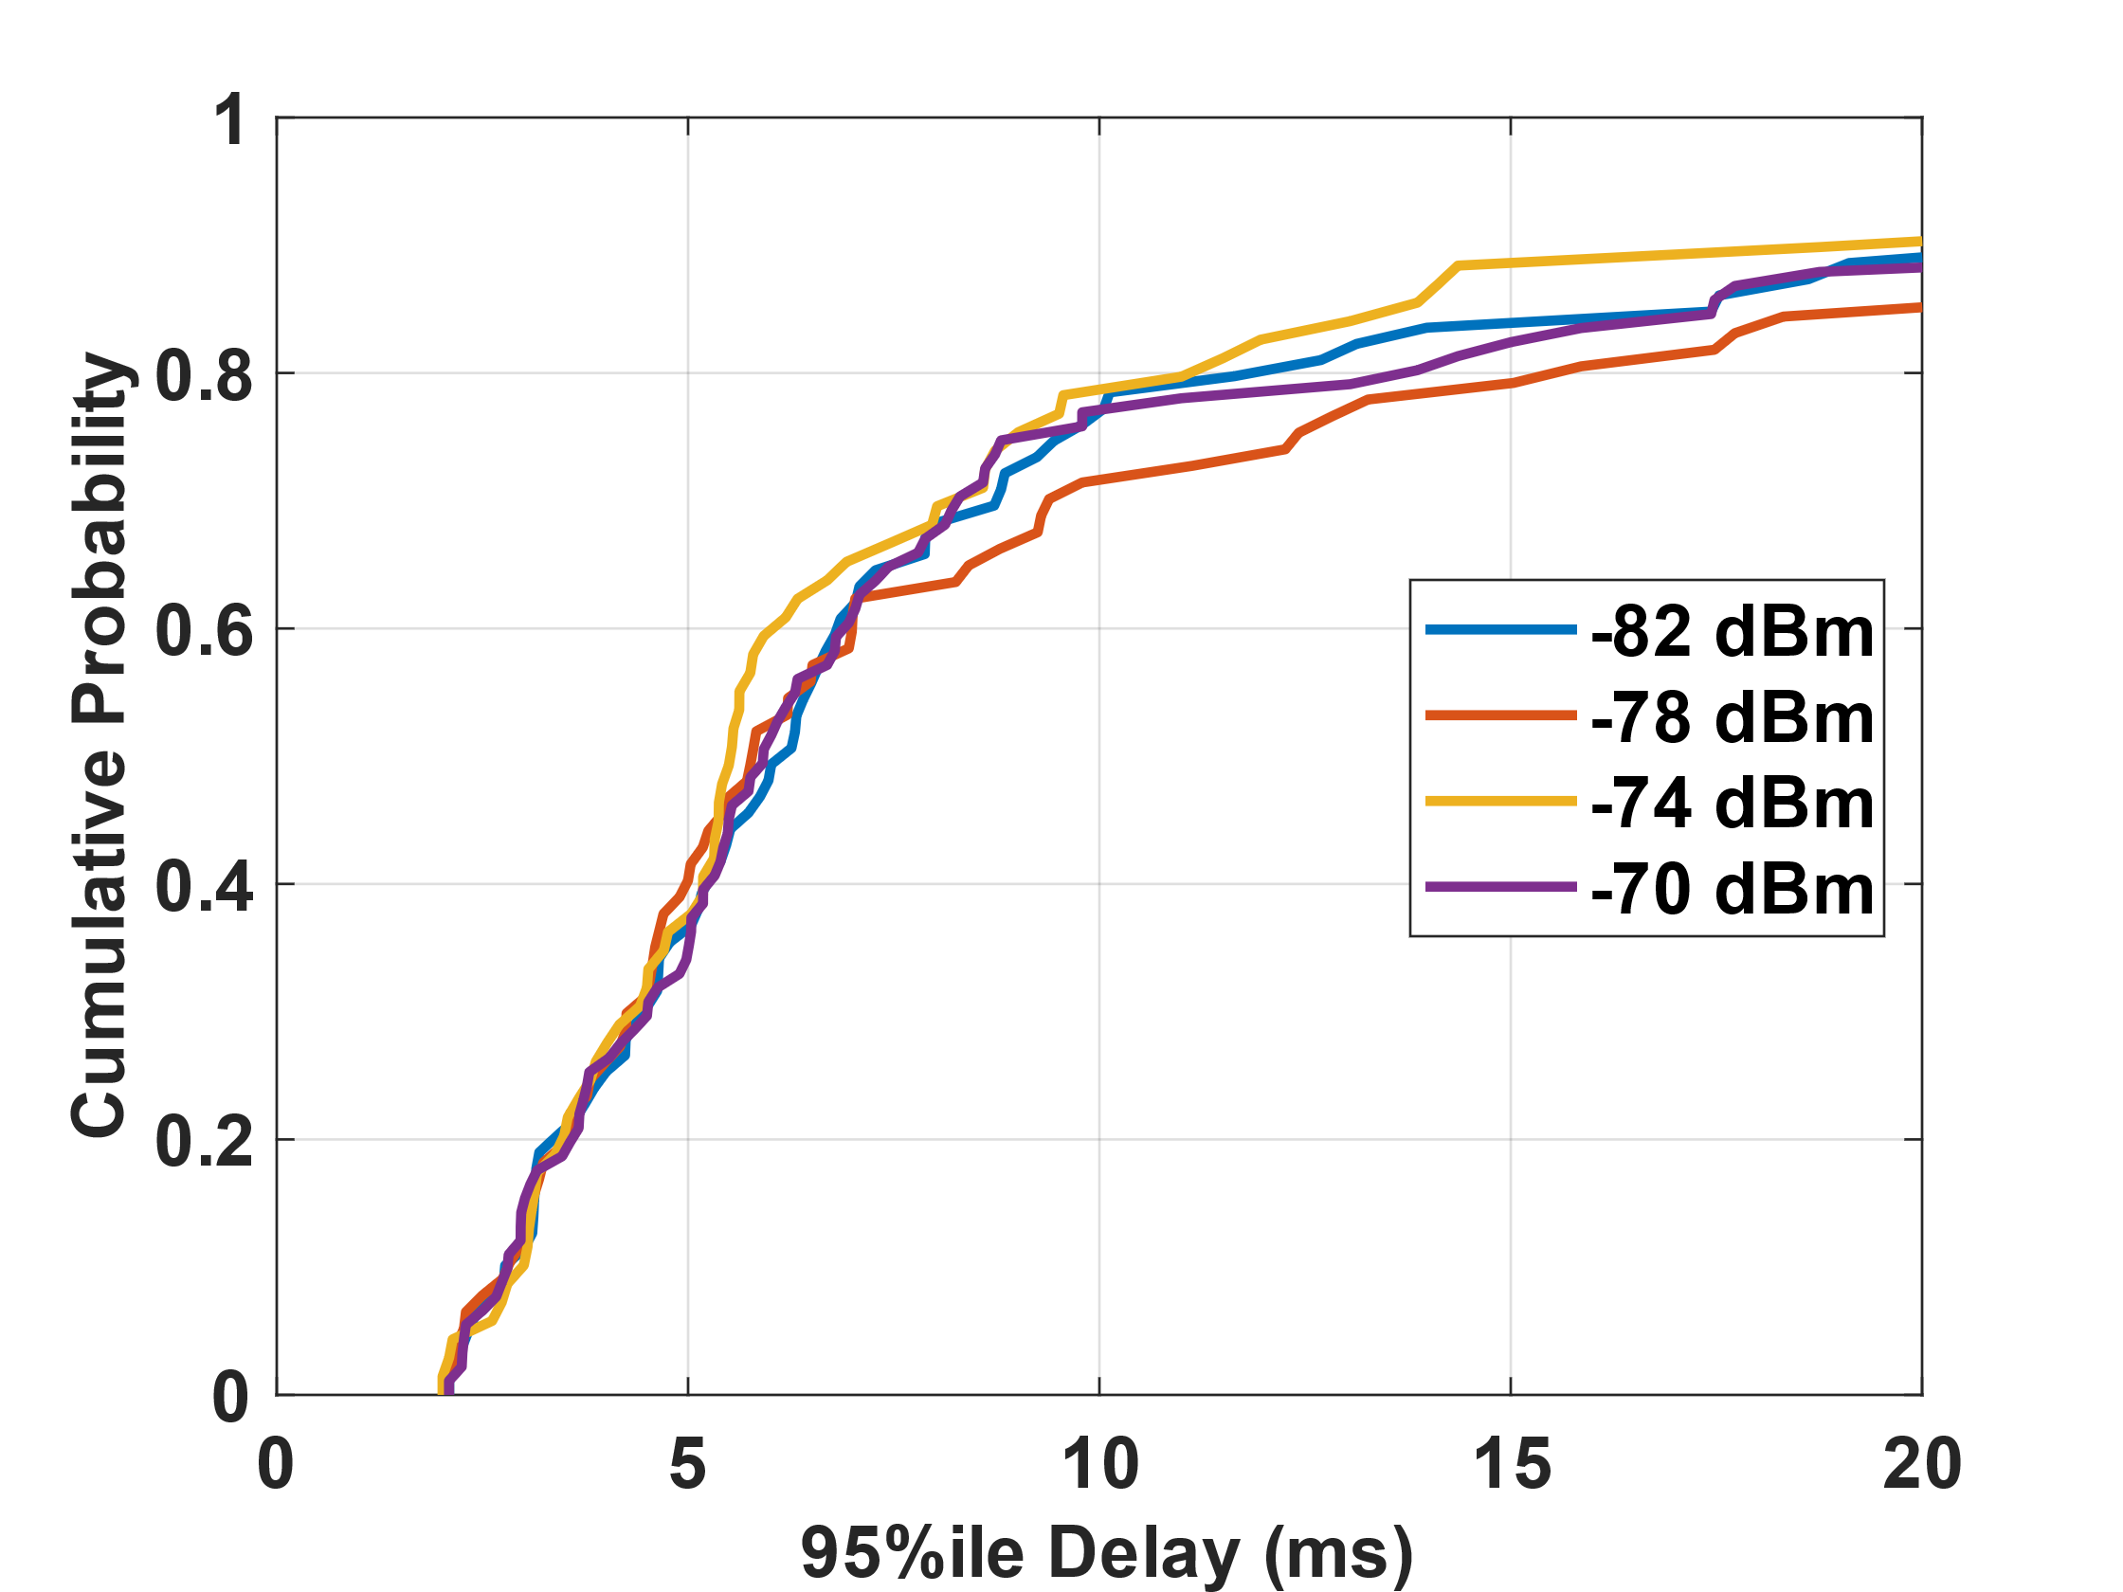
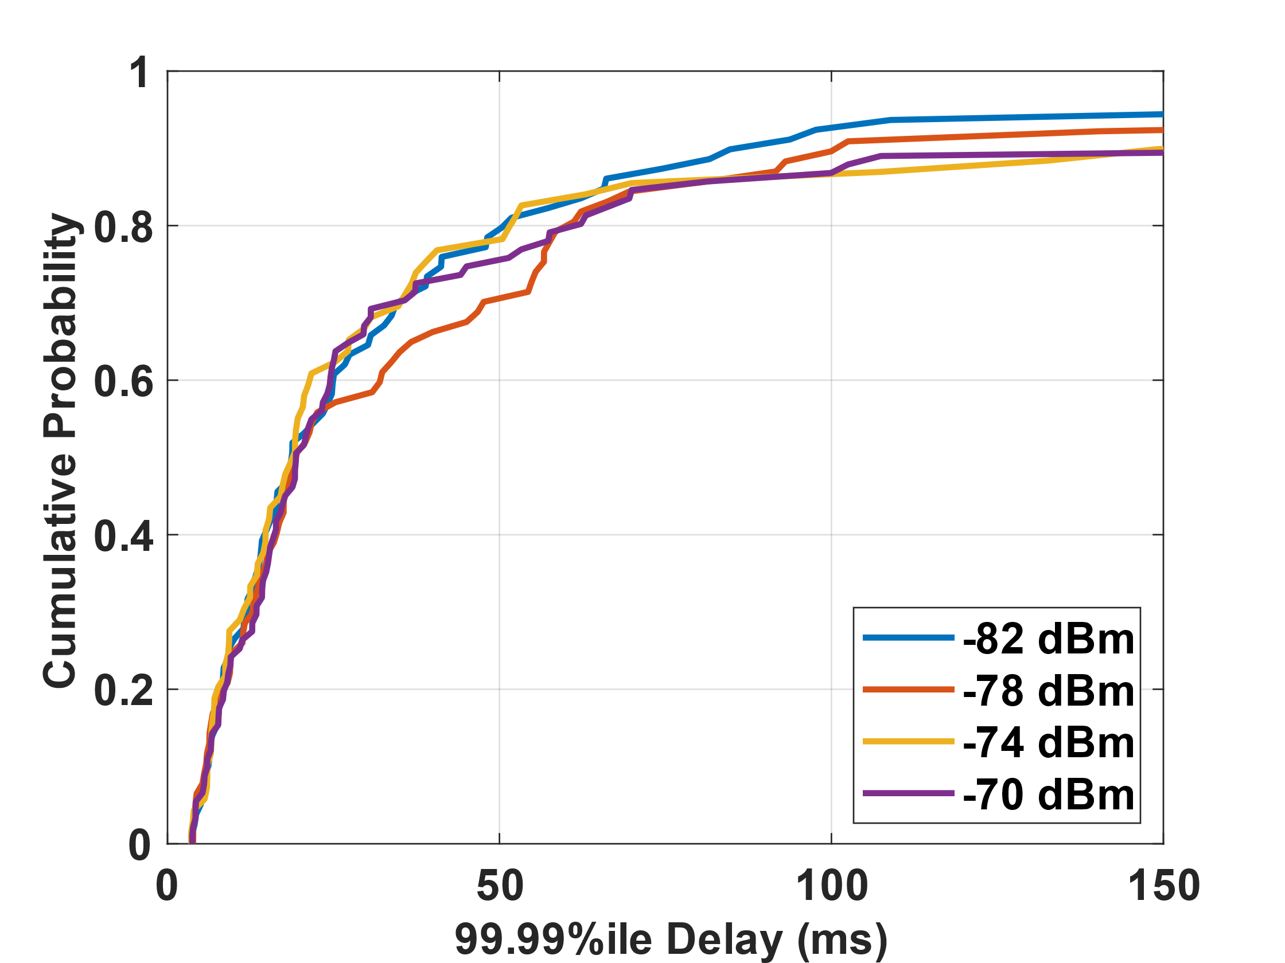
Simulation Results
Different realizations: Nodes are randomly distributed within a room with different (x, y); 100 cases
Brute force search for CCA-PD value in BSS-1 (VR) → plot CDF for all 100 realizations as a function of CCA-PD
51 Mbps
5 ms
10 ms
100 ms
Table: Results over different CCA PD (dBm) for R1 and R2
Due to topology changes and effect of the walls → noticeable variances for the 100 realizations
By choosing a constant CCA-PD regardless of locations in different realizations: can not meet VR requirements always (only around 80% cases met all the requirements).
→ Different network topologies, have different ‘optimal’ CCA PD thresholds! (As shown in the table for 2 example scenarios)
Results | Realization | -82 dBm | -78 dBm | -74 dBm | -70 dBm
VR T’put (Mbps) | R1 | 51.82 | 51.82 | 51.82 | 51.82
 | R2 | 51.82 | 51.82 | 51.82 | 51.82
VR 50%ile delay (ms) | R1 | 3.57 | 3.80 | 3.99 | 3.39
 | R2 | 3.65 | 3.91 | 4.18 | 5.40
VR 95%ile delay (ms) | R1 | 7.88 | 9.25 | 11.50 | 7.44
 | R2 | 6.88 | 6.26 | 9.27 | 18.60
VR 99.99%ile delay (ms) | R1 | 16.34 | 16.47 | 36.75 | 27.45
 | R2 | 18.94 | 15.57 | 34.34 | 51.81
Agg-T’put (Mbps) | R1 | 72.14 | 72.24 | 72.01 | 73.36
 | R2 | 81.49 | 78.47 | 78.47 | 78.48
Need more ‘intelligent’ approach for CCA adaptation !

Slide 19
Challenges and Motivation
Lessons learned from previous study
> Different Nodes locations per realization impact the optimal CCA PD selection
Various levels of inter-BSS interferences
Balance the hidden and exposed nodes for successful simultaneous transmissions
Limitations for the traditional optimization methods:
Model/Algorithm depends on some assumptions
Known the locations of the nodes
Known the channel/pathloss models etc.
Same transmission power and CCA over all the nodes and BSSs
Complexity of the real scenarios:
Transmission power may be different for APs and STAs
Input may be imperfect: no accurate location information
Only partial information about channel/pathloss models
Scalability: from 2D to 3D (including floors) , multiple BSSs ( >2), power and CCA per node per BSS control (BSS coloring) → hard to build analytical models for every case
Deep Reinforcement Learning Approaches:
Availability to learn from imperfect input and hidden properties
Availability to learn from large amount of wireless data and maintain the memory
Need to learn and adapt → AI/ML in special reuse [9]

Slide 20
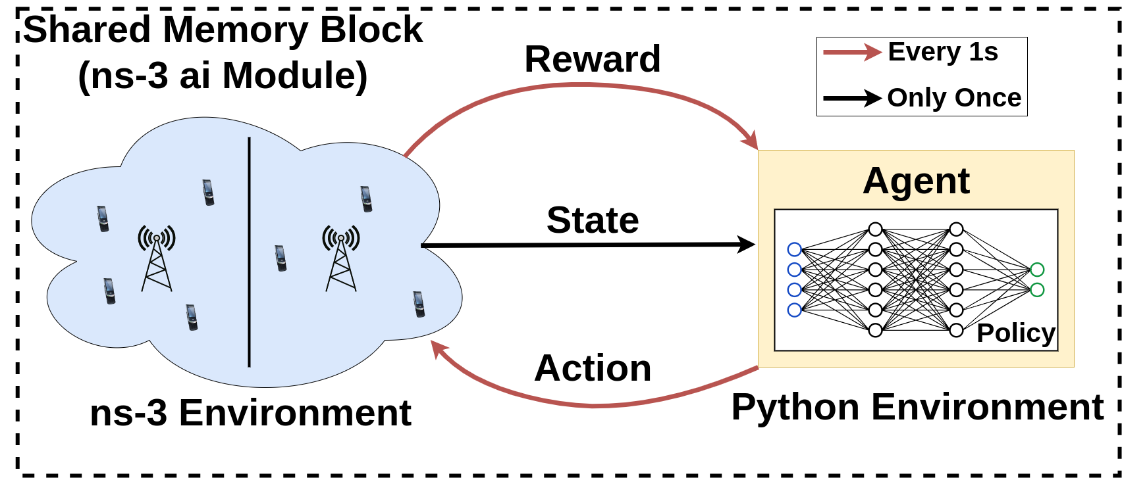
Example: Optimization with DRL and ns3-ai
State (Input): Rx Power and MCS of each node in the BSS-1:
M: total nodes in the BSS 1, i.e., STA1, STA2, …., AP1
N: total nodes in the whole network (BSS1+ BSS2 +BSS3 +BSS4)
$$\left[\begin{matrix}P_{rx}(0, 0) & ⋯ & P_{rx}\left(0,N\right), \\ ⋮ & ⋱ & ⋮ \\ P_{rx}(M,0) & ⋯ & P_{rx}\left(M,N\right),\end{matrix} \right]$$
$$\begin{matrix}MCS(0) \\ ⋮ \\ MCS(M)\end{matrix}$$
M
N + 1
Action (Output): CCA PD Threshold for BSS-1
Reward*: Aggregated throughput, VR Throughput and delay
$r_{t}= α∗Tpt+ β∗\left(T_{constraint}−Hol\right)+η∗(Tpt_{required} − Tpt_{vr})$
App store for ns3-ai: https://apps.nsnam.org/app/ns3-ai/
* For simplicity, we design this as linear combination of throughput and delay. $α$, $β$ and$η$ can be adjusted for the trade-off for 5 ms as the VR constraint.
Policy (Algorithm): Deep Q-learning: 2 fully connected layers with 64 neurons each layer
Training and testing:
Use 500 realizations to train the DQN networks, i.e. DQN learns from this 500 different realizations
Test on 100 new realizations, i.e., DQN only outputs the CCA-PD based on the power measurements

Slide 21
Deep Q-Learning
Deep Q-learning is one algorithm of DRL algorithms with gradient methods:
Simple for starter
Good at handling discrete action space
Easy to generalize across similar states
Overview of DQN policy
Objective: Maximize the accumulate reward from $R_{t}$
Q-function/value: Expectation of accumulate reward for a given action and state
Q-Learning: Choose the action with maximum Q-value for a given state
Update rule:
We need approximation for the Q function – Deep neural networks
Typical setups: $σ=1e^{−4}, γ=0.99$

Slide 22
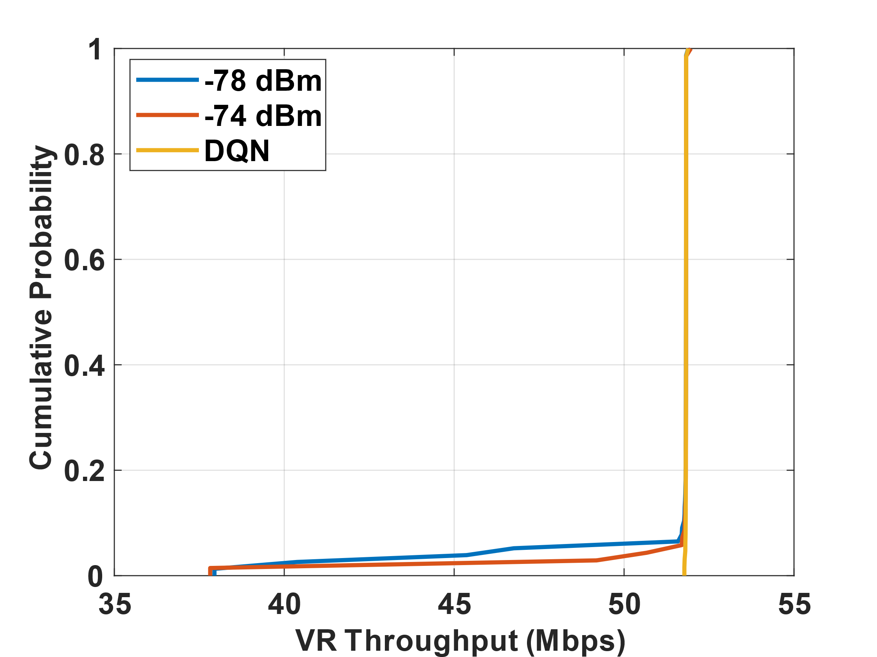
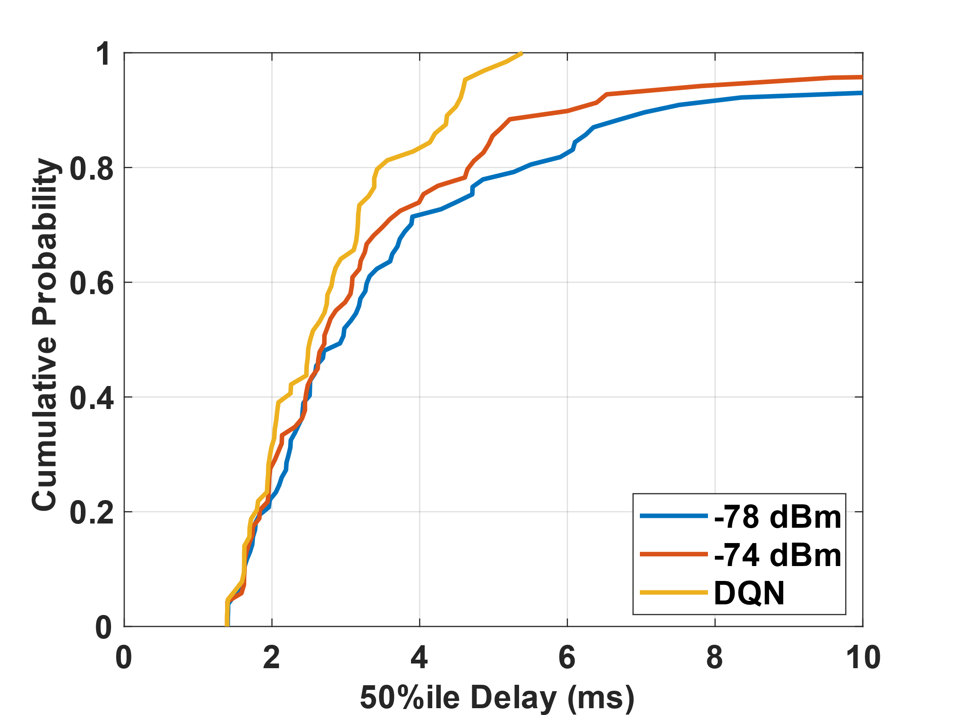
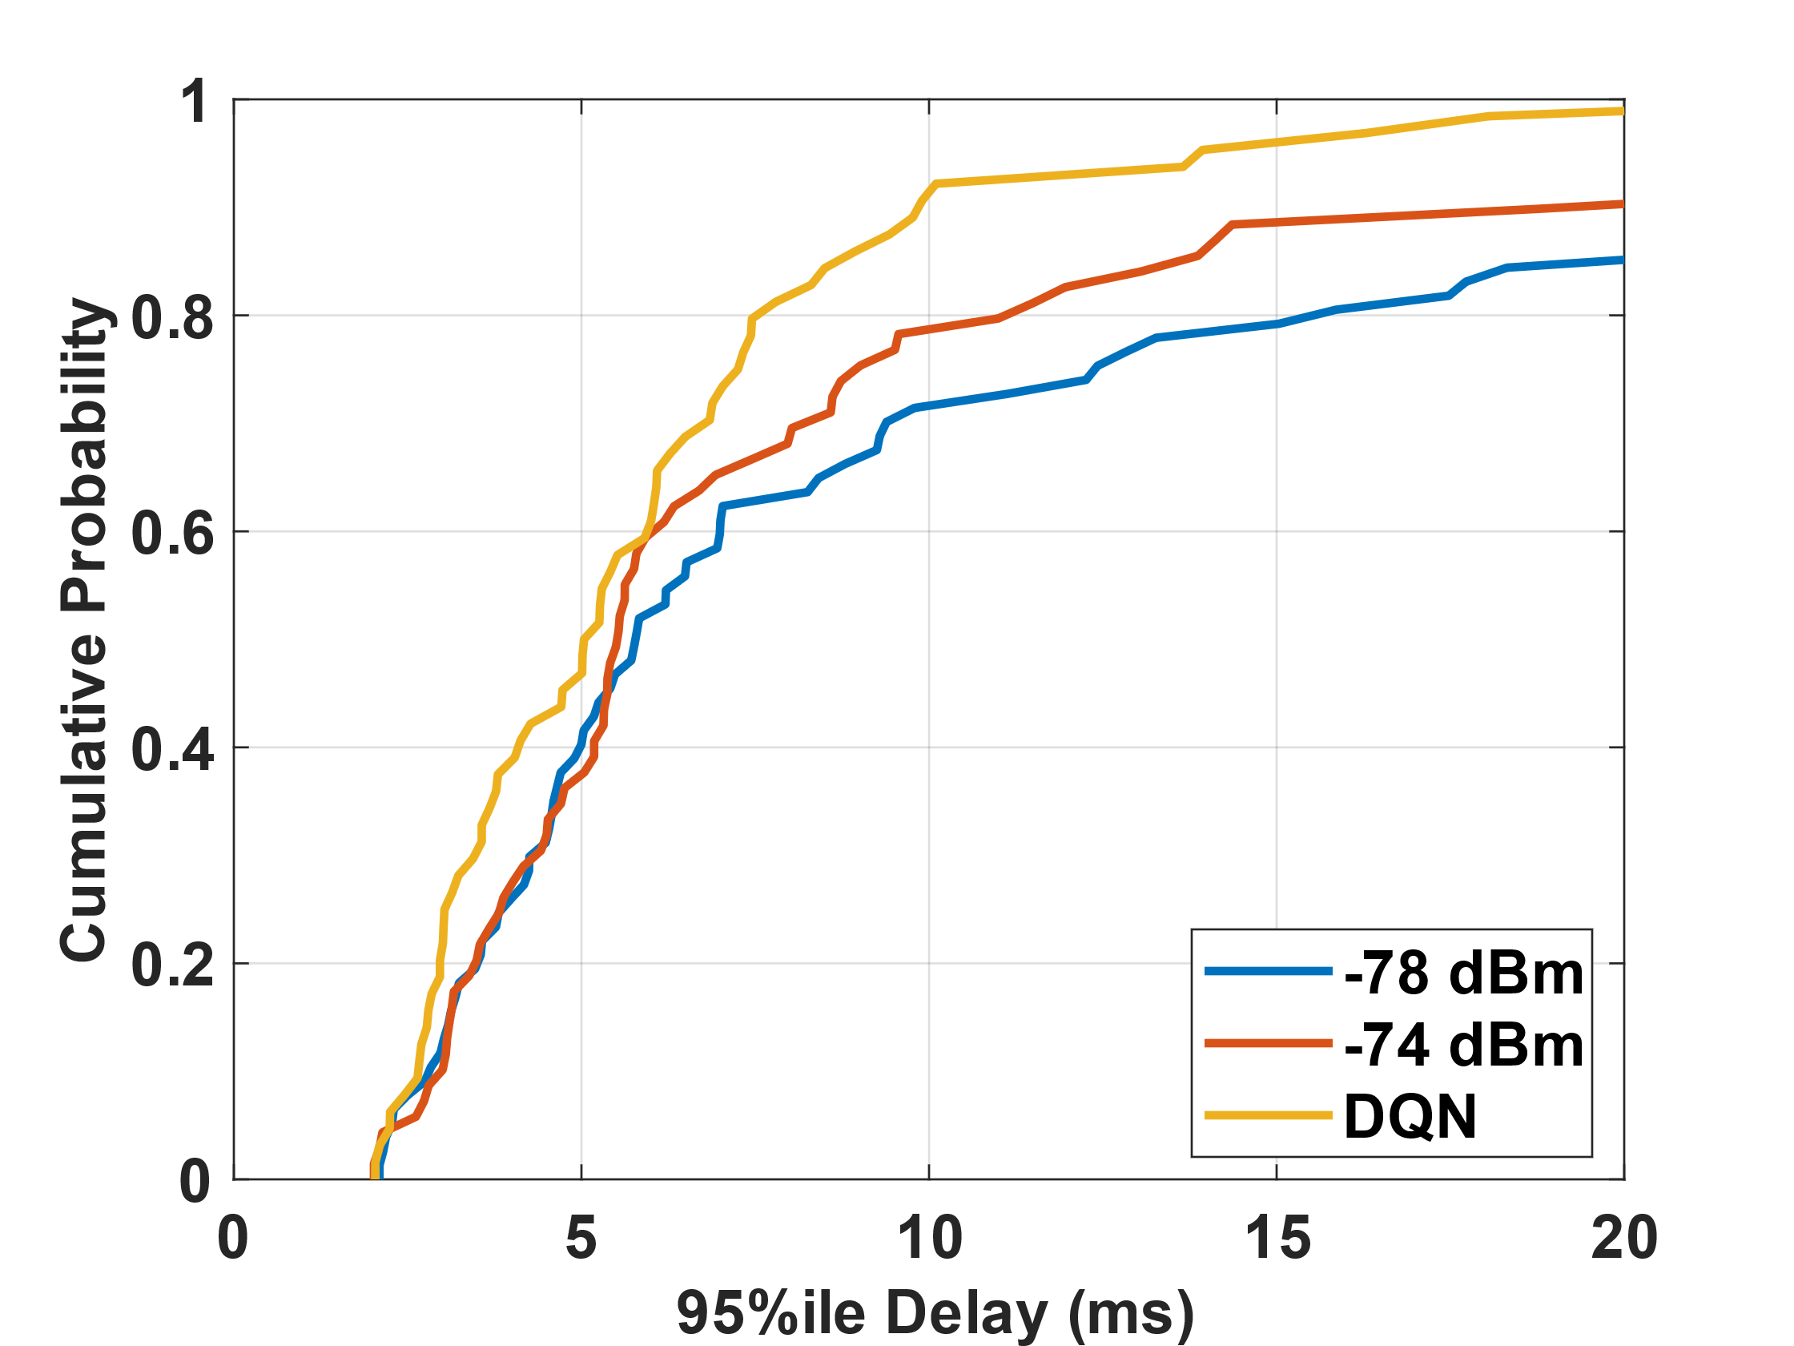
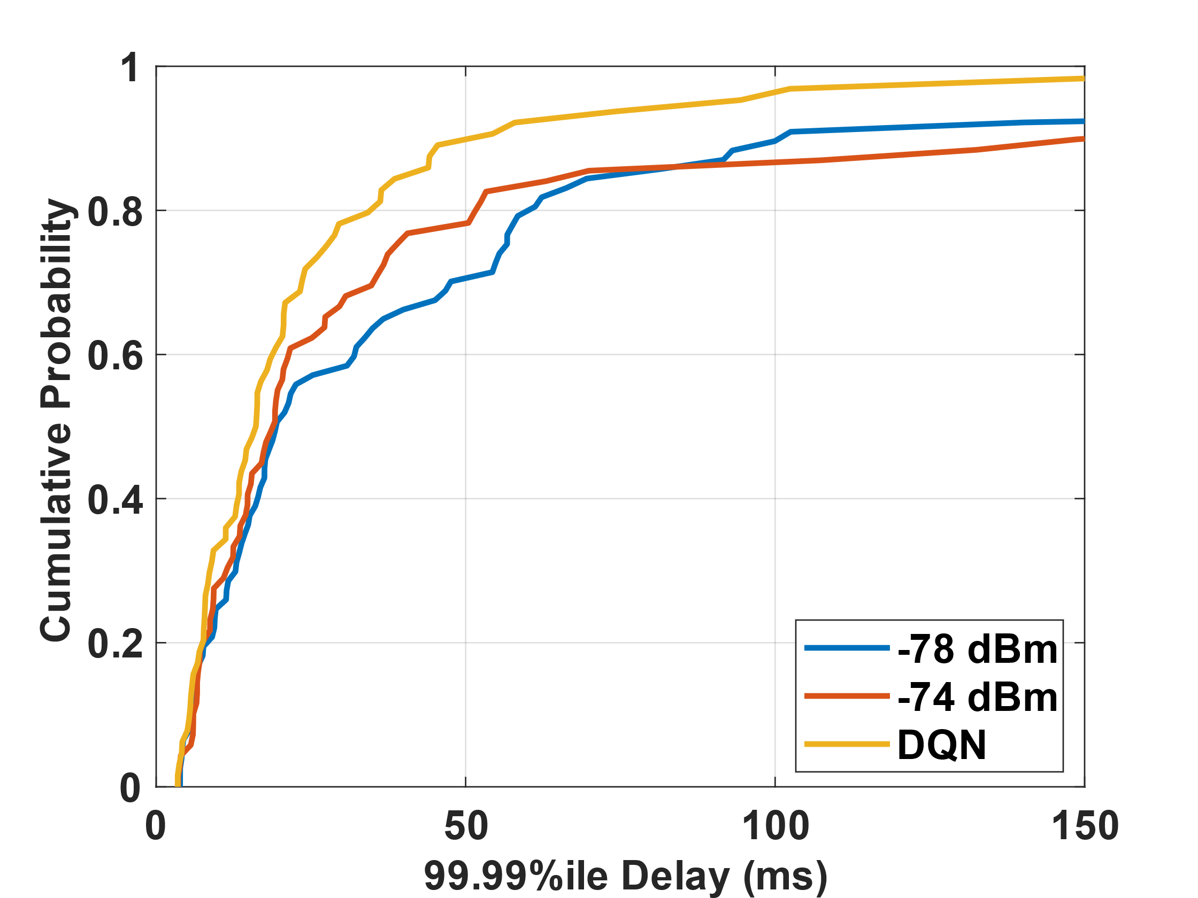
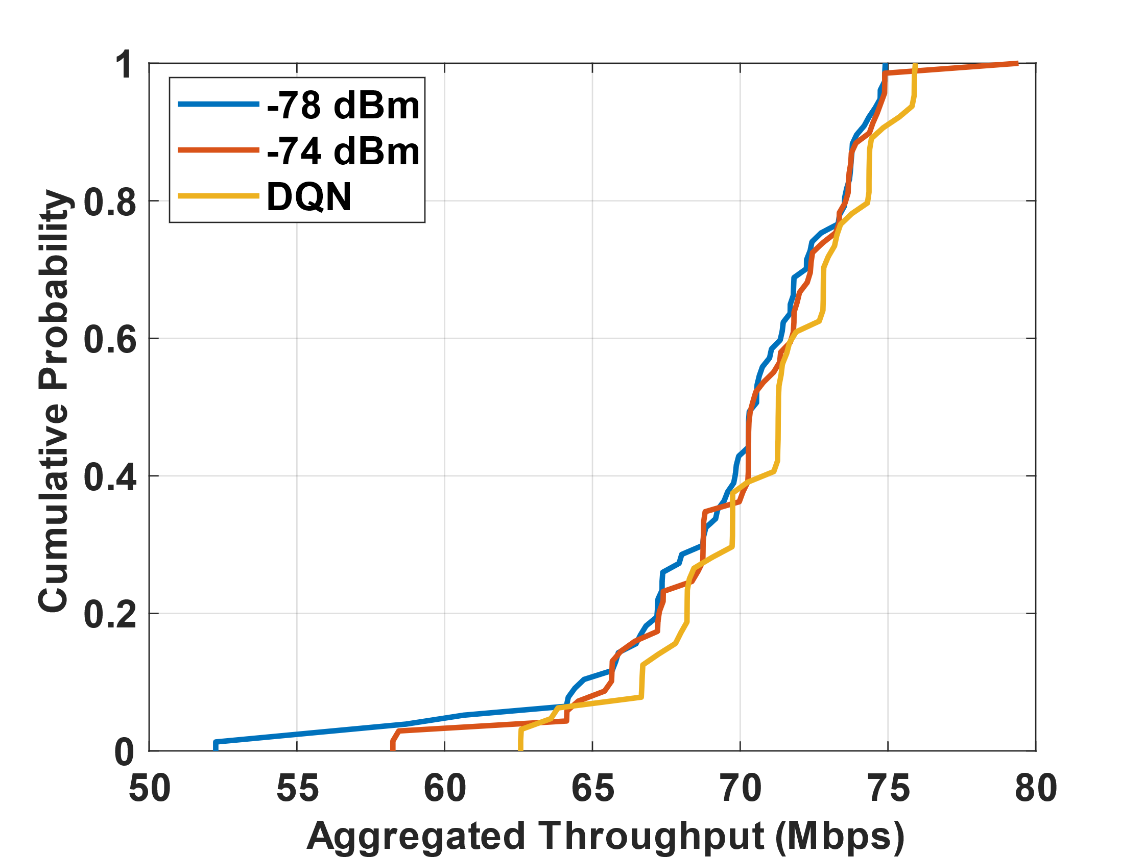
Simulation Results
T’put: 51 Mbps, DQN 100% satisfied
50%ile: 5 ms, DQN 98% satisfied
95%ile: 10 ms, DQN 92% satisfied
99.99%ile: 100 ms, DQN 96% satisfied
Results for 100 new realizations
DQN algorithm (trained on 500 realizations) outputs optimal CCA_PD for the realization
No updating of DQN while sequential testing
DQN can meet VR requirements better (compared to fixed CCA-PD) while maximizing the aggregated throughput
Missing cases can’t meet the requirements by simply changing CCA, e.g., have low VR MCSs and close to interferences, so we need to consider other methods:
802.11be Multi-link operation
AP coordination
Reward: Aggregated throughput, VR Throughput and delay
$r_{t}= α∗Tpt+ β∗\left(T_{constraint}−Hol\right)+η∗\left(Tpt_{required} − Tpt_{vr}\right),α\text{ = }\text{1}\text{, }β=5\text{, }η=3,T_{constraint}=5$

Slide 23
Future Work
Explore BSS coloring and spatial reuse based on 802.11ax standard
Validation of throughput for Channel bonding [10]
Two BSSs, 20+20 MHz channel, partially overlapping
Using the analysis from [10] to predict the throughput
Validation the BSS coloring and OBSS PD [11]
Two BSSs, 20+20 MHz channel, fully overlapping or partially overlapping
Using the analysis from [11] to predict the throughput
Explore multi-link operation (MLO) in 802.11be
Propose new models to validate the throughput and HOL delays in MLO
Scheduling and resource allocation problems in MLO

Slide 24
References
[1] G. Bianchi, "Performance analysis of the IEEE 802.11 distributed coordination function," in IEEE Journal on Selected Areas in Communications, vol. 18, no. 3, pp. 535-547, March 2000
[2] R. Kajihara, H. Wenkai, L. Lanante, M. Kurosaki and H. Ochi, "Performance Analysis Model of IEEE 802.11 CSMA/CA for Multi-BSS Environment," 2020 IEEE 31st Annual International Symposium on Personal, Indoor and Mobile Radio Communications, 2020, pp. 1-7, doi: 10.1109/PIMRC48278.2020.9217235.
[3] H. Ma, R. Vijayakumar, S. Roy and J. Zhu, "Optimizing 802.11 Wireless Mesh Networks Based on Physical Carrier Sensing," in IEEE/ACM Transactions on Networking, vol. 17, no. 5, pp. 1550-1563, Oct. 2009, doi: 10.1109/TNET.2008.2009443.
[4] ``TGax Simulation Scenarios,” IEEE 802.11-14/0980r16, July 2015.
[5] M. Lecci, M. Drago, A. Zanella, M. Zorzi, "An Open Framework for Analyzing and Modeling XR Network Traffic," in IEEE Access, vol. 9, pp. 129782-129795, 2021. Open Access DOI: 10.1109/ACCESS.2021.3113162. Code: https://github.com/signetlabdei/ns-3-vr-app
[6]11-22-1519-00-0uhr-requirements-of-low-latency-in-uhr.pptx

Slide 25
References
[7] 11-22-1926-00-0uhr-challenges-to-achieve-low-latency.pptx
[8] 11-22-1348-01-00be-lb266-cr-for-par-verification-low-latency.pptx
[9] 11-22-0979-01-aiml-applying-ml-to-802-11-current-research-and-emerging-use-cases.pptx
[10] L. Lanante and S. Roy, "Analysis and Optimization of Channel Bonding in Dense IEEE 802.11 WLANs," in IEEE Transactions on Wireless Communications, vol. 20, no. 3, pp. 2150-2160, March 2021, doi: 10.1109/TWC.2020.3041956.
[11] L. Lanante and S. Roy, "Performance Analysis of the IEEE 802.11ax OBSS_PD-Based Spatial Reuse," in IEEE/ACM Transactions on Networking, vol. 30, no. 2, pp. 616-628, April 2022, doi: 10.1109/TNET.2021.3117816.
BACKUP

Slide 26
BACKUP

Slide 27
Delay Analysis
Simulation Topology
AP: Center of circle
STAs: Evenly spaced on the circle
STAs are transmitting with a fixed MCS
Traffic Model
UL Only traffic
﻿Each STA have Bernoulli arrivals with rate λ, i.e., each STA has probability λ to generate a﻿ new packet every $τ_{T}$time [*].
$τ_{T}$time is the channel holding time at MAC layer for each frame
$Bernoulli\left(\frac{λ}{τ_{T}}\right):$
x
x
x
x
Every $τ_{T}$time
$\hat{λ}=n λ,$the aggregate input data rate for n nodes
[*] L. Dai and X. Sun, "A Unified Analysis of IEEE 802.11 DCF Networks: Stability, Throughput, and Delay," in IEEE Transactions on Mobile Computing, vol. 12, no. 8, pp. 1558-1572, Aug. 2013, doi: 10.1109/TMC.2012.128.

Slide 28
Delay Analysis - Simulation
Delay Components in ns-3
Queueing Delay: difference between time instant when packet enters queue till it becomes Head of Line (HOL)
DCF Back Off Delay: difference between time instant when it becomes HOL to 1st transmission
Transmission Delay: difference between 1st transmission instant till when packet is de-queued from TX Buffer
* Validated the delay components (2+3) in ns-3 as defined in analytical model
Cases | Scale by number of STAs | Scale by initial CW
Saturated: $\hat{λ}=1$, time=30s | n=[5,…,50]¹ w=15 k=6 | n=15 w=[15,…,1023]² k=6
Unsaturated: $\hat{λ}=0.15$, time=200s | n=[5,…,50]¹ w=15 k=6 | n=15 w=[15,…,1023]² k=6
$\hat{λ}$ = aggregate input rate, proportional to Bernoulli arrival probability;
n = number of STAs; w = initial CW; k = backoff stages.
¹ Step size = 5
² Powers of 2 from 2⁴ to 2¹⁰

Slide 29
Delay Validation - Analytical Model
Stable State from Markov chain for backoff window change due to collisions
Access Delay:
Saturated Case
Mean delay
Success
Failure
Unsaturated Case: e.g., with fixed $\hat{λ}=n λ=0.15,$the aggregate input data rate for n nodes
Mean delay
Delay mainly related to the initial backoff window size with low arrival rate and low collision probability.
τ_{T}/ τ_{F} = channel holding time of successful/failed transmission;
p = ﻿probability of successful transmission of HOL packet given that the channel is idle;
W = initial backoff window size;
K = cutoff phase;
q = 2 for the exponential backoff;
α = $\frac{1}{1+τ_{F}−τ_{F}∗p−\left(τ_{T}−τ_{F}\right)∗p∗lnp}$.

Slide 30
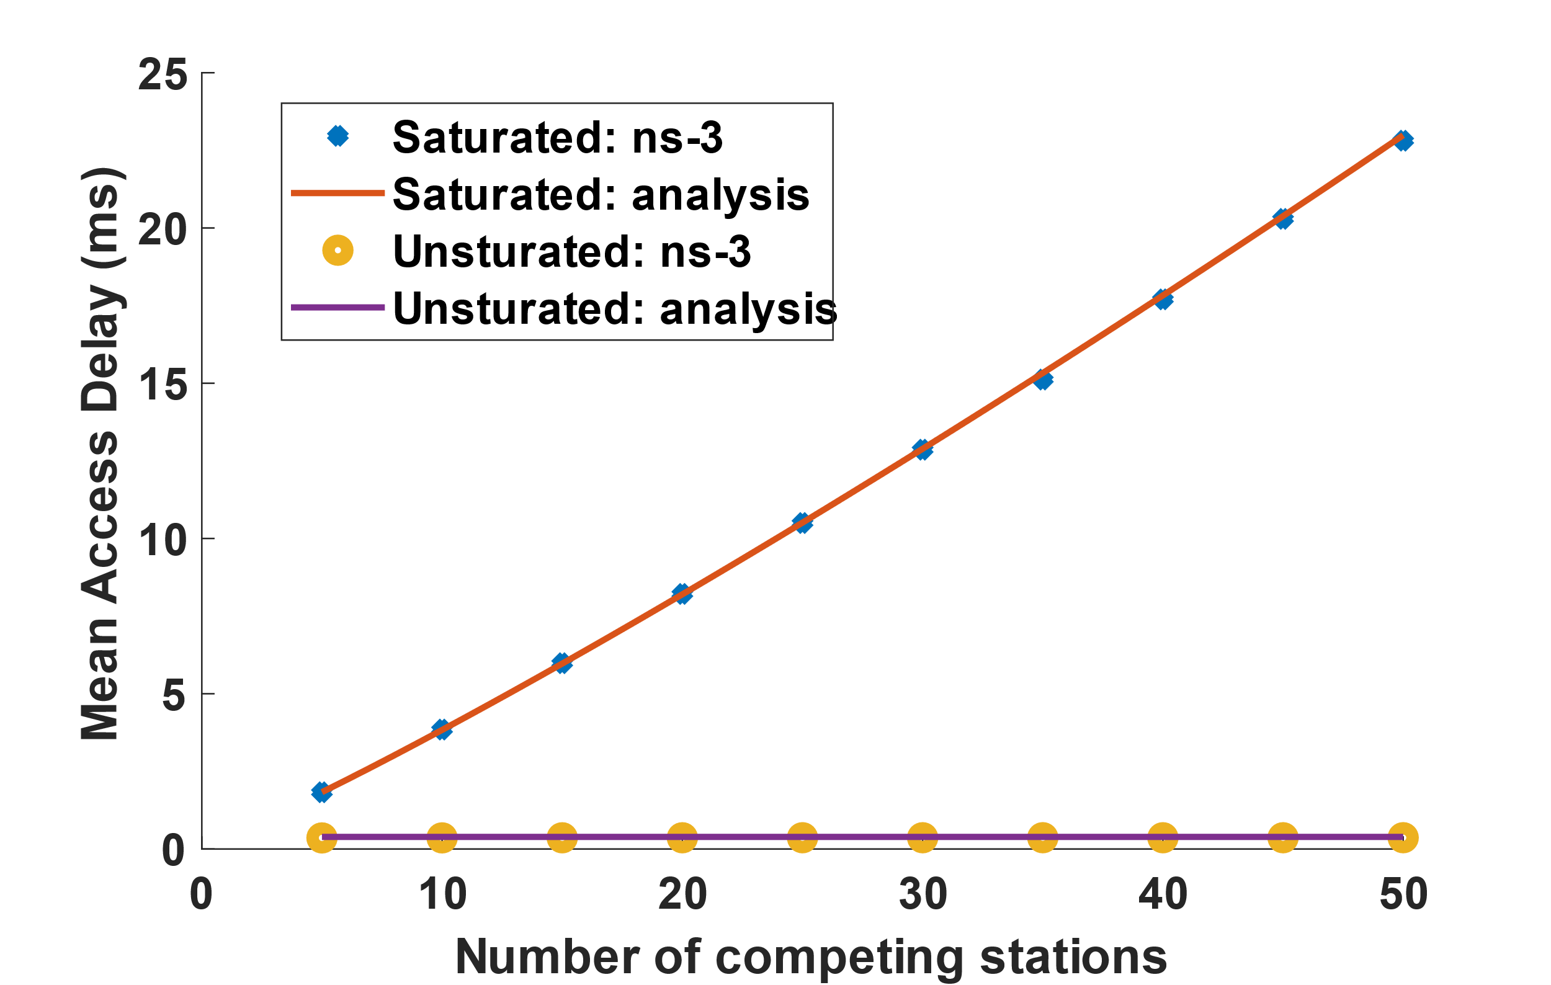
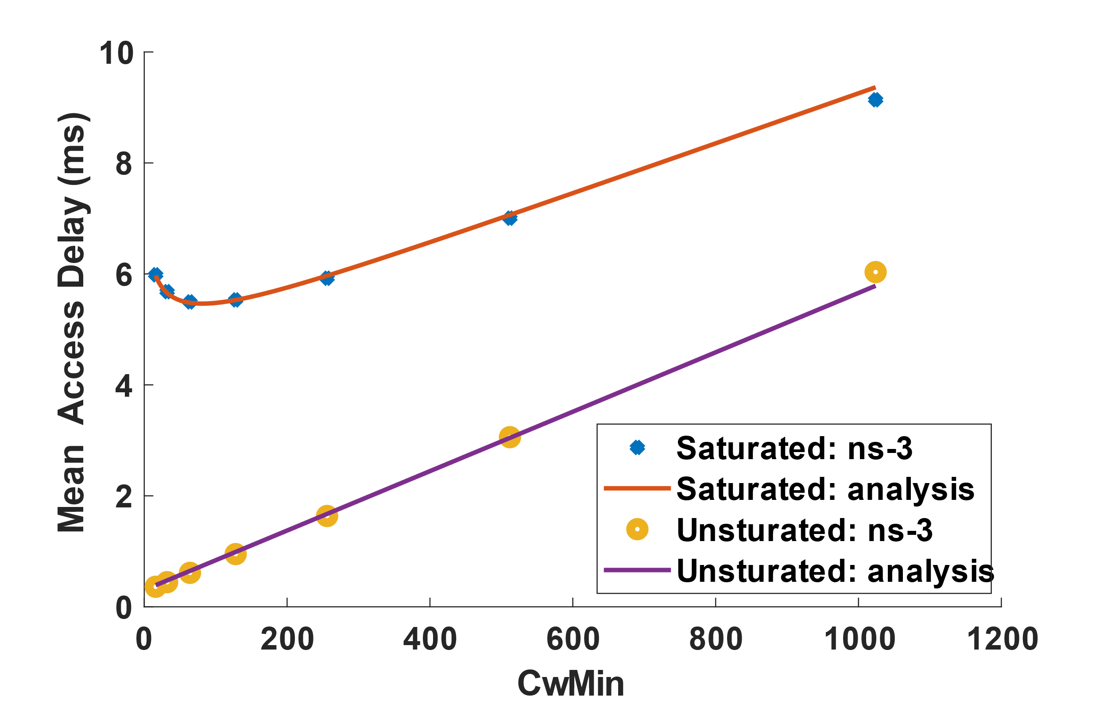
Delay Analysis – Simulation Results
802.11ax, CwMin=16, CwMax = $2^{6}$*CwMin, DCF Basic, Scale by number of STAs, MCS6
ns-3 simulation results aligned with analytical model
Under Saturated condition: delay scaled with node numbers → more nodes, more collisions
Under Unsaturated condition: delay is constant → with fixed aggregate rate, low collisions
802.11ax, nSTA = 15, CwMax = $2^{6}$*CwMin , DCF Basic, Scale by initial CW (CwMin) , MCS6
ns-3 simulation results aligned with analytical model
Under Saturated condition: delay first drops then increase → the tradeoff between less collisions and long backoff period
Under Unsaturated condition, delay increases with CwMin → only related to the initial CW size

Slide 31
ns3-ai module
Overview
Use shared memory as a data transmission module
Faster interaction compared with socket by ns3-gym
Divide the data transmission module into two parts
Python side
C++ side
Memory Management:
Shared memory pool management
Dynamic memory allocation
Read/Write lock
Current support of RL/DL algorithms
DL: RNN, LSTM
RL: Thompson sampling, DQN, PPO
Existing examples for Wi-Fi Simulations
Wi-Fi link adaptation with Thompson sampling
Wi-Fi multi-bss example
App store for ns3-ai: https://apps.nsnam.org/app/ns3-ai/

Slide 32
Basic Usage of ns3-ai
Codebase: ns-3-dev (https://gitlab.com/nsnam/ns-3-dev)
Installation guide: https://github.com/hust-diangroup/ns3- ai#installation
Basic usage example: https://github.com/hust-diangroup/ns3- ai/tree/master/example/multi-run
Online Tutorials:
Recording WNS3 2021: https://vimeo.com/566296651
Slides: https://www.nsnam.org/wp-content/uploads/2021/tutorials/ns3-ai-tutorial-June-2021.pdf

Slide 33
Future development of ns3-ai (GSoC 2023)
Phase 1
std::vector support (done): Add APIs for storing std::vector in shared memory to reduce the interaction between C++ and Python.
OpenAI Gym-like interface (in progress): Introduce a Gym-like interface to enable users to train RL models with ns-3.
Phase 2
Integration of C++-based ML: Introduce an interface to use C++-based ML framework directly in ns-3.
Finishing new examples & benchmarking: improve examples and documentation to better introduce the interfaces; compare performance with previous interface & ns3-gym.

