Slide 1
Ultra-Low Latency with Wi-Fi
Date: 5-Jul-23
Authors:

Slide 2
Introduction
Low latency is one of the goals of UHR
Most current latency-sensitive use cases appear to require latency of the order of milliseconds
  Might be achieved by suitable scheduling and priorities
Some forward-looking proposals [1, 2] suggest a need for latency 0.1 to 1 msec
  Microsecond latency also appears to be a preliminary goal for 6G
    NOTE: this is end-to-end latency, not just Wi-Fi latency
Can Wi-Fi realistically achieve latencies of this order of magnitude?

Slide 3
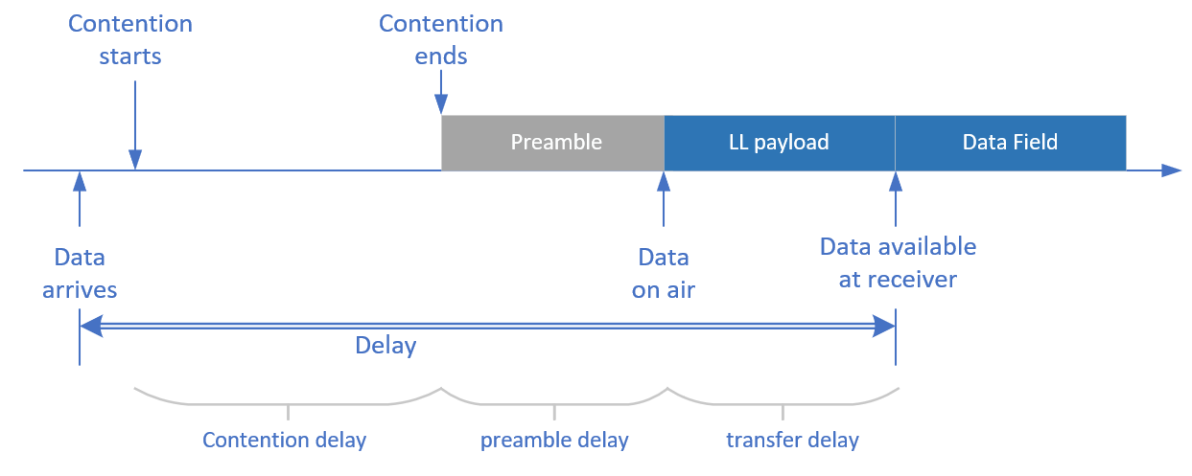
Wi-Fi Inherent delays
Wi-Fi channel access and PPDU structure by themselves incur an inherent latency of over 100 usec
  As measured between data available at Tx and data available at Rx
  Even when the medium is not occupied and traffic has been prioritized over everything else, there is no instantaneous access to the medium

Slide 4
Contributors to inherent delay
Contention
  Typically, contention starts after the availability of data
    No reason to contend with empty buffer
  This adds delay before Transmitter can access the medium
  Contention time of the order of 100 – 300 usec (depending on AC)
Preamble
  After gaining access to the medium, preamble will consume airtime before the data field – carrying the actual data – can be transmitted
  Typical value ~50 usec
Transfer time
  Receiver can only process data after last bit has been received
    Function of data length and PHY rate

Slide 5
Additional delays
When the medium is occupied, delays will be higher still
Waiting for Medium to become idle adds extra delay
  In addition to inherent delays

Slide 6
Problem statement
How can we reduce the effects of inherent delays?
  For both predictable and unpredictable types of latency-sensitive traffic
  Assuming other sources of latency (scheduling, …) have been addressed
Goal:
Make data access to the medium near-instantaneous from the application perspective, while preserving 802.11 Medium Access protocols.

Slide 7
Possible solution for “predictable” traffic
When traffic arrival times are (somewhat) predictable:
  “Pre-contend” such that the data field starts on the medium as close as possible to expected arrival of traffic at the transmitter
    Contention starts before data is available at transmitter
NOTE: the transmitter still contends as required by the standard
  No special access privileges to the medium!
  Contention will require the same amount of time, but is started ahead of the availability of traffic (based on expected traffic)

Slide 8
Managing unpredictability
Exact contention duration is unpredictable (and possibly data arrival times may have jitter as well)
  Data may arrive before or after the start of the PPDU Data Field
What to do if data arrives after start of Data Field?

Slide 9
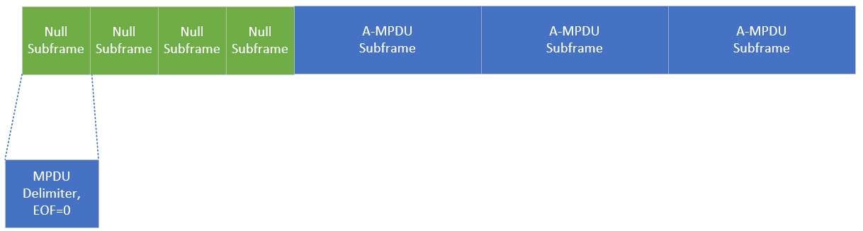
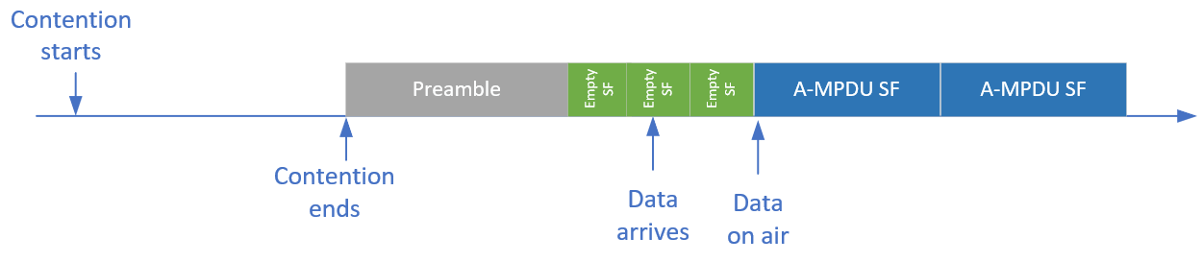
Pre-padding
If no data is available, start of Data Field needs to be padded until data arrives
Could be similar to EOF padding or MPDU start spacing
  Empty delimiters that will be filtered out at receiver

Slide 10
Reducing inherent latency for predictable traffic: summary
“Early contention”: Choose start of contention judiciously to make arrival of data coincide as closely as possible with start of the Data Field
  Eliminate contention delay and preamble delay
Indicate tentative PPDU duration in preamble
  Long enough to make sure PPDU fully covers expected arrival of data
Pre-padding allows starting a PPDU before the actual arrival of data, as well as insertion of data into a PPDU “in progress”
To avoid taking up excessive airtime, this could be combined with preemption
  PPDU is terminated as soon as all expected data has been processed

Slide 11
Reducing inherent latency for predictable traffic

Slide 12
Simulations – predictable traffic
Assume LL traffic always wins access to the medium around expected traffic arrival events
  E.g., through rTWT
Traffic is periodic, but allow some jitter in the exact arrival time
Compare 95th percentile latency:
  “regular” channel access (contention starts after data arrival)
    AC_BE and AC_VO
  Proposed method
    Early contention + early termination
Simulation models contention, data arrival, …
  Discrete event simulation

Slide 13
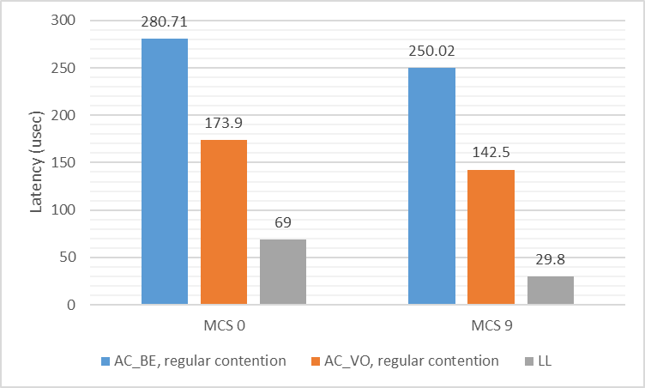
Results (p95) – Predictable traffic
Traffic
  100 Hz burst
  5% jitter on expected arrival times
  160 Bytes/burst
LL traffic sent at MCS 0 or MCS 9
  Affects transfer time
Significant reduction in end-to-end latency (as seen by application)

Slide 14
Non-predictable traffic
The method described earlier can not be used when traffic arrival times are unknown
  No notion of “right” time to start contention
However, a similar approach could be used in combination with OFDMA
  Assign an RU for LL traffic (representing a relatively small part of the total BW)
    whether traffic is available or not at the time the PPDU starts
  Pre-pad the reserved RU and insert LL traffic if/when it arrives

Slide 15
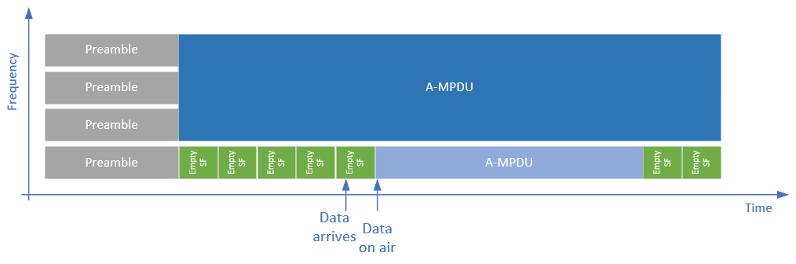
Non-predictable traffic

Slide 16
Simulations – unpredictable traffic
In 160 MHz BSS, reserve 242-tone RU for LL services
  Pre-padding if no LL data available
NOTE: in this case, other DL traffic can run concurrently

Slide 17
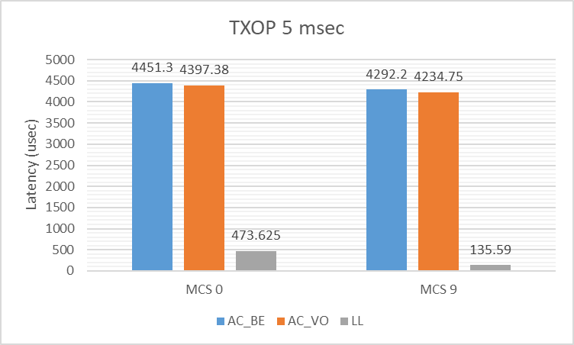
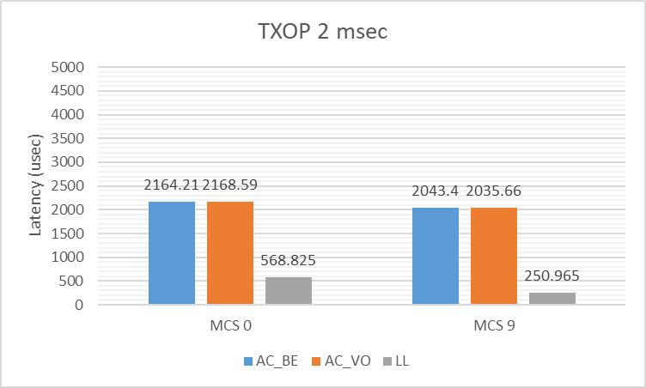
Results (p95) – unpredictable traffic
Notes
Latency without pre-padding dominated by PPDU duration
Longer transfer delay caused by smaller BW (20 MHz)
95 percentile increased due to possibility of LL traffic arriving outside of data field

Slide 18
Observations
Overall latency can be significantly reduced
  Eliminate most of the inherent delays (from application perspective)
  Contention unchanged
Remaining latency dominated by packet transfer time (function of PHY rate) and modulation
  OFDM with 16 usec symbols
  Further lowering the latency might require changes to modulation
Implementation specific delays were not considered
  E.g., execution time of FFT/IFFT
  Data arrival at Tx vs. availability for MAC
  Results should be considered “lower bound”

Slide 19
Conclusions
We discussed techniques to minimize inherent Wi-Fi delays for LL traffic
  Start contention at a suitable time before expected data availability (predictable traffic)
  Insert padding at start of data field if needed
  Early PPDU termination if needed
Using some or all of these techniques, inherent latency from Wi-Fi can be significantly reduced
Early contention appears compatible with current channel access
Pre-padding appears compatible with existing A-MPDU padding
  Should there be rules on when to use it?

Slide 20
References
[1] 11-22-0032-00-0wng-next-gen-after-11be
[2] 11-22-0046-01-0wng-next-generation-after-802-11be
[3] 11-23-0610-01-0uhr-low-latency-traffic-delivery-in-uhr

