Slide 1
Smooth Beamforming with Feedback Overhead Reduction
Date: 2023-08-28
Authors:
Name | Affiliation | Address | Phone | Email
Insik Jung | LG Electronics | 19, Yangjae-daero 11gil, Seocho-gu, Seoul 137-130, Korea |  | insik0618.jung@lge.com
Eunsung Park |  |  |  | esung.park@lge.com
Dongguk Lim |  |  |  | dongguk.lim@lge.com
Jinyoung Chun |  |  |  | jiny.chun@lge.com
Insun Jang |  |  |  | insun.jang@lge.com
Sunhee Baek |  |  |  | sunhee.baek@lge.com
Yelin Yoon |  |  |  | yl.yoon@lge.com
Geonhwan Kim |  |  |  | geonhwan.kim@lge.com
Jinsoo Choi |  |  |  | js.choi@lge.com
HanGyu Cho |  |  |  | hg.cho@lge.com

Slide 2
Introduction
Smooth beamforming enables obtaining smoothing gain at the receiver side when beamforming is applied [1]-[6].
Previous works [1]-[6] propose to conduct V matrix optimization to resolve the discontinuity of the estimated channel
In this contribution, we propose a method to reduce additional feedback overhead to deliver the optimized phase rotations for V matrix

Slide 3
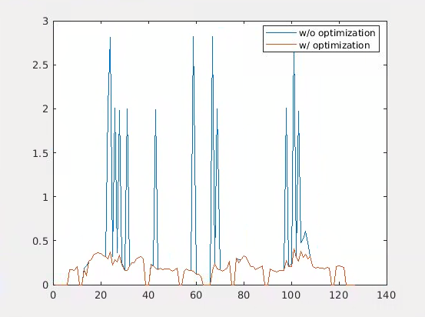
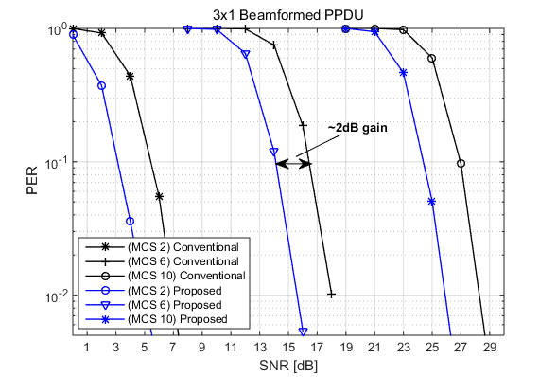
Recap: V matrix Optimization
It is shown in [4] that optimized column-wise phase shift resolves discontinuity of beam-steering matrices among adjacent tones
Resolving discontinuity results in obtaining channel smoothing gain at the receiver side
Discontinuty has been resolved after V matrix optimization

Slide 4
Beamformer Side Optimization
Channel estimation (BFee)
Estimate of the channel matrix H
H=U $Σ$V^{H}
Feedback (BFee)
Feedback of VD, where D is the diagonal matrix to make last row of V to be real values
Optimization (BFer)
BFer optimizes D* using VD
Beamforming (BFer)
BFer conducts VDD* beamforming
→ No additional signaling
BFer
BFee
NDPA
NDP
Estimation of H
Compressed beamforming feedback
D* optimization
data PPDU

Slide 5
Beamformee Side Optimization
Channel estimation (BFee)
Estimate of the channel matrix H
H=U $Σ$V^{H}
Optimization (BFee)
STA optimizes D* using VD
Feedback (BFee)
Feedback of VD, where D is the diagonal matrix to make last row of V to be real values
Additional feedback of D*
Beamforming (BFer)
AP conducts VDD* beamforming
BFer
BFee
NDPA
NDP
-Estimation of H
-D* optimization
Compressed beamforming feedback
data PPDU

Slide 6
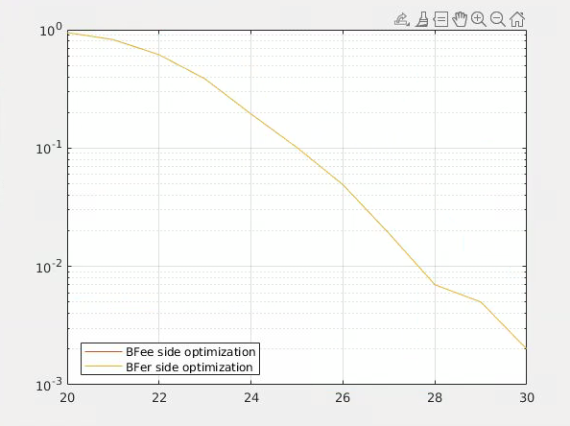
Comparison: BFer and BFee side
FER of BFer-side and BFee-side optimization is almost same
If BFer has optimization capability, we observed that BFer side optimization might be advantageous than BFee-side optimization in terms of throughput.
Parameters | Values
Ng | 4
MCS | 7
BW | 40MHz
MIMO configuration | 4 by 2

Slide 7
Possible Scenarios
Scenario 1: BFer has an optimization capability
BFer side optimization might be a better option in terms of throughput
Scenario 2: BFer doesn’t have an optimization capability
If BFer is a non-AP STA, it may not have optimization capability because of the computation cost
In this scenario, BFee may conduct optimization instead of BFer and feedback the optimization result to the BFer. For example, it might be conducted in UL SU MIMO
In our contribution, we propose a overhead reduction method for Scenario 2.

Slide 8
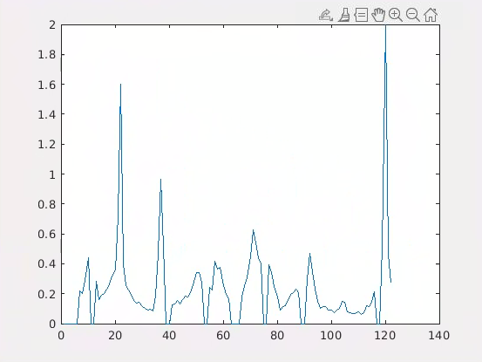
Part-of-tone Optimization
Notice that discontinuity on euclidean distance happens intermittently.
Then, we don’t have to optimize every tones
Proposal
Just optimize for the tones from the first discontinuity
We may set threshold value to detect the first discontinuity
Only feedback D* for the optimized tones
Benefit
Reduction of feedback overhead for D*
The first discontinuity based on the threshold
threshold
We don’t have to optimize these tones
First discontinuity happens in the tone index n

Slide 9
Simulation Settings
General parameters
BW = 40MHz
MCS = 7
Antenna configuration
4 by 2
Quantization
(Phi, psi) = (6,4) bits
Channel model
TGnD, NLoS
Receiver option
LMMSE receiver
LS channel estimation

Slide 10
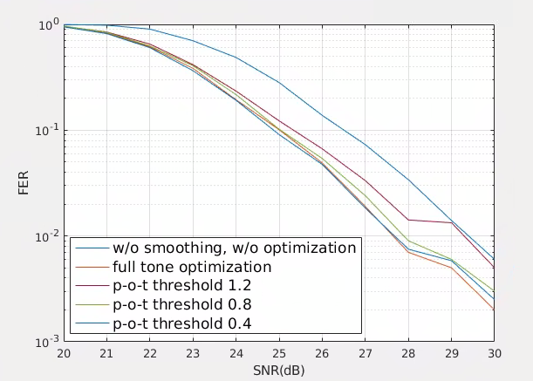
Simulation Results
[FER]
Baseline: w/o optimization
Option 1: Full tone optimization
Option 2: Part of tone optimization
Option 2-1) Threshold = 1.2
Option 2-2) Threshold = 0.8
Option 2-3) Threshold = 0.4
Note: # of additional indication bits (e.g. optimization starting tone index) has been considered as 9 bits (which can be 12 bits for 320MHz BW)
[Overhead analysis]
 | Option 1 | Option 2-1 | Option 2-2 | Option 2-3
Additional bits | 1464 | 801.6 (45.2% reduction) | 1106.6 (24.4% reduction) | 1357.7 (7.2% reduction)
Compare w/ baseline | 24% increased | 13.1% increased | 18.14% increased | 22.3% increased
Notes:
FB bits for compressed beamforming FB: 122 (FB tones) * 10 (# of angles) * 5 (avg. quantization bits)

Slide 11
Conclusion
In this contribution, the part of tone optimization and feedback method has been proposed.
The simulation results has shown that proposed method reduces feedback overhead without significant FER loss.

Slide 12
References
[1] 11-05-1635-01-000n-wwise-preambles-and-mimo-tx-beamforming
[2] 11-22-1392-00-0uhr-beamforming-improvement-for-uhr
[3] 11-22-1820-01-0uhr-bf-feedback-with-the-optimal-svd
[4] 11-22-1842-00-0uhr-channel-information-feedback-for-smooth-beamforming
[5] 11-22-1869-01-0uhr-txbf-based-on-the-optimal-svd
[6] E. Jeon, M. Ahn, S. Kim, W. B. Lee and J. Kim, "Joint Beamformer and Beamformee Design for Channel Smoothing in WLAN Systems," in Proc. IEEE 92nd Veh. Technol. Conf. (VTC2020-Fall), Nov. 2020, pp. 1-6.

Slide 13
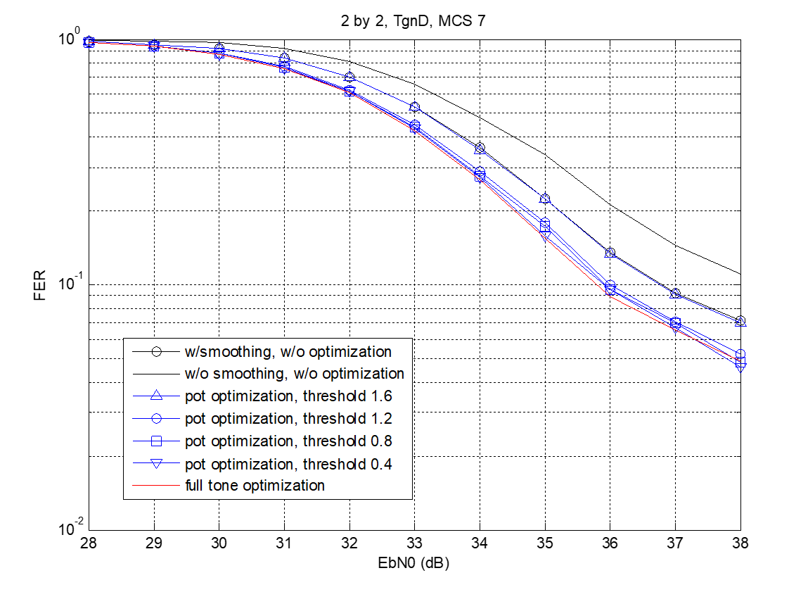
Appendix
2 by 2 MIMO performance

Slide 14
Appendix
Discussions
FER
Effect of discontinuity is smaller than that of 4 by 2
Additional smoothing gain provided by optimization is about 1dB
Overhead
When threshold is 0.8, proposed scheme reduces 60.8% overhead compared to the full-tone optimization scheme

