Slide 1
Discussion on setting of PSDU Length field in an EDMG multistatic sensing PPDU
Date: 2023-07-03
Authors:
Name | Affiliation | Address | Phone | Email
Yan Xin | Huawei Technologies | Ottawa, Ontario |  | yan.xin@huawei.com

Slide 2
Introduction
As defined in Table 28-12 in REVme D3.0, for an EDMG SU PPDU, the PSDU Length field in EDMG-Header-A field is set to length of the PSDU field in octets.
In subclause 28.9.3.3 (EDMG multistatic sensing PPDU header fields) in 802.11bf D1.0, it is specified that:
Therefore, different from the setting of PSDU Length field for an EDMG SU PPDU, a value in octets set in the PSDU Length field of the EDMG-Header-A field in an EDMG multistatic sensing PPDU should take into account both Data field and Sync field of the PPDU.
As commented in CID#1765, in 802.11bf D1.0, how to specify the PSDU Length in EDMG-Header-A for an EDMG multistatic sensing PPDU is needed in order for an EDMG multistatic sensing unaware STA, based on the values in PSDU Length field and the MCS field, to calculate the duration of the Data field as it in an EDMG SC PPDU equal to the summation of the Data field and the duration of the Sync field in an EDMG multistatic sensing PPDU.

Slide 3
Discussion of Data field in an EDMG multistatic sensing PPDU
Formation of the Data field in an EDMG multistatic sensing PPDU
Given the information of PSDU Length, MCS, GI Length and channel width, an EDMG multistatic sensing compliance STA is desirable to follow the same procedures of encoding, modulation, symbol blocking for Data field in an EDMG SC PPDU as specified in 28.5.9 (Data field).
In EDMG multistatic sensing, the information of PSDU Length should be transmitted during the multistatic sensing setup phase by the Initiator to the responder which is the receiver of Dara frame since the PSDU Length field in an EDMG multistatic sensing PPDU is no longer carry the true value of PSDU Length.
In general, in EDMG before applying LDPC encoding to PSDU data, padding PSDU data with some pad bits is needed to ensure the input of the LDPC encoder is an integer number of data words for a given MCS.
In general, in EDMG SC symbol padding is needed in order for the Data field to be an integer number of SC blocks.
Therefore, the generated Data field in an EDMG multistatic sensing PPDU should be an integer number of SC symbol blocks. The duration of the Data field can be calculated based on the correspondent number of SC symbol blocks.

Slide 4
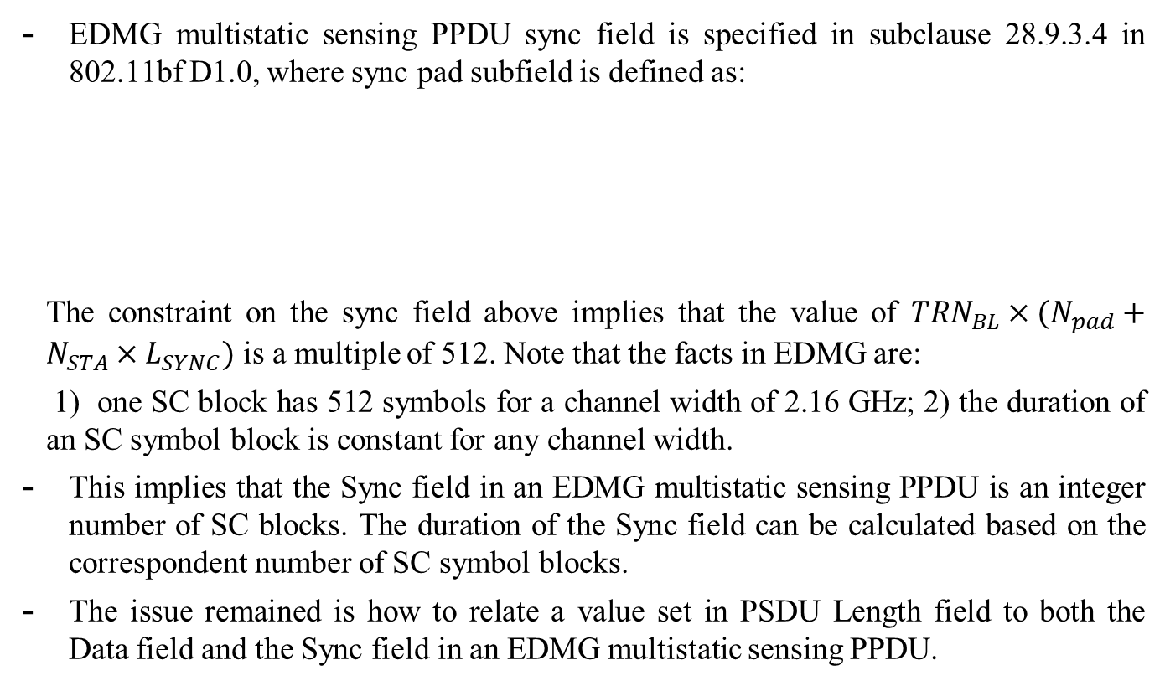
Discussion of Sync field in an EDMG multistatic sensing PPDU
Formation of the Sync field in an EDMG multistatic sensing PPDU
EDMG multistatic sensing PPDU sync field is specified in subclause 28.9.3.4 in 802.11bf D1.0, where sync pad subfield is defined as:
The constraint on the sync field above implies that the value of ${TRN}_{BL}×(N_{pad}+N_{STA}×L_{SYNC})$ is a multiple of 512. Note that the facts in EDMG are:
1) one SC block has 512 symbols for a channel width of 2.16 GHz; 2) the duration of an SC symbol block is constant for any channel width.
This implies that the Sync field in an EDMG multistatic sensing PPDU is an integer number of SC blocks. The duration of the Sync field can be calculated based on the correspondent number of SC symbol blocks.
The issue remained is how to relate a value set in PSDU Length field to both the Data field and the Sync field in an EDMG multistatic sensing PPDU.

Slide 5
EDMG multistatic sensing unaware STAs
When an EDMG multistatic sensing unaware STA detects the PSDU Length field and MCS field in the EDMG-Header-A field of an EDMG multistatic sensing PPDU, the STA can calculate the duration of data field as in an EDMG SC PPDU, which is expected to be equal to the summation of the duration of the Data field and the duration of the Sync field in the EDMG multistatic sensing PPDU, as specified in 28.9.3.3.
- By following the rules specified in EDMG, a value in the PSDU Length field should generate an integer number of SC symbol blocks, Note that as discussed above, each of the Data field and the Sync field in an EDMG multistatic sensing PPDU can generate an integer number of SC symbol blocks.

Slide 6
PSDU Length field in EDMG-Header-A of an EDMG multistatic sensing PPDU
Denote a value in PSDU Length field in EDMG-Header-A of an EDMG multistatic sensing PPDU as
LENGTH = PSDU_LENGTH + SYNC_LENGTH
where PSDU_LENGTH and SYNC_LENGTH can generate Data field and Sync field, respectively by following the procedures of coding, modulation and symbol blocking defined in EDMG.
Since PSDU_LENGTH data may not be an exact integer number of data words as the input of an LDPC encoder and the modulated symbols after coding and modulation may not be suitable for an exact integer number SC symbol blocks, data word padding and symbol padding are needed.
Therefore, this adds a constraint to SYNC_LENGTH. By following the procedures of coding, modulation and symbol blocking defined in EDMG, SYNC_LENGTH (in octets) data should be an exact integer number of data words and should generate an exact integer number SC symbol blocks.

Slide 7
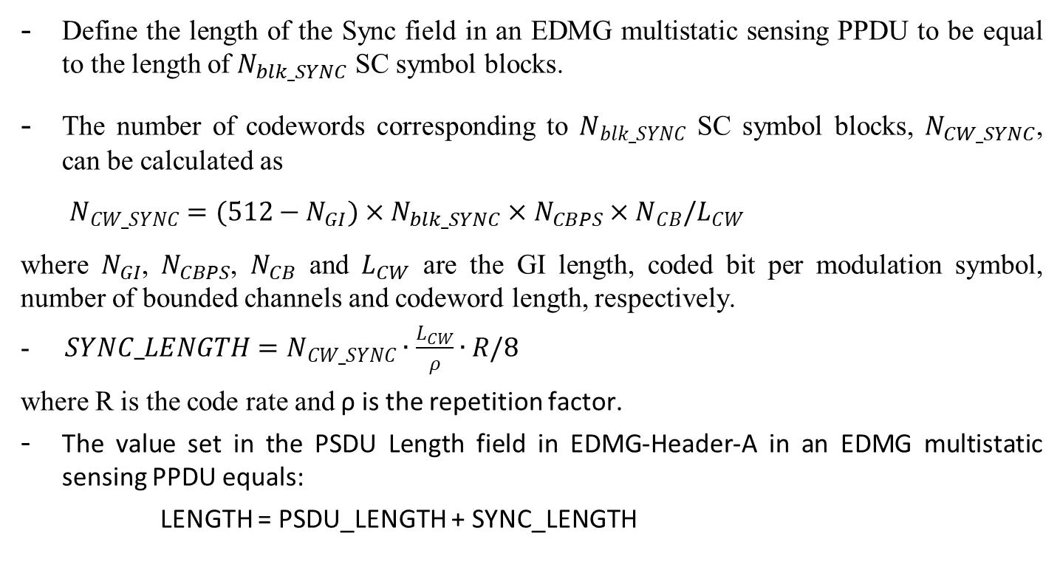
Calculation of SYNC_LENGTH based on a Sync field in an EDMG multistatic sensing PPDU
Define the length of the Sync field in an EDMG multistatic sensing PPDU to be equal to the length of $N_{blk_SYNC}$ SC symbol blocks.
The number of codewords corresponding to $N_{blk_SYNC}$ SC symbol blocks, $N_{CW_SYNC}$, can be calculated as
$N_{CW_SYNC}=(512−N_{GI})×N_{blk_SYNC}×N_{CBPS}×N_{CB}/L_{CW}$
where $N_{GI}$, $N_{CBPS}$, $N_{CB}$ and $L_{CW}$ are the GI length, coded bit per modulation symbol, number of bounded channels and codeword length, respectively.
- $SYNC_LENGTH=N_{CW_SYNC}∙\frac{L_{CW}}{ρ}∙R/8$
where R is the code rate and ρ is the repetition factor.
The value set in the PSDU Length field in EDMG-Header-A in an EDMG multistatic sensing PPDU equals:
LENGTH = PSDU_LENGTH + SYNC_LENGTH

Slide 8
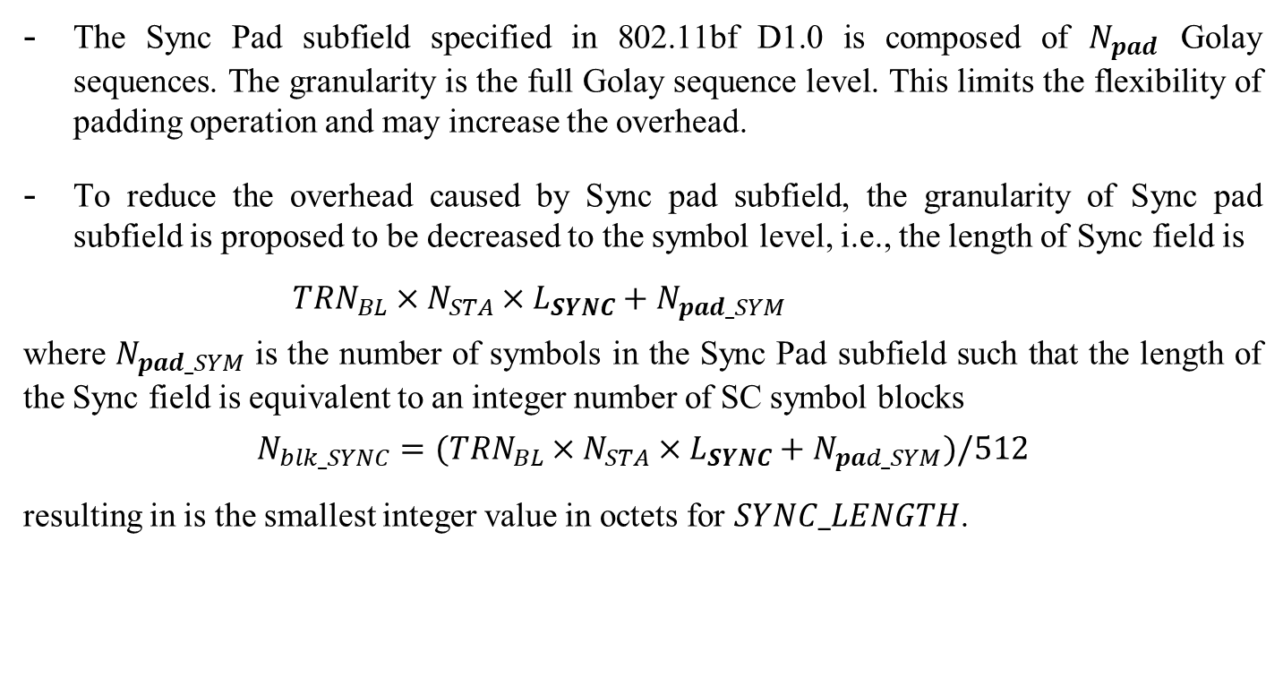
Sync Pad subfield in an EDMG multistatic sensing PPDU
The Sync Pad subfield specified in 802.11bf D1.0 is composed of $N_{pad}$ Golay sequences. The granularity is the full Golay sequence level. This limits the flexibility of padding operation and may increase the overhead.
To reduce the overhead caused by Sync pad subfield, the granularity of Sync pad subfield is proposed to be decreased to the symbol level, i.e., the length of Sync field is
${TRN}_{BL}×N_{STA}×L_{SYNC}+N_{pad_SYM}$
where $N_{pad_SYM}$ is the number of symbols in the Sync Pad subfield such that the length of the Sync field is equivalent to an integer number of SC symbol blocks
$${N_{blk_SYNC}=(TRN}_{BL}×N_{STA}×L_{SYNC}+N_{pad_SYM})/512$$
resulting in is the smallest integer value in octets for $SYNC_LENGTH$.

