Slide 1
dRU Signaling for UHR
Date: 2023-07-09
Authors:
Name | Affiliation | Address | Phone | Email
Eunsung Park | LG Electronics | 19, Yangjae-daero 11gil, Seocho-gu, Seoul 137-130, Korea |  | esung.park@lge.com
Dongguk Lim |  |  |  | dongguk.lim@lge.com
Jinyoung Chun |  |  |  | jiny.chun@lge.com
Insun Jang |  |  |  | insun.jang@lge.com
Jinsoo Choi |  |  |  | js.choi@lge.com
HanGyu Cho |  |  |  | hg.cho@lge.com

Slide 2
Introduction
To overcome PSD limitations which are defined per 1 MHz, dRU was introduced in [1]
We discussed our view on dRU design ways in [2]
In this contribution, we provide detailed methods on how to build dRU tone plan and how to indicate each dRU by using rRU indication

Slide 3
Recap
Our view on dRU design ways
  dRU tone plans are defined in 20 / 40 / 80 MHz channels
  The existing RU Allocation subfield is reused for dRU allocation
  dRUs and regular RUs (rRUs) are not used at the same time within 20 MHz
  For a dRU tone plan, the basic tone size of dRUs and the configuration of dRUs in each channel (i.e., combination of different dRUs in each channel) are defined the same as the conventional rRU tone plan
  Large size dRUs are built by combining small size dRUs (and null tones depending on the dRU size)
  An additional subfield for dRU indication (e.g., whether it is dRU or rRU for each 20MHz channel) is defined

Slide 4
How to Build dRU Tone Plan (1/2)
We maintain DC, guard and null tones defined in the rRU tone plan
We define N*nine 26 dRUs, N*four 52 dRUs and N*two 106 dRUs in N*20 MHz
  N is equal to 1, 2 and 4 for 20, 40 and 80 MHz, respectively
To begin with, 26 dRUs are defined by allocating available tones to each dRU in turn
Second, each 52 dRU is defined by combining two 26 dRUs and then each 106 dRU is defined by combining two 52 dRUs and two tones which are null tones in 26 / 52 rRUs but not in 106 rRUs
  N 26 dRU(s) is(are) not used to build 52 dRUs in N*20 MHz just as the middle 26 rRU in each 20 MHz channel
In 40 / 80 MHz, each 242 dRU is defined by combining two 106 dRUs, one 26 dRU which is not used to build 52 dRUs and four tones which are null tones in 106 rRUs but not in 242 rRUs
In 80 MHz, each 484 dRU is defined by combining two 242 dRUs

Slide 5
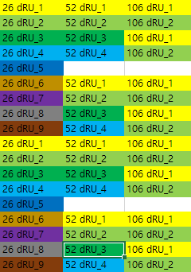
How to Build dRU Tone Plan (2/2)
When constructing one large size dRU, we combine two small size dRUs which are located as far away as possible to maximize power gain
  E.g., 20 MHz dRU tone plan
    52 dRU_1 = 26 dRU_1 + 26 dRU_6
    52 dRU_2 = 26 dRU_2 + 26 dRU_7
    52 dRU_3 = 26 dRU_3 + 26 dRU_8
    52 dRU_4 = 26 dRU_4 + 26 dRU_9
    106 dRU_1 = 52 dRU_1 + 52 dRU_3 + two null tones
    106 dRU_2 = 52 dRU_2 + 52 dRU_4 + two null tones
  Please see Appendix for 40 / 80 MHz dRU tone plans
x dRU_y means the yth x-tone dRU in frequency order
…
26 dRU_5 is not used to build 52 dRUs
subcarrier
…

Slide 6
How to Indicate Each dRU by rRU Indication (1/4)
In order to reuse the existing RU Allocation subfield, we need to determine which rRU indicates each dRU
  We cannot simply map each dRU to each rRU and need to contemplate the relationship between dRU and rRU combinations when large size dRUs and rRUs are constructed
  E.g., in 20 MHz
    First, we simply map 106 dRU_1 and 106 dRU_2 to 106 rRU_1 and 106 rRU_2, respectively, since 106 dRU is the largest dRU in 20 MHz
    By using following relationship, we can map each 52 dRU to a certain 52 rRU
      106 dRU_1 = 52 dRU_1 + 52 dRU_3 + two null tones
      106 rRU_1 = 52 rRU_1 + 52 rRU_2 + two null tones
      106 dRU_2 = 52 dRU_2 + 52 dRU_4 + two null tones
      106 rRU_2 = 52 rRU_3 + 52 rRU_4 + two null tones
x rRU_y means the yth x-tone rRU in frequency order

Slide 7
How to Indicate Each dRU by rRU Indication (2/4)
  E.g., in 20 MHz (cont.)
    By using following relationship, we can map each 26 dRU to a certain 26 rRU
      52 dRU_1 = 26 dRU_1 + 26 dRU_6
      52 rRU_1 = 26 rRU_1 + 26 rRU_2
      52 dRU_2 = 26 dRU_2 + 26 dRU_7
      52 rRU_3 = 26 rRU_6 + 26 rRU_7
      52 dRU_3 = 26 dRU_3 + 26 dRU_8
      52 rRU_2 = 26 rRU_3 + 26 rRU_4
      52 dRU_4 = 26 dRU_4 + 26 dRU_9
      52 rRU_4 = 26 rRU_8 + 26 rRU_9
      26 dRU_5 can be mapped to 26 rRU_5
  In 40 / 80 MHz, we can use a similar approach
    Please refer to Appendix

Slide 8
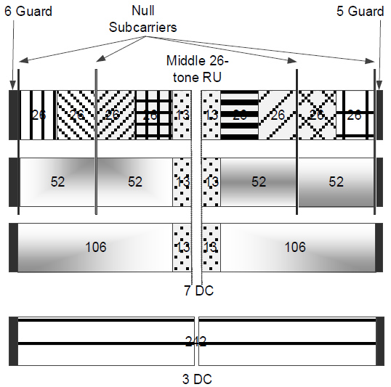
How to Indicate Each dRU by rRU Indication (3/4)
By using the conventional rRU indication in 20 MHz below, we can indicate each dRU
  All of the possible configurations in rRU are also possible even in dRU
26 rRU_1 26 dRU_1
26 rRU_2 26 dRU_6
26 rRU_3 26 dRU_3
26 rRU_4 26 dRU_8
26 rRU_5 26 dRU_5
26 rRU_6 26 dRU_2
26 rRU_7 26 dRU_7
26 rRU_8 26 dRU_4
26 rRU_9 26 dRU_9
52 rRU_1 52 dRU_1
52 rRU_2 52 dRU_3
52 rRU_3 52 dRU_2
52 rRU_4 52 dRU_4
106 rRU_1, 106 dRU_1
106 rRU_2, 106 dRU_2

Slide 9

How to Indicate Each dRU by rRU Indication (4/4)
One example for dRU configuration in 20 MHz
  Assuming the RU Allocation field indicates the RU / MRU configuration in 20 MHz as shown below
  Then, the dRU configuration in 20 MHz is as follows
106 dRU_1
26 dRU_5
52 dRU_2
26 dRU_4
26 dRU_9
…
…
subcarrier
…
…

Slide 10
Conclusion
We have discussed detailed approaches on how to build dRU tone plan and how to indicate each dRU by using rRU indication
With this approach, all of the RU / MRU configurations defined in the 11be spec are also available even in dRU tone plans

Slide 11
References
[1] 11-23-0037-00-0uhr-uhr-feature-to-overcome-psd-limitations-distributed-tone-resource-units
[2] 11-23-0281-00-0uhr-considerations-on-ru-mru-designs-for-uhr

Slide 12
Appendix

Slide 13
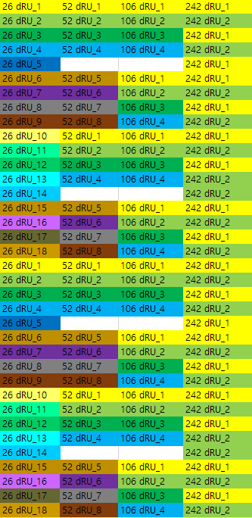
40 MHz dRU Tone Plan
…
40 MHz tone plan
  52 dRU_1 = 26 dRU_1 + 26 dRU_10
  52 dRU_2 = 26 dRU_2 + 26 dRU_11
  52 dRU_3 = 26 dRU_3 + 26 dRU_12
  52 dRU_4 = 26 dRU_4 + 26 dRU_13
  52 dRU_5 = 26 dRU_6 + 26 dRU_15
  52 dRU_6 = 26 dRU_7 + 26 dRU_16
  52 dRU_7 = 26 dRU_8 + 26 dRU_17
  52 dRU_8 = 26 dRU_9 + 26 dRU_18
  106 dRU_1 = 52 dRU_1 + 52 dRU_5 + two null tones
  106 dRU_2 = 52 dRU_2 + 52 dRU_6 + two null tones
  106 dRU_3 = 52 dRU_3 + 52 dRU_7 + two null tones
  106 dRU_4 = 52 dRU_4 + 52 dRU_8 + two null tones
  242 dRU_1 = 106 dRU_1 + 106 dRU_3 + 26 dRU_5 + four null tones
  242 dRU_2 = 106 dRU_2 + 106 dRU_4 + 26 dRU_14 + four null tones
…

Slide 14
40 MHz dRU Mapping (1/4)
First, we simply map 242 dRU_1 and 242 dRU_2 to 242 rRU_1 and 242 rRU_2, respectively
By using following relationship, we can map each 106 dRU to a certain 106 rRU and 26 dRU_5 and 26 dRU_14 to a certain middle 26 rRU
  242 dRU_1 = 106 dRU_1 + 106 dRU_3 + 26 dRU_5 + four null tones
  242 rRU_1 = 106 rRU_1 + 106 rRU_2 + 26 rRU_5 + four null tones
  242 dRU_2 = 106 dRU_2 + 106 dRU_4 + 26 dRU_14 + four null tones
  242 rRU_2 = 106 rRU_3 + 106 rRU_4 + 26 rRU_14 + four null tones

Slide 15
40 MHz dRU Mapping (2/4)
By using following relationship, we can map each 52 dRU to a certain 52 rRU
  106 dRU_1 = 52 dRU_1 + 52 dRU_5 + two null tones
  106 rRU_1 = 52 rRU_1 + 52 rRU_2 + two null tones
  106 dRU_2 = 52 dRU_2 + 52 dRU_6 + two null tones
  106 rRU_3 = 52 rRU_5 + 52 rRU_6 + two null tones
  106 dRU_3 = 52 dRU_3 + 52 dRU_7 + two null tones
  106 rRU_2 = 52 rRU_3 + 52 rRU_4 + two null tones
  106 dRU_4 = 52 dRU_4 + 52 dRU_8 + two null tones
  106 rRU_4 = 52 rRU_7 + 52 rRU_8 + two null tones

Slide 16
40 MHz dRU Mapping (3/4)
By using following relationship, we can map each 26 dRU to a certain 26 rRU
  52 dRU_1 = 26 dRU_1 + 26 dRU_10
  52 rRU_1 = 26 rRU_1 + 26 rRU_2
  52 dRU_2 = 26 dRU_2 + 26 dRU_11
  52 rRU_5 = 26 rRU_10 + 26 rRU_11
  52 dRU_3 = 26 dRU_3 + 26 dRU_12
  52 rRU_3 = 26 rRU_6 + 26 rRU_7
  52 dRU_4 = 26 dRU_4 + 26 dRU_13
  52 rRU_7 = 26 rRU_15 + 26 rRU_16

Slide 17
40 MHz dRU Mapping (4/4)
By using following relationship, we can map each 26 dRU to a certain 26 rRU (cont.)
  52 dRU_5 = 26 dRU_6 + 26 dRU_15
  52 rRU_2 = 26 rRU_3 + 26 rRU_4
  52 dRU_6 = 26 dRU_7 + 26 dRU_16
  52 rRU_6 = 26 rRU_12 + 26 rRU_13
  52 dRU_7 = 26 dRU_8 + 26 dRU_17
  52 rRU_4 = 26 rRU_8 + 26 rRU_9
  52 dRU_8 = 26 dRU_9 + 26 dRU_18
  52 rRU_8 = 26 rRU_17 + 26 rRU_18

Slide 18
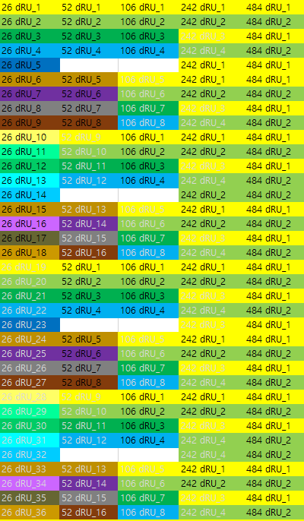
80 MHz dRU Tone Plan (1/3)
…
80 MHz tone plan
  52 dRU_1 = 26 dRU_1 + 26 dRU_19
  52 dRU_2 = 26 dRU_2 + 26 dRU_20
  52 dRU_3 = 26 dRU_3 + 26 dRU_21
  52 dRU_4 = 26 dRU_4 + 26 dRU_22
  52 dRU_5 = 26 dRU_6 + 26 dRU_24
  52 dRU_6 = 26 dRU_7 + 26 dRU_25
  52 dRU_7 = 26 dRU_8 + 26 dRU_26
  52 dRU_8 = 26 dRU_9 + 26 dRU_27
  52 dRU_9 = 26 dRU_10 + 26 dRU_28
  52 dRU_10 = 26 dRU_11 + 26 dRU_29
  52 dRU_11 = 26 dRU_12 + 26 dRU_30
  52 dRU_12 = 26 dRU_13 + 26 dRU_31
…

Slide 19
80 MHz dRU Tone Plan (2/3)
80 MHz tone plan (cont.)
  52 dRU_13 = 26 dRU_15 + 26 dRU_33
  52 dRU_14 = 26 dRU_16 + 26 dRU_34
  52 dRU_15 = 26 dRU_17 + 26 dRU_35
  52 dRU_16 = 26 dRU_18 + 26 dRU_36
  106 dRU_1 = 52 dRU_1 + 52 dRU_9 + two null tones
  106 dRU_2 = 52 dRU_2 + 52 dRU_10 + two null tones
  106 dRU_3 = 52 dRU_3 + 52 dRU_11 + two null tones
  106 dRU_4 = 52 dRU_4 + 52 dRU_12 + two null tones
  106 dRU_5 = 52 dRU_5 + 52 dRU_13 + two null tones
  106 dRU_6 = 52 dRU_6 + 52 dRU_14 + two null tones
  106 dRU_7 = 52 dRU_7 + 52 dRU_15 + two null tones
  106 dRU_8 = 52 dRU_8 + 52 dRU_16 + two null tones

Slide 20
80 MHz dRU Tone Plan (3/3)
80 MHz tone plan (cont.)
  242 dRU_1 = 106 dRU_1 + 106 dRU_5 + 26 dRU_5 + four null tones
  242 dRU_2 = 106 dRU_2 + 106 dRU_6 + 26 dRU_14 + four null tones
  242 dRU_3 = 106 dRU_3 + 106 dRU_7 + 26 dRU_23 + four null tones
  242 dRU_4 = 106 dRU_4 + 106 dRU_8 + 26 dRU_32 + four null tones
  484 dRU_1 = 242 dRU_1 + 242 dRU_3
  484 dRU_2 = 242 dRU_2 + 242 dRU_4

Slide 21
80 MHz dRU Mapping (1/8)
First, we simply map 484 dRU_1 and 484 dRU_2 to 484 rRU_1 and 484 rRU_2, respectively
By using following relationship, we can map each 242 dRU to a certain 242 rRU
  484 dRU_1 = 242 dRU_1 + 242 dRU_3
  484 rRU_1 = 242 rRU_1 + 242 rRU_2
  484 dRU_2 = 242 dRU_2 + 242 dRU_4
  484 rRU_2 = 242 rRU_3 + 242 rRU_4

Slide 22
80 MHz dRU Mapping (2/8)
By using following relationship, we can map each 106 dRU to a certain 106 rRU and 26 dRU_5, 26 dRU_14, 26 dRU_23 and 26 dRU_32 to a certain middle 26 rRU
  242 dRU_1 = 106 dRU_1 + 106 dRU_5 + 26 dRU_5 + four null tones
  242 rRU_1 = 106 rRU_1 + 106 rRU_2 + 26 rRU_5 + four null tones
  242 dRU_2 = 106 dRU_2 + 106 dRU_6 + 26 dRU_14 + four null tones
  242 rRU_3 = 106 rRU_5 + 106 rRU_6 + 26 rRU_23 + four null tones
  242 dRU_3 = 106 dRU_3 + 106 dRU_7 + 26 dRU_23 + four null tones
  242 rRU_2 = 106 rRU_3 + 106 rRU_4 + 26 rRU_14 + four null tones
  242 dRU_4 = 106 dRU_4 + 106 dRU_8 + 26 dRU_32 + four null tones
  242 rRU_4 = 106 rRU_7 + 106 rRU_8 + 26 rRU_32 + four null tones

Slide 23
80 MHz dRU Mapping (3/8)
By using following relationship, we can map each 52 dRU to a certain 52 rRU
  106 dRU_1 = 52 dRU_1 + 52 dRU_9 + two null tones
  106 rRU_1 = 52 rRU_1 + 52 rRU_2 + two null tones
  106 dRU_2 = 52 dRU_2 + 52 dRU_10 + two null tones
  106 rRU_5 = 52 rRU_9 + 52 rRU_10 + two null tones
  106 dRU_3 = 52 dRU_3 + 52 dRU_11 + two null tones
  106 rRU_3 = 52 rRU_5 + 52 rRU_6 + two null tones
  106 dRU_4 = 52 dRU_4 + 52 dRU_12 + two null tones
  106 rRU_7 = 52 rRU_13 + 52 rRU_14 + two null tones

Slide 24
80 MHz dRU Mapping (4/8)
By using following relationship, we can map each 52 dRU to a certain 52 rRU (cont.)
  106 dRU_5 = 52 dRU_5 + 52 dRU_13 + two null tones
  106 rRU_2 = 52 rRU_3 + 52 rRU_4 + two null tones
  106 dRU_6 = 52 dRU_6 + 52 dRU_14 + two null tones
  106 rRU_6 = 52 rRU_11 + 52 rRU_12 + two null tones
  106 dRU_7 = 52 dRU_7 + 52 dRU_15 + two null tones
  106 rRU_4 = 52 rRU_7 + 52 rRU_8 + two null tones
  106 dRU_8 = 52 dRU_8 + 52 dRU_16 + two null tones
  106 rRU_8 = 52 rRU_15 + 52 rRU_16 + two null tones

Slide 25
80 MHz dRU Mapping (5/8)
By using following relationship, we can map each 26 dRU to a certain 26 rRU
  52 dRU_1 = 26 dRU_1 + 26 dRU_19
  52 rRU_1 = 26 rRU_1 + 26 rRU_2
  52 dRU_2 = 26 dRU_2 + 26 dRU_20
  52 rRU_9 = 26 rRU_19 + 26 rRU_20
  52 dRU_3 = 26 dRU_3 + 26 dRU_21
  52 rRU_5 = 26 rRU_10 + 26 rRU_11
  52 dRU_4 = 26 dRU_4 + 26 dRU_22
  52 rRU_13 = 26 rRU_28 + 26 rRU_29

Slide 26
80 MHz dRU Mapping (6/8)
By using following relationship, we can map each 26 dRU to a certain 26 rRU (cont.)
  52 dRU_5 = 26 dRU_6 + 26 dRU_24
  52 rRU_3 = 26 rRU_6 + 26 rRU_7
  52 dRU_6 = 26 dRU_7 + 26 dRU_25
  52 rRU_11 = 26 rRU_24 + 26 rRU_25
  52 dRU_7 = 26 dRU_8 + 26 dRU_26
  52 rRU_7 = 26 rRU_15 + 26 rRU_16
  52 dRU_8 = 26 dRU_9 + 26 dRU_27
  52 rRU_15 = 26 rRU_33 + 26 rRU_34

Slide 27
80 MHz dRU Mapping (7/8)
By using following relationship, we can map each 26 dRU to a certain 26 rRU (cont.)
  52 dRU_9 = 26 dRU_10 + 26 dRU_28
  52 rRU_2 = 26 rRU_3 + 26 rRU_4
  52 dRU_10 = 26 dRU_11 + 26 dRU_29
  52 rRU_10 = 26 rRU_21 + 26 rRU_22
  52 dRU_11 = 26 dRU_12 + 26 dRU_30
  52 rRU_6 = 26 rRU_12 + 26 rRU_13
  52 dRU_12 = 26 dRU_13 + 26 dRU_31
  52 rRU_14 = 26 rRU_30 + 26 rRU_31

Slide 28
80 MHz dRU Mapping (8/8)
By using following relationship, we can map each 26 dRU to a certain 26 rRU (cont.)
  52 dRU_13 = 26 dRU_15 + 26 dRU_33
  52 rRU_4 = 26 rRU_8 + 26 rRU_9
  52 dRU_14 = 26 dRU_16 + 26 dRU_34
  52 rRU_12 = 26 rRU_26 + 26 rRU_27
  52 dRU_15 = 26 dRU_17 + 26 dRU_35
  52 rRU_8 = 26 rRU_17 + 26 rRU_18
  52 dRU_16 = 26 dRU_18 + 26 dRU_36
  52 rRU_16 = 26 rRU_35 + 26 rRU_36

