Slide 1
Thoughts on Secondary Channel Access
Date: 2023-07-10
Authors:
Name | Affiliation | Address | Phone | Email
Insun Jang | LG Electronics | 19, Yangjae-daero 11gil, Seocho-gu, Seoul 137-130, Korea |  | insun.jang@lge.com
Jinsoo Choi
 |  |  |  | js.choi@lge.com
Sunhee Baek
 |  |  |  | sunhee.baek@lge.com
Yelin Yoon |  |  |  | yl.yoon@lge.com
Geonhwan Kim |  |  |  | geonhwan.kim@lge.com
Dongju Cha |  |  |  | dongju.cha@lge.com
Eunsung Park |  |  |  | esung.park@lge.com
Dongguk Lim |  |  |  | dongguk.lim@lge.com
Jinyoung Chun |  |  |  | jiny.chun@lge.com
Insik Jung |  |  |  | insik0618.jung@lge.com
HanGyu Cho |  |  |  | hg.cho@lge.com
Sanggook Kim |  | 10225 Willow Creek Rd, San Diego, CA, USA |  | sanggook.kim@lge.com

Slide 2
Introduction
For a quite long time, we’ve tried to improve use of the medium
E.g., DL/UL MU based on MU-MIMO/OFDMA with preamble puncturing
However, we still assume that the primary channel is IDLE to achieve them, e.g., obtaining TXOP
It does not make the BSS operating channels due to the BUSY primary channel available even though the remaining secondary channels are available
Therefore in UHR, it would be good to design some mechanisms for improving efficient use of the medium as the main goal in UHR in the approved PAR [1]
By utilizing IDLE secondary channels only
Several presentations [2], [3] addressed in UHR SG have investigated
In this contribution, we share some thoughts on the secondary channel access in UHR

Slide 3
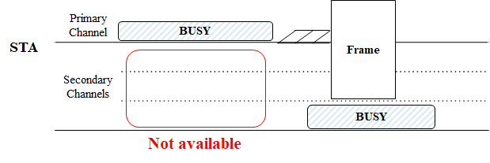
Recap: Wide Bandwidth Channel Access
Basically, the frame transmission happens on available channels including primary (20MHz) channel
Specifically, we perform a back-off on the primary channel (PCH) only
A Frame is transmitted only when the back-off counter reaches to zero
The channel for frame TX includes the PCH and IDLE Secondary channels (SCHs)
Preamble puncturing for the SCHs can be used based on the rules of each specification (e.g., 11ax/11be)

Slide 4
Basic Concept
Secondary Channel Access (SCA) should be performed only when the primary channel is not used due to a (Basic) NAV from OBSS
Considering intra-BSS NAV wouldn’t be proper, e.g., AP is currently exchanging frames
Back-off should be performed on Secondary Channel (SCHs)
Simple CCA check wouldn’t be unfair to neighboring BSSs using the channels
TXOP to be obtained on the SCH should end before the (Basic) NAV timer ends
If the NAV is not enough long to obtain TXOP on SCA, STA should not perform SCA

Slide 5
Back-off on Secondary Channel
SCA Capabilities
STAs can have several capabilities for performing SCA
E.g., Not capable of SCA, Capable of Back-off on one or more SCHs simultaneously
Depending on AP and STA with different capabilities, SCA methods may be different
In UHR, we can start with a simple case, e.g., AP and STA with Capable of Back-off on only one SCH
SCA Back-off related Parameters can be announced by an AP
SCH(s) for Back-off
It is important to align the SCH(s) between an AP and STA(s) to avoid transmission failure
If AP and STA is operating on different SCHs for back-off, the frame exchange cannot happen
Parameters for EDCA on Secondary Channels
We may need a new EDCA Parameters Set or reuse existing (MU) EDCA Parameters Sets
We need to note that the state of SCH may be different from the state of PCH
Additional ones can be discussed
Those parameters may be negotiated between AP and STA if needed

Slide 6
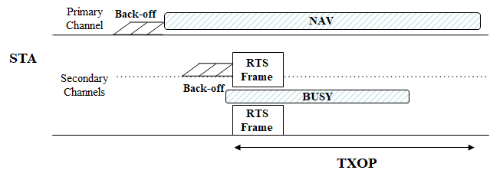
Frame Transmission and Reception
When a back-off counter on an SCH reaches to 0, a PPDU including Frame(s) can be transmitted on IDLE other SCH(s) including the SCH
Initial frame can be a control frame (e.g., RTS frame), which would be able to check whether the recipient STA is ready to exchange frames
It would be better not to make a new PPDU format only for SCA
If (BUSY) PCH is included in the set of channels for SCA, (BUSY) PCH can be punctured with the rule change
Some conditions could be introduced, e.g., Max PPDU Bandwidth depending on the set of channels performing SCA

Slide 7
Further Considerations
Synchronization
In terms of Medium Sync on SCH, when a STA switches the SCH for back-off, it would lose the medium synchronization (e.g., by hidden problem on SCH)
In terms of Switching to SCH, even though an AP and STA(s) are in the same BSS, they may have different states of PCH, e.g., the AP sets NAV (switch for SCA) while a STA does not set NAV (not switch for SCA) depending on their topologies
For those issues, we need to design mechanism(s) (e.g., timer, control frame as initial frame)
Multi-AP Coordination
SCA can improve the medium efficiency while SCA in a BSS may impact on neighboring BSSs if they have fully or partially overlapped channels (e.g., 320-1/320-2)
Negotiation between APs (maybe with negotiation in other AP coordination mechanisms) may be needed to compromise SCHs for SCA

Slide 8
Conclusion
In this contribution, we’ve shared some thoughts to achieve secondary channel access in UHR in terms of
NAV and TXOP
Back-off: SCA Capabilities and Parameters for SCA
Frame Transmission and Reception on SCH(s)
In addition, we introduced several further considerations
Synchronization in terms of Medium Sync on SCH and Switching to SCH
Multi-AP Coordination

Slide 9
References
[1] 23/0480r1, UHR Proposed PAR
[2] 23/034r1, Non-primary Channel Utilization
[3] 23/631r1, secondary channel usage and secondary 20MHz channel backoff

