Slide 1
Seamless Roaming Follow-up
Date: 2023-07-24
Authors:
Name | Affiliation | Address | Phone | Email
Yelin Yoon | LG Electronics | 19, Yangjae-daero 11gil, Seocho-gu, Seoul 137-130, Korea |  | yl.yoon@lge.com
Insun Jang
 |  |  |  | insun.jang@lge.com
Jinsoo Choi
 |  |  |  | js.choi@lge.com
Sunhee Baek |  |  |  | sunhee.baek@lge.com
Geonhwan Kim |  |  |  | geonhwan.kim@lge.com
Eunsung Park |  |  |  | esung.park@lge.com
Dongguk Lim |  |  |  | dongguk.lim@lge.com
Jinyoung Chun |  |  |  | jiny.chun@lge.com
Insik Jung |  |  |  | insik0618.jung@lge.com
HanGyu Cho |  |  |  | hg.cho@lge.com
Sanggook Kim |  | 10225 Willow Creek Rd, San Diego, CA, USA |  | sanggook.kim@lge.com

Slide 2
Introduction
In the previous UHR meeting, we share several considerations that help to achieve a seamless roaming in UHR [1]
In this contribution, we extend the discussion on these considerations and we focus on:
  Architecture
  Identification
  Multi-link Reconfiguration
  Collocated & non-collocated set

Slide 3
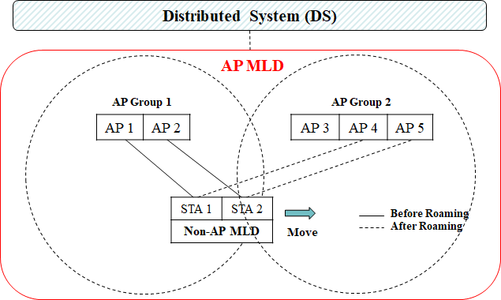
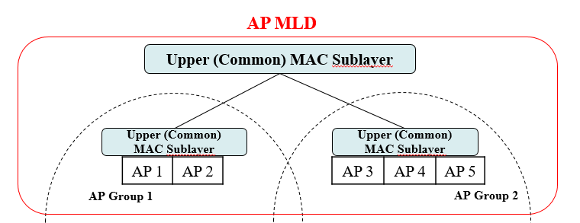
Recap: Seamless Roaming [1]
AP MLD based architecture
  AP Groups are affiliated with the same AP MLD
  APs in the same group may be collocated
  Roaming between AP Groups
A seamless Roaming can be done via ML setup reconfiguration without a tear-down
Further Considerations
  Identification for discovery and multi-link setup
  Upper MAC (UMAC) sublayers
The approach many contributions are taking is similar [2][3][4]
  MLD based architecture
  Tuple based identification

Slide 4
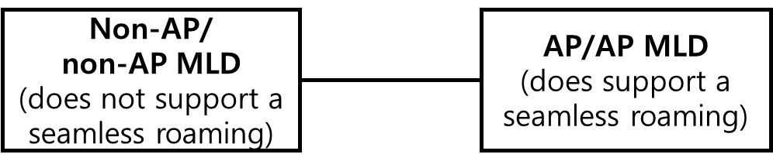
Architecture (1/2)
Architecture design
  Scalability
    Grouping of AP MLDs which support a seamless roaming
  Legacy support
    Non-AP STAs and non-AP MLDs should be able to communicate with a AP/AP MLD which support a seamless roaming
    We might want to avoid making any change in the AP MLD architecture and the MLD definition
MLD Definition
A logical entity that is capable of supporting more than one affiliated station (STA) and can operate using one or more affiliated STAs, and that presents one medium access control (MAC) data service and a single MAC service access point (SAP) to the logical link control (LLC) sublayer.

Slide 5
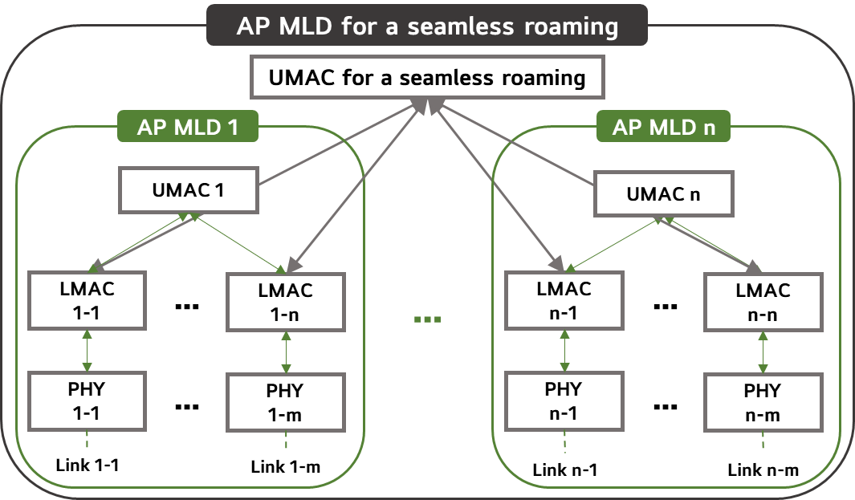
Architecture (2/2)
AP MLD for a seamless roaming
  A scalability and a legacy support
    EHT MLD’s architecture is unchanged
    Each AP MLD supports a EHT non-AP MLD/legacy
  A non-AP MLD supporting a seamless roaming can recognize this AP MLD
  A seamless roaming between the AP MLDs within the same AP MLD for a seamless roaming
    Fast BSS Transition between AP MLDs for a roaming
  An interface between a UMAC for a seamless roaming and EHT LMACs
    All functions for a seamless roaming managed in this UMAC

Slide 6
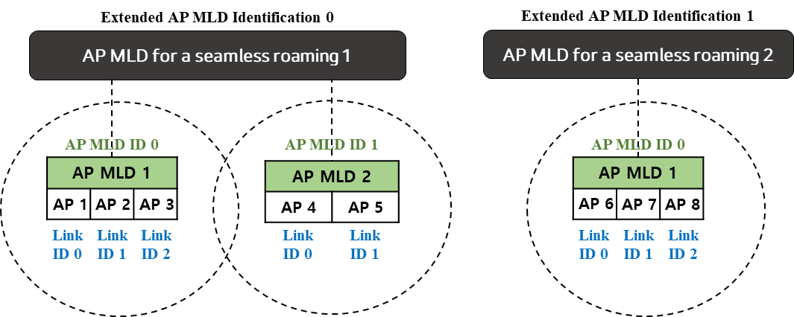
Identification
Extended AP MLD Identification
  For distinguishing different AP MLDs for a seamless roaming
    A 3-tuple Identification can be used
    An ID or a MAC address can be used
3-tuple (Extended AP MLD Identification, AP MLD ID, Link ID)
  A seamless roaming is only possible when a new AP MLD has the same Extended AP MLD Identification as the old AP MLD
  The 3-tuple Identification can be recognized by UHR non-AP MLDs
  Each AP can be recognized by EHT non-AP STA/MLDs (as an EHT AP MLD)
  The AP MLD ID recognized by the UHR non-AP MLD may not be the AP MLD ID used in the EHT
3-tuple ID: (0,0,1)
2-tuple ID: (0,1)
3-tuple ID: (1,0,1)
2-tuple ID: (0,1)

Slide 7
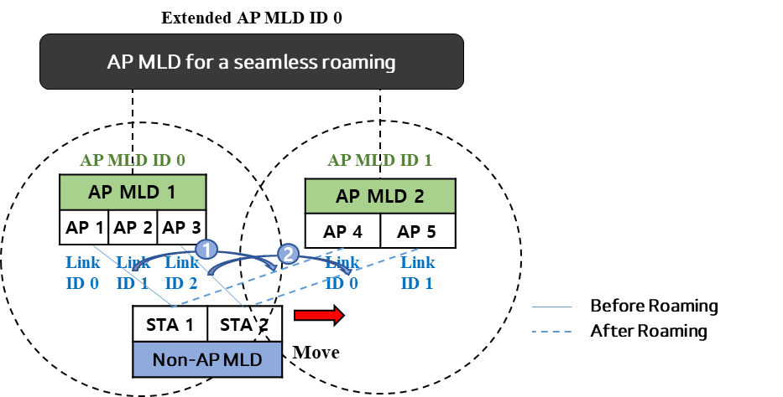
Multi-link Reconfiguration
An example of a Multi-link Reconfiguration for a seamless roaming
  Before the ML Reconfiguration, the 3-tuple Identification is shared between the AP MLD and the non-AP MLD
  STA 1 roams from AP 1 (ID: (0,0)*) to AP 4 (ID: (1,0)*)
    STA 1 requests to change the link from AP 1 to AP 4
    AP 1 accepts the request and provides the information of STA 1 to AP 4
    STA 1 can switch to AP 4
  STA 2 and AP 3&5 repeat the similar process above
*2-tuple ID: (AP MLD ID, Link ID)

Slide 8
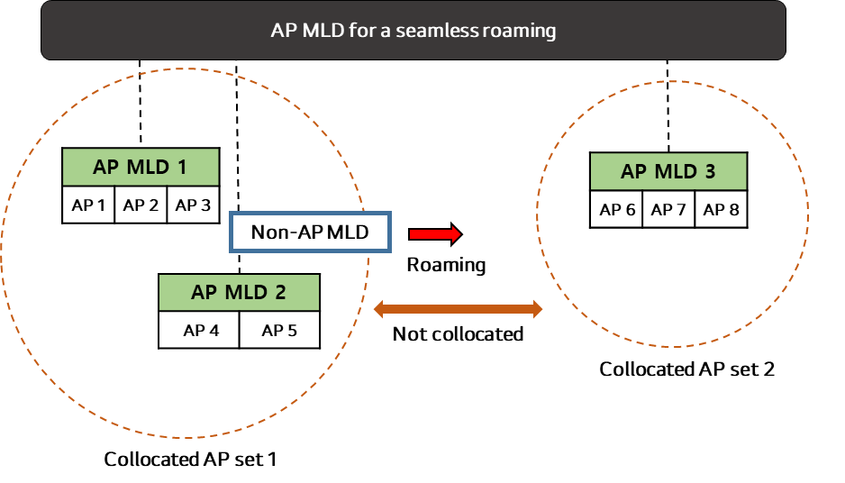
Collocated vs. Non-Collocated
In the current definition of an AP MLD, the collocation information of the affiliated AP(s) is not specified
However, it might be beneficial to inform whether APs in one or more AP MLD(s) affiliated with the same AP MLD for a seamless roaming are collocated or non-collocated
  If AP 1 and AP 4 are collocated (e.g., in the same collocated AP set), there is no need for a STA to roam to AP 4
  The collocation information may be indicated in the Co-Located AP field or in a Newly defined in the RNR IE

Slide 9
Conclusion
In this contribution, we have shared some ideas that may aid to achieve a seamless roaming in a UHR
  The architecture that extends the scalability and supports the legacy devices
  The extended AP MLD Identification for identifying APs affiliated with different AP MLDs for a seamless roaming
  The Multi-link Reconfiguration in a Seamless Roaming procedure
  The collocation information of AP MLDs affiliated with the same AP MLD for a seamless roaming

Slide 10
References
[1] 23/0279r0 Considerations on Seamless Roaming
[2] 23/0231r0 Thoughts on Seamless Roaming Under Non-collocated AP MLD Architecture
[3] 23/0632r1 Smooth Roaming Follow Up
[4] 22/1910r3 Seamless Roaming for UHR

