Slide 1
Device Density in Logistics
Date: 2023-06-27
Authors:

Slide 2
Abstract
This document presents typical densities and reading times for the logistics use-case.
It is a response to document 11-23/1005r0 that defines very low device numbers for the logistics use-case.

Slide 3
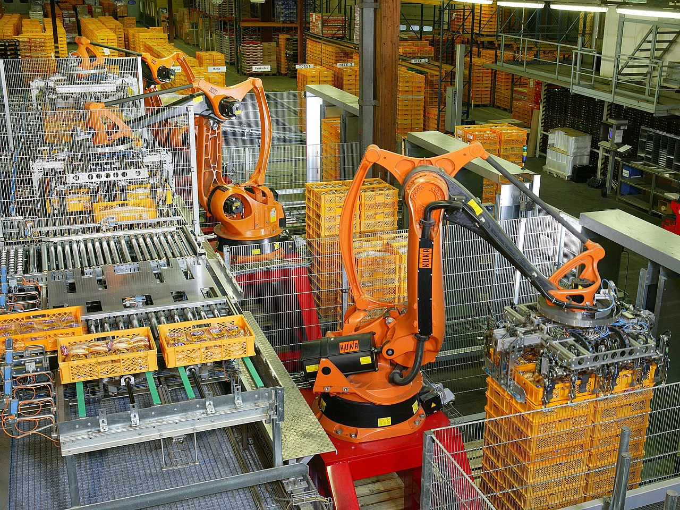
Production Hall with Small Containers (KLT)
Source: Wikipedia

Slide 4
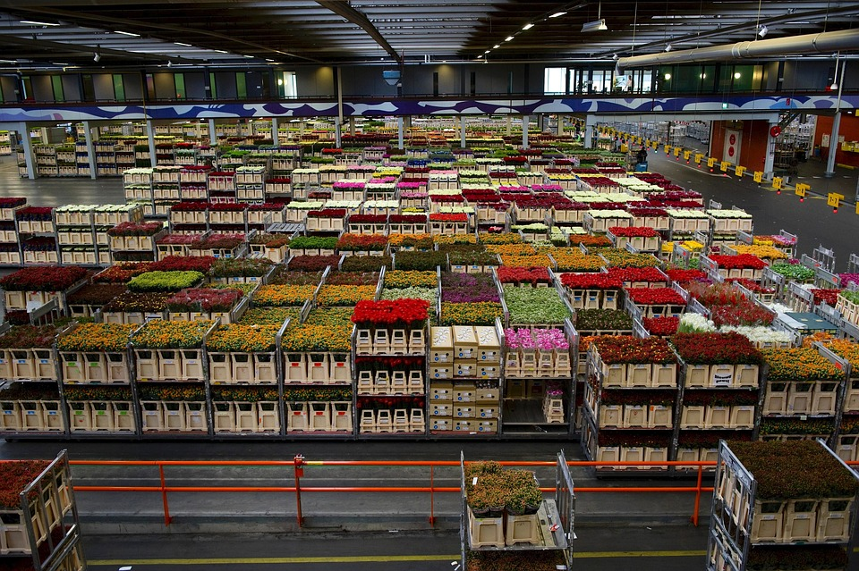
Flower Logistics

Slide 5
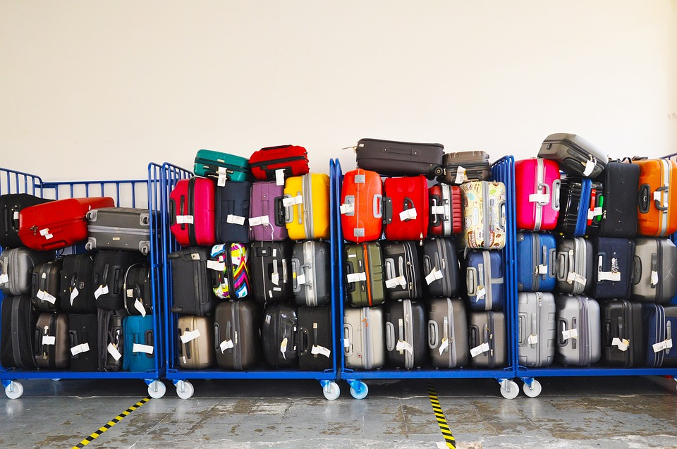
Luggage

Slide 6
Required Densities
Example 1: Small Containers (KLT)
  Size: 300 x 200 x 147.5 mm
  16 KLT / m² and 20 KLT stacked on each other
  ➔ 320 KLT / m²
Example 2: EUR-pallet
  Size: 1200 x 800 mm (approx. 1m²)
  200 KLT stacked on EUR-pallet
  Reading time of few seconds in case of truck loading
  ➔ 100 devices / s

Slide 7
Conclusions
The logistics use-case requires high densities of devices
Typical densities are in the range of 300 device/m² or more ➔ 1000 devices/m² should be the minimum assumption
Transporting devices with fork-lifts lead to short reading times with typical numbers of 100 devices / s

