Slide 1
Experiment Results with Wi-Fi to LC
Offloading in an Office Environment
Date: 2023-07-11
Authors:

Slide 2
Abstract
This presentation contains experiment results using light communications (LC) hardware together with a Wi-Fi access point.
The experiment examines the air utilization effects when applying ML-driven, adaptive offloading to LC in an Enterprise office cubicle setting.
The results show that significant network KPI benefits can be obtained by learning which devices are best to offload.

Slide 3
Disclaimer
This presentation should be considered as the personal views of the presenters not as a formal position, explanation, or interpretation of IEEE.
Per IEEE-SA Standards Board Bylaws, August 2020: At lectures, symposia, seminars, or educational courses, an individual presenting information on IEEE standards shall make it clear that his or her views should be considered the personal views of that individual rather than the formal position of IEEE.

Slide 4
Use Case
Allow users in an office cubicle environment to switch to LC when Wi-Fi is congested.
A new controller-based algorithm for offloading from Wi-Fi to LC is motivated, proposed, and evaluated in [1].
The basic idea is to predict the best device to offload for Wi-Fi network KPI and then steer the LC AP antenna to that device and move it from Wi-Fi to LC.
We train an ML-NN model to predict KPI for candidate offloading decisions.
Experiment workloads are produced by GANs (Generative Adversarial Network) trained with [2].

Slide 5
Neural Network Model
Input: Concatenated vector of Wi-Fi and LC traffic statistics of STA offloading candidates and LC antenna position
  Wi-Fi statistics vector for each STA and each direction (upload/download) is defined as the softmax operation over the vector of (normalized) traffic loads to each AP, where:
  Each entry in the (normalized) traffic loads vector is normalized with respect to the maximum traffic load to that AP, and therefore takes a value between 0 and 1
Output: KPI prediction (for the input LC antenna position)
Neural network architecture: fully-connected regression model with single hidden layer with 12 ReLU nodes

Slide 6
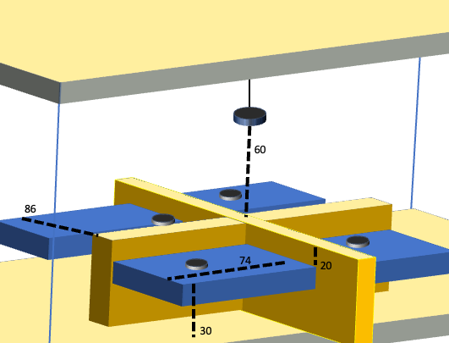
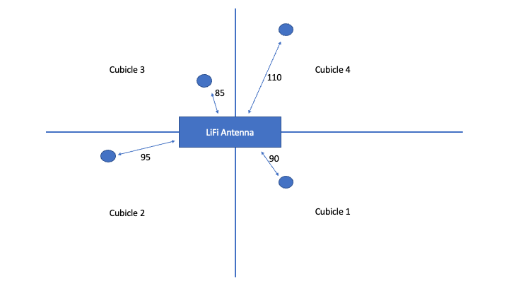
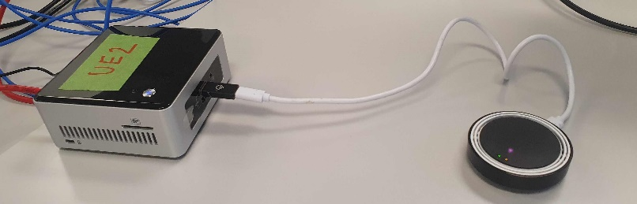
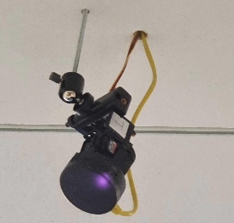
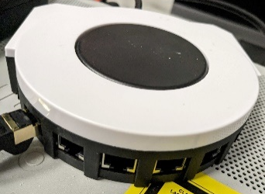
Setup

Slide 7
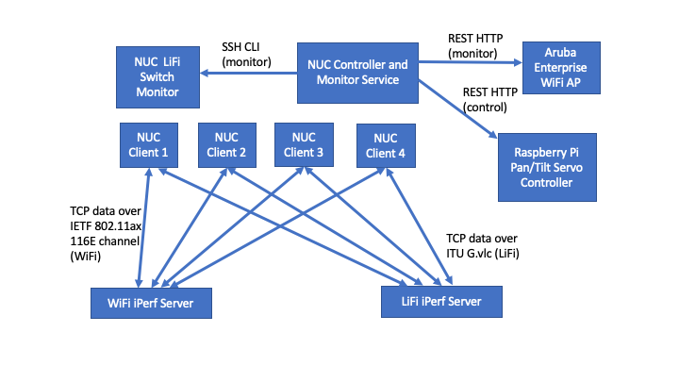
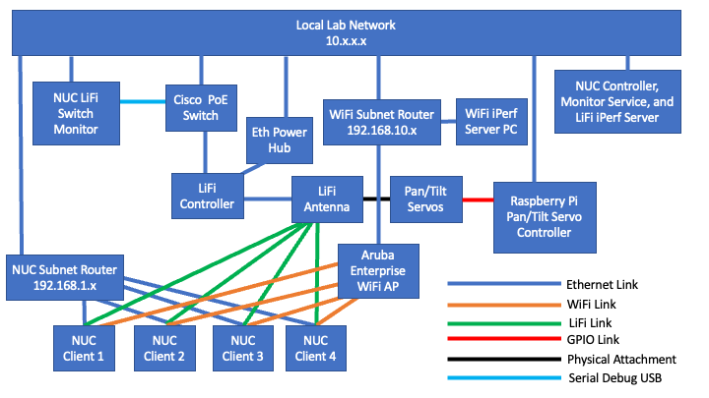
Setup

Slide 8
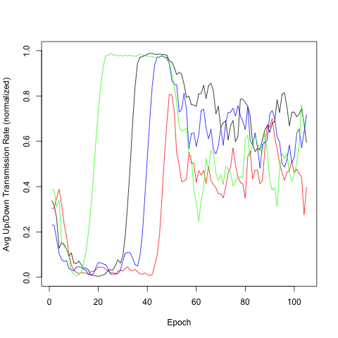
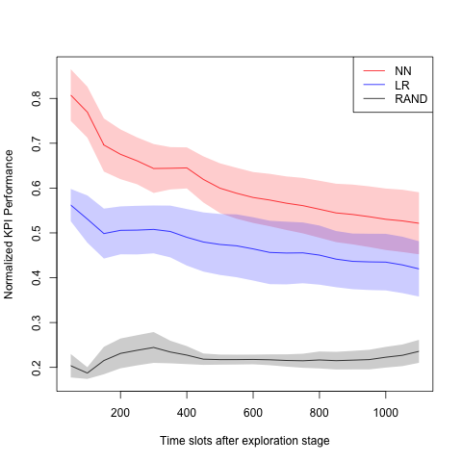
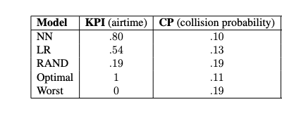
Experiment Results
Train (~4h)
Primary Eval (~3h)
Wi-Fi Air Utilization Drop from 77% to 60%
Collision Probability Drop from 19% to 10% with (ML-based) LC Offloading of 1/4 STAs
Secondary Eval (~10h)
Model
optimizes this
Linear Regression
Random

Slide 9
Conclusions and Lessons Learned
We saw both in simulations and experiments that collision probability and air utilization are positively impacted by offloading critical users from Wi-Fi to LC.
MPTCP and MPHTTP were evaluated but currently come with deployment obstacles and performance overhead.
The value of the approach could be enhanced with more seamless/application agnostic switching/handover/aggregation support between Wi-Fi and LC PHYs.
LC range is very sensitive to irradiance and incidence angles making dynamic beam steering (and LoS availability) attractive for future LC evolution.
Enterprise Wi-Fi and state-of-the-art LC performance on par but LC reliability needs to be improved. A possible approach is the use of multiple, distributed optical frontends, as described in 11-23-0091/r0 on slide 11.

Slide 10
Related Documents
Light Communication for UHR
https://mentor.ieee.org/802.11/dcn/23/11-23-0091-00-0wng-light-communication-for-uhr.pptx
Discussion on the Cooperation of 802.11bb with the Family of 802.11 Standards
https://mentor.ieee.org/802.11/dcn/18/11-18-1546-03-00bb-discussion-on-the-co-existence-of-802-11bb-with-the-family-of-802-11-standards.pptx
Multi-Band Operation in LC and Hybrid LC/RF Networks
https://mentor.ieee.org/802.11/dcn/19/11-19-1612-01-00bb-multi-band-operation-in-lc-and-hybrid-lc-rf-networks.pptx
Hybrid LC and RF in UHR
https://mentor.ieee.org/802.11/dcn/23/11-23-0221-01-0uhr-hybrid-lc-and-rf-in-uhr.pptx

Slide 11
References
[1] Sandholm, T., Macaluso, I., & Mukherjee, S. (2023). WHO-IS: Wireless Hetnet Optimization using Impact Selection. arXiv preprint arXiv:2306.03049.
[2] Sandholm, T., & Mukherjee, S. (2021). MASS: Mobile Autonomous Station Simulation. arXiv preprint arXiv:2111.09161.

