Slide 1
Low latency channel access
Date: 2023-07-10
Authors:

Slide 2
Improving latency in 11bn
There is a big focus in 11bn PAR towards low latency, with at least 2 main flavors:
1)
  Reducing the tail of the latency distribution in different environments
  This is still perceived as a very strong weakness of 802.11: latency is often very good, but you can experience some catastrophic delays
2)
  Allowing for high priority access for latency-sensitive applications
We try and address these 2 aspects in this presentation, focusing on the channel access part

Slide 3
Improving predictability of channel access latency on 802.11
There is a natural direction in investigating an almost fully triggered mode
  Reducing collisions in order to improve reliability
  Mostly when most traffic with high QoS (stringent latency requirements, …) are predictable and can be known a-priori
There are obviously theory and reality, and such mode will also be quite sensitive to legacy devices, non-coordinated overlapping APs or P2P, coordination difficulties, scheduling complexities with constantly evolving traffic characteristics, …
It would be very short-sighted to consider only such enhancements as tools in UHR to improve predictability/latency

Slide 4
Improving predictability of channel access latency on 802.11
It is therefore also important to provide enhancements to regular EDCA access so that enhancements are effectively seen on the field in the vast majority of deployments
  Scenarios of particular interest (but surely not limited to): uncoordinated overlapping BSSs (dense apartment, multi-operators), dense overlapping P2P networks in presence or not of infrastructure ESS,
  But also enterprise managed deployments of course…
UHR should define enhancements on predictability/latency for both modes (that we could call scheduled mode and unscheduled mode)
In this presentation, we are focusing on this second mode, mainly based today on EDCA access

Slide 5
Current EDCA Limitations with regards to channel access latency bounds
Collision avoidance with exponential backoff:
  Works well in average, but can lead to very long latency tail with catastrophic latency events due to failed retransmissions and doubling backoff
  In a sense, the exponential backoff concept is the contrary than what should be done if the goal is to bound latency. If a STA got unlucky and collided, it shouldn’t be deprioritized for channel access because it is the one that gets closer to the latency bound limit.
Limitations with QoS,
  There are limitations in the number of STAs that can efficiently use each AC without leading to too high number of collisions (worst for AC_VO obviously)
  Even with using the highest AC, there is a possibility that channel access will be gained by a STA with a lower AC
  Basically AC_VO needs low AIFSN and BO number to get priority over the other ACs, which limits the ability to avoid collisions between AC_VO contenders..

Slide 6
Scenarios where we want to see improvements
Scenario 1: Deployments with a large number of contenders using the same AC and where the goal would be mainly to cut the latency tail and bound worst-case latency
Scenario 2: Deployments where we want to ensure even more predictability of channel access than AC_VO without the risk of collisions

Slide 7
General direction for the solution
Not possible to define more aggressive parameters using same concept (AIFSN, CWmin/max) as used today without creating more collisions
Proposal would be to isolate STAs with prioritized access from the rest of the STAs at the beginning of a contention period
  Achieve this by allowing these STAs to transmit a Defer Signal at the beginning of a contention period to force all STAs that are not sending the Defer Signal to have CCA busy and not participate in the contention period
  If multiple of these STAs have prioritized access, they will transmit the same Defer Signal at the same time with the same result on other STAs (CCA busy)
And then to allow for a contention only between the STAs with prioritized access
  Only STAs that have sent a Defer Signal can participate in this immediately following contention
  More degrees of freedom for the contention parameters setting to avoid collisions without loosing priority
    don’t necessarily need to be too aggressive in order to scale to a larger number of STAs while ensuring low collision rates (contrary to AC_VO)

Slide 8
Illustration
Previous TxOP
From STA1
EDCA contention period
TxOP gained by STA3

Slide 9
Example of parametrization
We need and propose to regulate how STAs are allowed to use this high priority access
1) Scenario with all STAs using same AC:
  Allow to use prioritized access (send Defer Signal followed by contention (Rand 0-7) after 3 or 4 failed retransmissions
  Otherwise, use EDCA as usual
2) QoS scenario:
  Allow to use prioritized access (send Defer Signal followed by contention (rand BOmin-BOmax)
    After 1 retransmissions for AC-VO
    After 2 retransmissions for AC-VI
    After 4 retransmissions for AC-BE
    Not for BK
  And/or allow some traffic to use this prioritized access directly under some other conditions

Slide 10
Simulation configuration
Scenario 1
1 AP and variable number of STAs: 10, 20, 30, 50, 75 and 100
Full buffer traffic in DL and UL direction
2x2x40Mhz @ MCS2
  in fact, the BW, NSS and MCS does not matter here, they only define PPDU duration on air
TXOP limit = uniform (0.5ms; 5ms)
  New TXOP limit is selected each time when STA/AP won contention
  Randomization is only to introduce “burstiness” and extra randomness into channel occupancy time
Case 1: Everyone can hear everyone, no hidden nodes
  STAs randomly dropped inside 5x5x3m box; AP is in the middle
Case 2: Some hidden nodes
  STAs randomly dropped inside 50x50x3m; AP is in the middle
  In progress, will be added soon
Simulation time 100seconds
  Every 2 seconds STAs randomly re-dropped inside the box

Slide 11
Simulation configuration – R=4
EDCA
EDCA with CwMax limit ==127
HIPEDCA
  A STA that suffer from 4 consecutive failures allowed to send DS signal to announce high priority (HiP) EDCA
    STA that hear DS set their NAV in EIFS fashion giving ~7 slot of contention for STAs that announced HiP-EDCA
    HiP-EDCA STA draw new BK = uniform (0,X) (where X=7 is a function of EIFS)
    STA that successfully count down BK to zero transmit. STAs that experience failure/failed to finish contention send DS signal at next contention opportunity
    AP participate in HiP-EDCA contention but
      AP continue any existing contention but skip AIFSN
  Otherwise uses EDCA
Statistic of interest: channel access time
  Measured at a STA as time difference between end of previous TXOP and start of the next one
    Time from the last TXOP to the next _SUCCESSFULL_ TXOP (i.e. send RTS and get CTS)
    This is correct in full-buffer mode when STA always contend for the medium
  Resulting plots are aggregated data of all STAs in a simulation

Slide 12
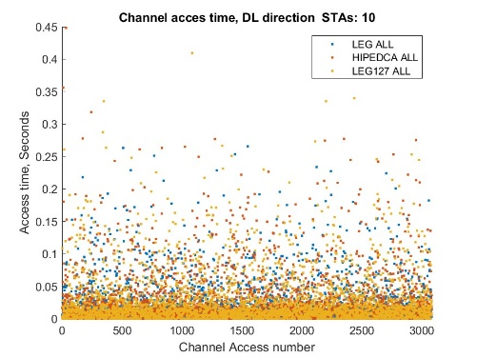
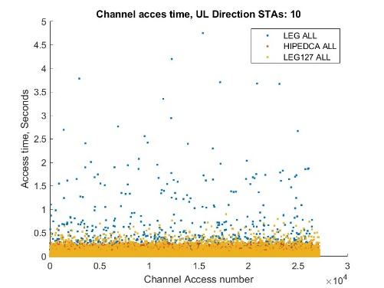
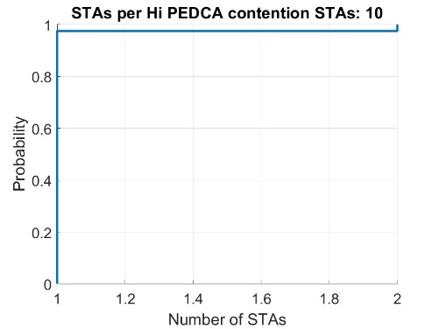
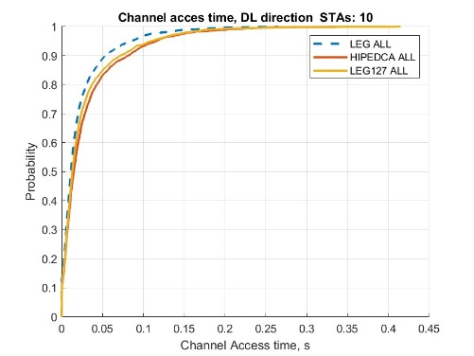
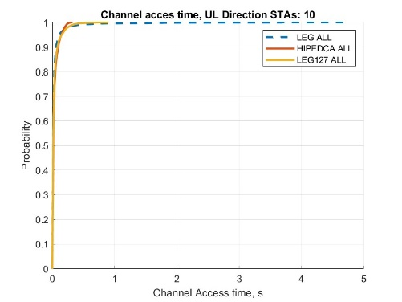
10 STAs

Slide 13
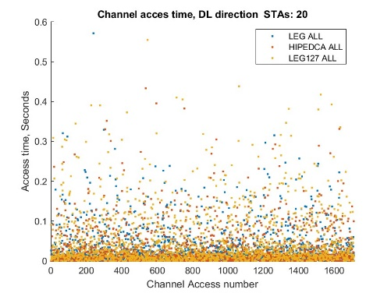
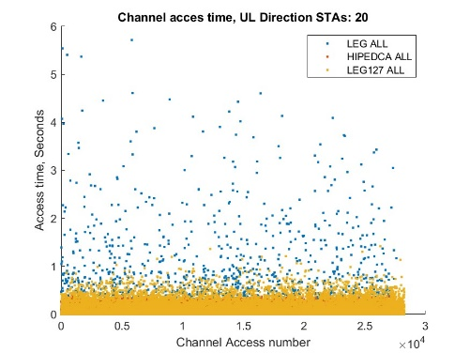
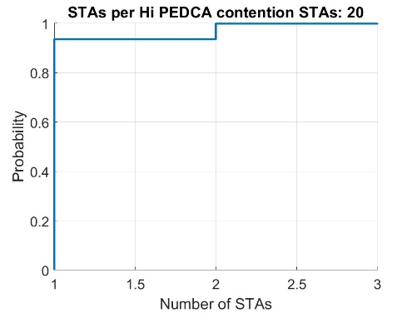
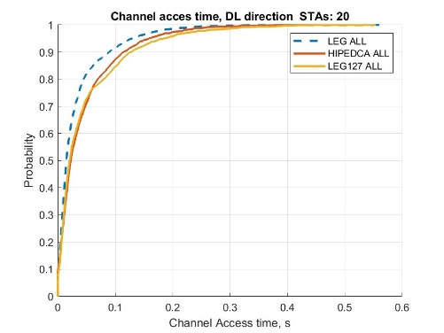
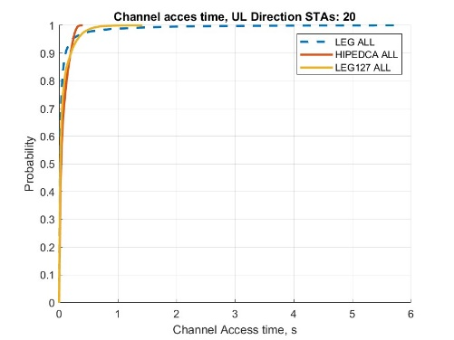
20 STAs

Slide 14
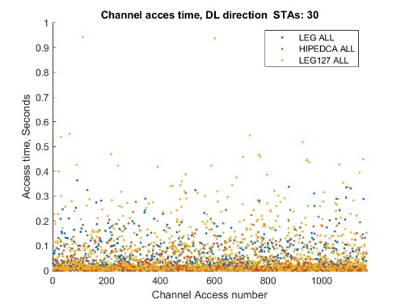
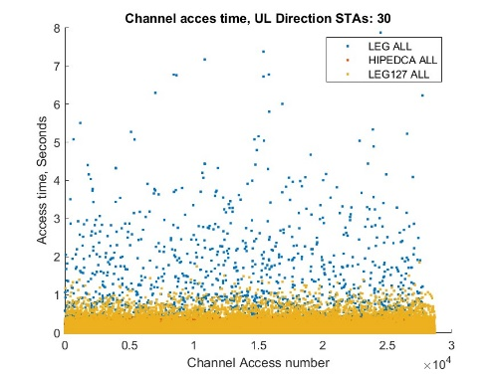
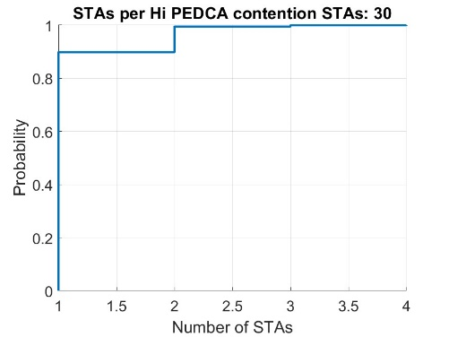
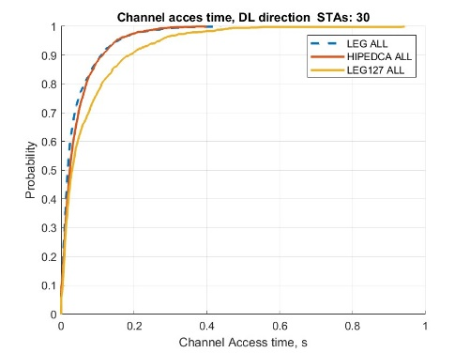
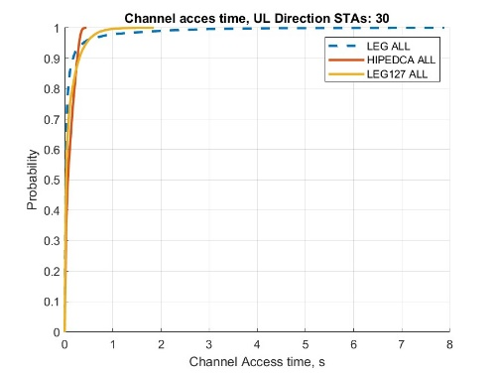
30 STAs

Slide 15
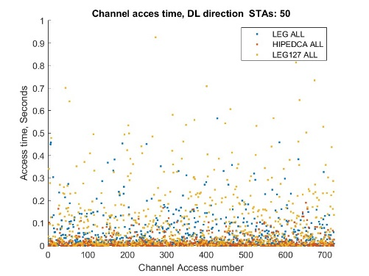
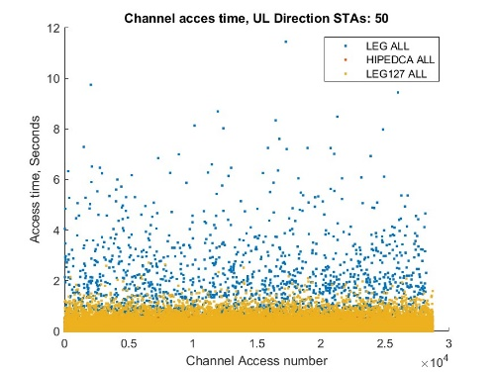
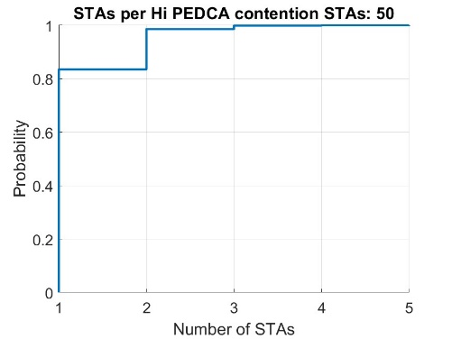
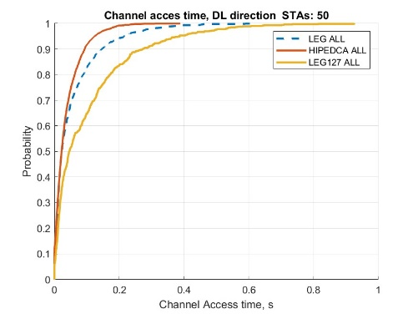
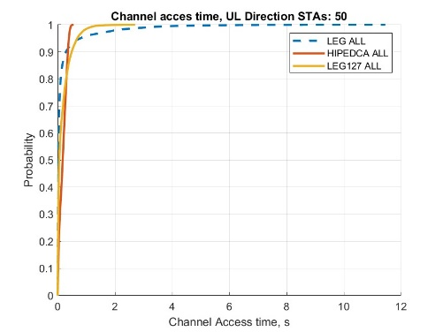
50 STAs

Slide 16
Observations
The HiP EDCA clearly capable of improving tail latency in UL direction
  The larger the number of contenders, the more significant the improvement : from 95th percentile (10 STAs) to 85th (50 STAs)
As a side effect, the higher the number of contenders, the more channel opportunities an AP has
  Unlike other STAs, every announced HiP EDCA provide AP an opportunity to contend with smaller number of devices at a time.

Slide 17
HiP EDCA for AC
Scenario 2
Compare Regular EDCA AC_VO channel access vs HiP EDCA for AC_VO
  A STA / AP use HiP EDCA to send frames enqueued to AC_VO;
  A STA / AP send DS signal to have isolated HiP contention it is has frame enqueued into AC_VO
1 AP and 5-10-15-20-25 STAs total
  1-2-3-4-5 STAs with LL AC_VO bi-directional traffic
    160 bytes every average 16ms =uniform (10ms, 22ms)
  4-8-12-16-20 STAs are legacy with bi-directional full buffer traffic
    TXOP=5ms
Statistic of interest:
    ETE delay

Slide 18
HiP EDCA VO implementation notes
AP _shall_ send DS as well if it has LL VO frame
  Announcement shall happen on both sides – STA and AP
  Unlike the “retry case”, AP need to announce the HiP EDCA interval in order to benefit for cleaner contention and to avoid entering contention with ALL clients in a BSS
AIFSN for AC_VO (legacy one) lifted
  As LL frames enqueued into AC_VO there are cases when LL frame from an AP collide with DS signal because AC_VO AIFSN =1 and DS is sent at DIFS (AIFSN=2)

Slide 19
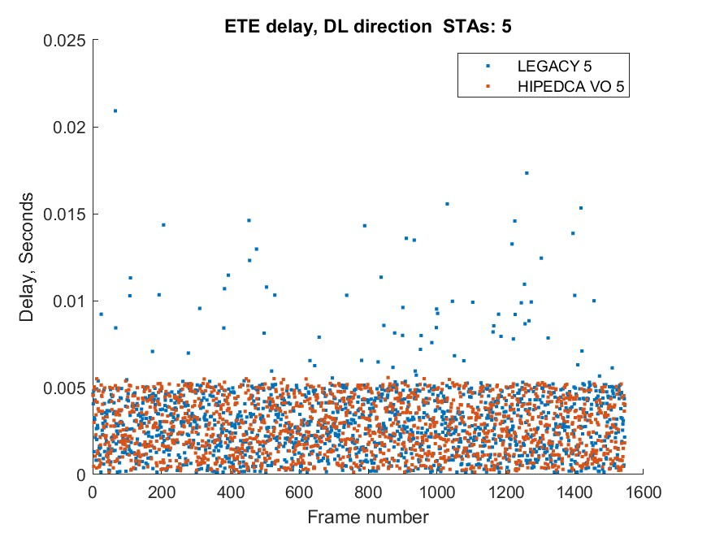
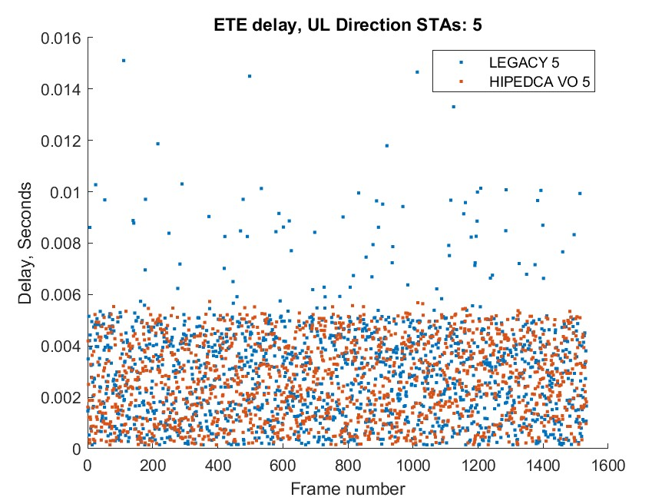
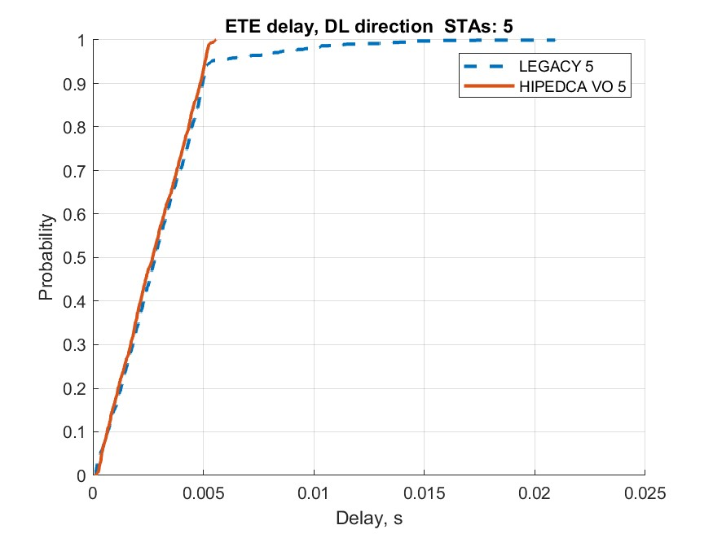
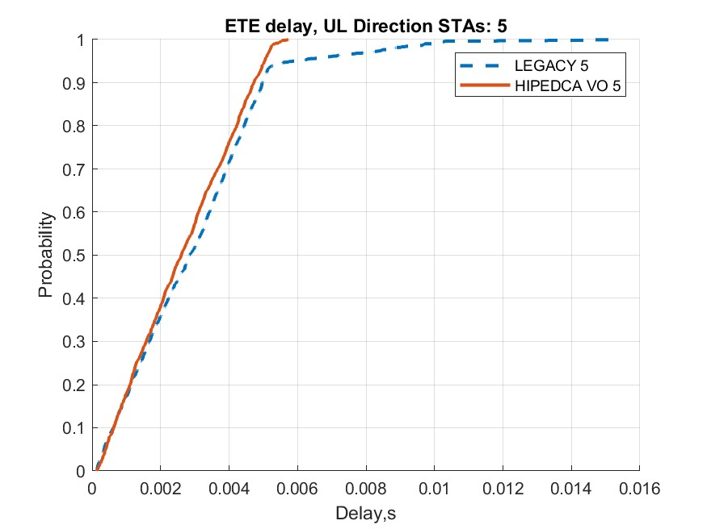
5 STAs

Slide 20
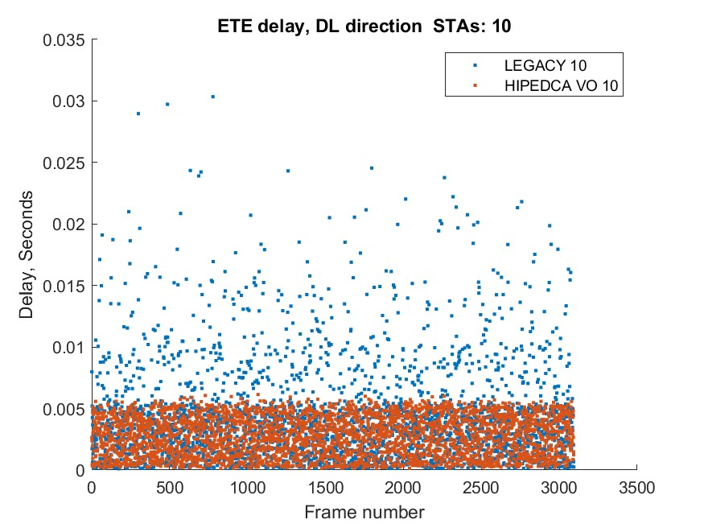
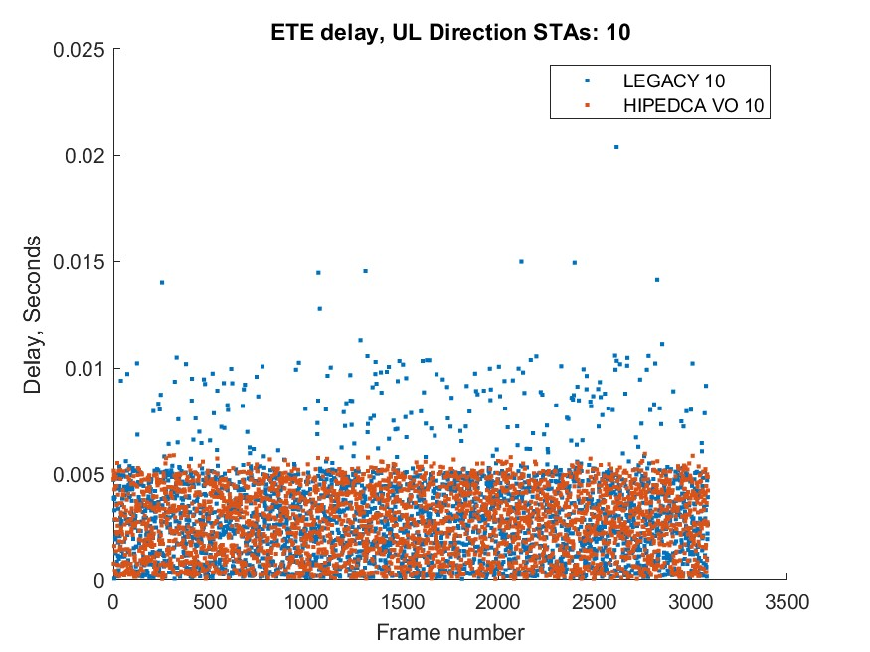
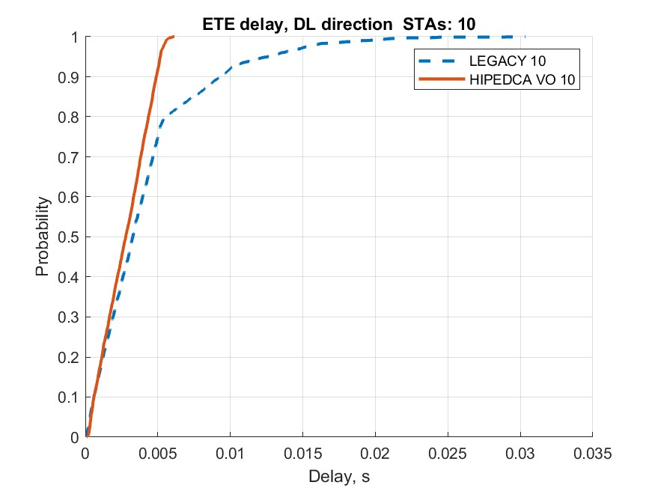
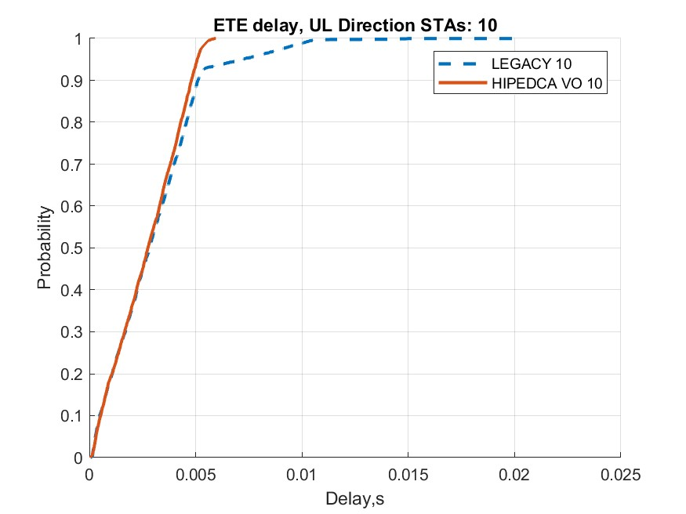
10 STAs

Slide 21
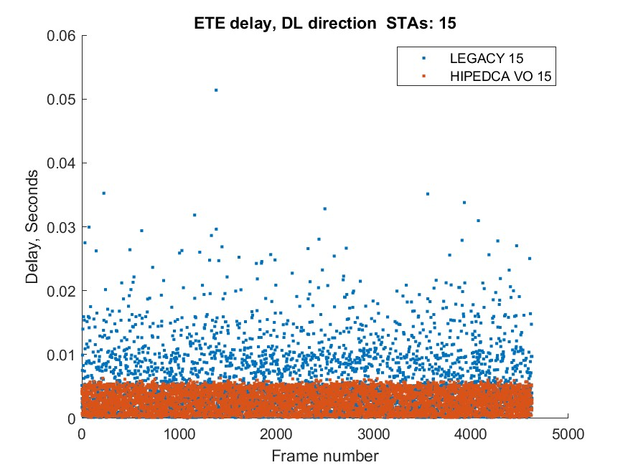
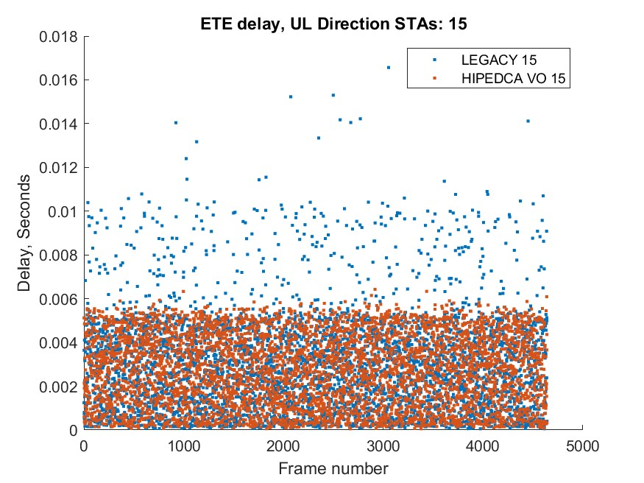
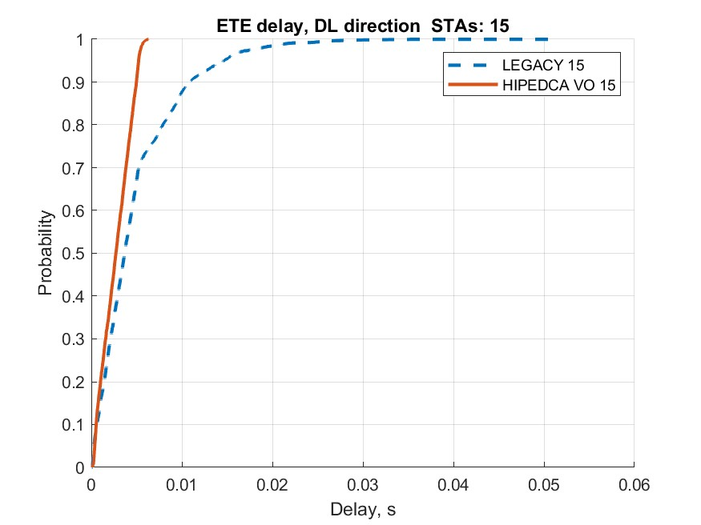
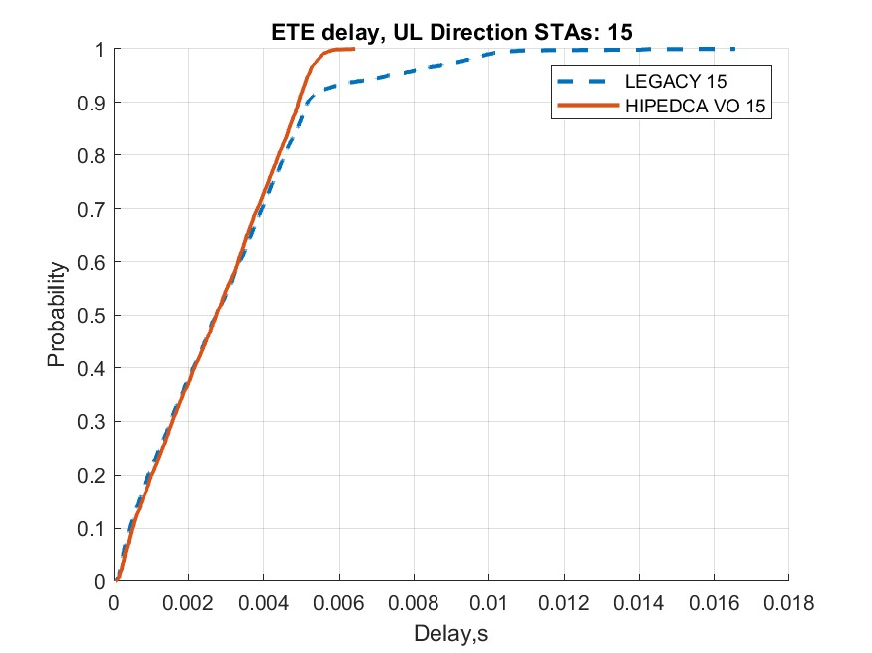
15 STAs

Slide 22
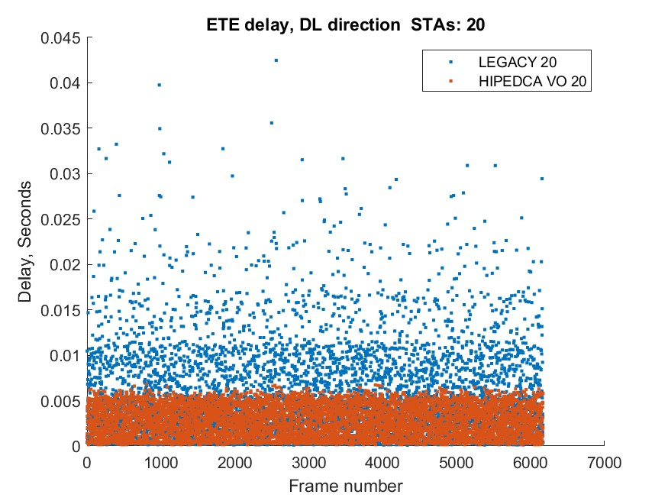
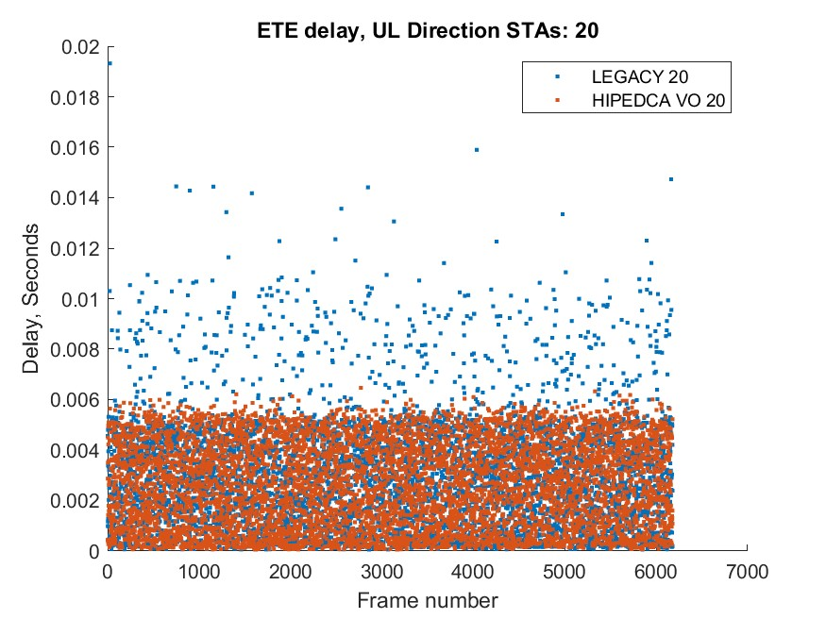
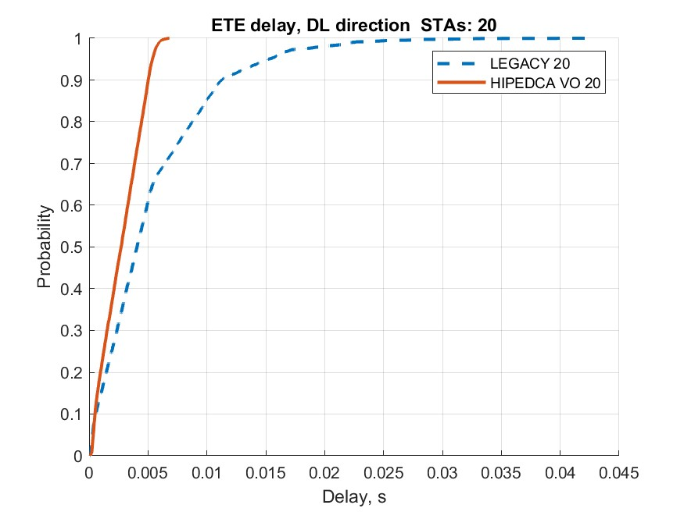
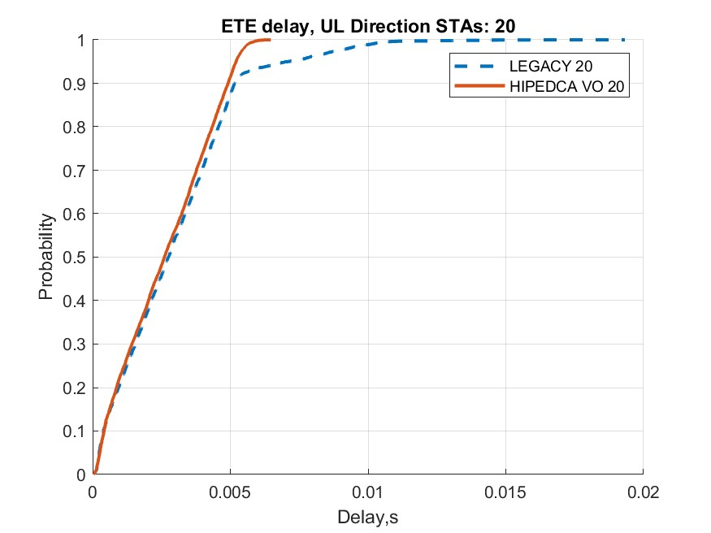
20 STAs

Slide 23
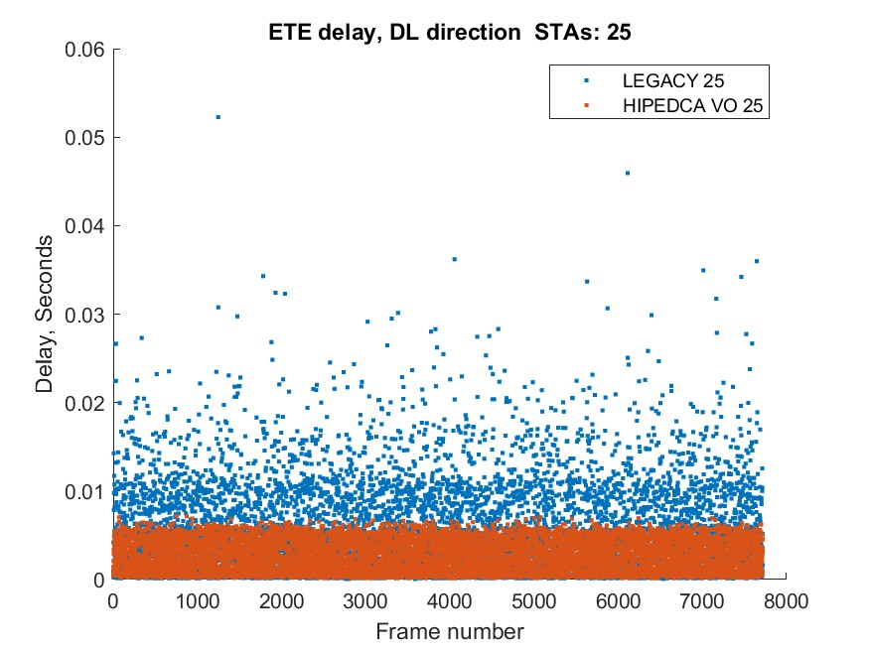
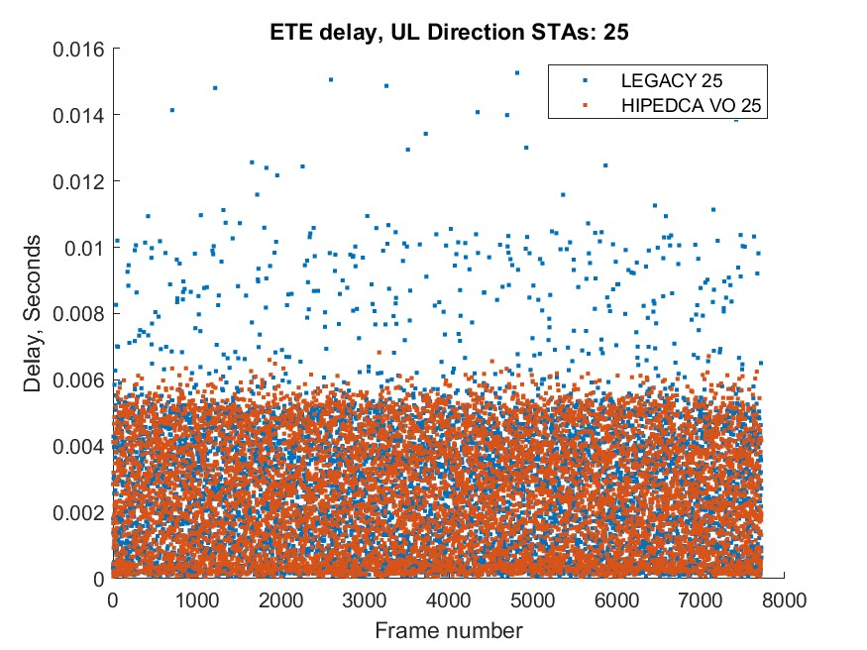
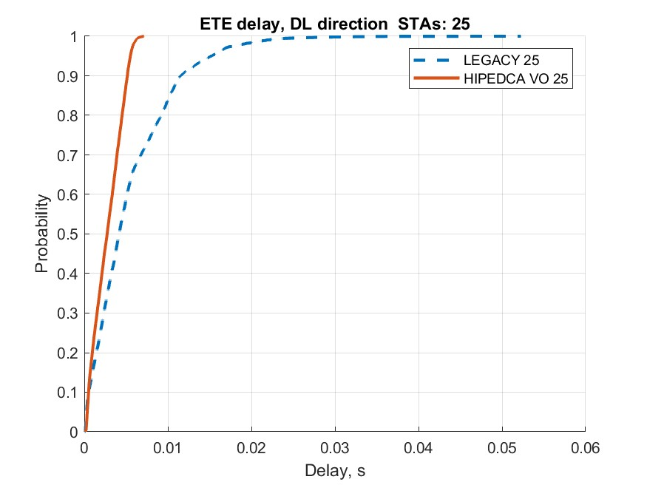
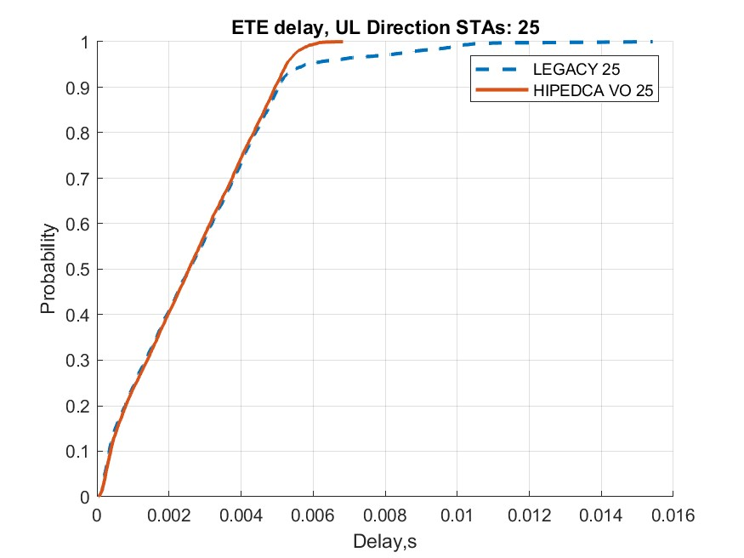
25 STAs

Slide 24
Observations
The HiP EDCA clearly capable of improving tail latency for frames that require prioritized access
  Virtually eliminates situations when LL traffic can be delayed by low priority channel access

Slide 25
Backup

Slide 26
Small(er) # of STAs

Slide 27
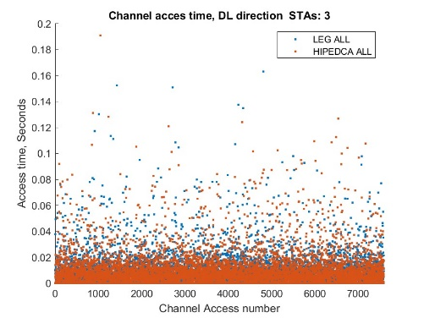
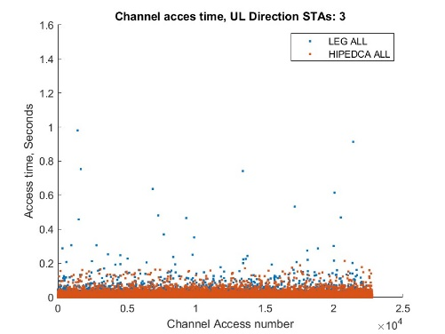
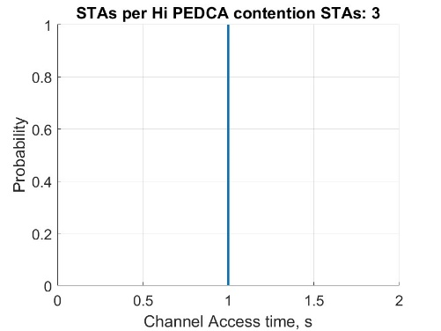
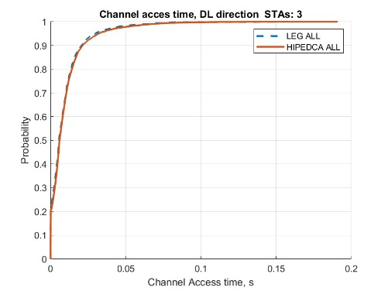
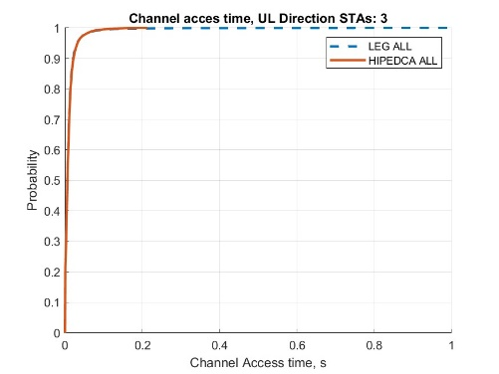
3 STAs

Slide 28
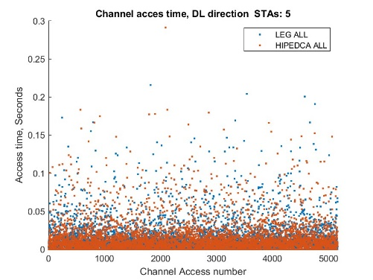
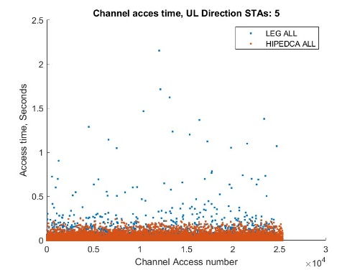
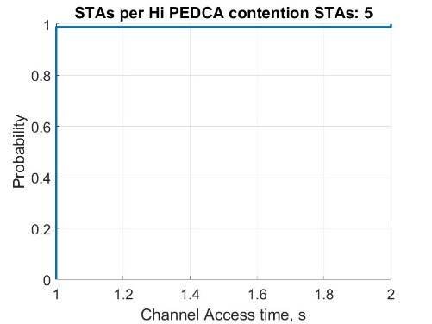
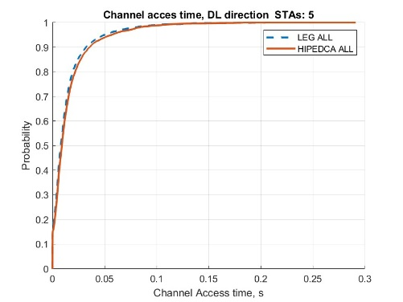
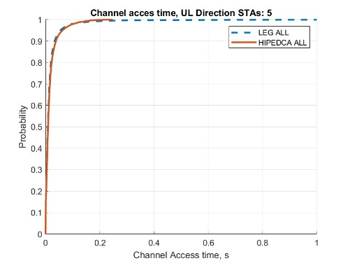
5 STAs

Slide 29





7 STAs

Slide 30





9 STAs

Slide 31








Zoom-in CDFs for 10-50 STAs

