Slide 1
Further Discussion on Requirements for AMP Use Cases
June 2023
Doc.: IEEE 802.11-23/1603r0
Date: 2023-06-27
Authors:
Name | Affiliation | Address | Phone | Email
Yinan Qi | OPPO |  |  | v-qiyinan@oppo.com
Weijie Xu |  |  |  | xuweijie@oppo.com

Slide 2
Abstract
Doc.: IEEE 802.11-23/1603r0
The purpose of this presentation is to further discuss the key requirements.

Slide 3
June 2023
Doc.: IEEE 802.11-23/1603r0
Initial Table for the Requirements
 | Coverage (dBm) | Maximum payload size (bit) | Peak device power consumption (mWatts) | Device density (per m²) | Horizontal Positioning accuracy (m) | Peak data rate (Kbps) | Others
UC1: Smart Manufacturing | Type1: -30 Type2: -82 | 256 | 1 | 1.5 | 3 | 51.2 kbps
UC2: Data Centre | Type1: -30 Type2: -82 | 256 | 1 | 3 | 1-3 | 51.2 kbps
UC3: Smart Home | Type1: -30 Type2: -82 | 256 | 1 | 0.25 | 1-3 | 51.2 kbps
UC4: Logistics and Warehouse | Type1: -30 Type2: -82 | 256 | 1 | 1.5 | 3 | 51.2 kbps
UC5: Smart Agriculture | Type1: -30 Type2: -82 | 256 | 1 | 1 | 10 | 51.2 kbps
UC6: Indoor Positioning | Type1: -30 Type2: -82 | 256 | 1 | 0.25 | 1-3 | 51.2 kbps
UC7: Smart Power Grid | Type1: -30 Type2: -82 | 256 | 1 | 10⁻² | 10 | 51.2 kbps
UC8: Fresh Food Supply Chain | Type1: -30 Type2: -82 | 256 | 1 | 1.5 | 3 | 51.2 kbps
Note 1: Coverage is calculated based on AWGN Channel Note 2: Type 1: RF powered AMP device; Type 2: non-RF powered AMP device, e.g., thermal, solar, etc. Note 3: Others include requirements only applicable to a subset of use cases
Slide 3
Yinan Qi (OPPO)

Slide 4
June 2023
Doc.: IEEE 802.11-23/1603r0
Device Density (1/2)
UC1 Smart Manufacturing:
1.5/m²
A typical car manufacturing plant takes up to 600 000 m² in surface. Around 1 million units of materials are used in the manufacturing area, but they are not used at the same time.
UC2 Data Centre
3/m²
Assuming the same density as UC1 but with 2-tier shelf
UC3 Smart Home:
0.25/m²
Based on the deployment assumption of 1 AMP device every 2 meter.
UC4 Logistics and Warehouse
1.5/m²
Assuming the same density as UC1
Slide 4
Yinan Qi (OPPO)
Notes:
[

Slide 5
June 2023
Doc.: IEEE 802.11-23/1603r0
Device Density (2/2)
UC5 Smart Agriculture
1/m²
Assuming 1 device per meter for collecting sensing data
UC6 Indoor Positioning:
0.25/m²
Based on the deployment assumption of 1 AMP device every 2 meter.
UC7 Smart Power Grid:
10⁻²/m²
The device density is calculated based on an individual substation, where typically several hundreds of Ambient IoT devices are required to monitor the environmental parameters.
UC8 Fresh Food Supply
1.5/m²
Same as UC1.
Slide 5
Yinan Qi (OPPO)

Slide 6
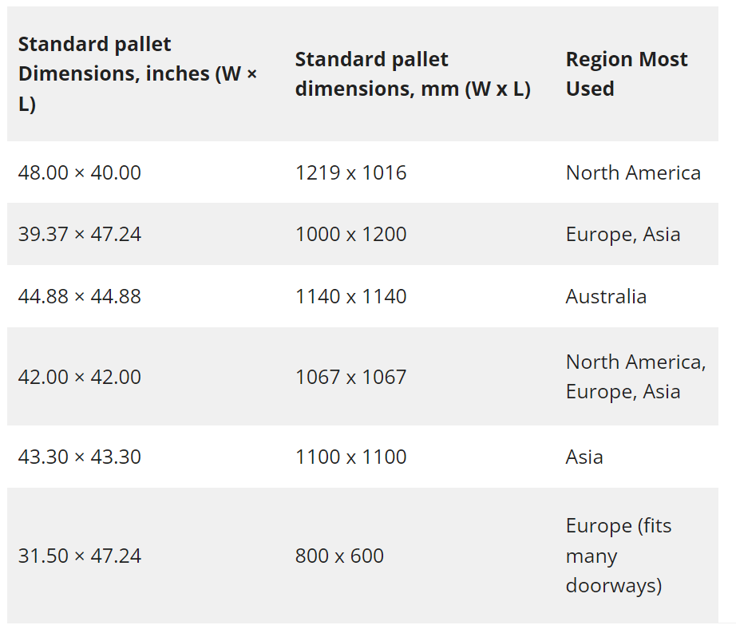
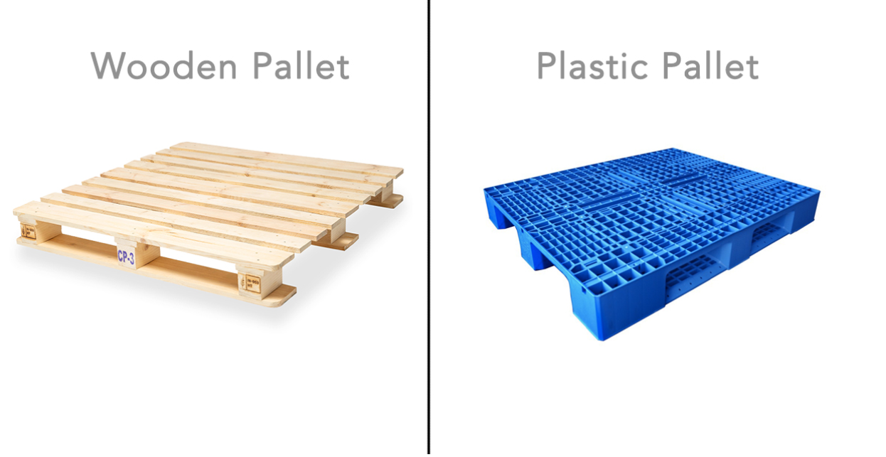
June 2023
Doc.: IEEE 802.11-23/1603r0
Device Density: Warehouse
AMP is expected to target only at high-value items, e.g., pallets, but not for every items, e.g., small boxes/cartons.
Taking most common items, i.e., pallets as an example
Typical pallet size is around 1m-by-1.2m
Standard Pallet Size [1]
Slide 6
Yinan Qi (OPPO)
Notes:
[1] https://www.bestforworld.com/the-complete-guide-of-standard-pallet-definition-size-and-dimensions-classification-loading-load-selection-attention-usage-method2022
Typical pallet size is 1-by-1.2, 1 per m2 for single layer, 5 per m2 for multiple layers
[2] https://crownlspgroup.com/how-to-calculate-warehouse-space-needs/
50%-80% space efficiency
[3] https://pplusglobal.com/2018/03/23/use-standard-pallet-sizes-stacking-height/#:~:text=Safe%20Stacking&text=When%20you%20stack%20them%2C%20don,layers%20to%20hold%20them%20tight.
<=60inches, 5 feet, 1.52m,
[4] https://www.miebach.com/en/publications/whitepapers/pallet-heights-in-logistics/
Up to 6 layers

Slide 7
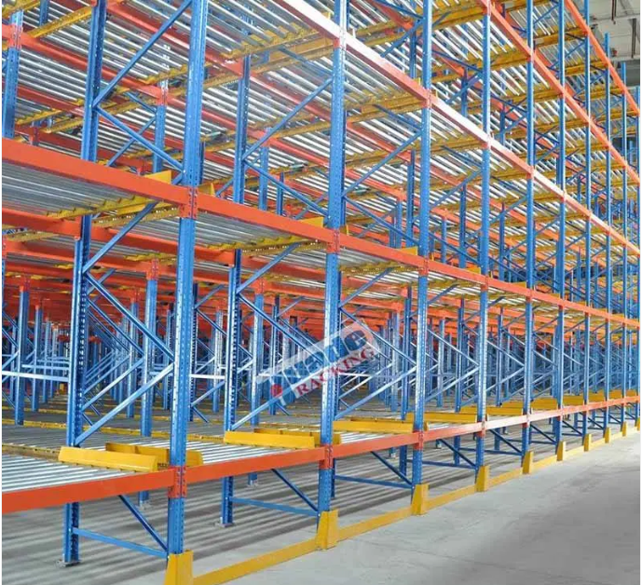
June 2023
Doc.: IEEE 802.11-23/1603r0
Device Density: Warehouse
Pallets can be stacked in single layer or multiple layer on the shelf
According to [2], shelf layers can normally be up to 6 levels and 2.5m due to safety reasons.
Assuming one AMP tag is attached to each pallet, the AMP tag density is around 0.83/m² for single layer and 5/m² for multiple layers.
It should be noted that the space within one warehouse cannot be fully used for the reasons including unusual shapes of the products, space for maneuver around shelfs, etc.
Typical space usage is 40%-80% [3]
Average density is around 0.56/m² for single layer and 4/m² for multiple layers.
Slide 7
Yinan Qi (OPPO)
Notes:
[1] https://www.bestforworld.com/the-complete-guide-of-standard-pallet-definition-size-and-dimensions-classification-loading-load-selection-attention-usage-method2022
Typical pallet size is 1-by-1.2, 1 per m2 for single layer, 5 per m2 for multiple layers
[2] https://crownlspgroup.com/how-to-calculate-warehouse-space-needs/
50%-80% space efficiency
[3] https://pplusglobal.com/2018/03/23/use-standard-pallet-sizes-stacking-height/#:~:text=Safe%20Stacking&text=When%20you%20stack%20them%2C%20don,layers%20to%20hold%20them%20tight.
<=60inches, 5 feet, 1.52m,
[4] https://www.miebach.com/en/publications/whitepapers/pallet-heights-in-logistics/
Up to 6 layers

Slide 8
June 2023
Doc.: IEEE 802.11-23/1603r0
Requirements
 | Coverage (dBm) | Maximum payload size (bit) | Peak device power consumption (mWatts) | Device density (per m²) | Horizontal Positioning accuracy (m) | Peak data rate (Kbps) | Others
UC1: Smart Manufacturing | Type1: -30 Type2: -82 | 256 | 1 | 4 | 3 | 51.2 kbps
UC2: Data Centre | Type1: -30 Type2: -82 | 256 | 1 | 3 | 1-3 | 51.2 kbps
UC3: Smart Home | Type1: -30 Type2: -82 | 256 | 1 | 0.25 | 1-3 | 51.2 kbps
UC4: Logistics and Warehouse | Type1: -30 Type2: -82 | 256 | 1 | 4 | 3 | 51.2 kbps
UC5: Smart Agriculture | Type1: -30 Type2: -82 | 256 | 1 | 1 | 10 | 51.2 kbps
UC6: Indoor Positioning | Type1: -30 Type2: -82 | 256 | 1 | 0.25 | 1-3 | 51.2 kbps
UC7: Smart Power Grid | Type1: -30 Type2: -82 | 256 | 1 | 10⁻² | 10 | 51.2 kbps
UC8: Fresh Food Supply Chain | Type1: -30 Type2: -82 | 256 | 1 | 4 | 3 | 51.2 kbps
Note 1: Coverage is calculated based on AWGN Channel Note 2: Type 1: RF powered AMP device; Type 2: non-RF powered AMP device, e.g., thermal, solar, etc. Note 3: Others include requirements only applicable to a subset of use cases
Slide 8
Yinan Qi (OPPO)

Slide 9
Summary
Doc.: IEEE 802.11-23/1603r0
For warehouse, the products/items size and stacking should follow regulations.
Device density in logistics and warehouse is updated based on such regulations.

Slide 10
Reference
June 2023
Doc.: IEEE 802.11-23/1603r0
https://www.bestforworld.com/the-complete-guide-of-standard-pallet-definition-size-and-dimensions-classification-loading-load-selection-attention-usage-method2022
https://www.miebach.com/en/publications/whitepapers/pallet-heights-in-logistics/
https://pplusglobal.com/2018/03/23/use-standard-pallet-sizes-stacking-height/#:~:text=Safe%20Stacking&text=When%20you%20stack%20them%2C%20don,layers%20to%20hold%20them%20tight.

