Slide 1
Performance of Coordinated Spatial Reuse
Date: 2023-06-
Authors:
Name | Affiliations | email
Kanke Wu | Qualcomm
Alice Chen
Bin Tian
Sameer Vermani

Slide 2
Introduction
Coordinated spatial reuse (C-SR) can improve upon existing spatial reuse by allowing better coordination across multiple APs through
  Better selection of transmit-receive pair for the reuse transmission
  More precise power control
  Selective enabling/disabling of medium reuse based on coordinated measurement
In this presentation we show PHY simulations of C-SR performance under different assumptions to understand the gain
  Metrics considered
    Sum throughput
    Fairness constraints
    CSI inaccuracy impact
  In the study, we consider only DL case → conclusions can be extended to UL and mixed DL/UL cases

Slide 3
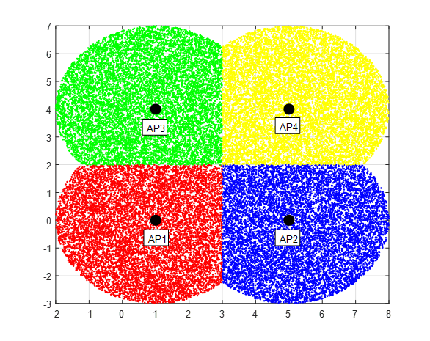
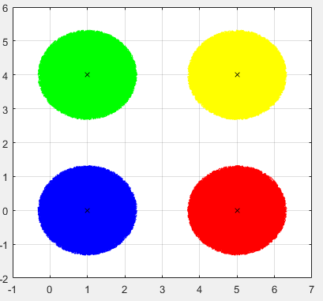
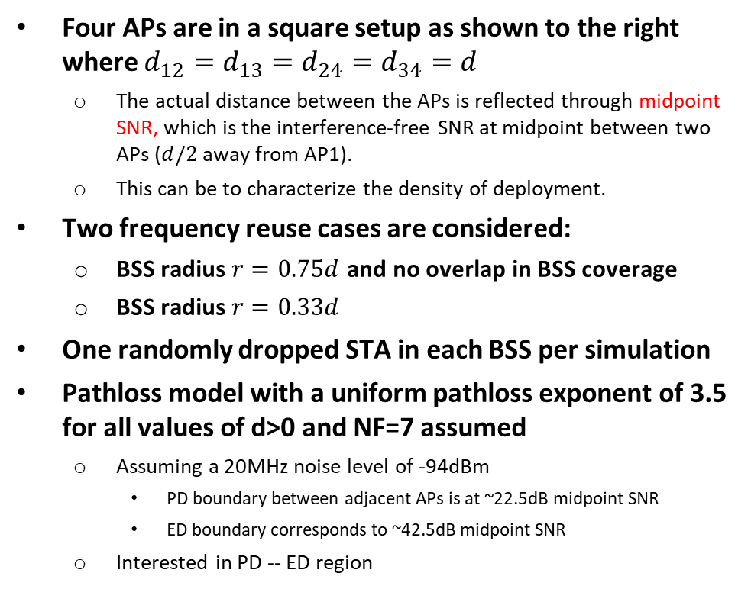
Four APs simulation setting
Four APs are in a square setup as shown to the right where $d_{12}=d_{13}=d_{24}=d_{34}=d$
  The actual distance between the APs is reflected through midpoint SNR, which is the interference-free SNR at midpoint between two APs ($d/2$ away from AP1).
  This can be to characterize the density of deployment.
Two frequency reuse cases are considered:
  BSS radius $r=0.75d$ and no overlap in BSS coverage
  BSS radius $r=0.33d$
One randomly dropped STA in each BSS per simulation
Pathloss model with a uniform pathloss exponent of 3.5 for all values of d>0 and NF=7 assumed
  Assuming a 20MHz noise level of -94dBm
    PD boundary between adjacent APs is at ~22.5dB midpoint SNR
    ED boundary corresponds to ~42.5dB midpoint SNR
  Interested in PD -- ED region
r
d
Midpoint SNR measurement

Slide 4
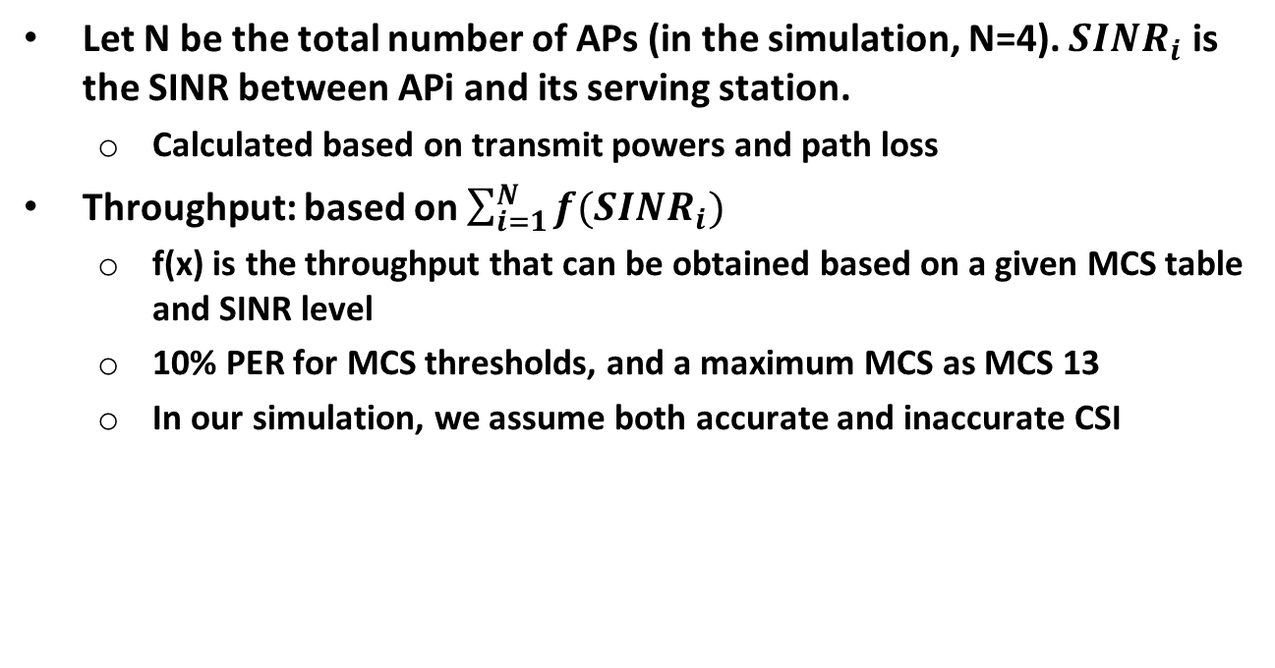
Sum throughput
Let N be the total number of APs (in the simulation, N=4). ${SINR}_{i}$ is the SINR between APi and its serving station.
  Calculated based on transmit powers and path loss
Throughput: based on $\sum_{i=1}^{N}{f({SINR}_{i})}$
  f(x) is the throughput that can be obtained based on a given MCS table and SINR level
  10% PER for MCS thresholds, and a maximum MCS as MCS 13
  In our simulation, we assume both accurate and inaccurate CSI

Slide 5
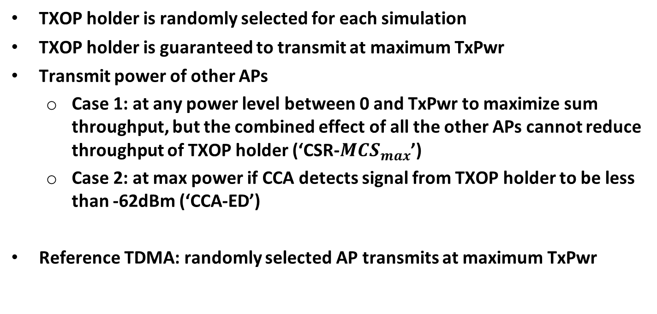
Fairness considerations
TXOP holder is randomly selected for each simulation
TXOP holder is guaranteed to transmit at maximum TxPwr
Transmit power of other APs
  Case 1: at any power level between 0 and TxPwr to maximize sum throughput, but the combined effect of all the other APs cannot reduce throughput of TXOP holder (‘CSR-${MCS}_{max}$’)
  Case 2: at max power if CCA detects signal from TXOP holder to be less than -62dBm (‘CCA-ED’)
Reference TDMA: randomly selected AP transmits at maximum TxPwr

Slide 6
CSI inaccuracy
Inaccuracy is introduced in pathloss measurement per-link and error is accumulated in the SINR calculation
  Error presented in the CSI feedback for all cases
  Uniform [-3,3]dB is assumed for all cases
Inaccurate SINR results in
  Underestimated →lower selected MCS and throughput
  Overestimated → higher selected MCS but failed transmission
To avoid failed transmission due to overestimation, each AP performs SNR backoff to avoid packet loss in MCS selection
  Backoff value optimized based on simulation

Slide 7
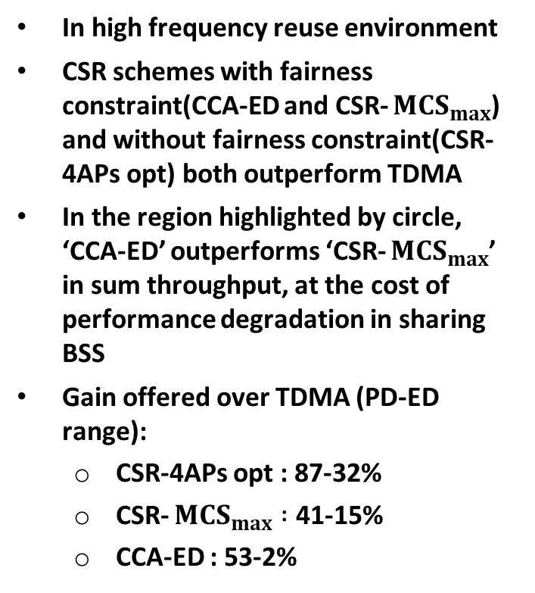
Sum Throughput, accurate CSI, r=0.75d
In high frequency reuse environment
CSR schemes with fairness constraint(CCA-ED and CSR- ${MCS}_{max}$) and without fairness constraint(CSR-4APs opt) both outperform TDMA
In the region highlighted by circle, ‘CCA-ED’ outperforms ‘CSR- ${MCS}_{max}$’ in sum throughput, at the cost of performance degradation in sharing BSS
Gain offered over TDMA (PD-ED range):
  CSR-4APs opt : 87-32%
  CSR- ${MCS}_{max} :$ 41-15%
  CCA-ED : 53-2%
PD
ED

Slide 8
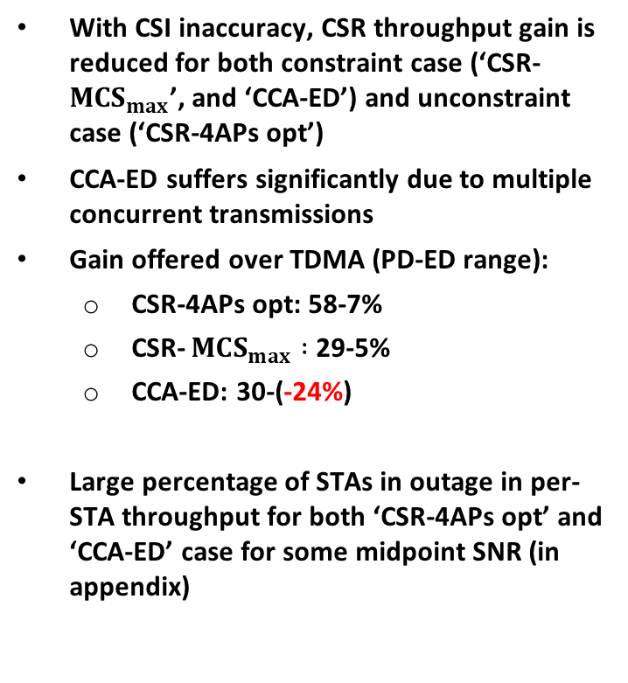
Sum Throughput, inaccurate CSI, r=0.75d
With CSI inaccuracy, CSR throughput gain is reduced for both constraint case (‘CSR- ${MCS}_{max}$’, and ‘CCA-ED’) and unconstraint case (‘CSR-4APs opt’)
CCA-ED suffers significantly due to multiple concurrent transmissions
Gain offered over TDMA (PD-ED range):
  CSR-4APs opt: 58-7%
  CSR- ${MCS}_{max} :$ 29-5%
  CCA-ED: 30-(-24%)
Large percentage of STAs in outage in per-STA throughput for both ‘CSR-4APs opt’ and ‘CCA-ED’ case for some midpoint SNR (in appendix)
PD
ED

Slide 9
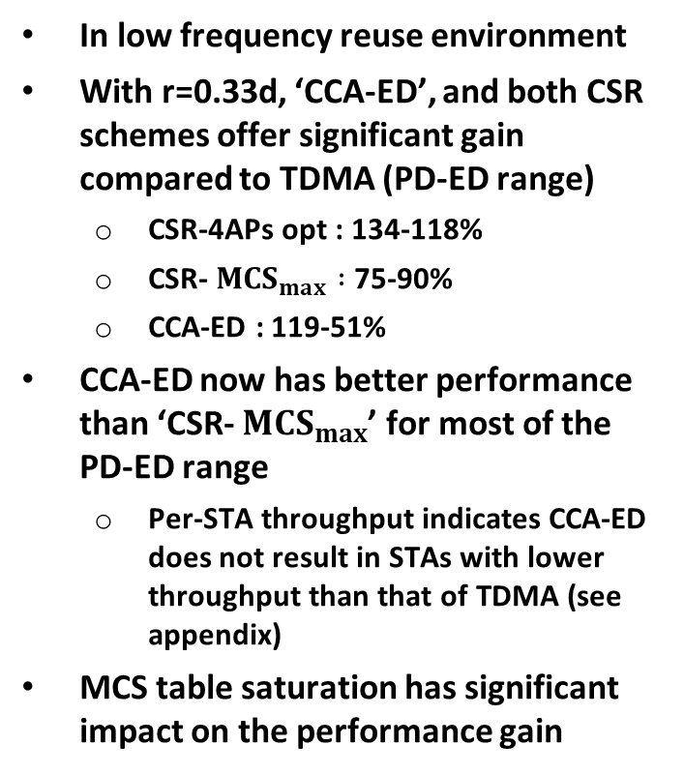
Sum Throughput, accurate CSI, r=0.33d
In low frequency reuse environment
With r=0.33d, ‘CCA-ED’, and both CSR schemes offer significant gain compared to TDMA (PD-ED range)
  CSR-4APs opt : 134-118%
  CSR- ${MCS}_{max} :$ 75-90%
  CCA-ED : 119-51%
CCA-ED now has better performance than ‘CSR- ${MCS}_{max}$’ for most of the PD-ED range
  Per-STA throughput indicates CCA-ED does not result in STAs with lower throughput than that of TDMA (see appendix)
MCS table saturation has significant impact on the performance gain
PD
ED

Slide 10
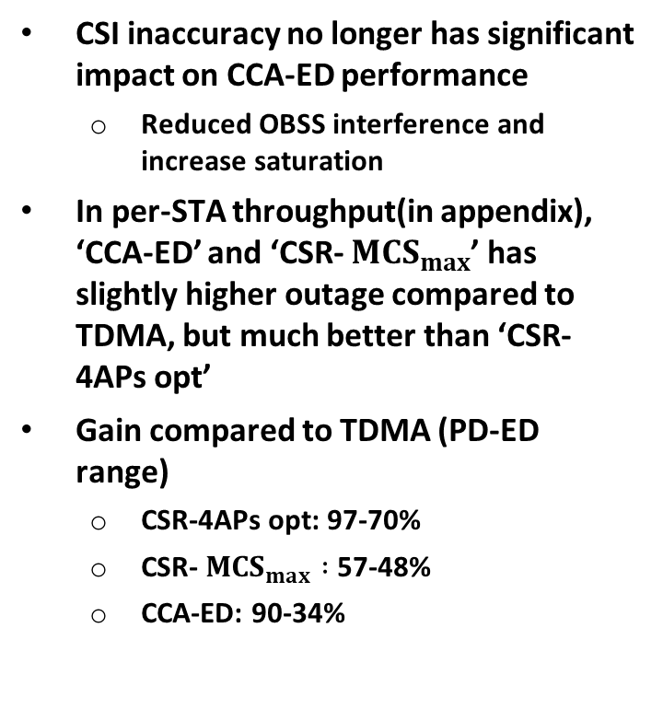
Sum Throughput, inaccurate CSI, r=0.33d
CSI inaccuracy no longer has significant impact on CCA-ED performance
  Reduced OBSS interference and increase saturation
In per-STA throughput(in appendix), ‘CCA-ED’ and ‘CSR- ${MCS}_{max}$’ has slightly higher outage compared to TDMA, but much better than ‘CSR-4APs opt’
Gain compared to TDMA (PD-ED range)
  CSR-4APs opt: 97-70%
  CSR- ${MCS}_{max} :$ 57-48%
  CCA-ED: 90-34%
PD
ED

Slide 11
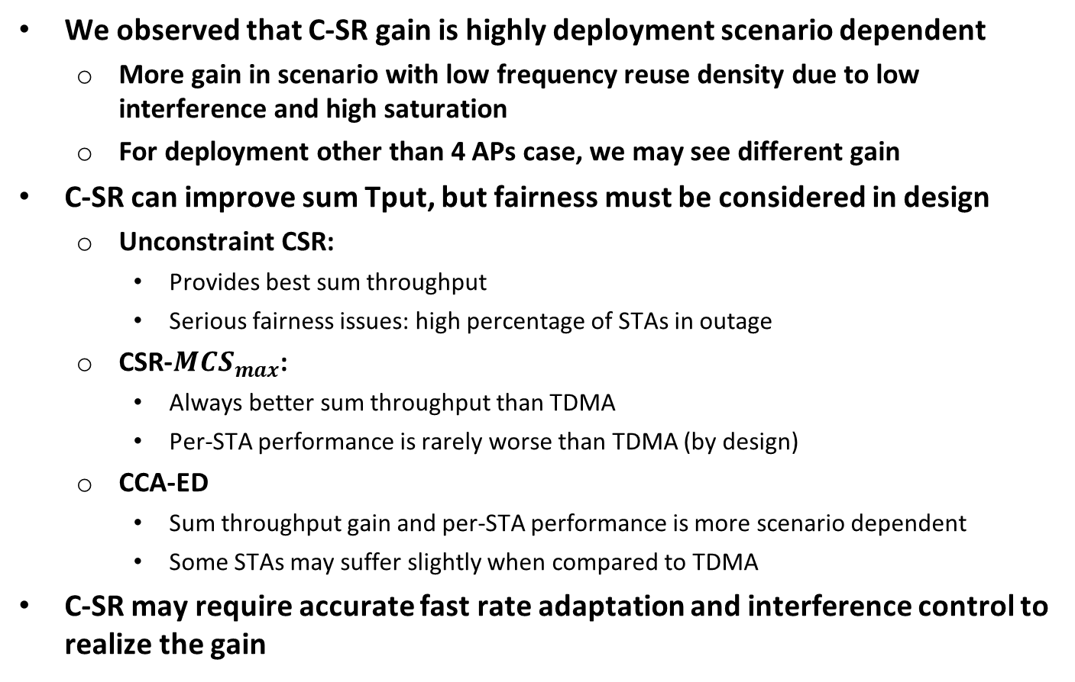
Summary of results
We observed that C-SR gain is highly deployment scenario dependent
  More gain in scenario with low frequency reuse density due to low interference and high saturation
  For deployment other than 4 APs case, we may see different gain
C-SR can improve sum Tput, but fairness must be considered in design
  Unconstraint CSR:
    Provides best sum throughput
    Serious fairness issues: high percentage of STAs in outage
  CSR-${MCS}_{max}$:
    Always better sum throughput than TDMA
    Per-STA performance is rarely worse than TDMA (by design)
  CCA-ED
    Sum throughput gain and per-STA performance is more scenario dependent
    Some STAs may suffer slightly when compared to TDMA
C-SR may require accurate fast rate adaptation and interference control to realize the gain

Slide 12
Appendix

Slide 13
Sum Capacity, r=0.75d
Optimal 4 APs cooperation without sharing BSS achieves the best sum capacity but scarifies fairness (unconstraint case)
CCA-ED can achieve about half of the gain offered by unconstrainted case over TDMA
  CCA-ED only guarantee sharing BSS to always transmit at peak TxPwr and does not have a fixed limit on interference from shared APs
  CCS-ED performs worse than TDMA around ED region, when it enables the diagonal AP for concurrent transmission
Gain offered over TDMA (PD-ED range):
  Optimal 4 APs cooperation without sharing BSS: 83-21%
  CSR with 3dB SINR drop limit: 55-0%
  CCA-ED: 59-(-13)%
PD boundary
ED boundary

Slide 14
Per-STA throughput, accurate CSI, r=0.75d

Slide 15
Per-STA throughput, inaccurate CSI, r=0.75d

Slide 16
Per-STA throughput, accurate CSI, r=0.33d

Slide 17
Per-STA throughput, inaccurate CSI, r=0.33d

