Slide 1
Coordinated Spatial Reuse in a 4 AP Topology
Date: 2023-07-01
Authors:
Name | Affiliations | Address | Phone | Email
Gary Anwyl | Mediatek Inc. |  |  | Gary.Anwyl@mediatek.com
Shengquan Hu
Jianhan Liu
Thomas Pare

Slide 2
Introduction
Multi-AP coordination is a technology being considered for UHR
  See [1] for an overview of Multi-AP coordination and a review of previous discussions in WNG and TGbe
Coordinated Spatial Reuse (CSR) is one of the Multi-AP coordination schemes
CSR simulation results have been presented in TGbe [2,3,4,5]
This contribution presents PHY level simulation results for CSR in a 4 AP topology
  Includes comparison with TDMA
  Includes practical considerations of fairness and CSI inaccuracy
  Includes a variety of configurations

Slide 3
AP Modes
Coordinated Spatial Reuse
  Two or more APs transmit simultaneously during the same TXOP
  Sharing AP obtains a TXOP
  Sharing AP coordinates with other Shared APs to share the TXOP
    Sharing AP estimates SINR from CSI parameters
    Sharing AP selects MCS and TX power for all APs to maximize sum throughput
    In some cases, only a subset of the APs will TX
TDMA
  Only one AP transmits
  AP may coordinate with other APs to share a TXOP in a TDMA fashion

Slide 4
Practical Considerations
Fairness
  Without a fairness constraint, Sharing AP could maximize throughput by only selecting APs with the best throughput and starving APs with poor throughput
  To ensure fairness, Sharing AP will always transmit during its TXOP
    Interference from Shared APs may reduce the Sharing APs SINR
    The Sharing AP will limit the amount of SINR reduction allowed.
CSI Inaccuracy
  The Sharing AP uses channel information to estimate SINR and select MCS and TX power control
  Errors in the measurement of RSSI and control of TX power will affect the actual SINR
  Sharing AP will add a margin to its SINR estimates to protect against CSI inaccuracy
    Higher margin for CSR than TDMA since more devices are involved

Slide 5
4 AP Topology
Four APs in a square configuration
  Distance between adjacent APs = D
Two BSS Radii
  Dense: R = 0.75 D. BSSs do not overlap.
  Frequency Reuse: R=0.375 D
One randomly dropped STA per BSS
D
R=0.75 D
D
R=0.375 D
D
D
D
D
D
D

Slide 6
Midpoint SNR Parameter
Goodput results are reported as a function of Midpoint SNR
Midpoint SNR Definition
  Interference-free SNR at D/2 point halfway between two APs
Midpoint SNR Range
  Consider RSSI values (as measured at distant AP) between the PD CCA threshold (-82 dBm) and ED threshold (-62 dBm)
  Assume a pathloss model with a uniform exponent of 3.5 and -94 dBm noise floor in 20MHz
Focus on Midpoint SNR values between 22.5 and 42.5 dB
RSSI @ Far AP | RSSI @ Midpoint | Midpoint SNR
(dBm) | (dBm) | (dB)
-82 | -71.5 | 22.5
-62 | -51.5 | 42.5
Midpoint
D
D
D
D

Slide 7
Simulation
Four APs each with 1 STA
Configurations
  1x1-1ss (1T AP, 1R STA), 2x2-2ss (2T AP, 2R STA)
BW
  20MHz, 80MHz
Channel
  AWGN, B-LOS, D-NLOS
  Uniform pathloss exponent of 3.5
  7 dB Noise Figure
11ax PHY Abstraction model for MCS selection and PER estimation
100 random drops
Metrics
  Mean Goodput of CSR and TDMA
  Ratio of CSR Goodput to TDMA Goodput for each STA drop
  Number of active CSR APs for each STA drop

Slide 8
Goodput Calculation
TDMA Goodput Calculation
  Random AP is chosen
  Calculate SNR based on signal loss and noise floor
  Select MCS based on 11ax PHY Abstraction model
  Goodput = PHY RATE * (1 - PER)
  CSI inaccuracy protection
    Add 3 dB margin to SNR estimate
CSR Goodput Calculation
  Random AP is chosen to be Sharing AP
  Calculate SINR for each STA based on signal loss and interference
  Search over the number of active APs and power levels to maximize Goodput
  Fairness constraint
    Sharing AP will always TX. It will allow up to a 3 dB loss in SINR versus TDMA SINR
  CSI inaccuracy protection
    Add 6 dB margin to SINR estimate

Slide 9
Simulation Results
Following slides present detailed results for three configurations:
  20M, 1x1-1ss AWGN
  20M, 1x1-1ss AWGN, reduced BSS radius
  20M, 2x2-2ss B-LOS, reduced BSS radius
Results
  Plot of Mean Goodput for CSR and TDMA over the range of Midpoint SNRs
  CDF plot of CSR Gain showing how often CSR outperforms TDMA
Final slide is a summary that includes additional configurations

Slide 10
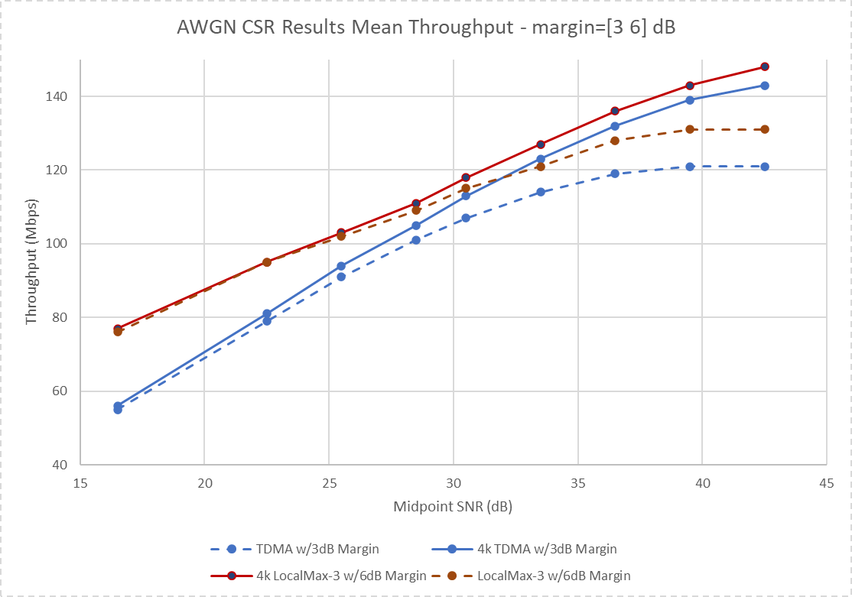
4 AP - 20M 1x1-1ss, AWGN
Mean Goodput versus Midpoint SNR
CSR (Red) and TDMA (Blue)
Maximum modulation is either 4K QAM (solid) or 1K QAM (dashed)
17-20% gain at Low Midpoint SNR (low interference)
Lower gain at Mid to High Midpoint SNR
1K
MP SNR | CSR Gain
22.5 | 20%
28.5 | 8%
36.5 | 8%
4k
MP SNR | CSR Gain
22.5 | 17%
28.5 | 6%
36.5 | 3%

Slide 11
Gain Details – 4k QAM, 22.5 dB and 28.5 dB MP SNR
Upper=22.5 dB Midpoint SNR. Lower=28.5 dB Midpoint SNR
Left=Goodput CDF. Right=CDF of Active APs & CSR/TDMA ratio
CSR (Blue) vs TDMA (Green)
Midpoint SNR=22.5 dB
  Low interference
  Gain over full range
  More than 1 AP active ~50% of the time
  CSR outperforms TDMA ~50% of the time
Midpoint SNR=28.5 dB
  Significant portion of the gain is from MCS saturation
  CSR outperforms TDMA ~20% of the time
Slide 11

Slide 12
Gain Details – 4k QAM, 33.5 dB MP SNR
Left=Goodput CDF. Right=Active APs & CSR/TDMA Goodput ratio
CSR (Blue) vs TDMA (Green)
Midpoint SNR=33.5 dB
  High interference
  CSR gain is small
  All gain is from MCS saturation

Slide 13
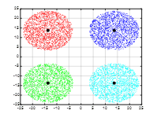
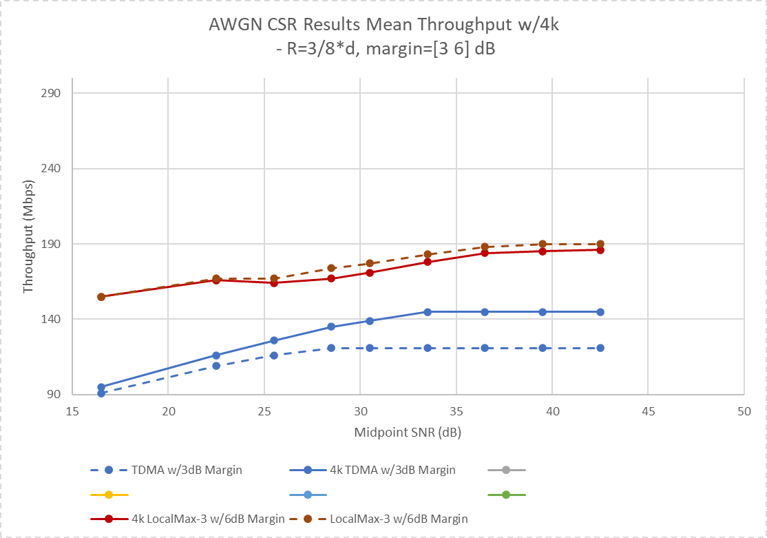
4 AP – 20M 1x1-1ss, AWGN
R=3/8*D
Reduced BSS Radius
CSR (Red) vs TDMA (Blue)
Maximum modulation is either 4K QAM (solid) or 1K QAM (dashed)
43-53% gain at Low MP SNR (low interference)
Higher CSR gain than R=0.75*D
1k
MP SNR | CSR Gain
22.5 | 53%
28.5 | 44%
36.5 | 55%
4k
MP SNR | CSR Gain
22.5 | 43%
28.5 | 24%
36.5 | 27%

Slide 14
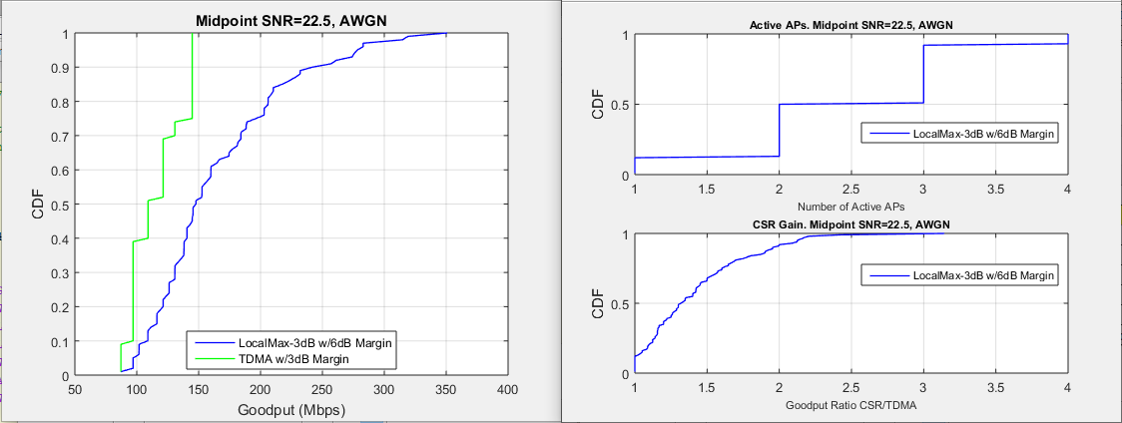
Gain Details – 4k QAM, 22.5 dB and 28.5 dB MP SNR
Upper = 22.5 dB Midpoint SNR. Lower = 28.5 dB Midpoint SNR
Left = Goodput CDF. Right = Active APs & CSR/TDMA ratio
CSR (Blue) vs TDMA (Green)
Midpoint SNR=22.5 dB
  Low interference
  CSR outperforms 80% of the time
  Some gain from MCS saturation
Midpoint SNR=28.5 dB
  Still low interference
  Gain from MCS saturation
  CSR outperforms 50% of the time
Slide 14

Slide 15
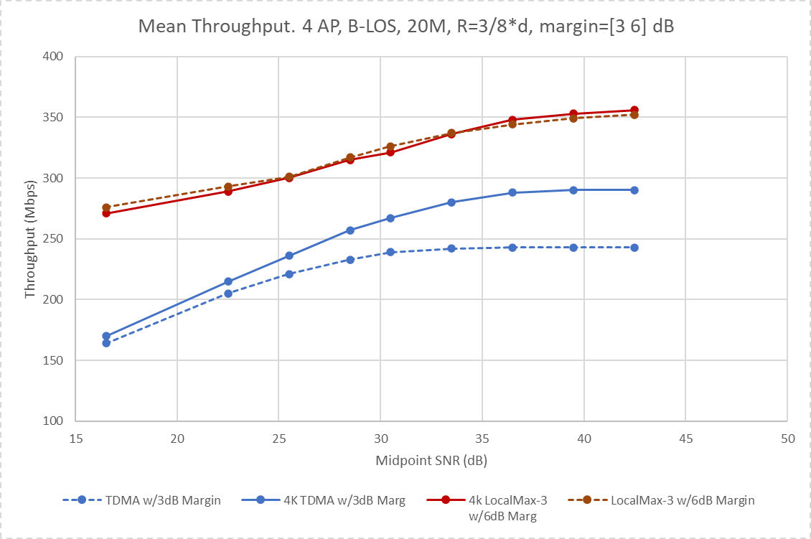
4 AP – 20M 2x2-2ss, B-LOS
R=3/8*D
Reduced BSS Radius
CSR (Red) vs TDMA (Blue)
Maximum modulation is either 4K QAM (solid) or 1K QAM (dashed)
34-43% gain at Low MP SNR (low interference)
Higher CSR gain than R=0.75*D
1k
MP SNR | CSR Gain
22.5 | 43%
28.5 | 36%
33.5 | 39%
4k
MP SNR | CSR Gain
22.5 | 34%
28.5 | 23%
33.5 | 20%

Slide 16
Gain Details – 4k QAM, 22.5 dB and 28.5 dB MP SNR
Upper = 22.5 dB Midpoint SNR. Lower = 28.5 dB Midpoint SNR
Left = Goodput CDF. Right = Active APs & CSR/TDMA ratio
CSR (Blue) vs TDMA (Green)

Slide 17
Summary of Results
Table of CSR Gain vs TDMA
  Results for dense topology (R=3/4*D) and topology with frequency reuse (R=3/8*D)
Similar gains across different BWs, configurations and channels
 | Midpoint SNR
% CSR Gain vs TDMA | 1K QAM |  |  | 4K QAM
 | 22.5 | 28.5 | 33.5 | 22.5 | 28.5 | 33.5
20M 1x1-1ss AWGN | 20% | 8% | 8% | 17% | 6% | 3%
80M 1x1-1ss AWGN | 20% | 11% | 8% | 17% | 8% | 4%
20M 1x1-1ss B-LOS | 30% | 18% | 13% | 28% | 15% | 8%
80M 1x1-1ss B-LOS | 20% | 11% | 8% |  |  |  | R=3/4*D
20M 1x1-1ss D-NLOS | 26% | 13% | 11%
20M 2x2-2ss B-LOS | 22% | 11% | 9% | 20% | 8% | 5%
80M 2x2-2ss B-LOS | 20% | 11% | 7%
20M 1x1-1ss AWGN | 53% | 44% | 51% | 43% | 24% | 23%
20M 1x1-1ss D-NLOS | 53% | 44% | 51% |  |  |  | R=3/8*D
20M 2x2-2ss B-LOS | 43% | 36% | 39% | 34% | 23% | 20%

Slide 18
Conclusions
CSR provides gain over TDMA
  Simulation is a practical implementation that includes fairness constraint and CSI inaccuracy protection
  Majority of gain in the low interference region
    20% in dense 4 AP topology
  CDF of CSR gain shows CSR can outperform TDMA for many specific STA drops
    In a dense topology CSR outperforms TDMA up to 50% of the time
Reduced BSS radius significantly improves CSR gain
  Up to 50% gain

Slide 19
References
[1] 11-22/1516r0, ‘Considerations on Multi-AP Coordination’, Tanaka et al
[2] 11-19/801r0, ‘AP Coordination in EHT’, Guo et al
[3] 11-19/1543r1, ‘Coordinated Spatial Reuse Performance Analysis’, Aio et al
[4] 11-20/73r0, ‘On Coordinated Spatial Reuse in 11be’, Liu et al
[5] 11-20/107r1, ‘Multi-AP Coordination for Spatial Reuse’, Akhmetov et al
[6] 11-20/457r1, ‘Discussion on Coordinated Spatial Reuse Operation’, Aio et al

Slide 20
Backup

Slide 21
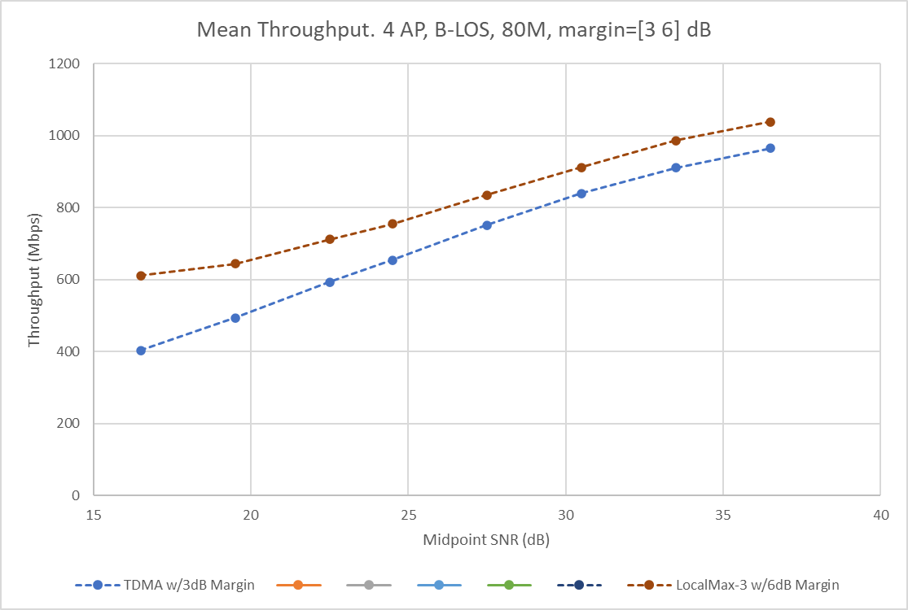
4 AP - 80M 2x2-2ss, B-LOS
Mean Goodput for CSR (Red) vs TDMA (Blue)
CSR gain comparable to 1x1-1ss AWGN case

Slide 22
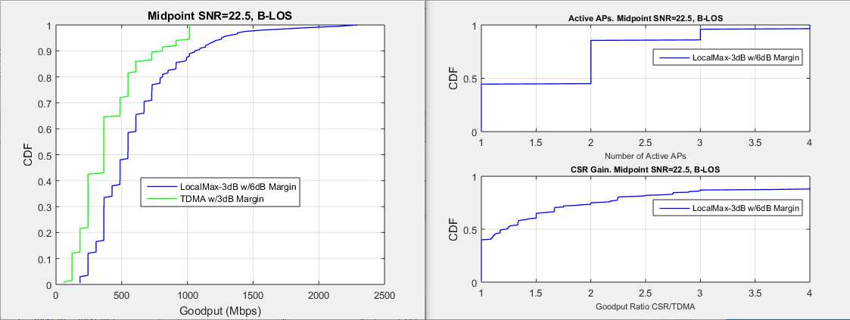
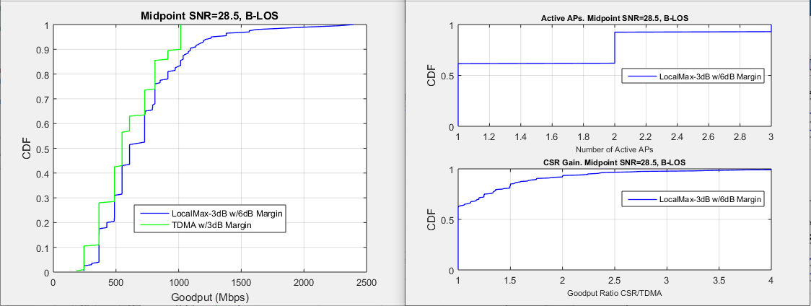
Gain Details
CSR (Blue) vs TDMA (Green)
Midpoint SNR=22.5 dB has gain over full range because of low interference
Gain shrinks at SNR=28.5 dB because of higher interference

Slide 23
Different Topology with Similar Loss
An Unmanaged Home topology can have a loss profile similar to an Enterprise topology designed for frequency reuse
  Consider a home with same BSS Radius, smaller AP-AP distance and walls
Green Text is loss relative to Green AP
Similar loss at APs and BSS edge would result in similar performance
Enterprise
Home
Add wall and shrink
AP-AP distance

