Slide 1
Draft D1.0 Bug Fix: CSI Matrix Dimensions
Date: 2023-06-12
Authors:

Slide 2
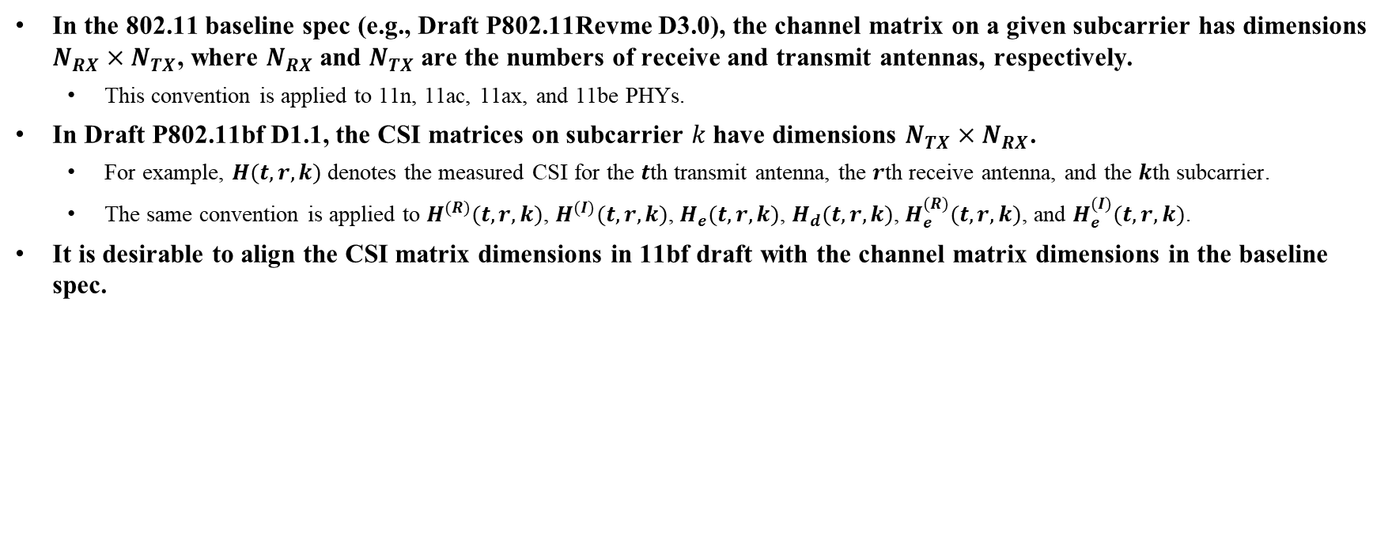
Discussion
In the 802.11 baseline spec (e.g., Draft P802.11Revme D3.0), the channel matrix on a given subcarrier has dimensions $N_{RX}×N_{TX}$, where $N_{RX}$and $N_{TX}$are the numbers of receive and transmit antennas, respectively.
  This convention is applied to 11n, 11ac, 11ax, and 11be PHYs.
In Draft P802.11bf D1.1, the CSI matrices on subcarrier $k$ have dimensions $N_{TX}×N_{RX}$.
  For example, $H(t,r,k)$ denotes the measured CSI for the $t$th transmit antenna, the $r$th receive antenna, and the $k$th subcarrier.
  The same convention is applied to $H^{(R)}(t,r,k)$, $H^{(I)}(t,r,k)$, $H_{e}(t,r,k)$, $H_{d}(t,r,k)$, $H_{e}^{(R)}(t,r,k)$, and $H_{e}^{(I)}(t,r,k)$.
It is desirable to align the CSI matrix dimensions in 11bf draft with the channel matrix dimensions in the baseline spec.

Slide 3

Proposed Changes to D1.1
Change the dimensions of the following CSI matrices on subcarrier $k$ to $N_{RX}×N_{TX}$:
  $H(r,t,k)$, $H^{\left(R\right)}(r,t,k)$, $H^{\left(I\right)}(r,t,k)$, $H_{e}(r,t,k)$, $H_{d}(r,t,k)$, $H_{e}^{\left(R\right)}(r,t,k)$, and $H_{e}^{\left(I\right)}(r,t,k)$
Change the dimensions of the following matrices to $N_{RX}×N_{TX}$:
  $m(r,t)$ and $γ(r,t)$
Reorder/revise the entries in Table 9-127j (Sensing Measurement Report information) according to the modified dimensions.

