Slide 1
Performance evaluation of non-primary channel access
Date: 2023-05-31
Authors:

Slide 2
Abstract
Performance evaluation of non-primary channel access focusing on throughput improvement

Slide 3
Basic protocol for the sims
DUT UHR AP and STA pre-negotiates an auxiliary non-primary channel to temporarily switch to when they detect medium busy on a primary channel.
In particular, for the sims, the switch happens after an RTS-CTS exchange between STAs of a non-DUT BSS.
The duration of the switch is limited to end of NAV set from those RTS-CTS exchanges.
The DUT UHR AP and STA tracks medium busy/idle events on auxiliary primary channel while they are listening on the primary channel.
After switching to the auxiliary channel at time t,
If the medium is busy, the UHR STA waits for the medium to become idle before transmitting.
If the medium is idle, the UHR STA defers for the following period max(0, t_{cca-idle} + T_{listen} – t) before starting contention where
t_{cca-idle} = last time when the auxiliary primary channel became idle from busy
T_{listen} = listen period.
All transmissions initiated by DUT AP with MU-RTS/CTS exchange.

Slide 4
Scenario 1
Auxilary channel
 | Primary channel
Primary channel
160 MHz
Primary channel
BSS 1
BSS 2
BSS 3
Each BSS has one AP and one STA. BSS-1 is UHR.
All STAs can hear each other.
Full buffer DL UDP traffic at each BSS.
Max OBSS TXOP = 6 ms, MCS = 9, DUT BSS NSS = 1.
T_{listen} = 0, 2.7, 4ms.

Slide 5
Results
Clearly, as expected no adverse effect of NPC on legacy performance since DUT STA is getting additional channel access from an empty channel.
Throughput improvement is of the order of 50% (since doubling channel access opportunity at half BW for the ones with NPC) when listen time is 0 ms and drops to ~ 30% when listen time is 4ms.

Slide 6
Scenario 2
Auxilary channel
 | Primary channel
Primary channel
160 MHz
Primary channel
DUT BSS
OBSS 1
OBSS 2
Each BSS has one AP and one STA. BSS-1 is UHR.
All STAs can hear each other.
Full buffer DL UDP traffic at BSS-1; variable DL throughput at other STAs as percentage of PHY throughput.
MCS = 9, DUT BSS NSS = 1.
T_{listen} = 0, 2.7 ms.
Max OBSS TXOP = 6 ms [Case A] or uniform(0.5ms,4ms) [Case B]

Slide 7
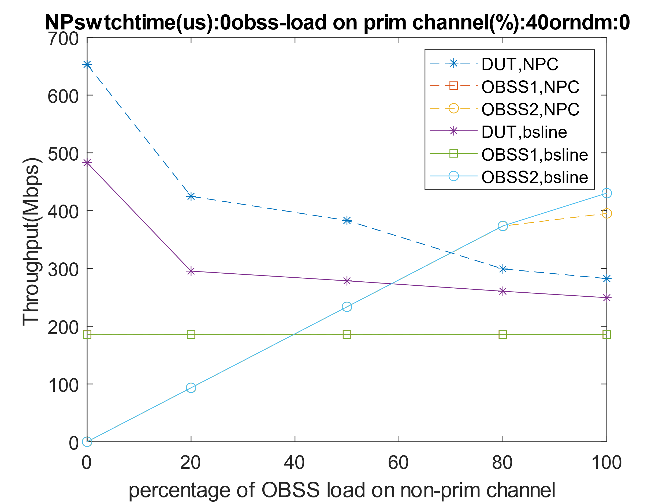
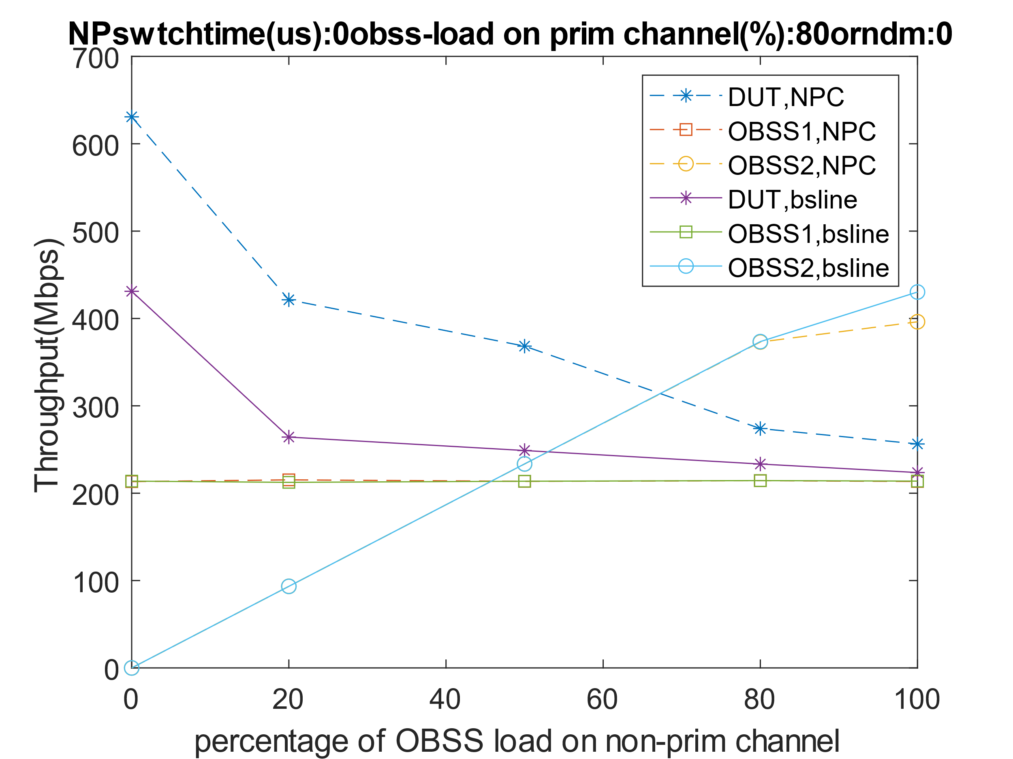
Scenario 2 [Case A] listen time: 0 ms
Low OBSS load on primary channel
Medium OBSS load on primary channel
High OBSS load/saturated on primary channel
DUT throughput increases with non-primary channel access while OBSS is able to deliver its own load before reaching saturation..

Slide 8
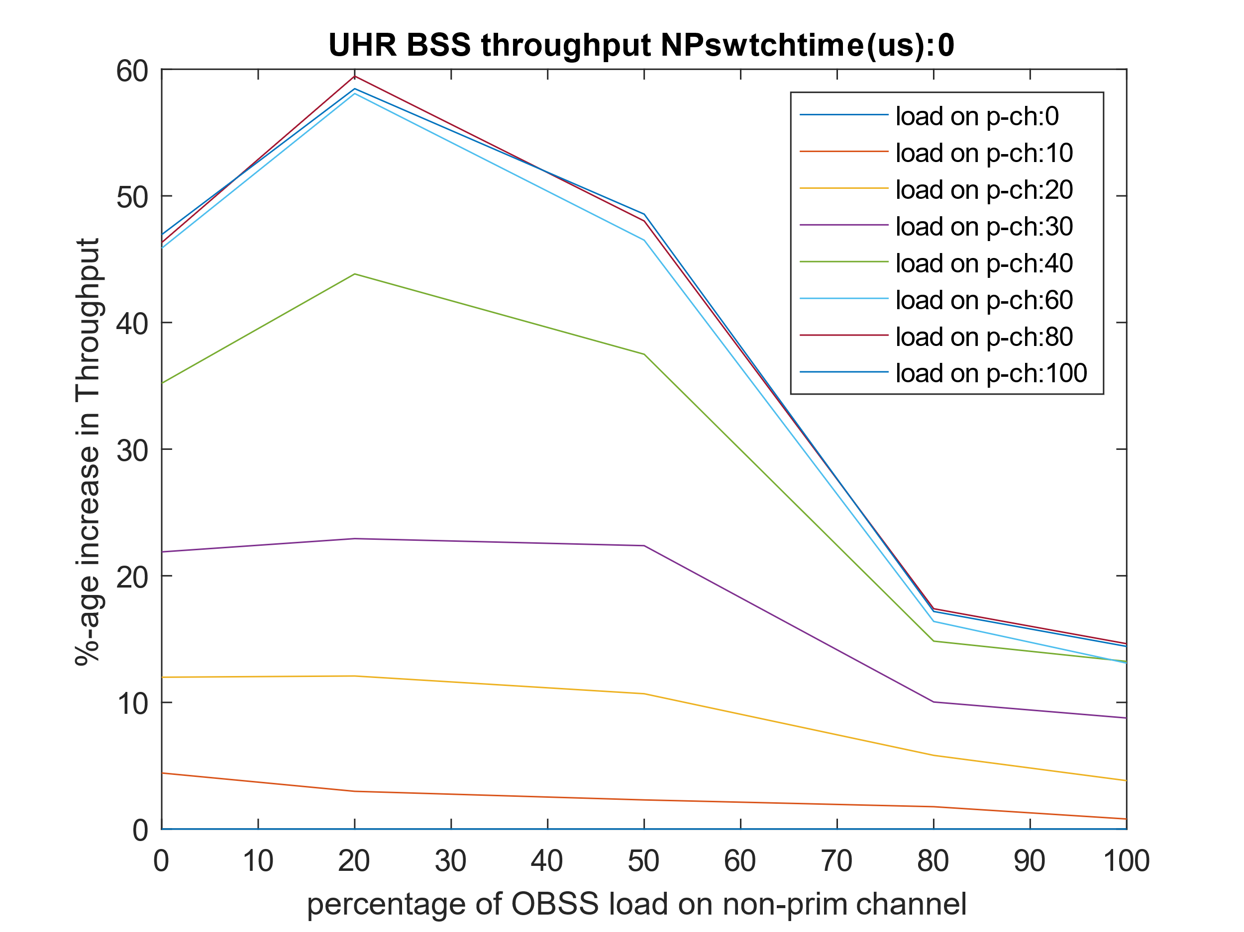
Scenario 2 [Case A] listen time: 0 ms (contd.)
Total throughput increases with NPC with gains increasing as primary channel becomes more loaded and maxing out when the primary channel gets closer to saturation.

Slide 9
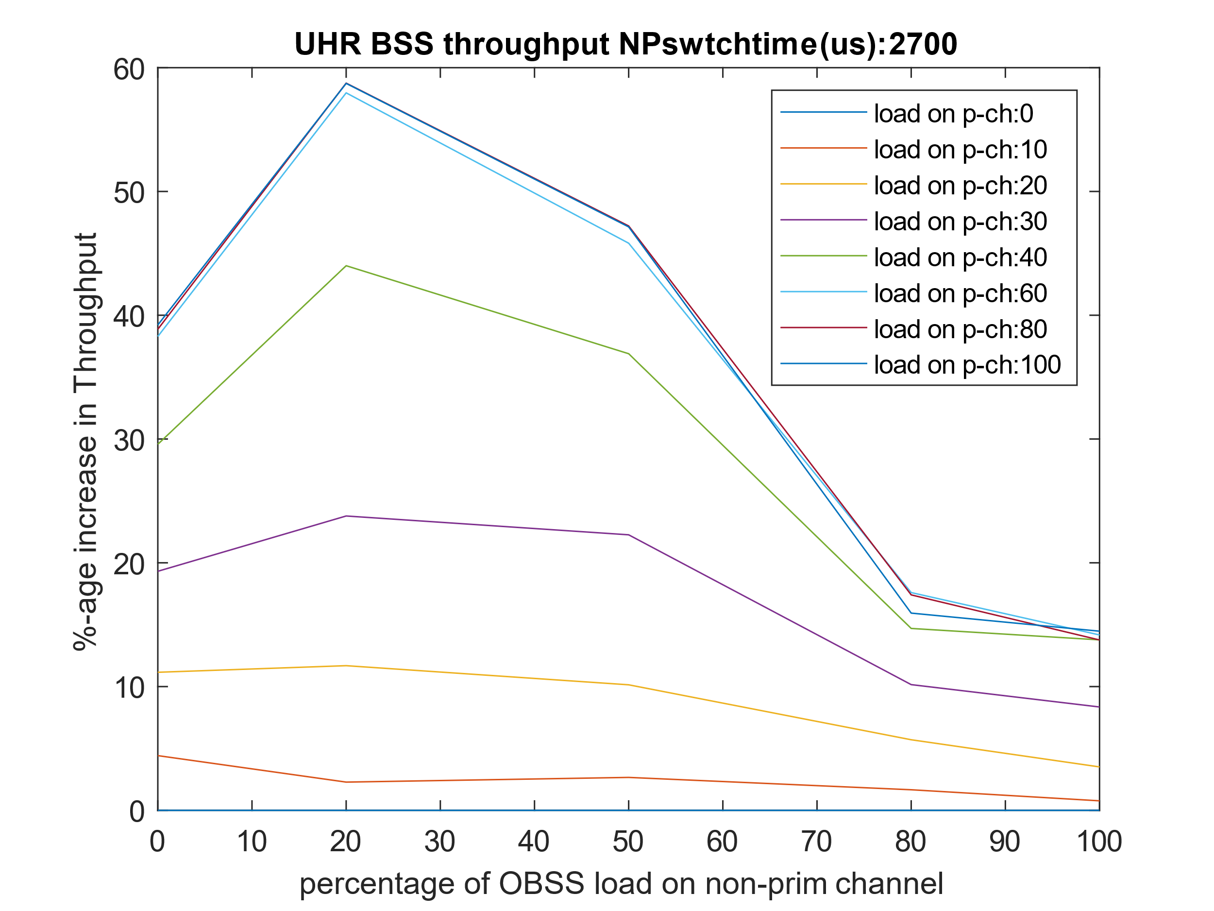
Scenario 2 [Case A] listen time: 2.7 ms
Similar trend as listen time on auxiliary channel is non-trivial. The difference in gains is limited to less than 5% when the non-primary channel is not loaded. As load increases, the effect becomes smaller since there are lesser events where the STA finds auxiliary channel to be idle at switch time.

Slide 10
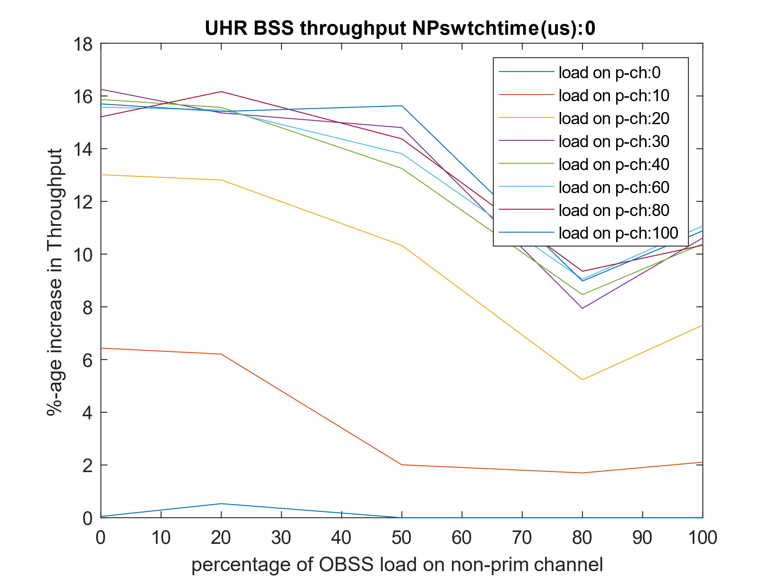
Scenario 2 [Case B] listen time: 0 ms
Similar trend overall (ignoring the sim artifacts) however, the gains are limited relative to case A. Note that there are three effects due to smaller and random OBSS TXOPs:
Higher probability of winning channel access on primary and auxiliary channel => better UHR throughput in baseline
Lower duration spent on auxiliary channel => lower tx time opportunity on that channel.

Slide 11
Conclusion and next steps
NPC shows promising gains by leveraging underutilized channels whenever they are available.
Need to quantify gains (esp. latency) in more general scenarios with non-ideal channel conditions, any co-existence issues and consequently identify the scenarios where switching to auxiliary channels is beneficial.

