Slide 1
Simulations on Application Awareness WLAN
Date: 2023-05-30
Authors:
Name | Affiliation | Address | Phone | Email
Ross Jian Yu | Huawei Technologies |  |  | ross.yujian@huawei.com
Ying Li
Mengyao Ma
Ming Gan

Slide 2
Recap
Higher Throughput and lower latency are two important scopes for UHR SG [1].
In [2], a detailed description on cloud VR use case has been presented, which needs high requirement on throughput and latency. Moreover, two aspects regarding latency reduction have been presented:
  QoS enhancement – application awareness WLAN
  Unequal error protection (multi-layer/coding transmission)
In [3] and [4], we point out that multi-layer transmission has the following benefits and we have provided simulation results for b) and c):
  Provide different protections for frames of different importance
  Take advantage of the channel selective gains
  Good for interference environment, errors happened in one RU layer doesn’t affect the other RU.
In this contribution, we further verifies the gains of QoS enhancement and verifies the benefit of a).

Slide 3
QoS enhancement
There are several contributions in UHR SG talking about low latency improvement or QoS enhancement:
  Layered QoS: application awareness QoS and inter-AC/different AC prioritization [3]
  Adding queues for low latency for a given AC [5]
  Adding new TID/sub TID for low latency traffic [7]
  Dynamic UP to AC Mapping (queue jumping) [7]
  Dedicated resources for low latency traffic [6] [8]
  Non-primary channel access [9]
  Urgency-based BSRP/BSR [10]
  Preemption [11]
  R-TWT enhancement [many]

Slide 4
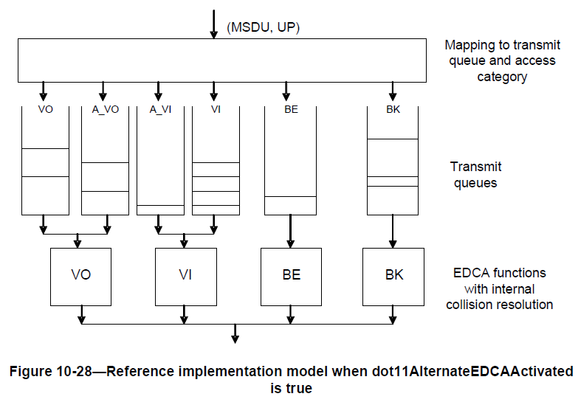
Layered QoS [2]
For WLAN, layered QoS can be helpful on latency reduction. 802.11aa proposed alternative queues of VI to enable inter-AC prioritization of transport streams (I/P/B frame, or base layer/enhancement layer). This can also be helpful for different modalities of XR services (Audio/Video/Haptic Data/Sensor Data).
In 3GPP Release 18, there is similar discussion: Study on XR enhancements for NR [16].
In this contribution, we show simulation results to show the benefits of layered QoS, and multi-layer transmission in PHY.

Slide 5
Simulation Setup
The following parameters has been used in the simulation:
Simulation Parameters | Values
Number of AP | 1
Number of STA | 3/6/9/12/15
Traffic Direction | UL
RTS/CTS | No
Maximum of A-MPDU | 256
Maximum PPDU Duration | 5.46ms
AC | AC_BE/AC_VI
BE CWmax | 1023
BE CWmin | 15
VI CWmax | 31
VI CWmin | 15
AIFS | 43us
PPDU Bandwidth | 80MHz
STA_NSS | 4
Maximum Retransmission Time | AC_VI 4, AC_BE 4
RU size | 484-tone for two or 996-tone for one RU
Jitter time of packet generation | (0，20ms)
Simulation Duration | 6s

Slide 6
Traffic Rate
Frame Rate: 50fps (frame per second)
Frame numbers: 200
GOP (Group of Picture): 50
Resolution:
  SVC Base layer: 1080p (1920*1080)
  SVC Enhancement layer: 4k (3840*2160)
  HEVC (Baseline) : 4k (3840*2160)
Traffic Rate:
  SVC Base layer: 897 KB/s
  SVC Enhancement layer: 2297 KB/s
  HEVC (Baseline): 3135 KB/s
SVC: Scalable Video Coding
HEVC: High Efficiency Video Coding

Slide 7
Simulation Setup
Three cases are compared:
Case # | APP layer | MAC layer | PHY layer
Case 1- LQoS+MLT | SVC, two layers: base layer and enhancement layer | Two TIDs, mapped to two different queues in AC_VI | 80MHz PPDU, two 484-tone RUs, one for each layer. RU with base layer is encoded with MCS 6, RU with enhancement layer is encoded with MCS 8.
Case 2- LQoS | SVC, two layers: base layer and enhancement layer | Two TIDs, two ACs, base layer mapped to AC_VI, enhancement layer mapped to AC_BE | 80MHz PPDU, single RU. PPDU with base layer is encoded with MCS 6, PPDU with enhancement layer is encoded with MCS 8.
Case 3- Baseline | HEVC, single layer | One TID, mapped to AC_VI | 80MHz PPDU, single RU. PPDU is encoded with MCS 7.

Slide 8


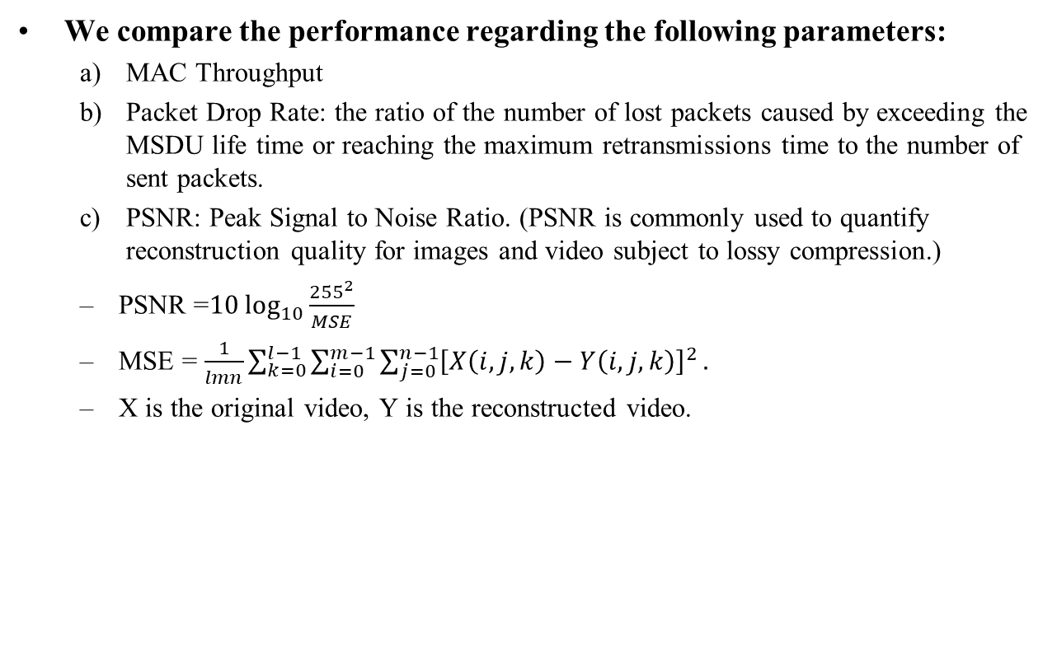
Simulation Setup
We compare the performance regarding the following parameters:
  MAC Throughput
  Packet Drop Rate: the ratio of the number of lost packets caused by exceeding the MSDU life time or reaching the maximum retransmissions time to the number of sent packets.
  PSNR: Peak Signal to Noise Ratio. (PSNR is commonly used to quantify reconstruction quality for images and video subject to lossy compression.)
  PSNR =$10\log_{10}{\frac{{255}^{2}}{MSE}}$
  MSE = $\frac{1}{lmn}\sum_{k=0}^{l−1}{\sum_{i=0}^{m−1}{\sum_{j=0}^{n−1}{{\left[X\left(i,j,k\right)−Y\left(i,j,k\right)\right]}^{2}}.}}$
  X is the original video, Y is the reconstructed video.
PSNR = 30dB
PSNR = 45dB

Slide 9
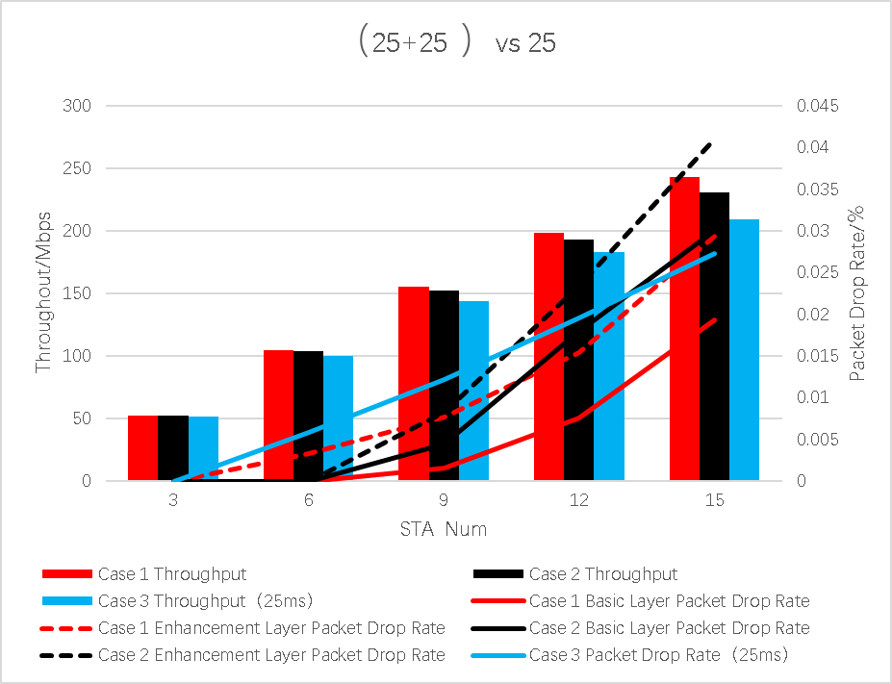
Simulation Results – Throughput and Packet Drop Rate
（a+b) vs c
a means the MSDU life time of base layer
b: enhancement layer c: single layer
ms

Slide 10
Simulation Results – PSNR
ms

Slide 11
Simulation Results Analysis
From the previous results, we can see compared with the baseline case 3, layered QoS (case 1 and case 2) provide better performance regarding MAC Throughput and PSNR when the traffic load is high.
Layered QoS provides different MAC QoS for frames of different importance at APP layer. Multi-layer transmission further provides different protection for frames of different important.
Case 1 shows better performance compared with case 2, we believe it is because of the following reasons:
  Videos of different layers are transmitted with a single AC, and reduce the collision probability of contention.
  Different layers simultaneously transmitting through multiple RUs improves the MAC efficiency.

Slide 12
Conclusion and Next Step
Layered QoS in MAC and multi-layer transmission in PHY improves the MAC throughput, and improves the PSNR at the APP layer.
Needs further study on the feasibility of mapping frames of different importance into different traffic classes in MAC (different TIDs). The first step may be to study what can be done in MAC layer to enable an interface for such mapping.

Slide 13
Reference
[1] 11-23/0480r0 UHR proposed PAR, Laurent Cariou (Intel)
[2] 11-22/0952r0, Cloud VR use case and requirements, Ross Jian Yu (Huawei)
[3] 11-22/1930r0, Layered QoS and multi-layer transmission
[4] 11-23/0060r1, Layered QoS and multi-layer transmission follow-up , Ross Jian Yu (Huawei)
[5] 11-23/0650r0 QoS Re-visited, Maulik Vaidya (Charter Communications, Inc.)
[6] 11-23/0610r1 Low latency traffic delivery in UHR, Si-Chan Noh(Newracom)
[7] 11-23/0069r1 Considerations on Latency Improvement, Insun Jang (LG Electronics)
[8] 11-23/0046r2 Multi-AP Coordination for Low Latency Traffic Delivery: Usage Scenarios and potential features, Liuming Lu (OPPO)
[9] 11-23/0034r1 Non-primary Channel Utilization, Sindhu Verma (Broadcom)
[10] 11-23/0045r1 Urgency-based Delivery of Latency Sensitive Traffic, Liuming Lu (OPPO)

Slide 14
Reference
[11] 11-23/0018r1 Low latency support in UHR, Kiseon Ryu (NXP)
[12] 11-23/0092r0 Preemption, Juan Fang (Intel)
[13] 11-22/1923r1 Enhanced Trigger-Based Uplink Transmission, Kazi Huq (Ofinno)
[14] 11-22/1926r0 Challenges to achieve low latency, Dmitry Akhmetov (Intel)
[15] 11-22/1880r1 Latency and Reliability enhancements for UHR, Thomas Handte (Sony)
[16] 38.835 Study on XR enhancements for NR, Juha Korhonen https://portal.3gpp.org/desktopmodules/Specifications/SpecificationDetails.aspx?specificationId=4048

Slide 15
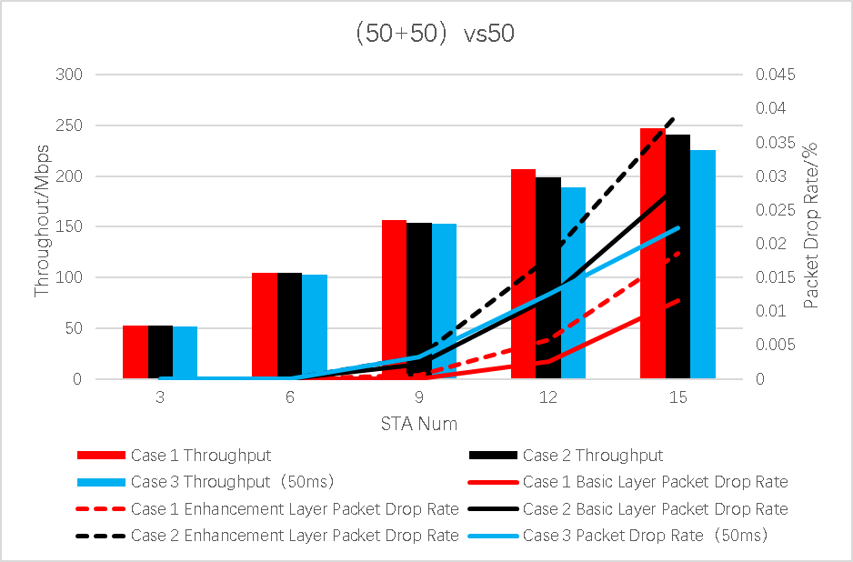
Simulation Results – Throughput and Packet Drop Rate
ms

Slide 16
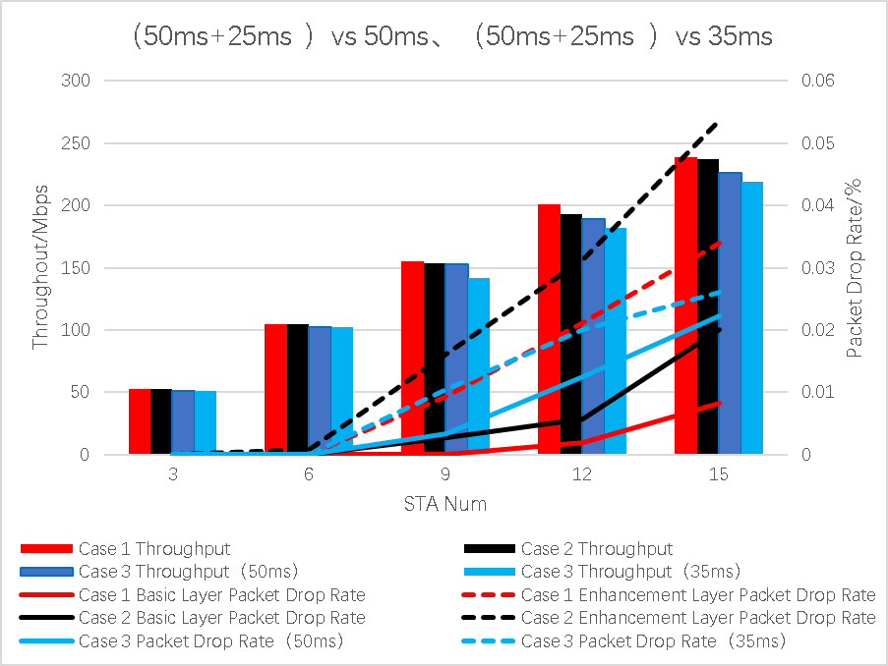
Simulation Results – Throughput and Packet Drop Rate

Slide 17
Simulation Results – PSNR
ms
ms
ms
ms

