Slide 1
Narrow Band Coex Studies
Author:
Name | Affiliation | Address | Email
Stuart Thomas | Apple | UK | sthomas5@apple.com

Slide 2
Background
This document looks at the document 11-23-0453-00-coex-nb-overview presented by Qualcomm in March 2023
This document discusses these simulations and some finer details on the assumptions made in these

Slide 3
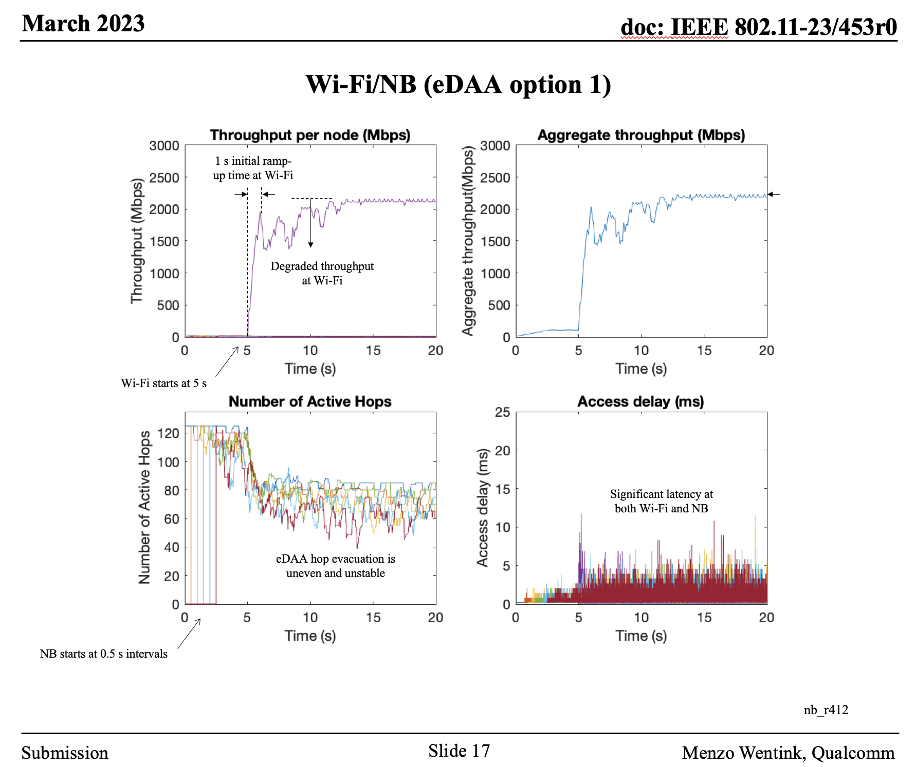
11-23-0453-00-coex-nb-overview – Slide 17
The simulation is not correct because eDAA removes channels before Wi-Fi starts.

Slide 4
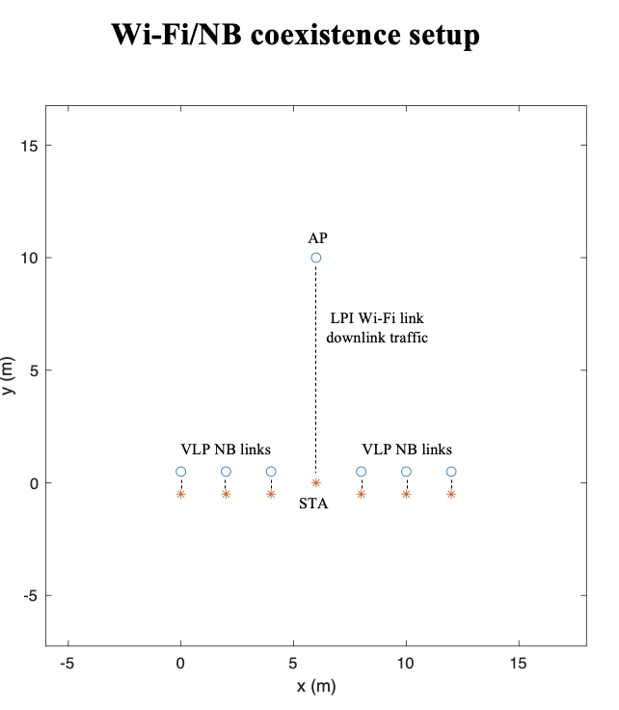
11-23-0453-00-coex-nb-overview – Slide 14 / 15
More realistic PHY
WIFI Rate - 20Mbps at HE MCS7, 160 MHz, 2x996-tone RU, Nss = 1, 800 ns GI
NB Settings - EDR3M 3-DH1 (3Mbps max PHY rate Nss=1) – Well know Technology
500 Hops
Change the band to UNII-5

Slide 5
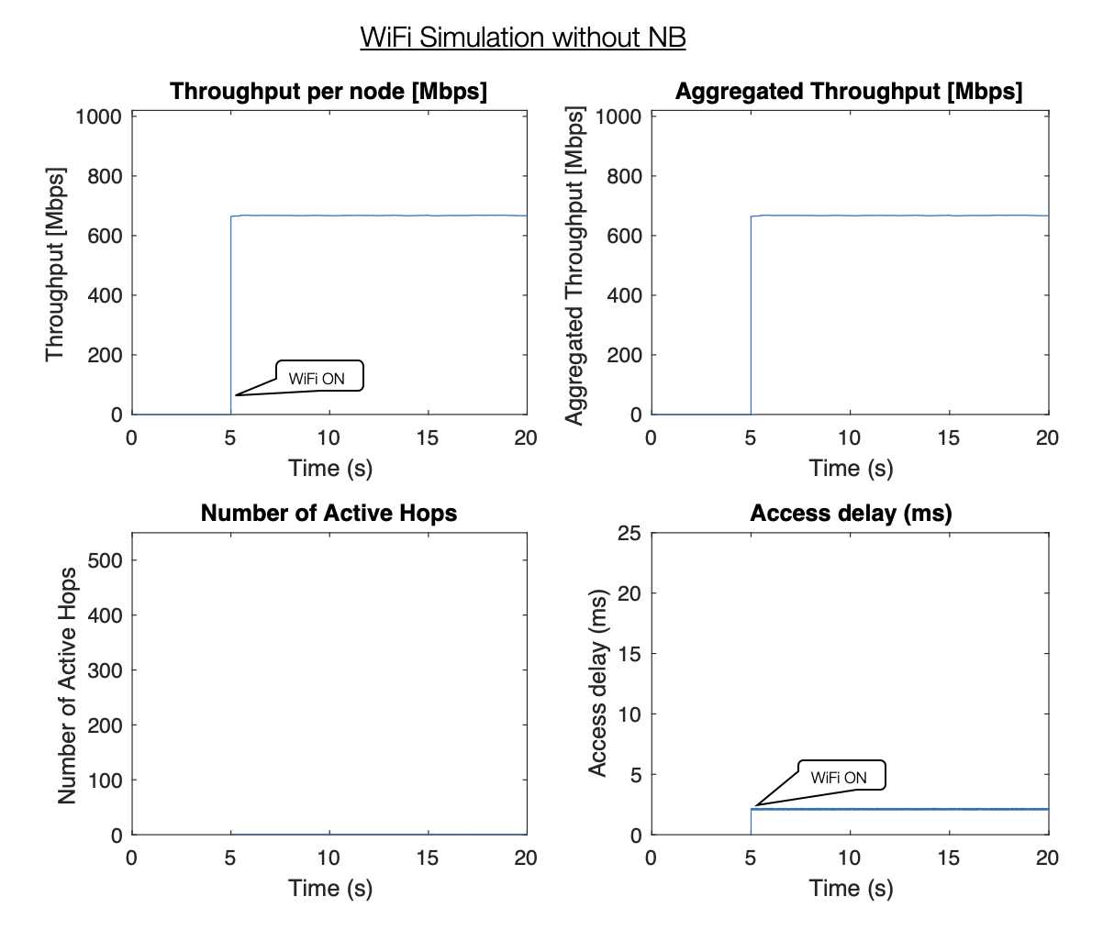
New Simulations – With these Parameters – Wi-Fi Only
Always Some access delay

Slide 6
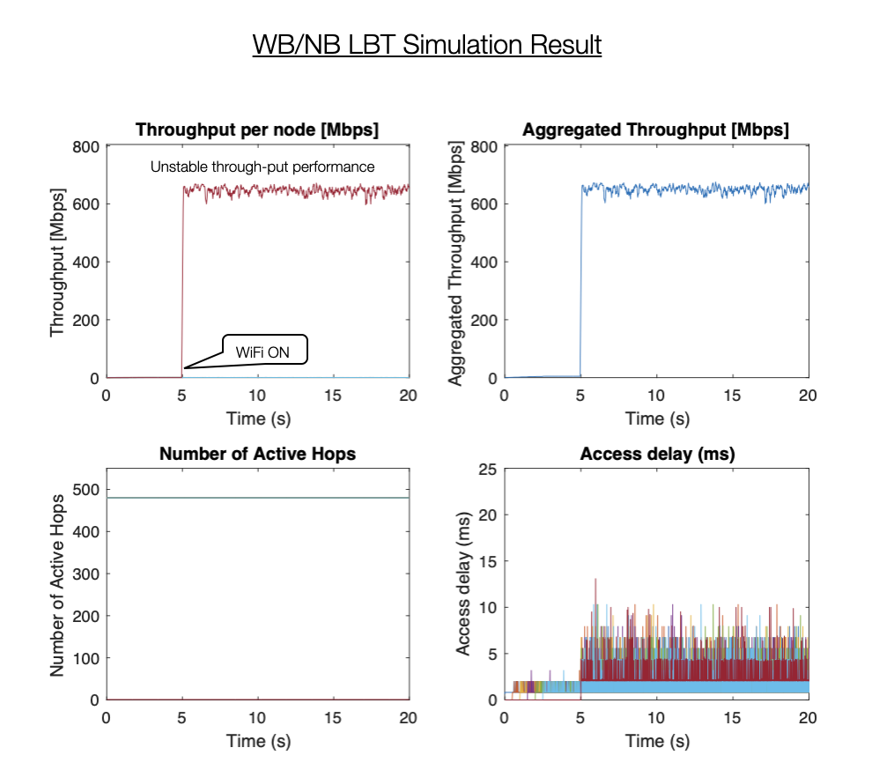
New Simulations – WB vs NB Simulation Settings (500hops)
LBT doesn’t work for Adjacent channels/null’s from NB hence causing long access delay

Slide 7
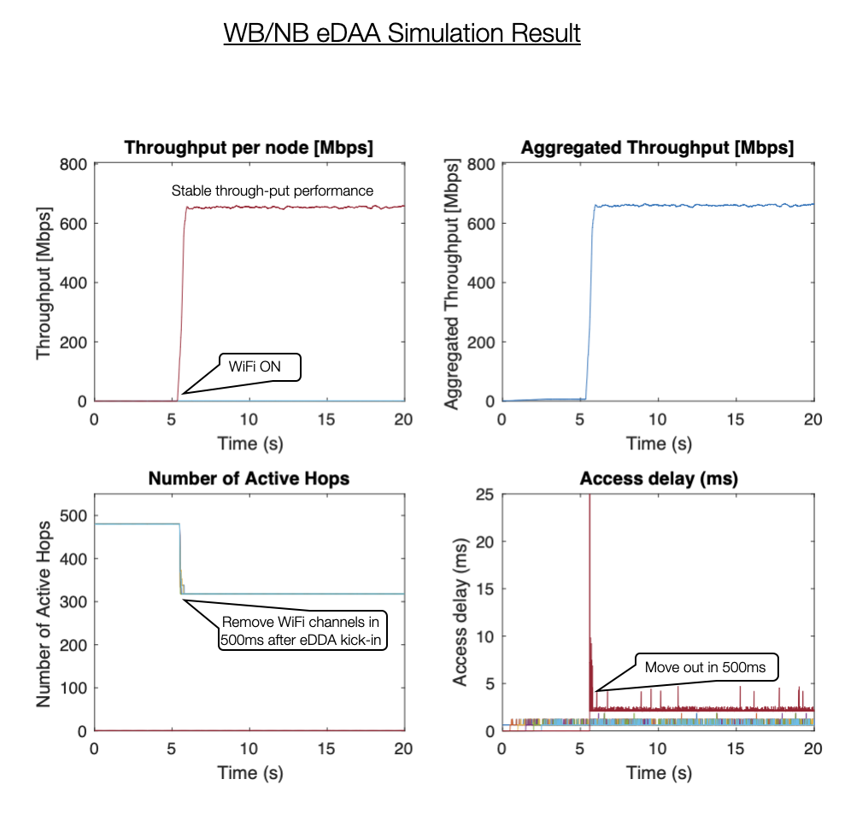
New Simulations – WB vs NB Simulation Settings (500hops)
Much better Access Delay after eDAA kicks-in.

Slide 8
Conclusions
Narrow eDAA can co-exist with Wi-Fi without LBT
eDAA removes Wi-Fi channel in 500ms
Access Delay/Throughput on Wi-Fi is less impacted compared to NB with LBT

Slide 9
References
11-23-0453-00-coex-nb-overview

