Slide 1
X-Band Operation for AMP
Date: 2023-05-16
Authors:

Slide 2
Abstract
This documents presents a proposal to achieve full duplex operation with typical smartphone hardware by using cross-band operation for the uplink and downlink.

Slide 3
Motivation
The AMP TIG report in 11-23/436r0 includes some use-cases where the use of smartphones “interrogators” is quite useful
Examples are use-cases 4 (Smart Home), 5 (Smart Agriculture), 6 (Indoor Positioning), 8 (Food Logistics)
This presentation analyses the potential issues if classical backscatter approaches are used
This presentation further makes a proposal to solve these problems using cross-band operation

Slide 4
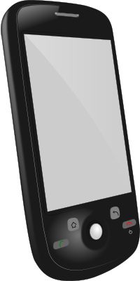
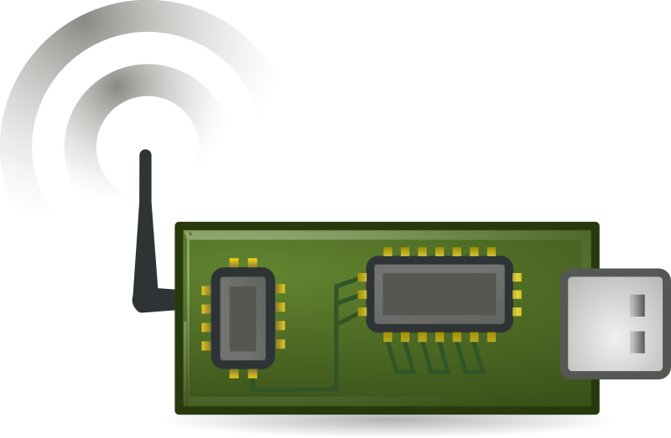
Backscatter Full Duplex Issue
f_{c}=915MHz, P_{TX}=36dBm
P_{RX}=P_{TX}
f_{c}=915MHz±Δf, P_{RX}=-80dBm
Interrogator
Passive Device
Backscatter modulation is full duplex with typically a small frequency offset Δf < 1MHz [1]
Full duplex with high deltas between P_{TX} and P_{RX} in the very same device is very challenging [2]
➔ Challenging in tiny and cost-sensitive smartphones

Slide 5
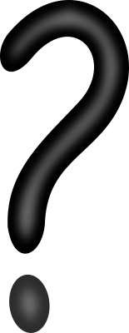
Solution: Bi-Static Approach
f_{c}=xMHz,
P_{TX}=?
f_{c}=xMHz±Δf,
P_{RX}=-80dBm
Energizer/
Ambient Sign.
Passive Device
P_{RX}<<P_{TX}
Receiver
Bi-static configuration reduces full duplex issue due to separation of energizer and receiver
What is the energizer / ambient signal?

Slide 6
Ambient Signal / Energizer
Classical energy-harvesting may not be available for the aforementioned use-cases (dark environments, no temperature difference, etc.)
Dimension of super-cap capacitor may be impractical for many applications
Reliable energy source only from the RF field
Strong RF fields are required to power the devices
What are the sources for these strong RF fields in the use-cases? I do not have any clever idea …

Slide 7
Intermediate Summary
Real full-duplex may be difficult to achieve in smartphones
Bi-static approaches are impractical in some of the use-cases mentioned in the AMP TIG report 11-23/436r0
Energy harvesting may not be available or impractical
Dimensions of super-cap capacitors may be too large
We have to have RF powering, but full-duplex is challenging

Slide 8
Proposal: Cross-Band Operation ( I / II )
f_{c}=868 or 915MHz
f_{c}=2.4GHz
Interrogator
Passive Device
Use sub-GHz for the downlink and the energy transfer
Use 2.4GHz for the uplink
Continuous power transfer during communication, but without full-duplex issue!

Slide 9
Proposal: Cross-Band Operation ( II / II )
Downlink: Sub-GHz OOK-Modulated Wake-Up like sequence (e.g. extended 802.11ba),
  Also used for energy supply
  The sub-GHz ISM/SRD frequencies are already supported by almost all smartphones for cellular communication due to different frequency bands around the world
  The downlink RX may support different frequency bands (e.g. like in UHD RFID)
Uplink: DSSS-Modulated single-carrier waveform (e.g. 802.11b) with high rate
  Power-efficient generation
  Low cost amplifiers

Slide 10

Link Budget Calculation ( I / II )
Detailed Analyses in [3]
P_{C}: Transmit power of “energizer”
G_{C}: Antenna gain of TX antenna of “energizer”
G_{device}: Antenna gain of passive device
P_{RX,deivce}: RX power of passive device
Example for 915 MHz dowlink, 2.4GHz downlink
P_{C}=27dBm, G_{C}=5dBi, G_{device}=0dBi, 10m distance

Slide 11
Link Budget Calculation ( II / II )
 | Downlink (TX smartphone) | Uplink (TX passive device)
Transmit Power | 27dBm (500mW) | -25dBm (0.003mW)
Transmitter Ant. Gain. | 5dBi | 0dBi
Receiver Ant. Gain | 0dBi | 5dBi
Path Loss for 10m | 52dB (915MHz) | 60dB (2.4GHz)
RX Power at Receiver | -20dBm | -80 dBm → works for .11b
All parameters are supported by classical smartphones
Even tiny transmit powers are sufficient for an error-free decoding of 802.11ba and 802.11b
The sub-GHz band is more suited for the downlink → lower path loss for improved harvesting, higher transmit powers due to frequency regulation
Optimize the system for sub-GHz, 2.4 GHz is relaxed ☺

Slide 12


Power Analyses of Passive X-Band Device
OOK (Wake-Up) receiver offers very power efficient operation with < 10µA [4]
DSSS is constant envelope and transmit times are very short (e.g. 1ms) → can be stored on very small capacitor
Frequency generation for 2.4 GHz uplink has to meet channel accuracy requirements, BUT
Typical crystal oscillators require multiple mA and have a long start-up time in the ms range [5, Tab.2]
➔ Problem is the clock generation

Slide 13
Problem with the Clock Generation
The use of crystal oscillators is too “expensive”
  Current consumption too high
  Long start-up time
  Additional size and complexity
Potential solution: Use of calibrated RC oscillators
  Very low power consumption, e.g. 190nW [6]
  Calibration of the RC oscillator using the sub-GHz downlink frequency

Slide 14
Possible X-Band AMP Device Structure
Downlink
(sub-GHz)
Uplink
(2.4 GHz)
Power Harvesting
Power
Calibration
Frequency-Estimation
Clock
PLL
Downlink Decoder (e.g. OOK)
µP
Downlink Decoder (e.g. OOK)

Slide 15
What are Required Extension to the PHY?
System can work with almost state-of-the-art smartphones
Fits perfectly into eco-system:
  IEEE 802.11ba used as basis for the downlink
  High rate single-carrier uplink waveform
Only missing aspect for the PHY is the extension of the signaling for the RC-calibration

Slide 16
Summary
Full duplex may be problematic if smartphones are used as “interrogators”
Bi-static operation may be difficult in many use-cases
Using Cross-Band operation offers “relaxed” full duplex, which can be easiliy supported by smartphones
The problem of the power consumption can be solved by means of RC oscillators

Slide 17
Literature
[1] K. Finkenzeller: “RFID handbook: fundamentals and applications in contactless smart cards, radio frequency identification and near-field communication”, John Wiley & Sons; 2010
[2] Full-Duplex TIG Report, 11-18/498r8
[3] C. Korn, J. Robert, T. Dräger, ” Theoretical Limits of Backscatter Communications”, arxiv pre-print, https://arxiv.org/abs/2302.13958
[4] J. Robert, T. Lindner and H. Milosiu, "Sub 10µW wake-up-receiver based indoor/outdoor asset tracking system," 2015 IEEE 20th Conference on Emerging Technologies & Factory Automation (ETFA), Luxembourg, 2015
[5] D. Griffith, F. Dülger, G. Feygin, A. N. Mohieldin and P. Vallur, "A 65nm CMOS DCXO system for generating 38.4MHz and a real time clock from a single crystal in 0.09mm2," 2010 IEEE Radio Frequency Integrated Circuits Symposium, Anaheim, CA, USA, 2010, pp. 321-324
[6] D. Griffith, P. T. Røine, J. Murdock and R. Smith, "17.8 A 190nW 33kHz RC oscillator with ±0.21% temperature stability and 4ppm long-term stability," 2014 IEEE International Solid-State Circuits Conference Digest of Technical Papers (ISSCC), San Francisco, CA, USA, 2014

