Slide 1
802.15 Liaison Report – May 2023
Date: 2023-05-16
Authors:

Slide 2
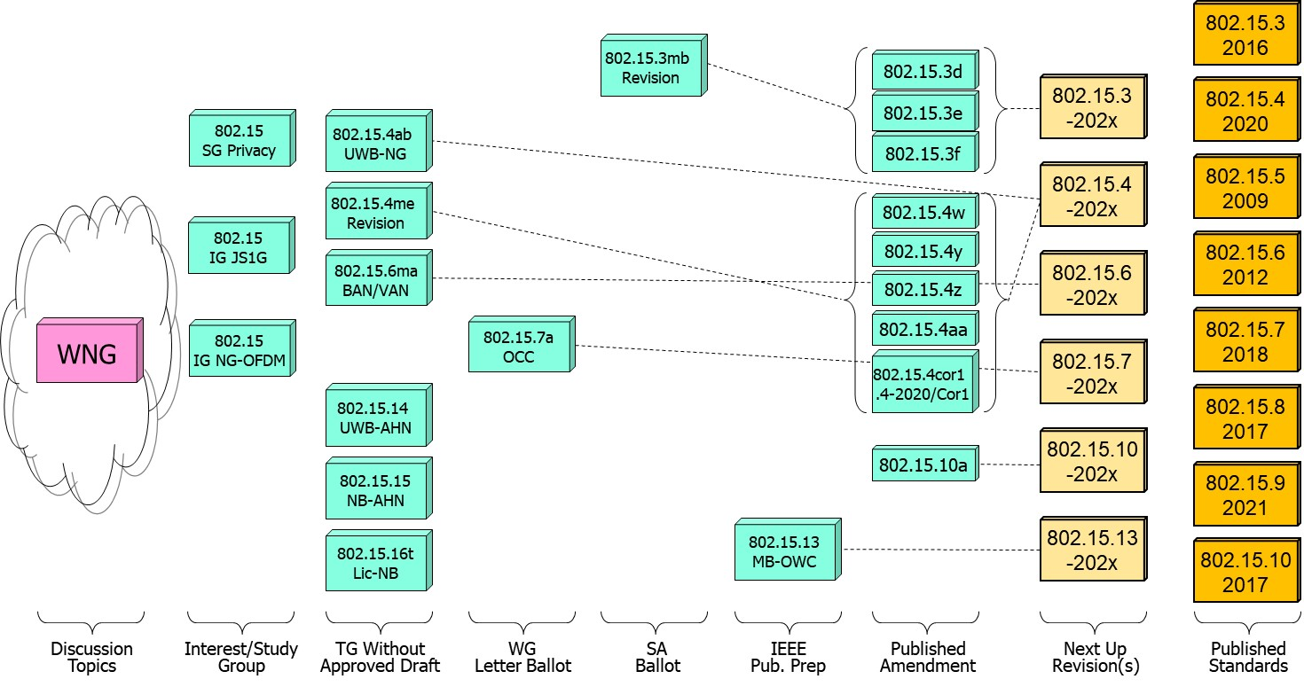
802.15 WG Standards Pipeline

Slide 3
IG JS1G (Interest Group Japan Sub 1GHz)
What is it:
Demand for IOT devices from refreshing Japanese utility infrastructure.
Status:
Discussed details on the differences between JJ-300.10 (low power IPv6 for home energy) and IEEE Std 802.15.4 channel access.
Discussed benefits and interests in aligning the two standards to enable greater opportunity in Japan and other places.
Outreach to 802.19 to extend 802.15.4 channel access to no-CCA.

Slide 4
IG NG OFDM (Next Gen SUN/Smart Utility Network OFDM)
What is it?
Long Range extension of the 802.15.4-2020 OFDM PHY.
Enhancing OFDM with Long Range extension for increased link budget and reliability while remaining compliant with existing regulatory regulations worldwide (FCC 15.247) and significantly increased operating range of the existing SUN-OFDM PHY .
Long range PHY to enable city wide simple star networks, dense networks with >10K nodes, Power efficient for battery operated end node.
Status:
Early in the process, meeting for the 1st time.

Slide 5
802.15.4ab Next Generation UWB
What is it:
Builds on 802.15.4z increasing footprint and usefulness to additional usages beyond range measurement. Area of enhancements relates to ranging resiliency, sensing, data rates, support for additional spectrum, improved detection and many more.
Status:
Ad hocs assigned to individual topics: NB operation, Sensing, improved data rates, MMS, developing amendment text and incorporating into single document by editor.
Substantial discussion on minimal shared feature set across the major topics.
Co-existence – topic of importance, especially with NB operation.
Proposal to work with 802.19 on non CCA operation for 802.15.4.

Slide 6
Privacy SG/TG
What is it:
New project development for increased privacy for 802.15.4-2020, baseline for 802.15.4z (UWB and Ranging) .
Improved security and privacy to protect from user tracking and profiling attack.
Amongst envisioned mechanism MAC address randomization and rolling MAC address.
Status:
SG transitioned to TG status during this meeting.
Progress on the identified issues of current standard: static MAC address , MAC address set across multiple radios in a single physical device, MAC address refresh, security context refresh for group and unicast, network discover and more.

Slide 7
802.15.16t Narrow Band Licensed Operation (NB-Lic)
What is it:
Licensed Narrow Band (NB) Operation in channels bandwidth between 5 – 100KHz in the VHF/UHF bands such as 160MHz, 450MHz, 700MHz and 900MHz, taking advantage of the superior channel propagation properties. Targeted usages mission critical operation.
Status and main discussion topics:
In comment resolution of amendment draft 0.9 pre WG approved draft.

Slide 8
802.15.6ma - Enhanced Dependability Body Area Network (ED-BAN)
What is it:
Enhancements to the BAN (Body Area NW) Ultra Wideband (UWB) physical layer (PHY) and media access control (MAC) to support enhanced dependability to a human BAN (HBAN) and support for vehicle body area networks (VBAN).
This revision focuses on international operation.
Status:
Completed the Technical Requirements phase and in protocol development stage.
Review propagation Simulations of UWB Communication Applications for HBAN and VBAN Use Cases.
Concept of channel coding for IEEE802.15.6ma and harmonization to .15.4ab (UWB) FEC evolution.

Slide 9
TG4me
Cor1 15.4 2020 Revision 1
TG4ab
Next Generation UWB
TG6ma
Body Area Networks
Revision
TG7a
Optical Camera Communications
TG13
Multi Gigabit/sec
Optical Wireless Communication
TG15
Ultra Wide-Band Ad-Hoc Networks
TG16t
Ultra Wide-Band Ad-Hoc Networks
TG3mb
TG HDR
High Data Rate
Revision
SCmaint
Maintenance Group
SCTHz
_{Standing Committee THz}
SCWNG
Wireless Next Generation
SCIETF
IETF liaison

