Slide 1
NULL beam steering based Spatial Reuse
Date: 2023-05-14
Authors:

Slide 2
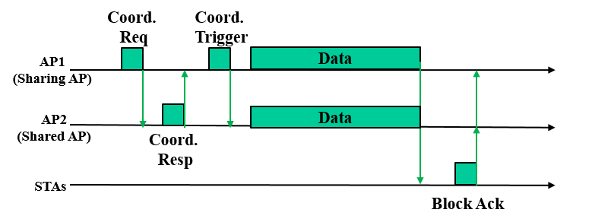
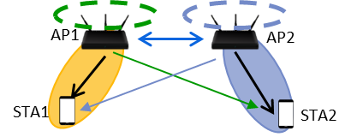
Background
Multi-AP coordination is a candidate feature for UHR.
Co-TDMA
Co-OFDMA
Co-SR
Co-JTX
Co-BF
Coordinated Beamforming. [1]
Each AP independently performs beamforming to reduce interference to other devices.

Slide 3
Discussion
Prerequisites are critical to achieve multi-AP co-BF.
There are DL data to transmit to the target STAs at the same time.
Both Sharing AP and Shared AP needs to have valid CSI to the target STAs to execute coordinated beamforming.
Co-BF request / co-BF response are just overhead in case of prerequisites are not matched.
Any simpler methods?
Low down prerequisites
Less overhead

Slide 4
NULL beam steering based Spatial Reuse
Notes:
Advanced CTS

Slide 5
Procedure
1. The Sharing AP EDCAs channel and sends an A-CTS, indicating the Shared AP(s) that NULL beam steering SR is allowed along with the following DL transmission and the target STA of the DL transmission.
2a. The Sharing AP sends a PPDU to STA1 SIFS after A-CTS.
2b. The Shared AP(s) with valid CSI for NULL beam steering to STA1, EDCAs channel for SR, SIFS after A-CTS. The Shared AP that EDCAed channel sends a PPDU to STA2
3. STA1 BAs the frames received.
4. The Shared AP EDCAs channel to BAR STA2.

Slide 6
Further considerations
A-CTS is sent by STA1.
Shared AP(s) are hidden to the Sharing AP but visible to STA1 can do SR transmission.
When and how to get CSI to STA1 for Shared AP(s)?
Right after the Sharing AP executes sounding procedure to STA1
Implicit sounding can be considered

Slide 7
Reference
[1] Kosuke Aio(Sony Group Corporation), “System Level Simulation of Co-BF and Joint Tx” 22/1821r1, November 2022.

