Slide 1
NULL beam steering based Spatial Reuse
Date: 2023-05-14
Authors:

Slide 2
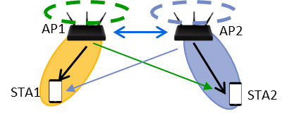
Background
Multi-AP coordination is a candidate feature for UHR.
  Co-TDMA
  Co-OFDMA
  Co-SR
  Co-JTX
  Co-BF
Coordinated Beamforming. [1]
  Each AP independently performs beamforming to reduce interference to other devices.

Slide 3
Discussion
To achieve multi-AP coordinated beamforming, pre-TX information such as per-STA DL BSR, needs to be exchanged in time among AP(s).
  per-STA DL BSR changes timely along with many random events such as new data arrival, frame transmission, etc.
  Challenging task while there is no wire backhaul.
Any simpler methods?
  No need to exchange pre-TX information
  No wire backhaul

Slide 4
NULL beam steering based Spatial Reuse
Notes:
Advanced CTS

Slide 5
Pre-condition
  The Shared AP(s) have the channel state information to execute NULL beam steering to STA1
Procedure
  1. The Sharing AP EDCAs channel and sends A-CTS indicating the Shared AP(s) that NULL beam steering SR is allowed along with the following DL transmission.
  2a. The Sharing AP sends a PPDU to STA1 SIFS after A-CTS.
  2b. The Shared AP(s) EDCAs channel for SR, SIFS after A-CTS. The Shared AP that EDCAed channel sends a PPDU to STA2
  3. STA1 BAs the frames received.
  4. The Shared AP EDCAs channel to BAR STA2.

Slide 6
Further considerations
A-CTS is sent by STA1.
  Shared AP(s) are hidden to the Sharing AP but visible to STA1 can do SR transmission.
When and how to get channel states to STA1 for Shared AP(s)?
  Right after the Sharing AP executes channel sounding to STA1
  Implicit sounding

Slide 7
Reference
[1] Kosuke Aio(Sony Group Corporation), “System Level Simulation of
Co-BF and Joint Tx” 22/1821r1, November 2022.

