Slide 1
Obtaining OBSS AP Channel Information for Multi-AP operation
Date: 2023-05-15
Authors:
Name | Affiliation | Address | Phone | Email
Jinyoung Chun | LG Electronics | 19, Yangjae-daero 11gil, Seocho-gu, Seoul 137-130, Korea |  | jiny.chun@lge.com
Eunsung Park
 |  |  |  | esung.park@lge.com
Dongguk Lim
 |  |  |  | dongguk.lim@lge.com
Insik Jung |  |  |  | insik0618.jung@lge.com
Insun Jang |  |  |  | insun.jang@lge.com
SunHee Baek |  |  |  | sunhee.baek@lge.com
Geonhwan Kim |  |  |  | geonhwan.kim@lge.com
Yelin Yoon |  |  |  | yl.yoon@lge.com
Jinsoo Choi |  |  |  | js.choi@lge.com
HanGyu Cho |  |  |  | hg.cho@lge.com
Sanggook Kim |  | 10225 Willow Creek Rd, San Diego, CA, USA |  | sanggook.kim@lge.com

Slide 2
Introduction
In March Meeting, UHR PAR was finalized with the below scopes in scenarios of an isolated BSS or of overlapping BSSs [1].
  increasing throughput at different SINR level
  improving the tail of the latency distribution and jitter with mobility between BSSs
  and improving efficient use of medium in scenario of overlapping BSSs.
To achieve 1st and 3rd scope in scenario of overlapping BSSs, it’s important to know OBSS’s channel status.
  The OBSS channel statues means that the channel information between OBSS AP and BSS STA. Based on the information, Sharing AP can manage the frequency resource, transmit power or beamforming method, etc well by avoiding the OBSS interference among APs.
So here we’d like to discuss how to get the channel information of OBSS in UHR.
  First of all, we’ll review the current way to obtain OBSS channel information.
  And we’ll study whether the enhanced or new schemes are needed.

Slide 3
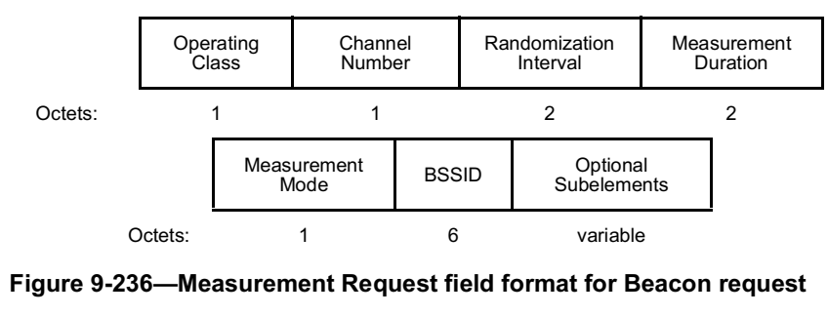
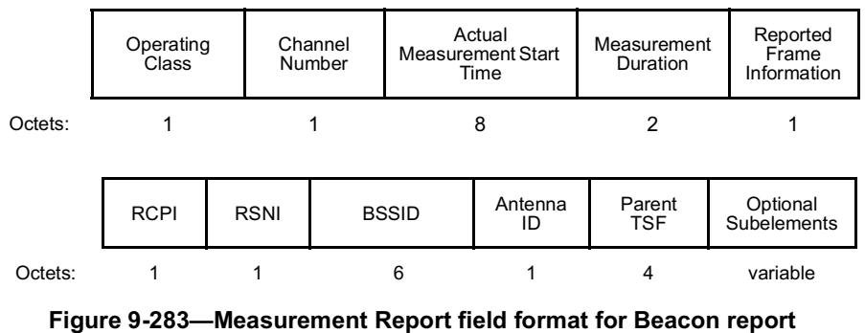
Review: Current way to get the channel information of OBSS AP
In Spatial Reuse section [2], the current spec says
  An HE AP participating in spatial reuse may request an associated non-AP HE STA to gather information regarding the neighborhood by sending a Beacon request.
  If a STA accepts a Beacon request, it shall respond with one or more Radio Measurement Report frames containing Beacon reports for all observed BSSs matching the BSSID and SSID in the Beacon request.
  The reported channel information is RCPI or RSNI, etc.
➔ So currently BSS AP can know the channel status such as received power or received signal-to-noise value between OBSS AP and BSS STA.

Slide 4
What information are needed in UHR(1/3)
OBSS channel information in unit of RU or subchannel?
  11be supports punctured channel and M-RU allocation. And the PSR value for PSR-based SR is in unit of 20/40 MHz. So OBSS channel information per subchannel can help more efficient Spatial Reuse operation in UHR.
  Moreover if C-OFDMA is supported in UHR, OBSS channel information in unit of frequency resource of C-OFDMA may make more efficient operation by applying spatial reuse in the resource unit [3].
  ➔ We can get the information, for example, by
    Adding the channel status reports of every/some subchannels or RUs in the subelement of beacon request/response.
    Or defining the new A-control field to report OBSS channel status of every/some subchannels or RUs.
    etc.

Slide 5
What information are needed in UHR(2/3)
More accurate and fast channel information of OBSS AP?
  Current radio channel measurement through beacon request/report is the long-term and the delayed report.
  Measurement like NDP sounding may be needed for Multi-AP operation.
    Sharing AP can select and schedule the frequency resource to shared APs based on the channel status information.
    For example, the channel information between OBSS AP and BSS STAs helps Sharing AP operates C-SR or C-BF by scheduling to avoid the interference. (J-TX needs joint-transmitted NDP sounding among multi-APs but it’s not the scope in this document.)
  ➔ We can get the information by OBSS NDP sounding.
    It may be difficult for BSS STAs to notice NDP Announcement frame and NDP sounding frame from OBSS AP. So we suggest that BSS AP trigger the OBSS NDP sounding procedure (see the figure in the next slide.)

Slide 6
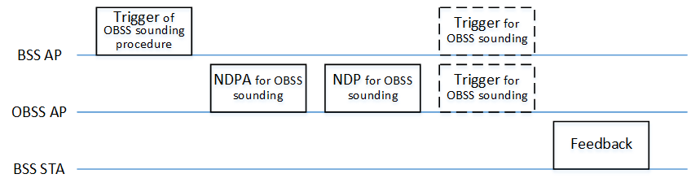
What information are needed in UHR(3/3)
    OBSS NDP sounding procedure
  Trigger of OBSS sounding procedure
    BSS AP triggers OBSS NDP sounding procedure. (set TXOP)
    RA address may be set to OBSS AP’s address or set to special address newly defined for candidate AP set of Multi-AP, OBSS NDP sounding procedure, etc.
    The trigger frame includes OBSS AP’s address/ID(s) (and may include some information to make NDPA frame). Then the OBSS AP prepares to transmit NDPA frame and NDP frame.
    The trigger frame includes BSS STA’s address/ID(s). Then the BSS STA(s) ready to decode the NDPA and NDP from OBSS AP after SIFS.
  NDPA and NDP for OBSS sounding
    OBSS AP transmits NDPA frame and NDP sounding for BSS STAs.
    The NDPA frame (and NDP sounding frame) has to include the indication of OBSS Sounding implicitly or explicitly for avoiding OBSS STAs’s confusion.
    The NDPA frame includes BSS STA’s address/ID(s) of BSS STAs measuring NDP sounding.

Slide 7
What information are needed in UHR(3/3)
    * BSS STA’s address/ID(s).
    AID is only assigned to the associated STAs by BSS AP, and OBSS AP can’t recognize AIDs of BSS STAs. So we may include BSS STA’s address/ID as the below examples:
      Define OAID (OBSS AID) to identify BSS STAs by OBSS AP. It may be assigned and shared by Shared AP and OBSS AP before the OBSS NDP sounding procedure. (We can refer RSID in Ranging Trigger/NDPA of 11az [4]. The details are TBD.)
      Use AID as it is. Trigger frame includes BSS STA’s AID to feedback and NDPA frame includes the AIDs as Trigger frame indicates. But it may bring OBSS STAs’ confusion. So some way is needed for OBSS STAs not to operate during OBSS NDP sounding procedure. For example, OBSS STAs set NAV during OBSS sounding procedure by decoding the indication of OBSS Sounding in Trigger frame or NDPA frame.
  Trigger for OBSS sounding
    BSS AP (or OBSS AP) may transmit Trigger frame for BSS STAs if the feedback format is TB PPDU.
  Feedback
    BSS STA feedbacks the measured channel information to BSS AP or OBSS AP.
    If the feedback goes to BSS AP, BSS AP has to wait during OBSS NDP procedure without any transmission and reception.
    If the feedback goes to OBSS AP, OAID has to be used.
  [NOTE] The OBSS NDP procedure may be performed several times for multiple OBSS APs.

Slide 8
Summary
We’d considered the below features as the enhanced OBSS channel measurement for UHR.
  OBSS channel report in unit of channel or RU
  OBSS NDP sounding procedure

Slide 9
Reference
[1] 11-23/0480r0, “UHR Proposed PAR”
[2] Draft P802.11REVme D2.0
[3] 11-23/0058r0, “Spatial Reuse in Coordinated M-AP for UHR”
[4] Draft P802.11az D6.0

