Slide 1
802.11az Next Generation Positioning Awards
Date: 2023-05-16
Authors:

Slide 2
Abstract
This presentation contains the list of awards for the P802.11az Next Generation Positioning project

Slide 3
Equitable Evaluation of IEEE 802.11az-2022
We asked ChatGPT what its thoughts are on the new IEEE 802.11az Standard.
To get an unbiased opinion we fed ChatGPT with the Complete IEEE 802.11az-2022 standard.
You wouldn’t believe what we got....

Slide 4
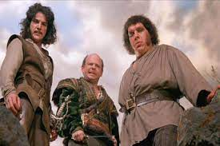
The 802.11az Shakespearian Sonnet
With AZ in the air,
We navigate with flair,
Indoor spaces large and small,
Our movement mapped one and all,
Gone are the days of getting lost,
With AZ’s help, we pay no cost,
Our phones and devices guide our way, Leading us onwards, day by day.
In malls and airports, we move with ease,
Finding our way, is just a breeze,
Through the twists and turns of indoor spaces,
We move with grace and smiling faces.
No longer do we wander aimlessly,
Or ask for help from strangers, oh so shamelessly,
For AZ is our trusty guide,
Leading us through the indoors, far and wide.
So let us celebrate, this tech sensation,
A new era of navigation,
Where Wi-Fi is our salvation,
AZ navigation a source of inspiration.
OK…we might have helped it a bit…
Created by ChatGPT…

Slide 5
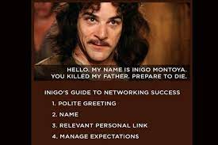
So how did we make sure Inigo will never be lost again?
Two new measurement sequences (SU and MU) with MIMO support
Two new waveforms for HE NDPs
A new Secured LTF concept
Passive Location/Hyperbolic navigation
A new unassociated security context establishment (PASN).
Two way reporting protocol with policy management
And more.

Slide 6
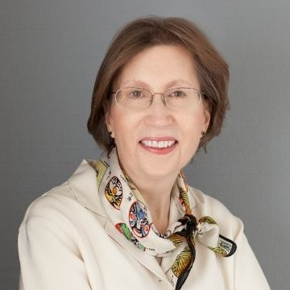
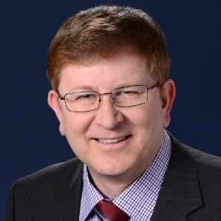
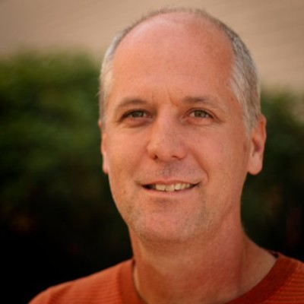
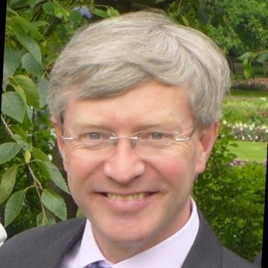
WG Officer Awards
Dorothy Stanley
(802.11 Chair)
Thanks for the support, for accommodating the requests over the lifetime of the Task Group.
Robert Stacey
(802.11 Vice Chair)
Jon Rosdahl
(802.11 Vice Chair)
Stephen McCann
(Secretary)

Slide 7
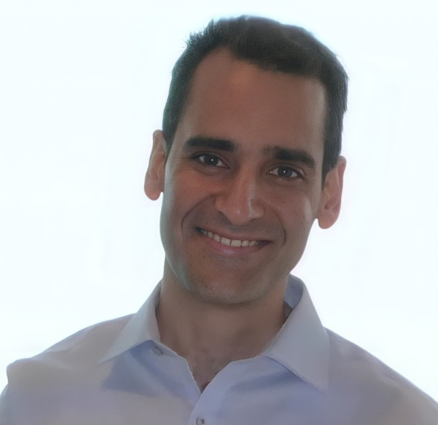
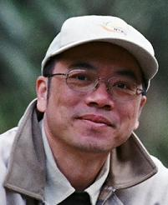
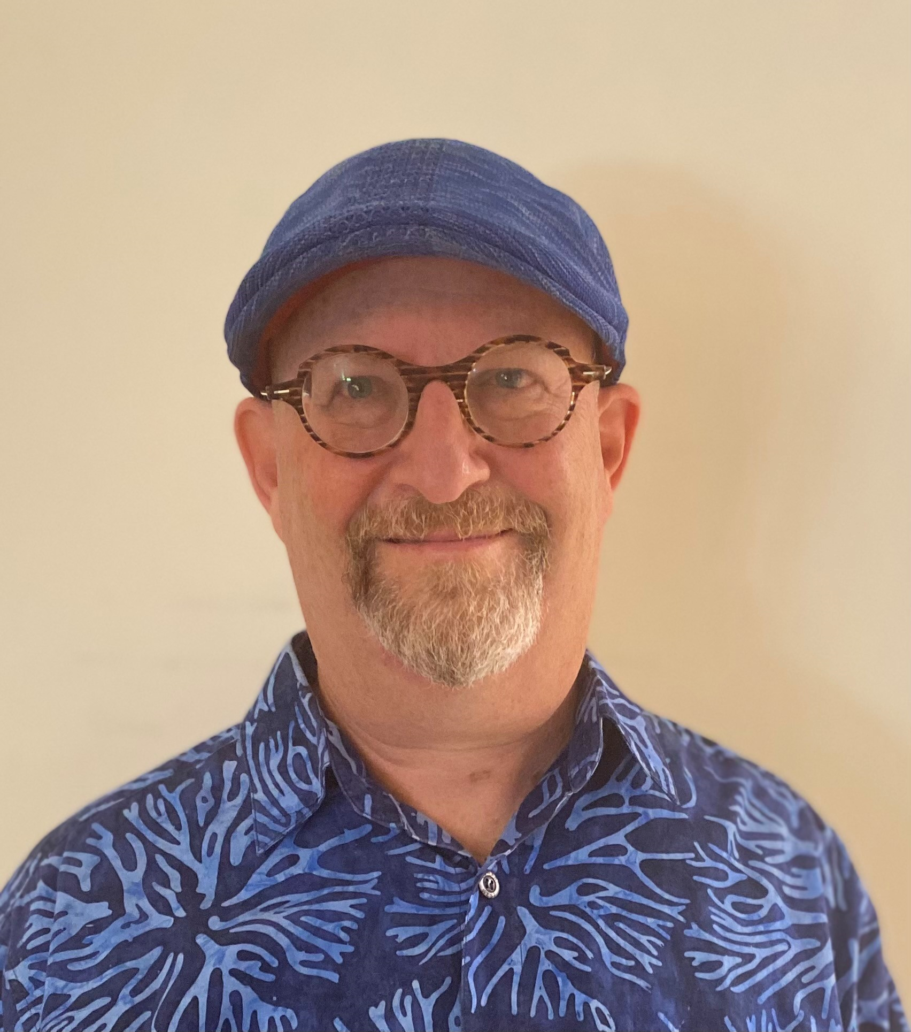
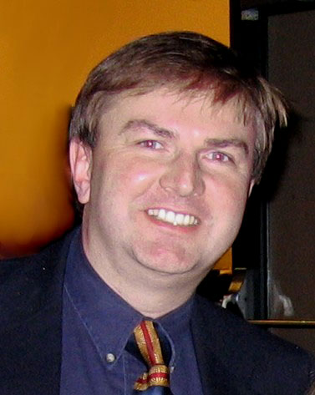
802.11az TG Officers
Assaf Kasher
(TG Vice Chair and
Secretary)
Chao Chun Wang
(TG Editor)
Roy Want
(TG Editor)
Jonathan Segev
(TG Chair)
Thank you for your special contribution!!

Slide 8
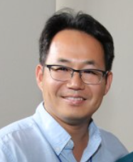
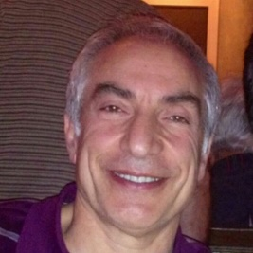
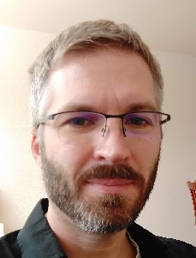
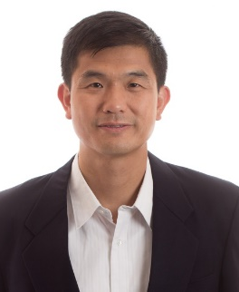
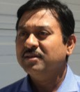
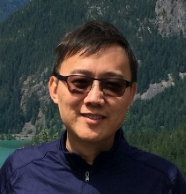
Major Contributions Received from:
Ali
Raissinia
Christian
Berger
Yongho
Seok
Nehru
Bhandaru
Qinghua
Li
Chittabrata
Ghosh
Feng
Jiang
Tianyu
Wu

Slide 9
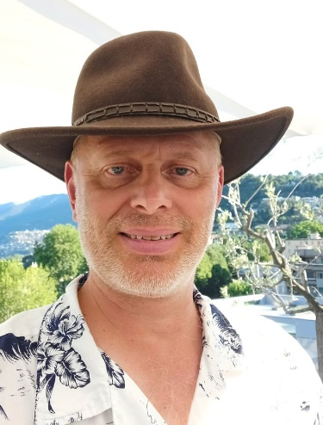
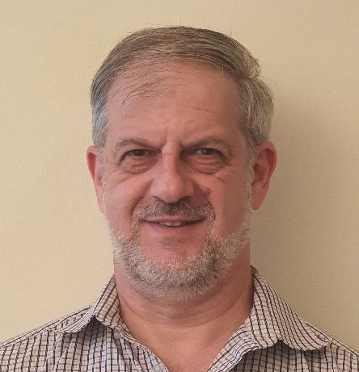
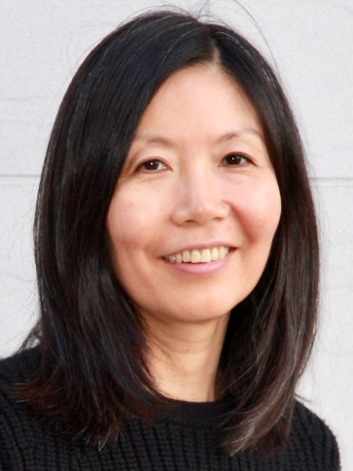
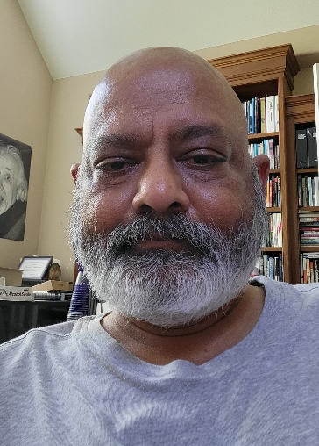
Major Contributions Received from:
Niranjan
Grandhe
Liwen
Chu
Erik
Lindskog
Dibakar
Das
Ganesh
Venkatesan
Girish
Madpuwar
Alecsander
Eitan
Qi
Wang

Slide 10
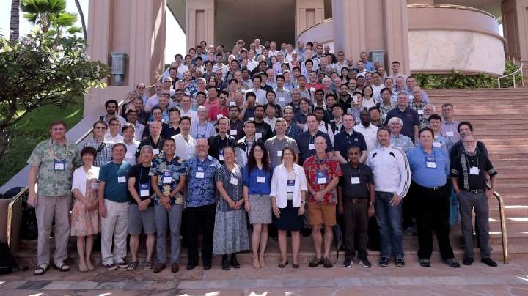
…. and the rest of 802.11 WG

Slide 11
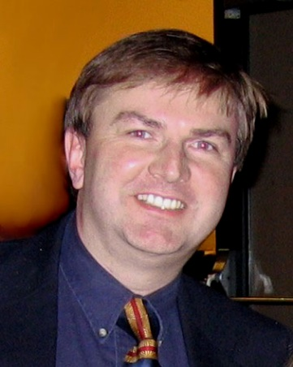
And in the spirit of Inigo, Vizzini and Andre
So Long, Thanks for All the Fish…and see you in 11bk.

Slide 12
References

