Slide 1
Multi-AP Coordination based on SCMA
Date: 2023-05-13
Authors:

Slide 2
Abstract
This document describes a new multi-AP mode to further improve WLAN performance.

Slide 3
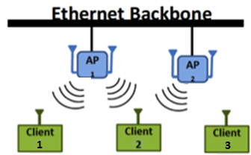
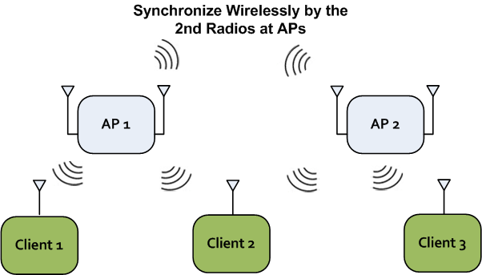
Multi-AP Coordination in EHT
Multi-AP coordination has been proposed in EHT TIG in multiple contributions [1].
Multi-AP coordination is considered as an EHT key feature to improve what we already have.
Better link budget and regulatory power limitation than a single AP with big antenna array.
Different modes of AP coordination are possible.
Each has different features and implementation complexity
Example modes: Coordinated OFDMA, Coordinated Spatial Reuse, Coordinated Beamforming, Joint Transmission
The goal is to achieve higher efficiency and higher throughput for Multi-AP systems.
We hope to provide a new multi-AP mode to further improve the performance we mentioned.

Slide 4
Modes of Multi-AP Coordination
 | Mode (Terminology) | Description | Benefit
1 | Coordinated OFDMA[2] | Multiple APs coordinate RUs and perform OFDMA. Only CSI between the STA and the AP is needed. *Multiple APs to one STA on different RUs (not a useful mode.) | Reduce overhead for short packets; Higher MCSs
2 | Coordinated Spatial Reuse[3][4] | Multiple APs coordinate or instruct transmission parameters (e.g., transmission power) and perform spatial reuse. CSI of multiple STAs and the nulling AP is needed at the nulling AP. | Simple, less feedback overhead Less interference
3 | Coordinated Beamforming[5][7] | Multiple APs form beam so as not to interfere with each BSSs. Joint Processing: the data for the STAs must be available at multiple APs. CSI of multiple STAs and multiple APs. | Better coverage Lower queuing delay Higher MCSs
4 | Joint Transmission[6][7] | Multiple APs transmit to the same single or multiple STAs simultaneously as if these are a single AP. Joint processing: the data for the STA must be available at multiple APs. CSI of multiple STAs and multiple APs. Frequency and Phase Synchronization accuracy. | High throughput Low latency More spatial streams
Notes:
AP coordination are able to address the several objectives by its coordination subtypes.
Coordinated OFDMA: Multiple APs coordinate RUs and perform OFDMA.
Coordinated Spatial Reuse: Multiple APs coordinate or instruct transmission parameters (e.g., transmission power) and perform spatial reuse.
Coordinated Beamforming: Multiple APs form beam/null so as not to interfere with each BSSs.
Joint Transmission: Multiple APs transmit to the same single or multiple STAs simultaneously as if these are a single AP.

Slide 5
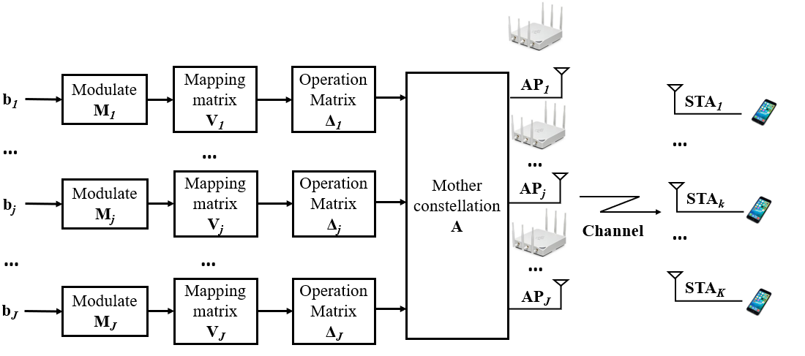
Multi-AP Coordination based on SCMA
SCMA is a non-orthogonal multiple access scheme for multi-user sharing RU.
High frequency spectral efficiency and stronger robustness.
The data to be transmitted by AP needs to be modulated and SCMA encoded to be transmitted to STA.
The SCMA encoding stage is divided into three parts[8]:
Constellation generation of the mother constellation
Rotation of the operation matrix to the mother constellation
Dimension expansion of the mapping matrix
The following explains the specific process from two parts:
The SCMA encoding stage
The Multi-AP Coordinated based on SCMA transmission process

Slide 6
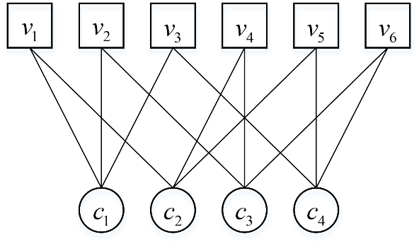
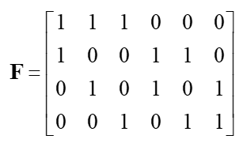
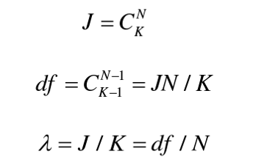
SCMA Encoding Steps (1)
The factor matrix represents the matching relationship between AP and STA
Where v represents AP and c represents STA.
Represented by factor matrix representation as
When , it indicates that the j th AP needs to transmit the data of the k th STA.
The design principles of this matrix are as follows:
Taking the model where J APs are transmitted to K STAs as an example, N represents the number of APs needed to transmit data from one STA, and df represents the number of STAs that one AP needs to transmit

Slide 7
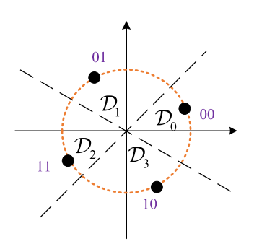
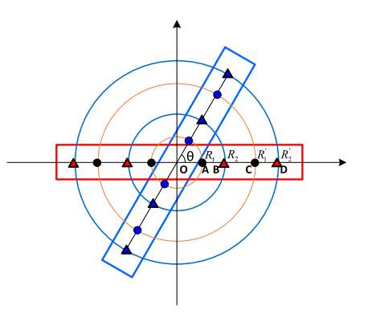
SCMA Encoding Steps (2)
Mapping matrix V
The mapping matrix is mainly used to expand the dimensions of codewords.
The mapping matrix of each AP meets the following conditions:
Operation Matrix Δ
The operation matrix rotates the mother constellation to ensure the diversity of the codebook and the correctness of decoding.
In the design of SCMA codebook set, we usually need to use the phase rotation matrix. The specific operations are as follows:
Mother constellation A
The mother constellation is the foundation of SCMA codebook rotation expansion, and our mother constellation is generated based on the Star QAM constellation.
Star QAM constitutes a special case of circular amplitude and phase shift keying, which is superior to the classic Square QAM constellation in peak power limited systems.

Slide 8
Multi-AP Coordination based on SCMA Transmission
Based on the features of SCMA codebook, we will obtain an SCMA codebook table before transmission.
We can set the SCMA codebook table as a built-in attribute of the AP without the need to set new interactions between the AP and AP.
The Multi-AP Coordinated based on SCMA transmission process is as follows:
AP1 as the master AP
AP1 and slave AP exchange coordination requests and coordinate responses to determine whether coordination should be initiated
Based on the obtained information, AP1 sends a slave trigger frame to enable the slave AP to initiate synchronization. The use of synchronous trigger frames and intermediate synchronization codes is consistent with joint transmission
AP1 sends a coordination set to the slave APs to initiate data sharing between them through backhaul
During data sharing, AP1 and slave APs pre share the corresponding STA data based on the matching relationship between AP and STA obtained from the factor matrix and wait for transmission for a period of time
AP1 sends a coordination trigger frame to the slave AP to initiate coordination transmission
AP1 receives the block Ack from STA (feedback of received data by STA)
Coord.
Req
Coord.
Set
Coord.
Trigger
AP₁
(Sharing AP)
Data Sharing
Data
AP₂
(Shared AP)
Data
…
Coord.
Resp
AP_{J}
(Shared AP)
Data
Block Ack

Slide 9
Summary
Compared with other Multi-AP transmission modes, the APs don’t have to need to share all STA data during the pre-sharing stage.
STA data is allocated based on a factor matrix
Improving the data sharing efficiency
Reducing data sharing overhead
The current Multi-AP transmission modes cannot adapt well to the RU limited scenario.
We suggest using this mode as a Multi-AP coordination mode.

Slide 10
References
[1] Jianhan Liu (Mediatek), “Discussions on Multi-AP Coordination,” 18/1509r0, August 2018.
[2] Liwen Chu (NXP), “Coordinated OFDMA,” 19/1919r3, January 2020.
[3] Jason Yuchen Guo (Huawei), “Coordinated spatial reuse operation,” 20/0033r1, February 2020.
[4] Jason Yuchen Guo (Huawei), “AP Coordination in EHT,” 19/0103r1, March 2019.
[5] Roya Doostnejad (Intel), “Coordinated beamforming for 802.11be,” 20/0099r1, April 2020.
[6] Ron Porat (Broadcom), “Joint transmission for 11be,” 20/0071r1, April 2020.
[7] Kosuke Aio (Sony), “System Level Simulation of Co-BF and Joint Tx,” 22/1821r0, November 2022.
[8] H. Nikopour and H. Baligh. Sparse code multiple access [A]. //2013 IEEE 24th Annual International Symposium on
Personal, Indoor, and Mobile Radio Communications (PIMRC) [C], 2013: 332-336.

