Slide 1
Discussion of Existing Technologies and Technical Challenges in AMP
May 2023
Doc.: IEEE 802.11-23/0836r2
Date: 2023-05-13
Authors:
Name | Affiliation | Address | Phone | Email
Yinan Qi | OPPO |  |  | v-qiyinan@oppo.com
Weijie Xu |  |  |  | xuweijie@oppo.com

Slide 2
Outline
Doc.: IEEE 802.11-23/0836r2
Reference for AMP : 802.11ba
Considerations on AMP DL receiver
Reference for AMP: existing MAC mechanism
Considerations on AMP MAC
Considerations on AMP uplink transmission
Summary of Candidate frequency bands for AMP
Security

Slide 3
May 2023
Doc.: IEEE 802.11-23/0836r2
Reference for AMP DL PHY: 802.11ba
    In 802.11ba, WUR with ultra-low complexity and ultra-low power consumption(< 1mw) has been specified.
    For WUR, MC-OOK spanning 4MHz is specified.
      With OOK, the complexity and power consumption of the receiver can be reduced.
      MC-OOK provide the flexibility of adjusting the DL transmission power (considering the PSD requirement) even at the same symbol rate.
      Manchester coding is used to ease the receiver implementation
      4MHz is a good compromise of the complexity and the DL transmission power
      For WUR PPDU, a legacy preamble part is added before the WUR portion.
    The main function of WUR is for transmission of control signalling
      wake up the main radio if there is buffered data, or,
      Inform the critical information update
    Two data rate is supported: LDR: 62.5Kbps, HDR: 250kbps. The receiver sensitivity of WUR shall be lower than -82dBm.
Slide 3
Yinan Qi (OPPO)

Slide 4
May 2023
Doc.: IEEE 802.11-23/0836r2
Considerations on AMP DL receiver(1)
    For AMP device, design of WUR can be a good reference for AMP DL receiver
      The power consumption of WUR is expected to be lower than 1mw, which matches with the requirement of AMP device
    For AMP device, the ultra-low power DL receiver needs to work by itself. It itself is the main radio for AMP devices.
      It shall be able to complete all the possible DL operation/transmission.
        Such as: Scanning, time/frequency synchronization, association, security establishment, DL frame acquisition and data transmission.
    With same duty cycle, ultra-low power DL receiver can get 100-1000 times power saving compared with the existing devices (100mw is assumed for legacy DL receiver).
Slide 4
Yinan Qi (OPPO)

Slide 5
May 2023
Doc.: IEEE 802.11-23/0836r2
Considerations on AMP DL receiver(2)
    If operate at 2.4GHz, most of the existing WUR PHY design can be directly reused.
    If operate at sub-1 GHz, the methodology can be reused, with adjusted numerologies.
      The waveform, OOK, etc
      The sub-carrier spacing, OOK symbol length, the bandwidth of the OOK signal.
      The Channelization needs to be aligned with the regional regulation, e.g.,
    20 channels with 250kHz channel bandwidth each@920-925MHz in China
    For data transmission, frequency hopping also needs to be considered (e.g. the maximum dwell time within each channel is 2s @920-925MHz in China).
Slide 5
Yinan Qi (OPPO)

Slide 6
May 2023
Doc.: IEEE 802.11-23/0836r2
Considerations on AMP uplink transmission(1)-Active transmitter
    Waveform: OOK can be baseline since OOK is already supported in DL.
      FSK or PSK can also be considered.
      The power consumption and the complexity needs to be considered when we choose the waveform for uplink transmission
        The power includes the output power, the transmitter consumed power (when considering the transmitter efficiency) , the power consumed by oscillator and the baseband (coding and modulation).
    Active transmitter is feasible for AMP UL transmission
      Transmission power in a range of -20dbm~-10 dBm.
      The key issue is how to get RF frequency for uplink transmission
        Legacy crystal oscillator is not preferred due to its power consumption
        Low complexity and low power frequency generation (10x uw~100x uw) shall be studied for AMP device
    With same duty cycle, the peak power consumption for AMP can be 100x times lower than that of the existing devices (200mw is assumed for legacy transmitter).
Slide 6
Yinan Qi (OPPO)

Slide 7
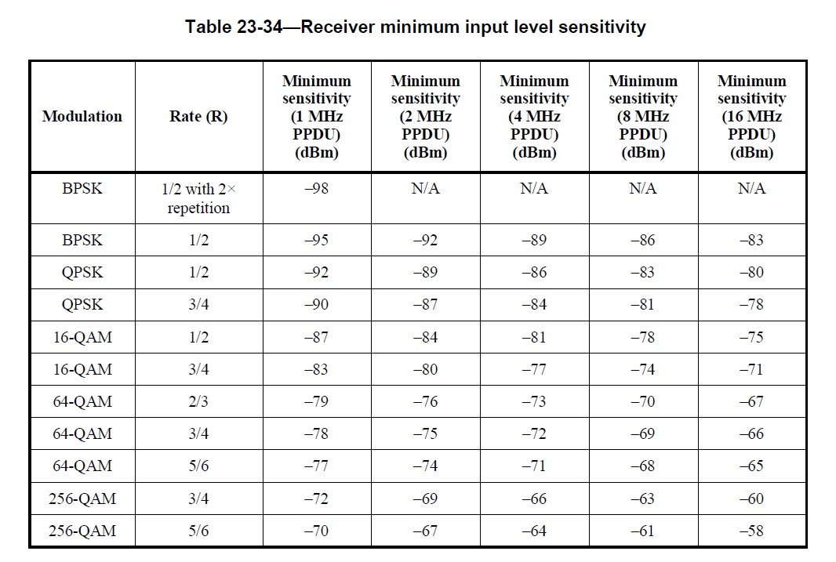
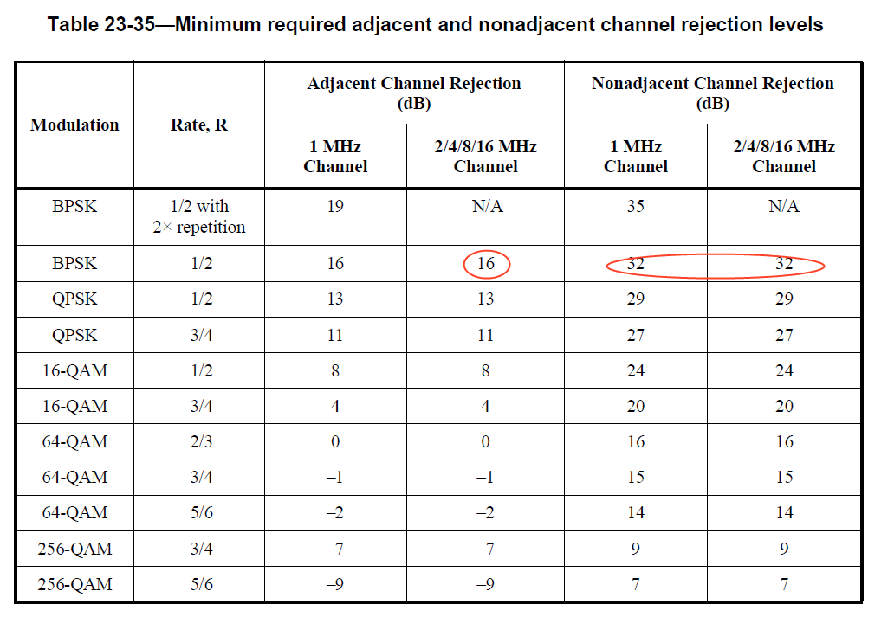
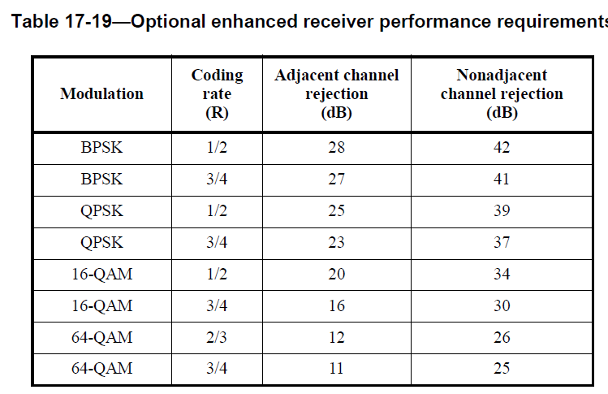
May 2023
Doc.: IEEE 802.11-23/0836r2
Considerations on AMP uplink transmission(2)-backscatter
    Backscattering
      Lower power consumption (x uw~10x uw) can be expected than active transmitter, due to no need of the oscillator
      However, there is self-interference issue for the AP, especially when the incident carrier and the backscattering signal are in the same channel
        Even for difference channel, the existing ACR requirement is difficult to be met for mono-static AP
      Backscattering on different channel with the incident carrier and biostatic deployment of the AP can be considered.
Slide 7
Yinan Qi (OPPO)

Slide 8
May 2023
Doc.: IEEE 802.11-23/0836r2
Reference for AMP: existing MAC mechanisms
    Many MAC mechanism can be used as the reference for AMP MAC
      AID extension
      RAW
      Shortened MAC headers/TIM slicing
      NDP frames(NDP paging)
      Normal/short beacons
      RID
      TWT
      PS-Poll
      Doze state extension
      EoL
      TXOP sharing……
Slide 8
Yinan Qi (OPPO)

Slide 9
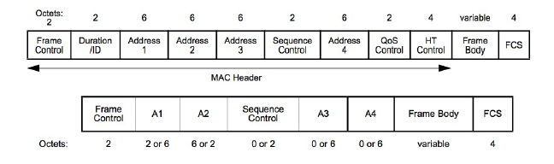
May 2023
Doc.: IEEE 802.11-23/0836r2
Considerations on AMP MAC(1)
    It can be considered to further reduce the MAC overhead for AMP
      Due to its lower data rate (e.g. with narrow bandwidth)
      Reduce the transmission time duration for power saving
    Legacy MAC header and short MAC header
    It can be considered to try to reduce the time during which the AMP device is in awake state for power saving
    It can be considered to reduce the unnecessary interaction between the AP and AMP devices for power saving
Slide 9
Yinan Qi (OPPO)

Slide 10
May 2023
Doc.: IEEE 802.11-23/0836r2
Considerations on AMP MAC(2)
    Consider to relax the requirement of co-existence for AMP device
      The AP can help to handle the co-existence
        The AP is able to send legacy preamble and share the TXOP to the AMP devices
      Also consider the ultra-low transmission power from the AMP device ( e.g. less than -25dBm for backscattering or less than -10dBm for active transmission)
      In sub-1 GHz, there is no legacy device, expect 802.11ah device deployed in some countries.
      Can we allow the AMP device’s PPDU transmission without a legacy preamble part for the following 2 cases:
      1) Green field without any legacy device.
      2) There is legacy 802.11 ah device, but restrict the maximum power from AMP devices to lower than -10 dBm.
Co-existence of AMP device and 802.11ah device @sub-1 GHz
Slide 10
Yinan Qi (OPPO)

Slide 11
February 2023
Doc.: IEEE 802.11-22/1960r5
Summary of Candidate frequency bands for AMP
Frequency band | Sub-1 GHz | 2.4GHz
Maximum RF power | 33dBm ERP@920-925MHz @CN 30+6 = 36 EIRP dBm @902~928@US 29.14 dBm EIRP@865-867 EU for RFID 35.15dbM EIRP@865-867 EU for RFID for antennas having a beamwidth ≤90° | 20dBm@EU/CN 27dBm@CN for high Ant gain(>10dBi) 30+6 = 36dBm@US ……
DL Receiver sensitivity | To be specified | Re-use WUR: -82dBm
PSD | No limitation | 10dBm/1MHz@CN and EU 17dBm/1MHz@CN for high Ant gain(>10dBi) ……
Channel bandwidth | 250KHz @CN 200K-250KHz @EU 1MHz @US | OFDM: 20MHz WUR: 4MHz
Slide 11
Weijie Xu (OPPO)

Slide 12
February 2023
Doc.: IEEE 802.11-22/1960r5
On security
    For a many AMP use cases, user privacy needs to be protected.
    AES 128 level security is used in current 802.11 WiFi.
    It needs to be further check whether AMP device is able to support AES-128
    The most important issue is the power consumption.
    Contributions are called for to show the power consumption of AES-128.
Slide 12
Weijie Xu (OPPO)

Slide 13
Summary
Doc.: IEEE 802.11-23/0836r2
In this presentation, several important reference for AMP DL receiver and MAC are summarized.
Based on that, the consideration on AMP DL receiver, MAC, uplink transmitter, candidate frequency band and security are present.

Slide 14
Reference
Doc.: IEEE 802.11-23/0836r2
http://www.srrc.org.cn/article29539.aspx
https://www.etsi.org/deliver/etsi_en/302200_302299/302208/03.03.01_60/en_302208v030301p.pdf
https://www.ecfr.gov/current/title-47/chapter-I/subchapter-A/part-15/subpart-C/subject-group-ECFR2f2e5828339709e/section-15.247
IEEE 802.11-23/0436r0 Technical Report on support of AMP IoT devices in WLAN

