Slide 1
Enhancements for latency sensitive traffic and in-device-coexistence
Date: 2023-04-19
Authors:
Name | Affiliations | Address | Email
Sindhu Verma | Broadcom |  | sindhu.verma@broadcom.com
Shubhodeep Adhikari |  |  | shubhodeep.adhikari@broadcom.com
Matthew Fischer |  |  | matthew.fischer@broadcom.com
Bobby Joseph
Pradhap A
Vinko Erceg
Notes:
November 2012

Slide 2
Abstract
This contribution discusses possible enhancements to achieve improvements in performance in the context of latency sensitive traffic, multi-link operation, link adaptation and in-device-coexistence.
It discusses different mechanisms to achieve this:
Enhancements to the existing AMPDU-BA mechanism and TXOP structure for more efficient multi-link operations, latency reduction, link adaptation and in-device-coexistence
Adjustment of traffic parameters and TXOP for better in-device-coexistence

Slide 3
Overview
Limitations of the current immediate BA mechanism
Limitations of the current TXOP/PPDU/AMPDU structure
Lack of recipient’s control over burst durations
Proposal 1: Informed delayed BA mechanism
Proposal 2: Enhanced TXOP/PPDU/AMPDU structure
Proposal 3: Semi-static adjustment of burst durations
Proposal 4: Dynamic adjustment of burst durations

Slide 4
Limitations of the current immediate BA mechanism (1)
Processing constraints at the recipient
When an AMPDU recipient is required to respond with BA at SIFS after the eliciting AMPDU’s PPDU, the recipient might be incapable of doing so due to internal processing limitations (e.g. processing delay beyond SIFS, based on MCS/byte count/MPDU count, etc). Such constraints may make it incapable of receiving later MPDUs within a long AMPDU
Minimum MPDU Start Spacing is a parameter to take care of processing constraints. However,
It specifies the minimum spacing between any 2 MPDUs in microseconds irrespective of the MCS/bandwidth/MIMO order, etc used.
The spacing needs to be guaranteed even through padding which wastes transmission resources.
It is desirable if the solution gets exercised only if the specified maximum MPDU count/MPDU byte count etc are exceeded at the recipient and without wastage of resources.

Slide 5
Limitations of the current immediate BA mechanism (2)
In-device Coexistence constraints at the recipient
When an AMPDU recipient is required to respond with BA at SIFS after the eliciting AMPDU’s PPDU, the recipient might be incapable of doing so due to an upcoming burst of activity on another in-device technology like Bluetooth/UWB/LTE/NR which would prevent it from receiving the later MPDUs or transmitting the BA due to in-device interference.
Handling of NSTR clients at the AP
To avoid UL transmission from the recipient that may cause destructive interference to recipient’s ongoing reception on another link, the originator can perform consecutive DL transmissions to multiple recipients and then trigger BA in an MU fashion instead of using immediate BA
Link Adaptation Convergence
Multiple MCSs/NSSs cannot be tried together and each combination must be tried one at a time followed by a corresponding feedback. Convergence of the link adaptation algorithm can be made faster if a composite feedback can be obtained for multiple MCSs/NSSs and only when the originator desires. Having mandatory intermediate BA reduces efficiency.

Slide 6
Limitations of the current TXOP/PPDU/AMPDU structure (1)
Lack of time margin in MLO for AMPDU construction
The MLD may be prepared to transmit AMPDUs simultaneously on both the links and may have prepared transmissions accordingly with different sequence number sets. However, if one of the links wins access first or if the other link becomes busy, the earlier sequence numbers would preferably need to be transmitted on the winning link especially in case of an NSTR/EMLSR MLD.
If the bandwidth for which access to any link is won, is different from what was assumed while preparing disjoint sets of transmissions for the two links, the AMPDU contents may need to be assembled again.
Transmitting without rebuilding in some cases may cause unnecessary retransmission of MPDUs or transmission of MPDUs with unnecessary gaps in sequence numbers.
An STR MLD which wants to align PPDUs on 2 links, may be waiting to decode length information of a transmission from an NSTR ML device on one of the links (say link1) while it wins access to the other link (say link2).
If the STR MLD does not align the end of its link2 transmission with the end of its link1 reception, the NSTR ML device having missed the link2 preamble, may collide with the link2 transmission.

Slide 7
Limitations of the current TXOP/PPDU/AMPDU structure (2)
In MLO, events on a link 1 might impact decisions regarding transmissions on a link 2. For e.g. the MLD might receive BA correctly on link 1 but not on link 2, and in an asynchronous manner.
In this case, the transmitter MLD may want the flexibility to prioritize retransmissions of erroneous packets from link 2 even though link 1 transmission started earlier than the end of link 2 transmission.
In MLO and in case of NSTR ML recipients, PPDUs on the two links may need to be aligned so that UL transmission of BA on one link is not destructive to reception on another link.
The LENGTH and contents of an AMPDU cannot be adjusted once the transmission of a PPDU starts, as LENGTH is contained in the L-SIG.

Slide 8
Limitations of the current TXOP/PPDU/AMPDU structure (3)
Handling of latency sensitive transmissions
If latency-sensitive traffic arrives newly, it needs to wait for the end of an ongoing transmission burst/TXOP before it can be transmitted.
AMPDUs are typically constructed as long as feasible, since longer AMPDUs increase MAC efficiency by omitting intermediate PHY header/SIFS/BA.
For long AMPDUs, if the initial PHY header is missed, decoding fails for the receiving device and preamble detection fails for any device performing CCA
The problem is especially pronounced in case of hidden nodes, fading channels and blindness in NSTR/EMLSR ML devices.
Link adaptation convergence
Multiple MCSs/NSSs cannot be tried together and each combination must be tried one at a time followed by a corresponding feedback

Slide 9
Lack of recipient’s control over burst durations (1)
In-device-coexistence (IDC) is significantly impacted by lack of control over long bursts of transmissions from the AP or triggered by the AP to the recipient.
In IDC scenarios with 802.11 and Bluetooth/UWB, there are certain cases where continuous 802.11 medium availability is limited to a few milliseconds.
For example, depending on the Bluetooth profile, the medium availability for 802.11 could be: 2.5ms every 3.75ms, OR 6.25ms every 7.5ms, OR 8.5ms every 11ms etc.
A long receive packet or a burst of RX packets has a high chance of crossing 802.11 medium boundaries and getting curtailed by Bluetooth
So, this requires the Rx packet duration to be reduced in order to fit the medium availability at 802.11 (outside of Bluetooth slots or any other coexisting device).
At present, coexistence between 802.11 and Bluetooth/UWB/LTE is mostly handled in a proprietary manner.

Slide 10
Lack of recipient’s control over burst durations (2)
Some non-standardized implementations may overload existing functionalities to indirectly control the time duration of the Rx/Tx packet.
For Downlink, one can reduce AMPDU aggregation, even turn off AMPDU/AMSDU aggregation altogether or reduce the maximum length in bytes. This causes suboptimal performance without addressing the actual problem. Even upon turning off aggregation, there is no means to control the duration of a single MSDU which can be long enough to spill into the desired inactivity period.
For Uplink, one can disable triggered mode of operation, which also disables Uplink OFDMA. This is again suboptimal.
Coexistence between 802.11 and BT/UWB can be improved if there are standardardized mechanisms to support coexistence.
The same mechanisms can be used to solve other issues of in-device-coexistence such as coexistence between 802.11 and LTE/NR. They can also be used to optimize performance in case of any activity that results in temporary inability to receive/transmit 802.11 frames

Slide 11
Proposal 1: Informed delayed BA mechanism (1)
AMPDU Recipient indicates its limitations to AMPDU originator
Maximum MPDU count, maximum byte count, maximum duration of the AMPDU to be able to transmit BA at SIFS
Minimum delay, maximum delay for BA transmission
In device-coexistence issues if they exist.
AMPDU Originator allows for delayed BA response
If the AMPDU originator follows the recipient’s limitations e.g. transmits AMPDUs which fall below the RX-TX delay limits, and recipient has not signaled that coexistence issues are present
AMPDU originator interprets lack of BA at SIFS as failure
Otherwise, AMPDU originator interprets lack of BA as delayed BA

Slide 12
Proposal 1: Informed delayed BA mechanism (2)
If the AMPDU originator interprets lack of BA as delayed BA
It assumes that the missing BA will be transmitted by the recipient after a negotiated minimum delay X and before a maximum delay Y, either using contention OR triggered by a BAR
The expiry of maximum delay will lead to the assumption at the originator that the AMPDU is in error
It optionally continues with its TXOP (i.e. after PIFS) transmitting the next PPDU to same recipient or other recipient(s)
AMPDU recipient exercising delayed BA
If the recipient transmits BA within SIFS, the BA indicates the last processed sequence number of the AMPDU (<=last sequence number in the AMPDU) .
Else when transmitted, the BA should be cumulative in terms of ACK information e.g. if additional AMPDUs arrive before BA is transmitted

Slide 13
Proposal 1: Informed delayed BA mechanism (3)
The originator may not desire BA after SIFS because:
It intends to send sequence of AMPDUs (with no gaps or SIFS gap)
E.g. for handling latency sensitive traffic, MCS exploration for link adaptation, improving decoding/CCA (details later)
There are known recipient limitations vs AMPDU contents
E.g. AMPDU exceeds recipient maximum byte count
In this case:
The originator indicates a provision/desire for delayed BA (to a recipient that indicates capability)
E.g. indication in PHY header or MAC header
After signaling, the originator is free to transmit again after SIFS or even without any gap
The originator will elicit a BA later e.g. using Implicit BAR / Explicit BAR
Optionally allows the recipient to initiate BA transmission e.g. within the recipient’s own TXOP
The difference between the existing delayed BA procedure and this proposal is that this proposal allows dynamic per-burst behaviour regarding the choice of BA (i.e. whether immediate or delayed) while the existing procedure forces the BA for every burst to be a delayed BA once the BA agreement is setup.

Slide 14
Proposal 2: Enhanced TXOP/PPDU/AMPDU structure (1)
A short PPDU (AMPDU) could precede a longer PPDU (AMPDU) with either SIFS gap or no gap in between.
Inserting SIFS+BA+SIFS between the two AMPDUs would lead to wastage. It might also cause a problem with synchronous MLD receivers.
It helps if there is flexibility to insert a small PPDU in the beginning after which the PPDU with desired final length and contents can occur.
This has the following advantages:
A time margin for the AMPDU originator to build/rebuild AMPDUs based on the link that wins channel access and the bandwidth with which it wins channel access or while waiting to decode length information for the purpose of alignment
An option for the AMPDU originator to react to asynchronous events on the multiple links of the MLD. So, the MLD could tentatively use a small PPDU at the beginning of link 1 transmission and follow it up with a larger PPDU depending on the ACK status on link 2.

Slide 15
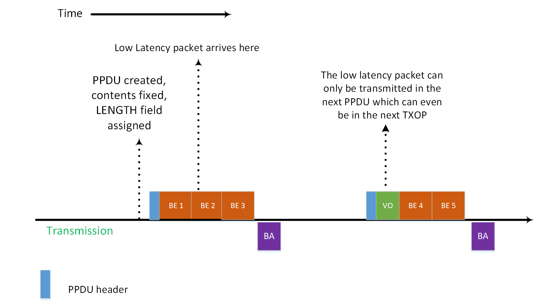
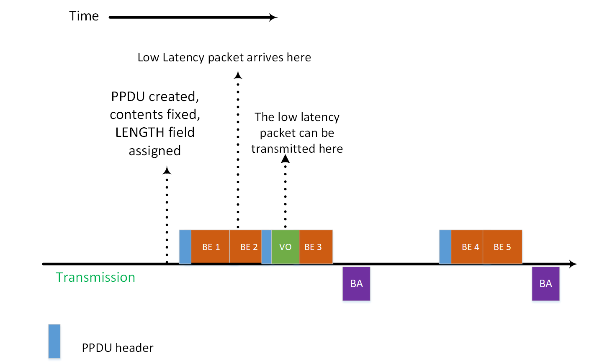
Proposal 2: Enhanced TXOP/PPDU/AMPDU structure (2)
Handling latency-sensitive traffic
Allowing multiple PPDUs with SIFS gap or no gap in between can also help better prioritize latency sensitive traffic and hence reduce latency
For example, this can enable the insertion of latency sensitive traffic in an ongoing transmission, rather than wait for the end of the ongoing transmission burst/TXOP
When low-latency packets are anticipated, long PPDUs in a TXOP can be broken into a sequence of shorter PPDUs to allow insertion of low latency traffic

Slide 16
Proposal 2: Enhanced TXOP/PPDU/AMPDU structure (3)
Decoding/CCA failure for long AMPDUs/PPDUs
The problem can be alleviated if instead of a long PPDU, a sequence of shorter back-to-back PPDUs without gaps or with SIFS gap can be transmitted followed by a single composite BA.
Even if any intermediate PPDUs are in error, the remaining can be decoded
This will result in better throughput at the receiver in case of fading/dynamic channels.
This will also help collision avoidance through preamble detection especially in case of blindness in NSTR/EMLSR ML devices, since such a device will get to decode multiple preambles instead of only one for the same amount of data transmission and without the overhead of repeated SIFS+BA

Slide 17
Proposal 2: Enhanced TXOP/PPDU/AMPDU structure (4)
Link Adaptation Convergence
Convergence of the link adaptation algorithm can be made faster if a composite feedback can be obtained for a back-to-back PPDU (AMPDU) sequence with multiple MCSs/NSSs.
The transmitter can pack back-to-back PPDUs each with a different MCS/NSS combination without any gap or with SIFS gap.
At the end of the burst, a composite BA is elicited which helps the transmitter know which MCS/NSS combination was the most successful.
Not having intermediate BA (and SIFS) helps increase efficiency.
Flexibility for NSTR ML recipients
To avoid UL transmission from the recipient that may cause destructive interference to recipient’s ongoing reception on another link, the originator can perform consecutive DL transmissions to multiple recipients and then trigger BA in an MU fashion.
The originator indicates this (absence of immediate immediate BA and the back-to-back structure) dynamically in the PHY or MAC header. This provides much higher flexibility than setting Ack Policy = Block Ack (within the HT-immediate context), as the latter provision means that none of the AMPDUs can be acknowledged with an immediate BA and have to be instead acknowledged with a BAR-SIFS-BA combination.

Slide 18
Proposal 3: Semi-static Adjustment of traffic parameters without re-association (1)
It is desirable to have a semi-static limit on the time duration of a burst to/from the concerned non-AP irrespective of the number of bytes or the extent of MSDU/MPDU aggregation
A new action frame can be defined for semi-statically changing the Downlink burst duration that can be supported by the non-AP in a coex environment.
Similar procedure can also be used to semi-statically adjust the duration limit for triggered Uplink. This will obviate the need to disable triggered uplink altogether.
In addition to Downlink/Uplink burst duration, it may also be beneficial to indicate the desired periodicity of Downlink/Uplink activity. For example, it can be preferred by a non-AP to have a burst duration of up to x ms in every y ms so that at least (y-x) ms is available every y ms for non-802.11 operations
The supported burst parameter will be per-link/per-channel/per-band basis, as each link/channel/band can have different in-device coexistence issues (with respect to different technologies like BT/UWB/LTE/LAA/NR/NR-U).

Slide 19
Proposal 3: Semi-static Adjustment of traffic parameters without re-association (2)
Below is an illustration of a negotiated burst limit of x ms and every y ms.

Slide 20
Proposal 4: Dynamic Adjustment of burst duration (1)
The device with an IDC constraint can dynamically request to reduce the remaining burst duration
Preferred remaining burst duration can be indicated through CTS or BA in response to a Downlink transmission. For example,
CTS: The initial TXOP duration is contained in the RTS and the responder that has an IDC constraint suggests how much of remaining TXOP duration it prefers resulting in dynamic reduction of the TXOP
BA: The transmission starts with a shorter DL burst and in the BA, the responder suggests the remaining TXOP duration
Preferred remaining burst duration can be indicated in an Uplink packet transmitted in response to a trigger frame
The remaining burst duration can be used either for Downlink transmission to this device or Uplink transmissions from this device that is facing an IDC constraint.
It may also be beneficial to indicate the desired inactivity time after completion of the current burst. This will serve as a notice of absence.

Slide 21
Proposal 4: Dynamic Adjustment of burst duration (2)
Below is an illustration of dynamic adjustment of burst duration and inactivity period
Here, the preferred remaining burst duration and the time until the preferred next start of 802.11 activity are indicated using a BA in response to an AMPDU
In the same way, these parameters can be indicated in a CTS in response to an RTS and in a TB PPDU in response to a trigger frame
Additional considerations
If the remaining burst duration is reduced after the medium is reserved for a longer duration using RTS, there can be unused reserved air time left after the end of the burst to the particular non-AP.
This can result in potential unfairness
However, in that case, CF-end can be used by the AP in order to make this remaining duration available to other devices on the channel.
The AP can also use this remaining reserved time for other exchanges (i.e. with other non-APs)

Slide 22
Straw Poll 1
Do you support the inclusion of the following in the SFD:
802.11bn AMPDU-BA exchange mechanism allows for the following enhancements:
Recipient indication of constraints regarding immediate BA transmission
Maximum MPDU count, maximum byte count of AMPDU to meet SIFS response time for BA transmission
Minimum delay, maximum delay for BA transmission
In-device coexistence issues
Originator indication within a PPDU that a BA transmission at SIFS after the PPDU is not permitted.
Y/N/A

Slide 23
Straw Poll 2
Do you support the inclusion of the following in the SFD:
802.11bn AMPDU-BA exchange mechanism allows for the following enhancement:
Transmission by the AMPDU originator of PPDUs without any intervening gaps or with SIFS gap, where each PPDU is allowed to have different MCS/NSS/duration.
Y/N/A

Slide 24
Straw Poll 3
Do you support the inclusion of the following in the SFD:
A new action frame for semi-statically changing the Downlink/Uplink burst duration that can be supported by the non-AP in a coex environment.
In addition to the burst duration, the preferred periodicity of the burst can also be indicated
The supported burst parameter can be per-link/per-channel/per-band
Y/N/A

Slide 25
Straw Poll 4
Do you support the inclusion of the following in the SFD:
Support for a mechanism or a field to dynamically indicate the remaining desired Downlink/Uplink burst duration immediately after the current transmission by the non-AP that can be supported by it in a coex environment.
The field can be included in a CTS, BA or a TB PPDU
In addition to the remaining burst duration, the preferred next occurence of the burst can also be indicated
Y/N/A

