Slide 1
S1G+ UL MU-MIMO
Date: 2023-05-10
Authors:
Name | Affiliation | Address | Phone | email
David Halasz | Morse Micro |  |  | dave.halasz@morsemicro.com
Ganesan Thiagarajan | Morse Micro |  |  | ganesan.thiagarajan@morsemicro.com
Dave Goodall | Morse Micro |  |  | dave@morsemicro.com

Slide 2
Abstract
Follow up submission to 11-22/1831, which is about updating Sub 1 GHz with functionality already in the IEEE 802.11 specification.
Three functionalities identified were,
  1024 QAM
  Uplink Multi User MIMO
  Preamble Puncturing
This submission reviews UL MU-MIMO changes from High Efficiency(.11ax) to Sub 1 GHz(.11ah)

Slide 3
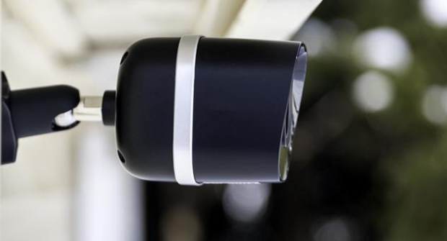
Faster Use Case
Camera & Video Use Case
IEEE 802.11ah useful for low power cameras and video.
UL MU-MIMO will enable greater number of concurrent camera streams.

Slide 4
Changes Identified
S1G-TB-PPDU format will be new
Sounding changes from High Efficiency
Trigger frames from High Efficiency
Broadcast TWT for scheduling DL/UL MU-MIMO
High Efficiency MAC to enable the above
Other : PICS & MIB

Slide 5
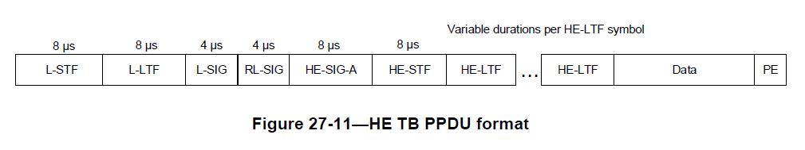
S1G TB PPDU
Will need to introduce S1G TB PPDU, analogous to the HE TB PPDU

Slide 6
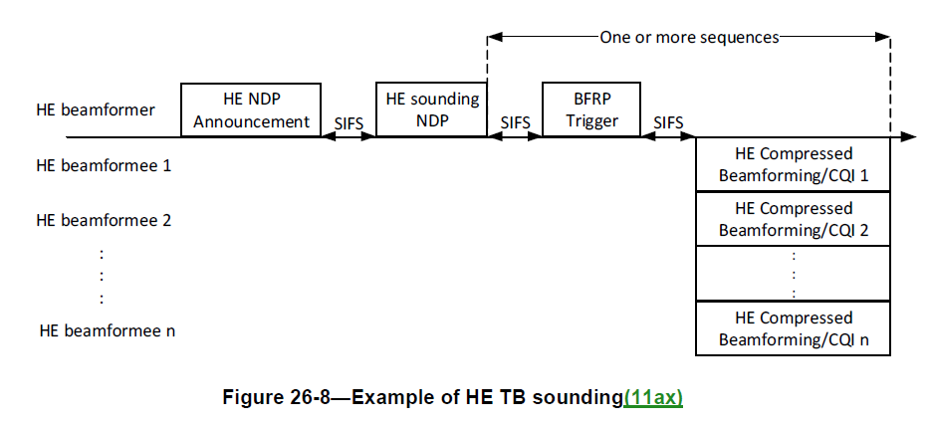
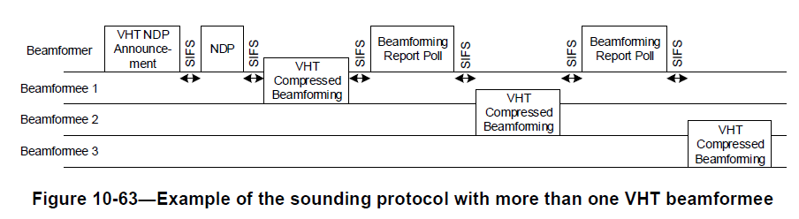
Sounding changes from High Efficiency
More efficient sounding
Trigger MAC/Control frame (11ax)

Slide 7
Trigger frames from High Efficiency
Allocates resources for and solicits one or more HE TB PPDU transmissions
Basic Trigger - For data
BFRP Trigger - For HE trigger based sounding
MU-BAR - Multi User Block Ack Request
MU-RTS - For protection of data
BSRP - Buffer Status Report
              Assists AP in allocating UL MU resources
GCR MU-BAR - Groupcast w/retries BAR
BQRP - Bandwidth Query Report
              Assists AP in allocating UL MU resources
NFRP - NDP Feedback Report

Slide 8
Broadcast TWT for scheduling DL/UL MU-MIMO
High Efficiency brought in Broadcast TWT to have different clients have their traffic scheduled at the same time.
S1G to follow additional rules in 26.8 (TWT operation) which includes Broadcast TWT.

Slide 9
High Efficiency MAC to enable the above
Go through the HE MAC for sections.
Not bringing in OFDMA.
Will also look to simplify.
Examples of sections will be bringing in,
26.7 HE sounding protocol
26.8 TWT operation
etc

Slide 10
References

