Slide 1
Non-Primary Channel Access
Date: 2023-07-05
Authors:

Slide 2
Abstract
This contribution discusses the non-primary channel access.
Reduce a latency
Improve a throughput

Slide 3
Non-Primary Channel Access
When a STA listens on a primary channel a RTS/CTS frame exchange sent by an OBSS STA and sets NAV counter from the PPDU,
The STA may switch to an auxiliary primary channel.
An auxiliary primary channel is declared by a management frame sent by an AP.
After switching to an auxiliary primary channel,
A STA invokes a new back-off procedure after sensing the wireless medium on an auxiliary primary channel for TBD time.
An auxiliary primary channel sensing can be performed in parallel with the primary channel sensing.
Or it can be performed after switching to the auxiliary primary channel.
After the NAV counter is expired, the STA shall switch to the primary channel.

Slide 4
Non-Primary Channel Access
After obtaining a TXOP on an auxiliary primary channel,
A STA initiates a frame exchange with the (MU-)RTS/CTS or BSRP/BSR.
The TXOP duration on the auxiliary primary channel shall be less than the current NAV counter of the primary channel.
After receiving the (MU-)RTS or BSRP frame on an auxiliary primary channel,
A STA responds with the CTS or BSR frame if the following is met,
The CS of the auxiliary primary channel is idle.
The (MU-)RTS or BSRP frame was sent on the same auxiliary primary channel.

Slide 5
Non-Primary Channel Access
Frame exchange sequence example
The STA should check the CS idle on the auxiliary primary channel before obtaining a TXOP.
But, if a STA can identify the NAV status on the auxiliary primary channel, the STA accounts the channel activity during the identified duration as idle activity.
auxiliary primary channel sensing
S80
DATA
(OBSS)
BA
(OBSS)
RTS
CTS
DATA
BA
P80
DATA
BA
RTS (OBSS)
CTS (OBSS)
DATA (OBSS)
BA
(OBSS)
auxiliary primary channel sensing
S80
RTS
CTS
DATA
BA
RTS
CTS
DATA
BA
P80
RTS (OBSS)
CTS (OBSS)
DATA (OBSS)
BA
(OBSS)

Slide 6
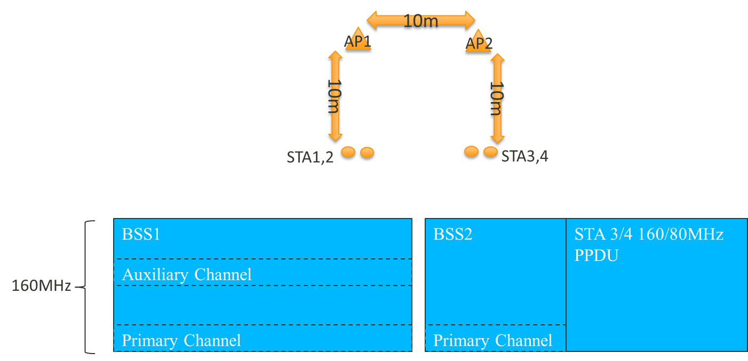
Simulation-1
Topology
2 BSS: 1 AP and 2 STA in each BSS.

Slide 7
Simulation-1
Parameters
BSS1: STA 1 and 2 are 160MHz UHR STA with non-primary channel access.
BSS2: STA 3 and 4 are 80MHz and 160MHz 11be STA.
AP2 transmits either 80MHz or 160MHz SU PPDU to these two STAs.
RTS/CTS is enabled.
Running UDP DL traffic from each AP to the associated STA.
Different 80MHz/160MHz traffic loading from AP2 in BSS2.
MCS: 9
Auxiliary primary channel sensing
Sequential channel sensing (S-CS): Wait for 0/2.7/4 ms after switch to auxiliary channel.
Parallel channel sensing (P-CS): Monitor the aux channel parallelly.
The wait time starts from the end of last blindness event on aux channel.
Blindness events are tx or rx of own BSS traffic with only lower 80MHz occupied.

Slide 8
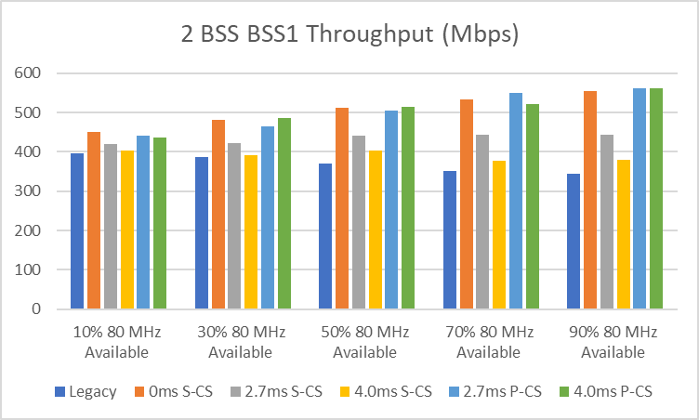
Simulation-1
With non-primary channel access, there are some opportunities for BSS1 to use upper 80MHz while BSS2 is transmitting on lower 80MHz.
Monitoring the auxiliary primary channel (P-CS) could achieve similar performance as S-CS with 0ms wait time.

Slide 9
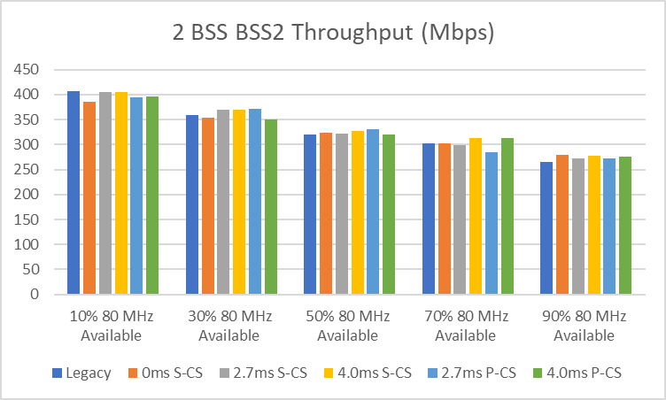
Simulation-1
BSS2 has no performance impact caused by a non-primary channel access mechanism.

Slide 10
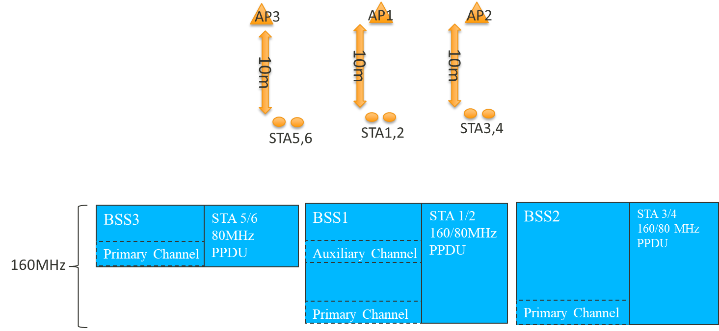
Simulation-2
Topology
3 BSS: 1 AP and 2 STA in each BSS.

Slide 11
Simulation-2
Topology
3 BSS: 1AP and 2 STA in each BSS.
Parameters:
BSS1: STA 1 and 2 are 160MHz UHR STA with non-primary channel access.
BSS2: STA 3 and 4 are 80MHz and 160MHz 11be STA.
AP2 transmits either 80MHz or 160MHz SU PPDU to these two STAs.
BSS3:
BSS3 is operating on upper 80MHz with a different primary channel.
STA 5 and 6 are 80MHz 11be STA.
RTS/CTS is enabled.
Running full buffer UDP DL traffic from AP1 and AP2 to the associated STA and adjusting UDP DL traffic from AP3 to the associated STAs
MCS: 9
Auxiliary primary channel sensing : S-CS and P-CS (refer slide 7)

Slide 12
Simulation-2
When the aux channel is occupied by BSS3 traffic, most of the time non primary channel access from AP1 won’t be too aggressive to affect BSS 3.
The only exception is when traffic on upper and lower 80MHz are aligned. AP1 and AP2 might transmit 160MHz data which would reduce BSS3 throughput. Either it’s collision or less channel access.
In general, upper 80MHz is used by BSS3 and lower 80Mhz is used by BSS1 and BSS2.
As the traffic load of BSS3 decreases, there is some opportunities for BSS1 to use upper 80MHz while BSS2 is transmitting on lower 80MHz.

Slide 13
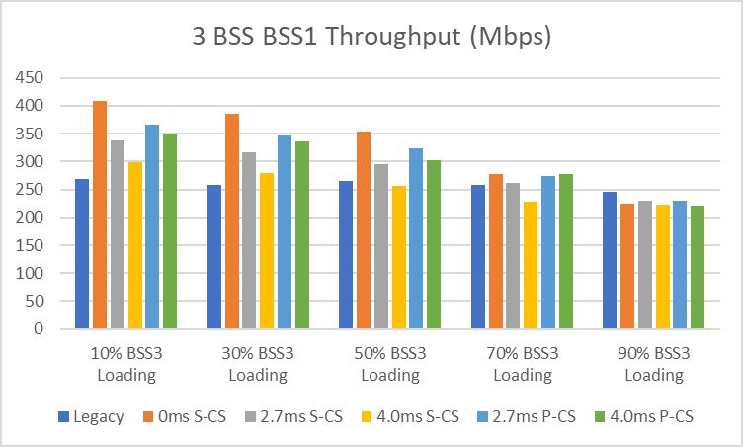
Simulation-2
BSS 1 throughput

Slide 14
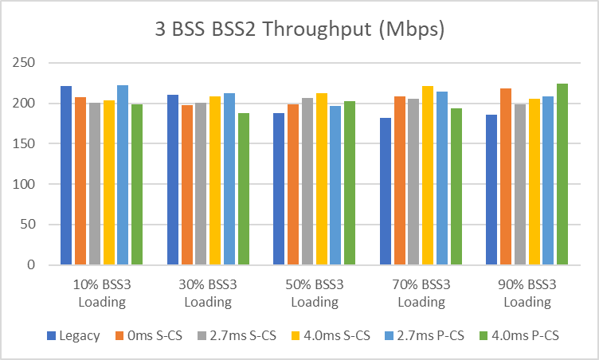
Simulation-2
BSS 2 throughput

Slide 15
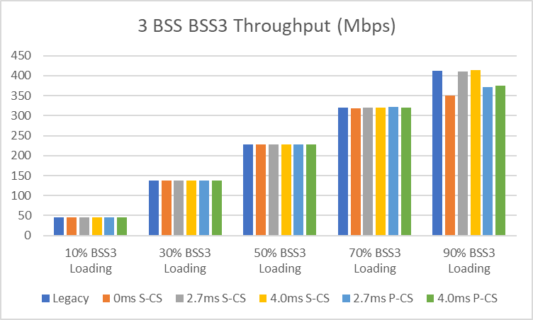
Simulation-2
BSS 3 throughput

Slide 16
Conclusion
Non-primary channel access can improve the throughput and reduce the latency of the delay sensitive traffic.
Depending on the topology,
The auxiliary primary channel sensing threshold can have an impact on the OBSS performance.
Distance with AP operating on the auxiliary primary channel is less than -62dBm, the CCA threshold of the auxiliary primary channel sensing should be decreased to a value below to -62dBm (-82dBm in the worst case).
We prefer that the AP determines the CCA threshold level and announce to STA.

Slide 17
Backup

Slide 18
Multiple auxiliary primary channels
When an AP supports the parallel auxiliary primary channel sensing, more than one auxiliary primary channel can be declared.
The AP can configure the priority of auxiliary primary channels.
The highest priority of available auxiliary primary channels is chosen.
The STA does not support parallel auxiliary primary channel sensing, it uses only the first auxiliary primary channel.
Inter-BSS PPDU
Inter-BSS PPDU
Backoff
Backoff
First auxiliary primary channel
S160
Backoff
Second auxiliary primary channel
Inter-BSS PPDU
Inter-BSS PPDU
Backoff
Inter-BSS PPDU
Inter-BSS PPDU
Third auxiliary primary channel
S80
P80
Inter-BSS PPDU
Inter-BSS PPDU
Inter-BSS PPDU
Inter-BSS PPDU
Primary channel
Case 1
Case 2
Case 3
Case 4

