Slide 1
Adaptive Sounding Using ML
Date: 2023-05-08
Authors:

Slide 2
Introduction
Channel aging issue
  Inaccurate CSI results in severe inter-user interference for MU-MIMO, which leads to throughput degradation.
  The CSI accuracy depends not only on the accurate channel estimation of the BFee but also on the sounding interval.
  However, the frequent sounding increases the overhead.
    Trade off between collecting up-to-date CSI and reducing overhead.

Slide 3
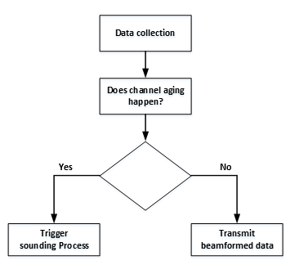
Main contribution
Previous work
  Throughput based sounding interval determination [1]
    Trigger the sounding procedure (NDPA - NDP - (BFRP Trigger) – Collecting CSI) when the throughput starts to degrading.
In this contribution
  We propose a scheme utilizing the machine learning to identify channel aging.

Slide 4
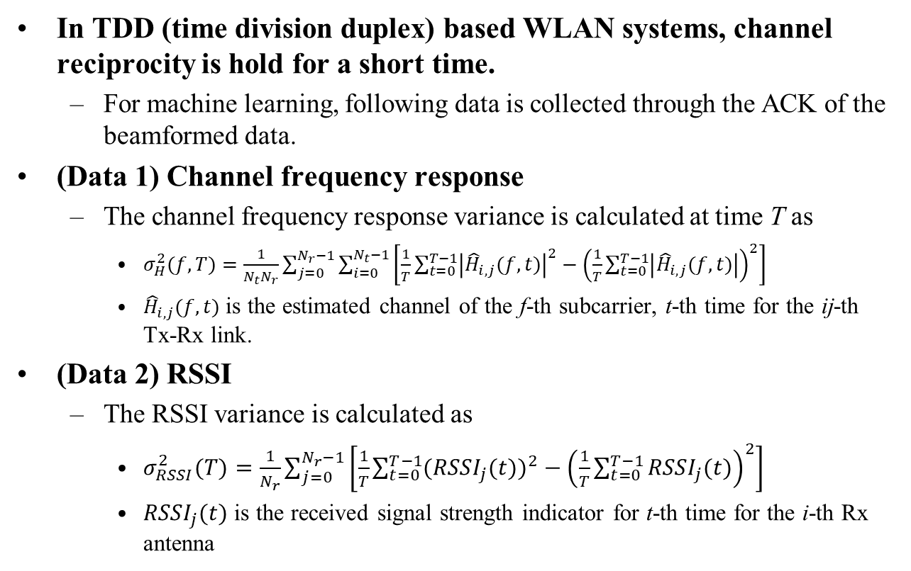
Measurement of channel aging
In TDD (time division duplex) based WLAN systems, channel reciprocity is hold for a short time.
  For machine learning, following data is collected through the ACK of the beamformed data.
(Data 1) Channel frequency response
  The channel frequency response variance is calculated at time T as
    $σ_{H}^{2}(f,T)=\frac{1}{N_{t}N_{r}}\sum_{j=0}^{N_{r}−1}{\sum_{i=0}^{N_{t}−1}{\left[\frac{1}{T}\sum_{t=0}^{T−1}{{\left|{\hat{H}}_{i,j}(f,t)\right|}^{2}}−{\left(\frac{1}{T}\sum_{t=0}^{T−1}{\left|{\hat{H}}_{i,j}(f,t)\right|}\right)}^{2}\right]}}$
    ${\hat{H}}_{i,j}(f,t)$ is the estimated channel of the f-th subcarrier, t-th time for the ij-th Tx-Rx link.
(Data 2) RSSI
  The RSSI variance is calculated as
    $σ_{RSSI}^{2}(T)=\frac{1}{N_{r}}\sum_{j=0}^{N_{r}−1}{\left[\frac{1}{T}\sum_{t=0}^{T−1}{{({RSSI}_{j}(t))}^{2}}−{\left(\frac{1}{T}\sum_{t=0}^{T−1}{{RSSI}_{j}(t)}\right)}^{2}\right]}$
    ${RSSI}_{j}(t)$ is the received signal strength indicator for t-th time for the i-th Rx antenna

Slide 5
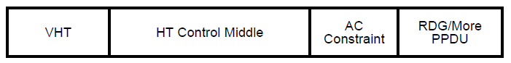

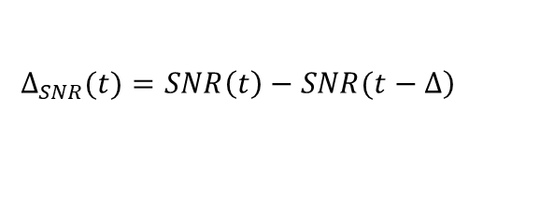
Measurement of channel aging
In addition, the non-AP STA may feed back channel status information such as MCS and SNR with a link adaptation (LA).
  AP can predict the downlink channel status.
(Data 3) Link adaptation parameter
  Delta-SNR is the deviation in dB of the current SNR relative to the SNR of the previous LA, where the difference of the SNR is calculated as
$$\left.∆_{SNR}(t)=SNR\left(t\right)−SNR(t−∆\right)$$
VHT variant HT Control field for LA [2]

Slide 6

Channel aging determination
A threshold-based determination can be used where the threshold is determined by heuristic way.
  Given SNR estimates, whether channel aging occurs is identified by comparing with a threshold value.
  Example
    If SNR $>$ SNR_m & SNR $≤$ SNR_(m+1), and $σ_{H}^{2}$ $<$ TH_m
    Then, channel aging does not happen → Transmit beamformed data
SNR | SNR_1 | SNR_2 | … | SNR_K
Threshold | Th_1 | Th_2 | … | Th_K

Slide 7
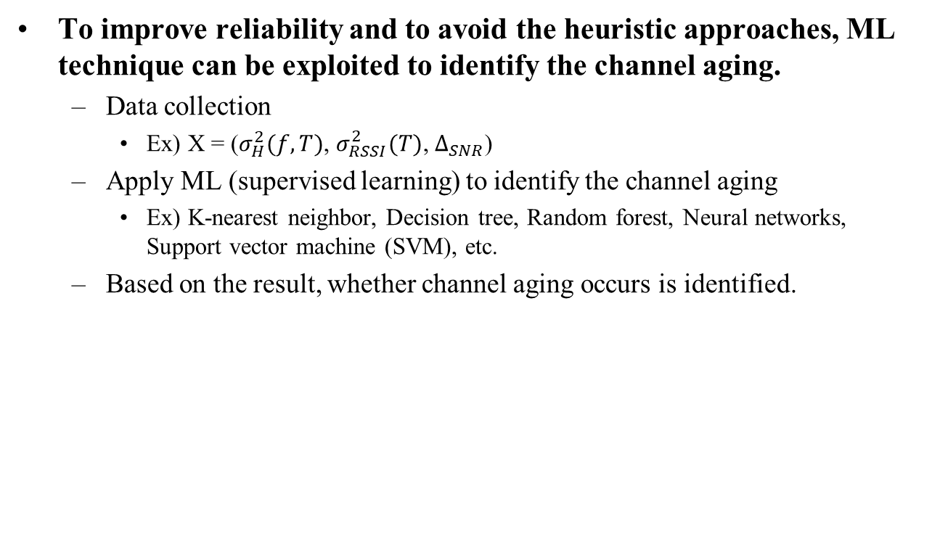
Channel aging determination
To improve reliability and to avoid the heuristic approaches, ML technique can be exploited to identify the channel aging.
  Data collection
    Ex) X = ($σ_{H}^{2}(f,T)$, $σ_{RSSI}^{2}(T)$, $∆_{SNR}$)
  Apply ML (supervised learning) to identify the channel aging
    Ex) K-nearest neighbor, Decision tree, Random forest, Neural networks, Support vector machine (SVM), etc.
  Based on the result, whether channel aging occurs is identified.

Slide 8
Feedback of channel aging indication
Alternatively, the Non-AP STA may measure the down-link channel status and feedback channel aging indication to the AP.
  Non-AP STA can identify the channel aging by using ML.
  The format of ACK (Block ACK) should be be modified to carry this information.

Slide 9
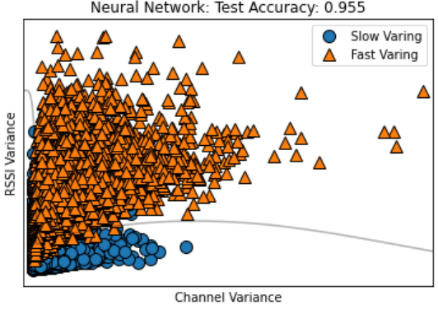
Simulation Results
Simulation setup
  Neural networks with the 100 nodes on each of the two layers.
  Time varying channel model [3]
    Fast varying: >= 5 Km/h,
    Slow varying: < 5 Km/h
Classification performance
  Almost 95% success can be achieved by using the ML.

Slide 10
Conclusion
In this contribution, we proposed a dynamic sounding scheme for WLAN beamforming, which adjusts the sounding interval base on the real-time channel aging identified by ML.
In the future, the throughput performance will be validated through the experimental test.

Slide 11
Reference
[1] X. Ma, Q. Gao, J. Wang, V. Marojevic, and J. H. Reed, “Dynamic Sounding for Multi-User MIMO in Wireless LANs,” IEEE Transactions on Consumer Electronics, 2017.
[2] 802.11-14/1329r2, Link Adaptation for HE WLAN, Newracom.
[3] H. Yu and T. Kim, “Beamforming Transmission in IEEE 802.11ac under Time-Varying Channels,” The Scientific World Journal, Volume 2014, https://doi.org/10.1155/2014/920937

