Slide 1
Discussions on Wireless Sensing Privacy
Date: 2023-05
Authors:
Name | Affiliations | email
Peng Liu | Huawei | Jeremy.liupeng@Huawei.com
Li Sun | Huawei | sunli50@huawei.com
Michael Montemurro | Huawei | michael.montemurro@huawei.com
Stephen McCann | Huawei | stephen.mccann@huawei.com

Slide 2
Outline
Wireless sensing privacy issues
Discussions within other SDOs
  3GPP (Release 19)
  IEEE 802.15.4ab (NG-UWB)
IEEE 802.11az solution (secure LTF + 64QAM)
Potential solutions
Summary

Slide 3
Three Privacy Issues in Wireless Sensing
Issue #1: The sensing report (CSI) sent from the responder to the initiator can be obtained by an unauthorized device or a malicious user, which causes sensitive/private information leakage [1]. —— Confidentiality of the sensing results
Issue #2: The attacker overhears the wireless transmissions between sensing initiator and sensing responder, from which it can identify and track the sensing devices [2]. —— Privacy of the devices performing sensing
Issue #3: The sensing signal from the transmitter can be overheard by an eavesdropper, who will perform channel estimation and extract personal/private information (e.g., the heart rate, respiratory rate, location, etc.) based on his own collected CSIs. —— Privacy of the objects being sensed

Slide 4
Three Privacy Issues in Wireless Sensing (cont.)
Issue #1 was discussed in [1] (11-22/0099r0), where it was proposed that AP should control access of sensing measurements (e.g., CSI) for the sake of privacy protection.
Issue #2 was pointed out In [2] (11-22/0401r4), where it was suggested that the tracking of sensing STAs should be prevented to protect users’ privacy.
While all these three issues are related to privacy, we focus on Issue #3 in this contribution, which is a unique problem incurred by wireless sensing and has not be addressed in TGbf.

Slide 5
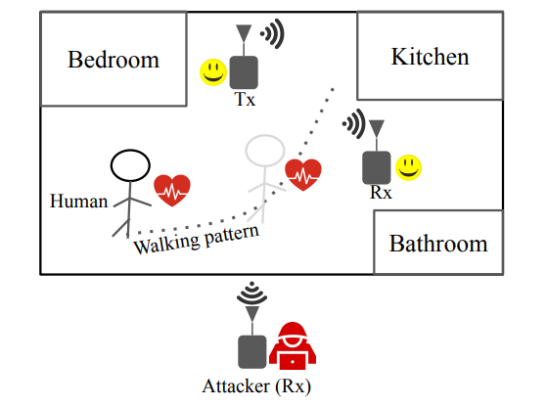
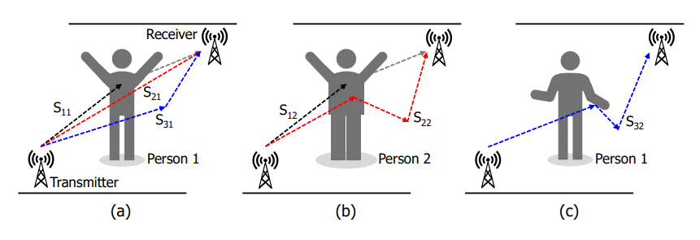
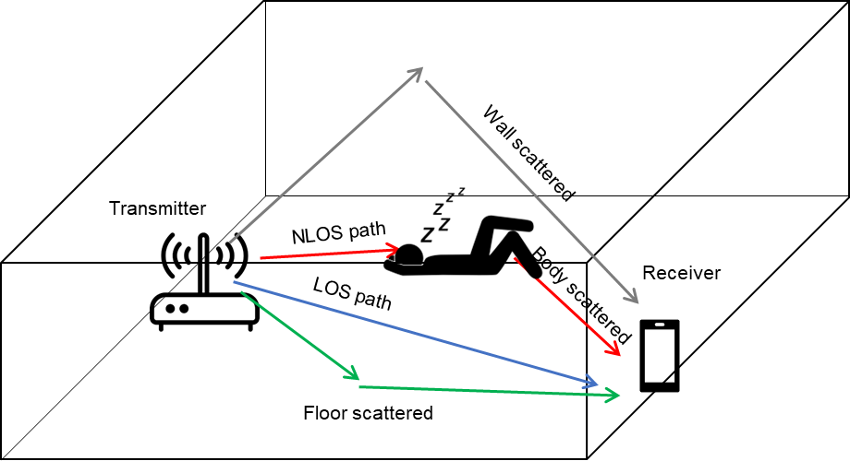
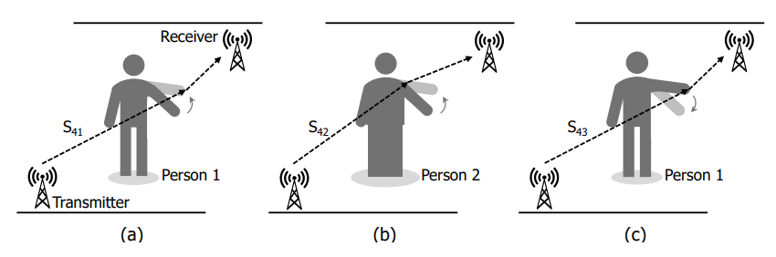
Wireless Sensing Privacy Issue #3
A transmitter (Tx) is a device (e.g., a Wi-Fi access point) that transmits sensing signals at home. The eavesdropper (i.e., a passive observer) can sniff the wireless signals to extract private information about the objects (e.g., the person) being sensed.
Walking pattern inference [3]
Respiratory rate estimation and presence inference [5]
Behavior and identification inference [4]
Private information include locations, living habits, behavioral biometric characteristics, heart rate, respiratory rate, and even the identification.

Slide 6
Wireless Sensing Privacy Issue #3 (cont.)
One may concern that even without sensing, a passive observer can still monitor wireless signals coming from a home and extract information about people’s locations or behaviors.
To extract “useful” information about a person or the environment, a series of continuously-varying CSI measurements are required to be collected.
Wireless sensing provides an opportunity for the eavesdropper to continuously perform channel estimation because a sensing session typically consists of several rounds, which lasts for a long time. However, for regular communications, the preambles are not transmitted continuously. So, it would be rather difficult for the eavesdropper to collect a series of continuously-varying CSIs.

Slide 7
Discussions within other SDOs
3GPP (Release 19)
  In [5, Sect. 5.16], it was stated that the 5G system shall provide a mechanism to protect identifiable information that can be derived from the sensing measurements data from eavesdropping.
  In [5, Sect. 6], it was further declared that:
    With sensing technology by-standers can be affected in a completely new way, previously only UEs have been able to be tracked but now sensing capabilities may enable tracing and potentially identification of anything in the environment, including humans that do not carry a UE, or any objects. This has implications for privacy.
    Since Sensing is almost for the whole environment under the RF signal coverage, the privacy of sensing operation is an important consideration factor for real deployment.
IEEE 802.15.4ab (NG-UWB)
  In[6], it was pointed out that by listening to legitimate transmissions and estimating the CSI, the unauthorized parties can infer the presence and locations of the objects, analyze the behaviors of users, and do environmental mapping, which incurs privacy concerns.
  In [7], a collaborative sensing method was proposed to prevent the unauthorized users deciphering the CSI from its received sensing packets.
Notes:
In TGbi, three sensing-privacy related issues have been discussed. 1) The STA that performs sensing might be identified and tracked. 2) Sensing results are sent in the OTA, which reveals identifiable characteristics of the device that may be used to track the device. 3) The sensing measurement frames are subject to eavesdropping, and a mechanism shall be defined to prevent the eavesdroppers from performing sensing based on the received frames. It appears that the third issue is more closely related to the topic discussed in our contribution.

Slide 8
IEEE 802.11az Solution
(secure LTF + 64QAM)
To prevent the Early Detect, Late Commit (EDLC) attack[11], IEEE 802.11az adopts secure LTF and updates 8PSK to 64QAM.
Take speed estimation [8] as an example. The “Secure LTF + 64QAM” solution causes non-negligible degradation in sensing accuracy due to the adoption of high-order QAM modulation.
Method | Secure LTF +8PSK | Secure LTF +64QAM
Speed estimation accuracy | good | Bad
Privacy protection | No | Yes (for single-antenna Eve)

Slide 9





IEEE 802.11az Solution
(secure LTF + 64QAM)
While the “Secure LTF + 64QAM” solution may take effect in privacy protection for some scenarios, it does not work if the eavesdropper has multiple antennas.
Take respiratory rate estimation [9] as an example. The eavesdropper can still infer the respiratory rate from its collected CSIs, despite the fact that the legitimate user’s signal is encrypted.
RX1 at Eve:
$$r_{1e1}\left[n\right]=q\left[n\right]∗h_{1e1}[n]$$
$$R_{1e1}\left[k\right]=Q\left[k\right]H_{1e1}\left[k\right]$$
RX2 at Eve:
$$r_{1e2}\left[n\right]=q\left[n\right]∗h_{1e2}[n]$$
$$R_{1e2}\left[k\right]=Q\left[k\right]H_{1e2}\left[k\right]$$
This peak clearly indicates that the respiratory rate is 15 times/min
The absolute value of the spectrum of H(k, t)
The time-varying property of the “equivalent” CSI exposes the private information, i.e., the respiratory rate of the person in this case
$$\frac{R_{1e1}\left[k\right]}{R_{1e2}\left[k\right]}=\frac{H_{1e1}\left[k\right]}{H_{1e2}\left[k\right]}$$
Respiratory rate (times per minute)

Slide 10
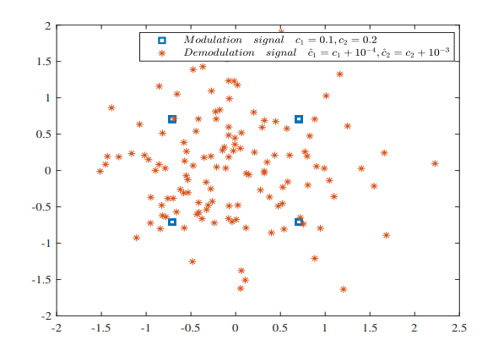
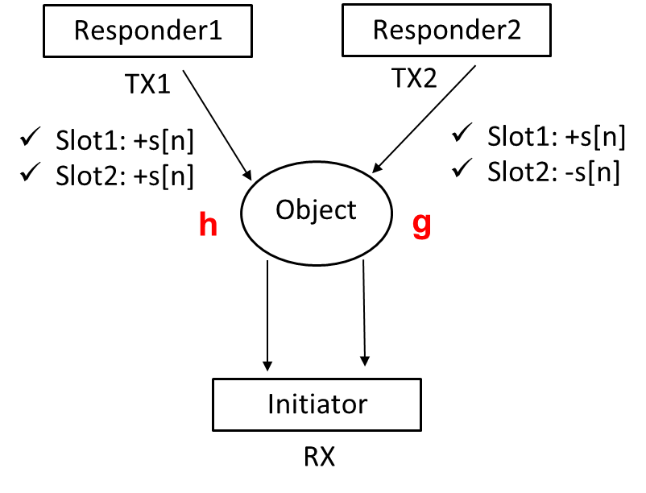
Potential Solutions
The key point in sensing privacy protection is obfuscating wireless sensing signals while not degrading sensing performance.
Potential technical solutions may include
  Apply new waveforms with secret parameters, where the secret parameters are only known by legitimate parties [10].
  Collaborative sensing [7] such as the one discussed in NG-UWB (needs to be tailored to Wi-Fi sensing standard).
  …

Slide 11
Summary
CSI measurement by unauthorized devices during WLAN sensing may expose private/personal information and violate users’ privacy requirement.
The aforementioned sensing privacy issue is less discussed in 802.11bf, while it is addressed by other SDOs and the literature.
The current security solution in IEEE 802.11az (secure LTF + 64QAM) causes degradation in sensing performance, and even worse, fails in privacy protection.
There is no way to prevent passive capture of wireless signals, but it is still possible to manipulate the wireless transmission to obfuscate the CSI at the eavesdroppers such that privacy-related information cannot be extracted from the obfuscated CSIs.
Candidate solutions shall be studied and discussed.
Notes:
There is no way to prevent passive capture of wireless signals, but we can still figure out solutions to manipulate the wireless transmission such that the estimated CSIs at the eavesdropper are incorrect, or at least the observed CSIs at the eavesdropper is obfuscated such that privacy-related information (e.g., breath rate) cannot be extracted from the obfuscated CSIs.

Slide 12
References
[1] 11-22-0099-00-00bf-wlan-sensing-privacy-use-cases, Jan. 2022.
[2] 11-22-0401-04-00bf-sensing-security-requirements, Apr. 2022.
[3] W. Sun, T. Chen, and N. Gong, “SoK: Inference attacks and defenses in human-centered wireless sensing,” available online, https://arxiv.org/abs/2211.12087, Nov. 2022.
[4] J. Liu, C. Xiao, K. Cui, J. Han, X. Xu, and K. Ren“Behavior privacy preserving in RF sensing,”IEEE Trans. Dependable and Secure Computing, vol. 20, no. 1, pp. 784-796, Jan. 2023.
[5] 3GPP TR 22.837, Feasibility Study on Integrated Sensing and Communication, Nov. 2022.
[6] 15-22-0177-01-04ab-privacy-issues-in-uwb-sensing, Mar. 2022.
[7] 15-22-0248-00-04ab-privacy-preserving-and-performance-enhancement-for-uwb-sensing, May 2022.
[8] F. Zhang, C. Chen, B. Wang and K. J. R. Liu, “Wispeed: A statistical electromagnetic approach for device-free indoor speed estimation,” IEEE Internet Things J., vol. 5, no. 3, pp. 2163-2177, Jun. 2018.
[9] J. Liu, Y. Wang, Y. Chen, J. Yang, X. Chen, and J. Cheng, “Tracking vital signs during sleep leveraging off-the-shelf WiFi,” in Proc. ACM MobiHoc’15, Hangzhou, China, Jun. 2015, pp. 267-276.
[10] Y. Zhang, H. Wang, P. Liu, and X. Lu, “A robust joint sensing and communications waveform against eavesdropping and spoofing,” in Proceedings of the IEEE VTC2022-Spring, Helsinki, Finland, Jun. 2022.
[11] 11-20-0374-00-00az-computational-attacks-on-11az-physecure-ranging

