Slide 1
802REVc Topics and Discussion Update
Date: 2023-05-08
Authors:

Slide 2
Abstract
This document provides a summary of discussions and decision during 802.1 802REVc comment resolution meetings and comments of interest to 802.11.
This document is intended to be used as a working document for the 802.11 ARC SC.

Slide 3
802.1 Maintenance Meetings – Comment Resolution
802.1 802REVc meetings held since March 802.11 Plenary Meeting:
2 May 2023 – 11:00 – 13:00 h ET:
https://mentor.ieee.org/802.1/dcn/23/1-23-0009-07-Mntg-802-revc-editors-update.odp
https://mentor.ieee.org/802.1/dcn/23/1-23-0010-04-Mntg-802-revc-proposed-resolutions.pdf
25 April 2023 – 11:00 – 13:00 h ET:
https://mentor.ieee.org/802.1/dcn/23/1-23-0009-06-Mntg-802-revc-editors-update.odp
https://mentor.ieee.org/802.1/dcn/23/1-23-0010-02-Mntg-802-revc-proposed-resolutions.pdf
11 April 2023 – 11:00 – 12:00 h ET:
https://mentor.ieee.org/802.1/dcn/23/1-23-0008-07-Mntg-802-revc-comments-wg-lb1-pdis.ods
https://mentor.ieee.org/802.1/dcn/23/1-23-0009-03-Mntg-802-revc-editors-update.odp
https://mentor.ieee.org/802.1/dcn/23/1-23-0010-01-Mntg-802-revc-proposed-resolutions.pdf
4 April 2023 – 11:00 – 13:00 h ET:
https://mentor.ieee.org/802.1/dcn/23/1-23-0008-06-Mntg-802-revc-comments-wg-lb1-pdis.ods

Slide 4
802.1 Maintenance Meetings – 4 April 2023
Figure 8 “An example of a bridged IEEE 802 network” – an updated figure proposed
While discussing Figure 8– there was discussion on: IEEE 802 network link – link is not always the correct term, as not always P2P, but it is always a MAC to MAC connection. e.g., “fat yellow cable” – (also wireless)
Some discussion on YANG text – concern that referring to SNMP as “historically” is not correct for all 802 specs.
CID 103 Discussion on SNAP AA and AB – proposal to be provided (Roger Marks)
CID 105 discussion of VLANs – suggestion to reference 802.1Q, but comments that end stations can support VLAN and not just bridges. Call for a contribution – otherwise comment will be rejected.
Documents:
https://mentor.ieee.org/802.1/dcn/23/1-23-0008-06-Mntg-802-revc-comments-wg-lb1-pdis.ods

Slide 5
802.1 Maintenance Meeting – 11 April 2023
Current Plan:
Working with 1-23/0009r2
Will wait till 802f is complete before next ballot (will roll in, will do internal review of roll in)
Discuss editorials:
Some open issues: “data center” is not defined, what is an L2 data center, is DCN targeted at the network? There is congestion in data centers at both the Data Link Layer and the Network Layer.
Documents:
https://mentor.ieee.org/802.1/dcn/23/1-23-0008-07-Mntg-802-revc-comments-wg-lb1-pdis.ods
https://mentor.ieee.org/802.1/dcn/23/1-23-0009-03-Mntg-802-revc-editors-update.odp
https://mentor.ieee.org/802.1/dcn/23/1-23-0010-01-Mntg-802-revc-proposed-resolutions.pdf

Slide 6
802.1 Maintenance Meeting – 25 April 2023
Discussed editorials: CIDs 18, 19, 23, 28, 33, 39-48-56, 47, 54-55, 109, 117 –
Potential ARC issue: How does the 802.11 “Portal” fit into 802 when discussing bridging the 802.11 DS to other 802s?
When through most of Bob Grow’s comments
Documents:
https://mentor.ieee.org/802.1/dcn/23/1-23-0009-06-Mntg-802-revc-editors-update.odp
https://mentor.ieee.org/802.1/dcn/23/1-23-0010-02-Mntg-802-revc-proposed-resolutions.pdf

Slide 7
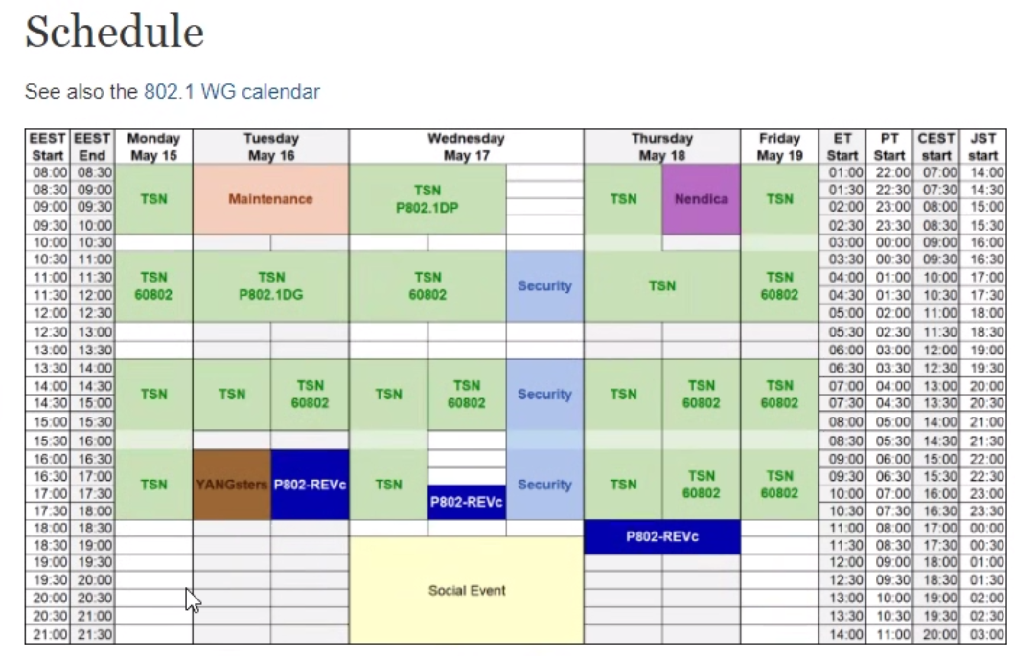
802.1 Maintenance Meeting – 2 May 2023
Discussion on “Backbone Network” – a network of bridges, see changes in 1-23/0010r4
Issue regarding 6.3 – it is written for wired and optical – but is should include all networks (wireless).
Discussed meetings for upcoming Interim meeting:
Documents:
https://mentor.ieee.org/802.1/dcn/23/1-23-0009-07-Mntg-802-revc-editors-update.odp
https://mentor.ieee.org/802.1/dcn/23/1-23-0010-04-Mntg-802-revc-proposed-resolutions.pdf

Slide 8
References

