Slide 1
Neural Network Quantization for Overhead Reduction in AIML Model Sharing
Date: 2023-05-15

Slide 2
Background and introduction
A use case for AIML model sharing has been defined in [1].
AIML model sharing seems to have the most significant standard impact and its technical feasibility needs to be well discussed [2].
It has been discussed in [2] how to share AIML model parameters between STAs.
Neural network model is a key category of AIML models under discussion in AIML TIG (e.g., [3]-[6])
In this contribution, we will discuss what parameters can be shared for neural network based AIML model.

Slide 3
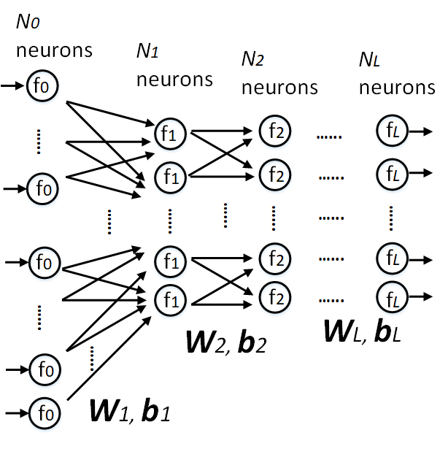


Neural Network Model Sharing
A feedforward neural network:
Weighting and bias coefficients (W, b) is trained at a STA
The STA may need to send the trained coefficients to the other STAs (i.e., model sharing)
The format of the coefficients is usually in single-precision floating-point (32-bits), thus requires a lots of communication overhead, especially for large models
Similar for other models, such as convolutional and recurrent neural network models
$$s_{0}$$
$$s_{l}=W_{l}f_{l−1}\left(s_{l−1}\right)+b_{l}, l∈\left[1,L\right]$$

Slide 4
Neural Network Quantization for AIML Model Sharing
Neural network quantization is a well-known AI technique to reduce computational complexity and model storage requirement [7], we propose to use the technique for communication overhead reduction for AIML model sharing.

Slide 5
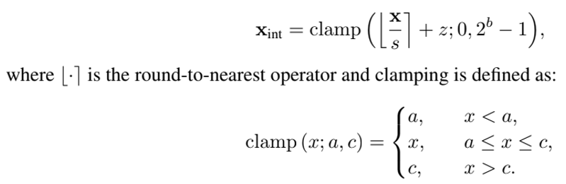
Fundamentals of Neural Network Quantization
x: a single-precision floating point coefficient to be quantized
xint: quantized integer from x
b: bit width of xint (<32)
s: scaling factor
z: zero-point
After quantization, STAs can share xint, s and z, stead of share x

Slide 6
Categories of Neural Network Quantization
Post-training quantization (PTQ)
  Very effective and fast to implement because it does not require retraining of the network with labelled data.
  It may not be enough to mitigate the large quantization error introduced by low-bit quantization.
Quantization-aware training (QAT)
  Treats scaling factor and zero point as learnable parameters to be optimized during training.
  Aiming for low-bit quantization, such as 4-bits and below.

Slide 7
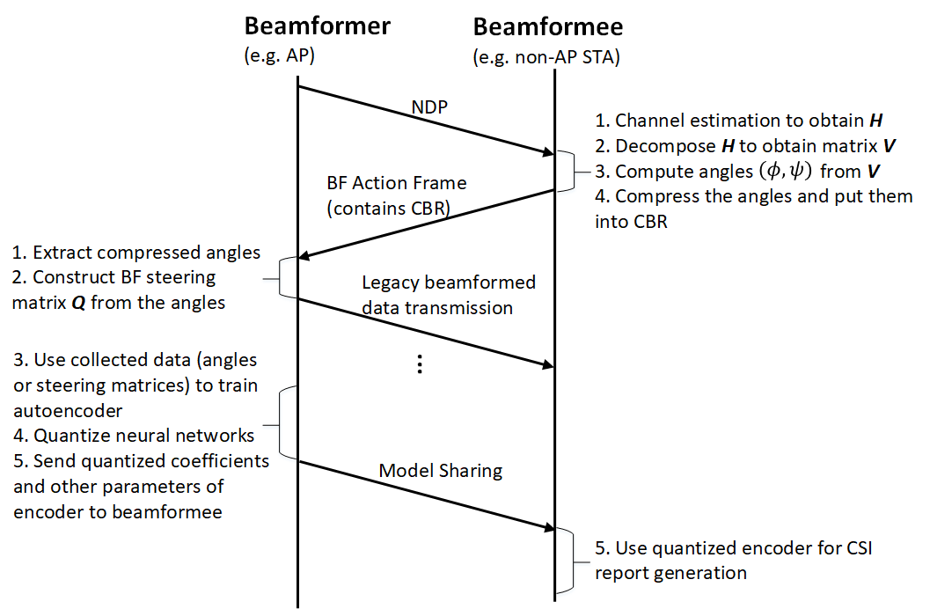
Example: AIML Beamforming Using Quantized Autoencoder
AIML training phase
Legacy beamforming

Slide 8
Model Sharing Overhead Reduction for Autoencoder-based Beamforming Scheme in [5]
Method | Required overhead per model sharing (bits)
Encoder without quantization (single-precision floating point) | 104192 (3256 coefficients)
Encoder with 8-bits-PTQ on weighting coefficients | 27456
Model sharing overhead during training is reduced by 74%

Slide 9
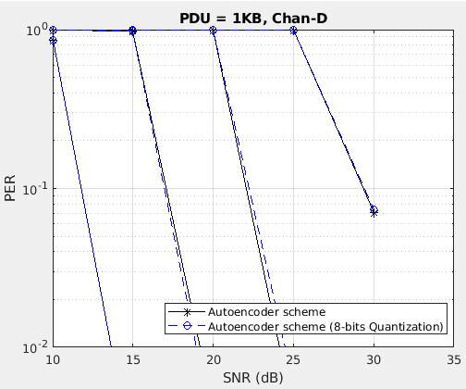
PER Performance with Autoencoder-based Beamforming
MCS11
MCS9
Same PER performance
with and without quantization
MCS7
MCS4

Slide 10
Standard impact
Signalling and protocol related to model parameters sharing, such as floating-point/integer neural network coefficients and other quantization parameters (e.g., scaling factor, zero point)

Slide 11
Summary
We have proposed to use neural network quantization for communication overhead reduction in AIML model sharing
We have given an example of using quantized autoencoder for training overhead reduction in AIML beamforming

Slide 12
Question
By considering existing use case for “AIML Model Sharing” in [1], do you think this contribution should be considered as a separate use case for AIML TIG or merged into [1]?

Slide 13
References
[1] 11-23/0050r3, Proposed Technical Report Text for AIML Model Sharing Use case
[2] 11-23/0397r1, Technical Feasibility Analysis of ML Model Sharing
[3] 11-22/1934r5, Proposed IEEE 802.11 AIML TIG Technical Report Text for the CSI Compression Use Case
[4] 11-23/0290r1, Study on AI CSI Compression
[5] 11-23/0755r0, AIML Assisted Complexity Reduction For Beamforming CSI Feedback Using Autoencoder
[6] 11-23/0750r0, Discussions on Neural Network Model Sharing for WLAN
[7] M. Nagel, et al., “A White Paper on Neural Network Quantization”, Qualcomm AI Research, Jun. 2021.

