Slide 1
AIML Assisted Complexity Reduction For Beamforming CSI Feedback Using Autoencoder
Date: 2023-05-15

Slide 2
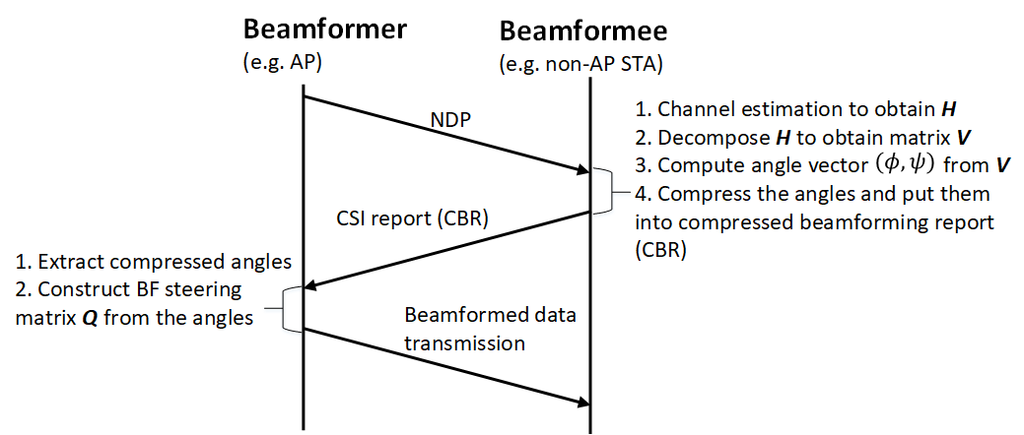
Recap: Legacy beamforming scheme

Slide 3
Recap: Existing AIML Beamforming schemes
K-means based schemes (e.g., [1]-[2])
The scheme feedbacks an index which represents a codeword in a pre-trained codebook
The codebook design in [1] is in angles obtained from V matrix
The codebook design in [2] is in either angles (scheme I) or steering matrix (scheme II)
Autoencoder based schemes (e.g., [3]-[4])
Neural network is used to compress feedback information
In [3], angles are compressed, and the feedforward neural network (FNN) is used for autoencoder
In [4], convolutional neural network (CNN) or transformer is used for autoencoder

Slide 4
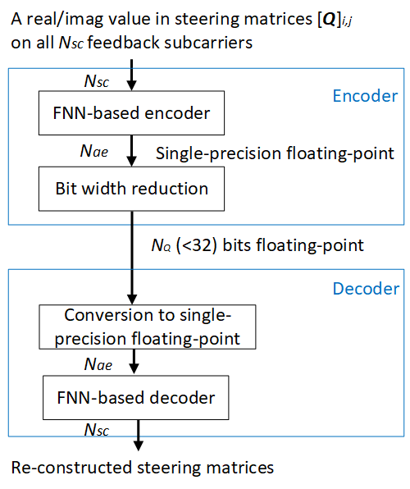
Proposed autoencoder-based scheme
Parameters Nae and NQ need to be optimized to
trade-off between model precision and feedback overhead
CSI feedback at beamformee
Advantages:
Steering matrix is compressed directly to avoid angle computation using Givens rotation
FNN is used in the encoder to reduce computational complexity

Slide 5
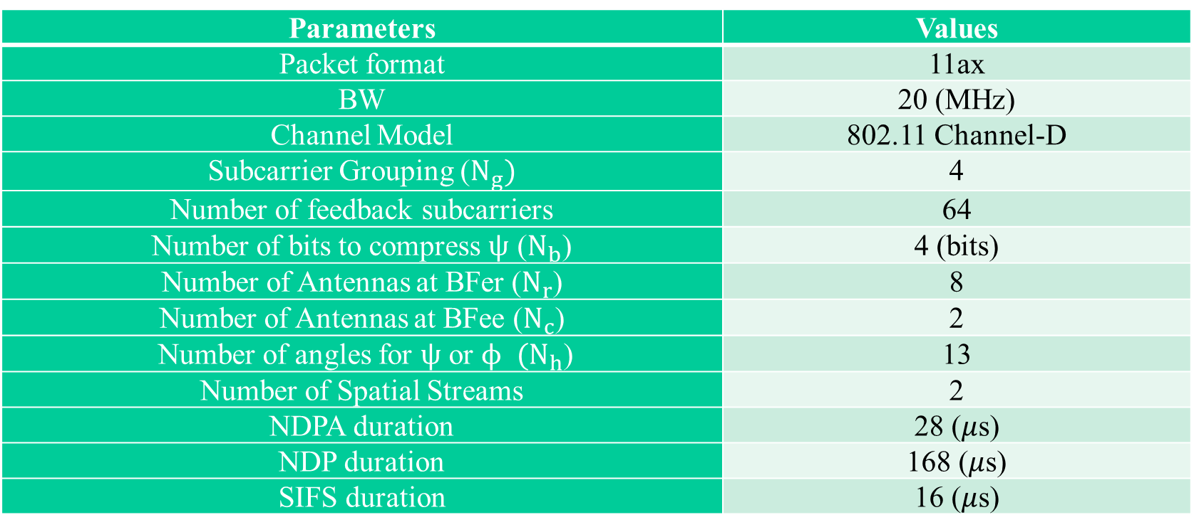
Considered system parameters for performance evaluations
Parameters | Values
Packet format | 11ax
BW | 20 (MHz)
Channel Model | 802.11 Channel-D
Subcarrier Grouping ($N_{g})$ | 4
Number of feedback subcarriers | 64
Number of bits to compress $ψ$ ($N_{b}$) | 4 (bits)
Number of Antennas at BFer ($N_{r}$) | 8
Number of Antennas at BFee ($N_{c}$) | 2
Number of angles for $ψ$ or $ϕ$ $(N_{h}$) | 13
Number of Spatial Streams | 2
NDPA duration | 28 ($μ$s)
NDP duration | 168 ($μ$s)
SIFS duration | 16 ($μ$s)

Slide 6
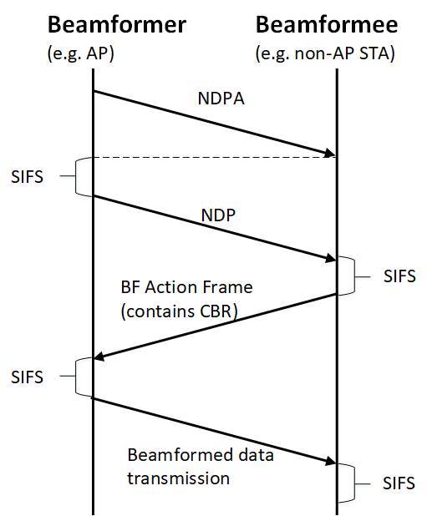
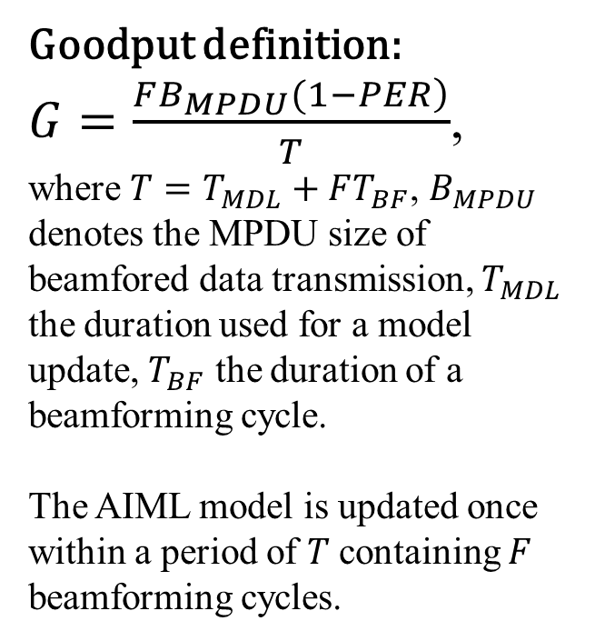
Goodput evaluation method
Goodput definition:
$G=\frac{\left.FB_{MPDU}(1−PER\right)}{T}$,
where $T=T_{MDL}+FT_{BF}$, $B_{MPDU}$ denotes the MPDU size of beamfored data transmission, $T_{MDL}$ the duration used for a model update, $T_{BF}$ the duration of a beamforming cycle.
The AIML model is updated once within a period of $T$containing $F$ beamforming cycles.
MCS for both BFed data transmission and CSI reports are selected according to mean SNR
Model sharing uses legacy beamforming
A beamforming cycle

Slide 7
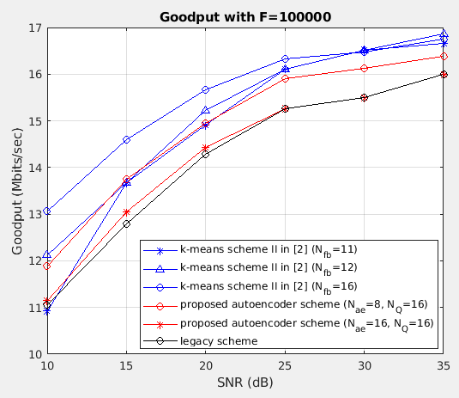
Goodput comparison
For the proposed scheme, the format of the output from the encoder is half-precision floating-point (16 bits)
$B_{MPDU}$ = 1KB

Slide 8
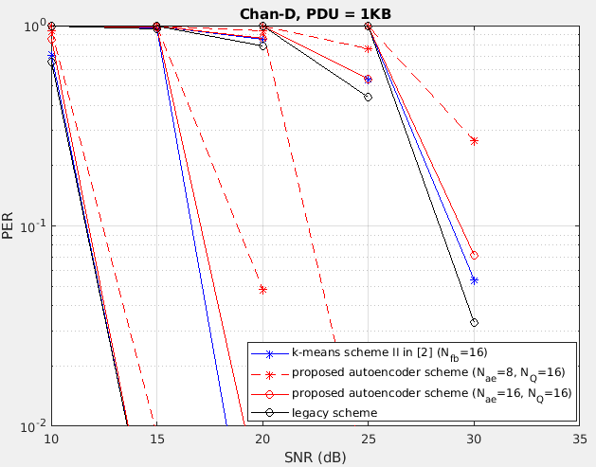
PER performance comparison
MCS8
MCS10
MCS11
MCS4
MCS7
$B_{MPDU}$ = 1KB

Slide 9
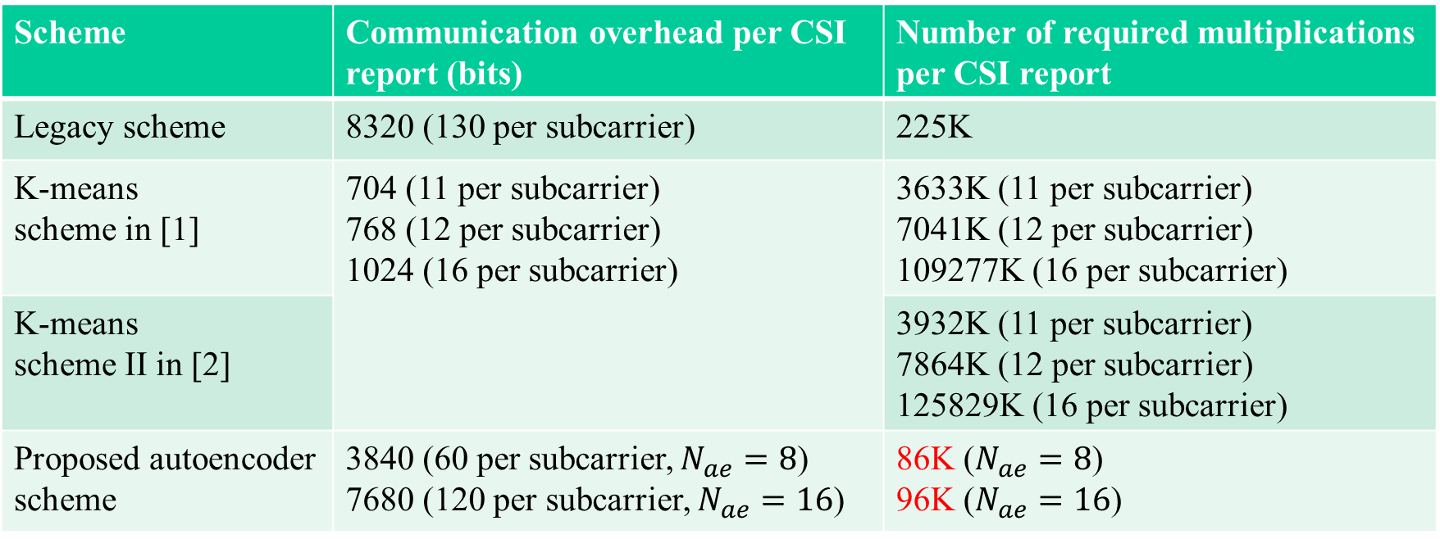
Comparisons of overhead and complexity for CSI reports
Scheme | Communication overhead per CSI report (bits) | Number of required multiplications per CSI report
Legacy scheme | 8320 (130 per subcarrier) | 225K
K-means scheme in [1] | 704 (11 per subcarrier) 768 (12 per subcarrier) 1024 (16 per subcarrier) | 3633K (11 per subcarrier) 7041K (12 per subcarrier) 109277K (16 per subcarrier)
K-means scheme II in [2] |  | 3932K (11 per subcarrier) 7864K (12 per subcarrier) 125829K (16 per subcarrier)
Proposed autoencoder scheme | 3840 (60 per subcarrier, $N_{ae}=8$) 7680 (120 per subcarrier, $N_{ae}=16$) | 86K ($N_{ae}=8$) 96K ($N_{ae}=16$)
Note: complexity of k-mean schemes mainly comes from codeword index searching (Euclidean distance as the metric); complexity of the legacy scheme comes from angle computation (Givens rotation)

Slide 10
Summary
We have presented a beamforming CSI feedback scheme with low computational complexity, the key purpose is to enable faster feedback and lower power consumption at non-AP STAs (e.g., mobile devices).
This is different from the existing use case in [5] whose main purpose is CSI compression and goodput improvement.

Slide 11
Question
Do you agree that “Complexity reduction for CSI feedback” should be considered as a separate use case for AIML TIG?

Slide 12
References
[1] M. Deshmukh, Z. Lin, et al., “Intelligent Feedback Overhead Reduction (iFOR) in Wi-Fi 7 and Beyond,” IEEE Vehicular Technology Conference (VTC), Jun. 2022
[2] 11-23/0275r1, Improved AIML Enabled Index Based Beamforming CSI Feedback Schemes
[3] P. Sangdeh, H. Pirayesh, A. Mobiny and H. Zeng, “LB-SciFi: Online Learning-Based Channel Feedback for MU-MIMO in Wireless LANs,” 2020 IEEE 28th International Conference on Network Protocols (ICNP), Oct. 2020.
[4] 11-23/0290r1, Study on AI CSI Compression
[5] 11-22/1934r5, Proposed IEEE 802.11 AIML TIG Technical Report Text for the CSI Compression Use Case

