Slide 1
Discussions on Neural Network Model Sharing for WLAN
Date: 2023-05
Authors:
Name | Affiliations | Address | Phone | Email
Peng Liu | Huawei | Huawei Base, Bantian, Longgang, Shenzhen, Guangdong, China, 518129 |  | Jeremy.liupeng@huawei.com
Ziyang Guo
Ross Jian Yu

Slide 2
Introduction
Model sharing, one of the main use cases in standardization, has been discussed in AIML TIG [1-3].
In Technical Report [1], model has a broad description and may include specific learning algorithms and parameters.
As neural network is a core and symbolic component in AI, and most of the use cases in the survey [4] are related to deep (reinforcement) learning, we focus on neural network model sharing in this submission.

Slide 3
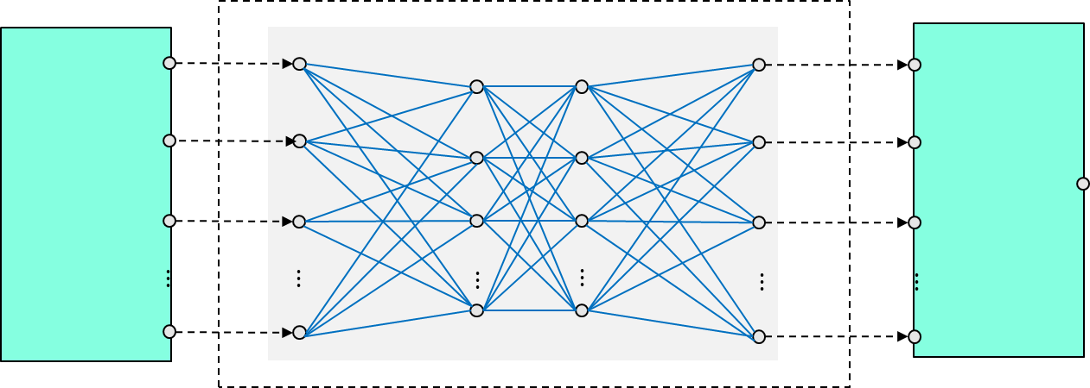
Neural Network Model Sharing between AP and non-AP STA
Neural network model sharing can be applied between STAs (AP and AP, AP and non-AP STA, non-AP STA and non-AP STA), depending on specific use cases.
As an example, we focus on the model sharing scenario where AP trains NN models and shares/deploys NN models to non-AP STAs.
It looks most likely to be widely used as
  Training is usually energy consuming and not friendly to battery powered non-APs
  All non-AP data can be fully utilized for training a model
  Easy to get a network-level optimization goal
  Easy for model operation and maintenance (O&M)
  Facilitate model reuse, one model is applied for multiple non-AP STAs and even multiple features [5].
Train@AP
Training data report
AP
Model deployment/sharing
Non-AP 3
Non-AP 1
Non-AP 2
Inference@non-AP STA
Input
Neural Network
Output

Slide 4
Revisit the Use Cases in [6]
Use cases | Discussed in AIML TIG | Related DCN | Relevance to the current discussion (neural network model sharing between AP and non-AP STA)
Enhanced roaming/mobility | Yes | 11-23/0433r2 | NA
Multi-RU/channel allocation/channel bonding/Multi-AP | Yes | 11-23/0201r0, 11-23/0227r3 | NA, model sharing may be involved between APs
Latency/QoS optimization |  |  | NA, seems a scheduling problem, completely implements at AP
Traffic prediction |  |  | NA
Device level power consumption |  |  | AP trains a neural network model for non-AP to determine the power-off time duration
Spatial reuse | Yes (only mentioned) | 11-22/0979r1 | AP trains a neural network model model for non-AP to determine OBSS ED/CS threshold and power, non-AP infers the SR parameter based on local observation
Distributed channel access | Yes | 11-22/0979r1,11-22/1522r1,11-23/2119r6 | AP trains a neural network model model for non-AP to determine channel access decision (CW, transmit probability, or transmit/wait directly)
Channel estimation/MIMO detection |  |  | NA
Link adaptation | Yes (only mentioned) | 11-22/0979r1 | AP trains a neural network model model for non-AP to determine rate/bandwidth/number of spatial streams/power …
Beam management | Yes (only mentioned) | 11-22/0979r1 | AP trains a neural network model model for non-AP to determine beam sector/beamwidth/rate …
MU-MIMO MAC scheduling (user selection and resource allocation) | Yes (only mentioned) | 11-22/0979r1 | NA, seems a scheduling problem, completely implements at AP
CSI compression and feedback | Yes | 11-23/0290r1,11-23/1934r5,11-23/0275r1,11-23/0280r0 | AP trains encoder and decoder, and sends encoder to non-AP

Slide 5
Transmission Scheme Use Cases
Most use cases such as device level power consumption, non-AP spatial reuse, distributed channel access, link adaptation and beam management can be categorized as transmission scheme optimization.
AP trains neural network models to assist non-AP to determine an optimal transmission scheme.
In the following, we discuss neural network model architecture for transmission scheme use cases and look for common ground that facilitates standardization.

Slide 6




Neural Network Model Workflow for Transmission Scheme Optimization
Input
Neural Network (NN)
Output
Channel
ACK
Buffer status
RSSI
Load
Neighbor report
…
Channel access
power-off time duration
OBSS ED/CS threshold
MCS
$$⋮$$
$$⋮$$
$$⋮$$
$$⋮$$
$$⋮$$
$$⋮$$
MAC/PHY measurements
Can be a sequence of historical observations
Pre-processing
Format conversion (normalization) to NN model readable format
Feature extraction, compress the raw data
either NN or other algorithms
Core Neural Network Model
structure, e.g., CNN or DNN
Layer types, number of layers, number of neurons per layer, activation function
Post-processing
Map neural network output to specific transmission scheme
probability distribution or argmax
Transmission scheme

Slide 7
Discussions on Neural Network Model Workflow
The inputs from wireless radio measurements
  Include local radio measurements at PHY/MAC layer
  Some parameters have already been defined in Sec.4.3.11 of the 802.11-2020, i.e., Wireless LAN radio measurements
  May also include customized measurements, not expected to be standardized
  Could be a sequence of measurements, not only statistics, difficult to be standardized
  If possible, standardize some basic and common inputs for a variety of use cases. It may have the advantage that AP can obtain some training data (by monitoring non-AP’s status) without the report from non-AP STAs, thus reducing the overhead of uploading training data
Channel
ACK
Buffer status
RSSI
Load
Neighbor report
A sequence of historical above measurements
…
Notes:
Include local radio measurements at PHY/MAC layer
Some measurements have already been defined in Sec.4.3.11 of 802.11-2020, i.e., Wireless LAN radio measurements
Some measurements may include customized measurements which are not expected to be standardized
Could be a sequence of measurements, not only statistics, which are difficult to be standardized
One possible way of standardization is to figure out some basic and common inputs for a variety of use cases
Standardize some common inputs may have the advantage that AP can obtain some training data (by monitoring non-AP’s status) without the report from non-AP STAs, thus reducing the overhead of uploading training data

Slide 8
Discussions on Neural Network Model Workflow
Pre-processing
  Format conversion (normalization) to neural network model readable format, e.g., normalized to [0,1]
  Feature extraction, compress the raw historical observed data from wireless environment
  Either NN or other algorithms can be applied
  If Pre-processing is left for implementation, the output of Pre-processing (i.e., the input of core neural network model ) shall be standardized. For example, it could be regulated as a vector with M dimension. In this case, the M-dimensional vector is the training data and shall be reported to AP in order to execute training.
$$⋮$$
M-dimensional vector

Slide 9
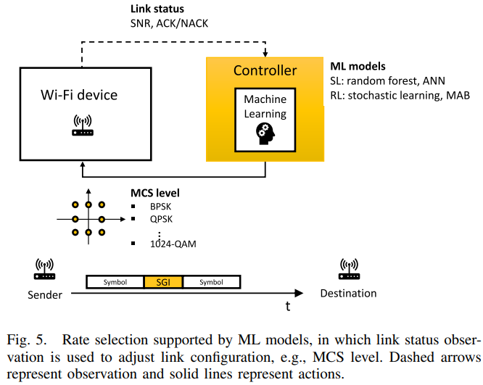
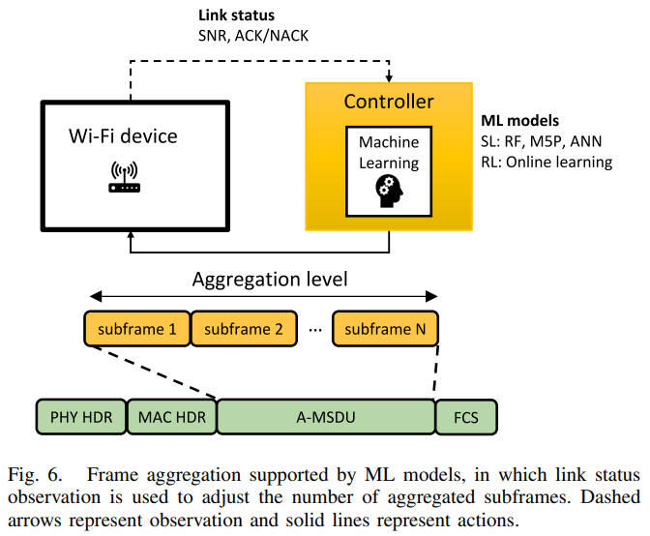
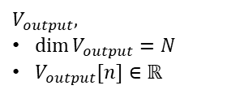
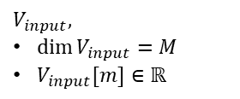
Discussions on Neural Network Model Workflow
Core Neural Network Model
  Layer types, number of layers, number of neurons per layer, activation function
  If possible, standardize several basic and mandatory model structure such as DNN and CNN
  Alternatively, employ other standardized neural network model format on top of the 802.11, such as NNEF(Neural Network Exchange Format)[7] and ONNX(Open Neural Network eXchange)[8]
  Explore model reuse, one neural network model structure applied to multiple transmission scheme optimization use cases, to reduce implementation complexity and facilitate standardization [5].
$$⋮$$
$$⋮$$
$$⋮$$
$$⋮$$
$$V_{input},$$
$\dim{V_{input}}=M$
$V_{input}[m]∈ℝ$
$$V_{output},$$
$\dim{V_{output}}=N$
$V_{output}[n]∈ℝ$
Different use cases (rate selection and frame aggregation) with same inputs [4]
Notes:
It is feasible as different transmission scheme optimization use cases may have the same goal of boosting channel efficiency and guaranteeing the fairness, and they may leverage similar observations from wireless radio measurements

Slide 10
Discussions on Neural Network Model Workflow
Post-processing
  Map neural network output to specific transmission scheme
  Post-processing can be categorized as two types based on the output of Core NN model
    Type A. if Core Neural Network model outputs a probability distribution. Take MCS selection as an example, it corresponds to the probability distribution of each MCS, and post-processing randomly outputs one MCS based on the probability distribution
    Type B. if Core Neural Network model outputs scores of transmission scheme. Again, take MCS selection as an example, it corresponds to the score of each MCS, and post-processing outputs one MCS whose score is the maximum
  Both two types of post-processing can be considered to be standardized to support a variety of AI algorithms
Channel access
power-off time duration
OBSS ED/CS threshold
MCS
$$⋮$$
N-dimensional vector
Probability distribution
Scores

Slide 11
Summary of Neural Network Model Workflow
Components | Descriptions | Thoughts on Standardization
The inputs | local radio measurements at PHY/MAC layer, defined in Sec.4.3.11 of 802.11-2020 or customized Can be a sequence of historical observations | Standardize some basic and common inputs for a variety of use cases
Pre-processing | Format conversion (normalization) to NN model readable format Feature extraction, compress the raw data either NN or other algorithms | If Pre-processing is left for implementation, the output of Pre-processing (i.e., the input of core NN model ) shall be standardized
Core Neural Network Model | Structure, e.g., DNN or CNN Layer types, number of layers, number of neurons per layer, activation function | Standardize several basic and mandatory model structure such as DNN and CNN Alternatively, consider ONNX or NNEF on top of the 802.11 Explore Model reuse
Post-processing | Map Neural Network output to specific transmission scheme probability distribution or ArgMax | Both two types can be considered to be standardized

Slide 12
Summary
In this contribution, we discussed some general considerations on neural network model sharing for WLAN.
We revisit the use cases in the previous submission and observe that most of them can be categorized as transmission scheme optimization.
We investigate the neural network model architecture on transmission scheme optimization use cases, which consists of inputs, pre-processing, core neural network model and post-processing, and discuss the functions and possible standardization impacts/ways for each part.

Slide 13
Reference
[1] 11-23-0397-01-aiml-technical-feasibility-analysis-of-ml-model-sharing
[2] 11-22-1948-00-aiml-aiml-model-sharing-use-case
[3] 11-23-0397-01-aiml-technical-feasibility-analysis-of-ml-model-sharing
[4] S. Szott, K. Kosek-Szott, P. Gawłowicz, J. Torres Gómez, B. Bellalta, A. Zubow and F. Dressler, "Wi-Fi Meets ML: A Survey on Improving IEEE 802.11 Performance with Machine Learning," in IEEE Communications Surveys & Tutorials, doi: 10.1109/COMST.2022.3179242.
[5] 11-23-0075-01-0uhr-more-discussions-on-deep-learning-for-wlan
[6] 11-22-0458-01-0wng-looking-ahead-to-next-generation-follow-up
[7] The Khronos NNEF Working Group, “Neural Network Exchange Format”, https://www.khronos.org/registry/NNEF/specs/1.0/nnef-1.0.5.html
[8] Open Neural Network Exchange (ONNX), https://onnx.ai

