Slide 1
Uplink MU MIMO Precoding – Follow-up
Date: 28-Apr-23

Slide 2
Introduction
[1] presented uplink MU MIMO precoding for uplink rate and reliability improvement
This contribution gives more simulation results and details to respond to the questions raised for [1]:
  MAC overhead and channel aging
  Additional simulations
    Comparison to beamforming
    Performance on LOS channels
    Performance with 3 stations
    Nonlinear Receiver
  Details on the precoder calculation

Slide 3
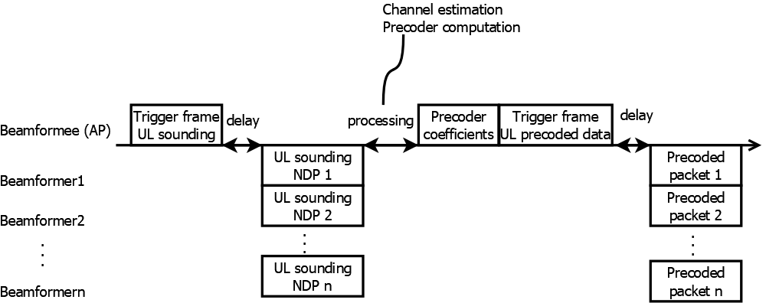
MAC Overhead - Introduction
Uplink precoding introduces a new sounding procedure with the following steps
  Sounding trigger frame
  Uplink NDP
  Precoder coefficient message
Due to channel aging, there is a trade-off between precoding performance and sounding overhead, which determines the sounding frequency

Slide 4
MAC Overhead Estimation
  Sounding trigger frame (EHT) 64µs (48µs preamble/extension+16µs content), carries 245Byte at 320MHz mcs0 (>>34Byte required)
  Uplink NDP 8x8+48µs = 112µs (2x LTF, 4 STA)
  Precoder+trigger packet:
    48µs preamble /packet extension
    6bit phase/5bit amplitude format: 2 antennas require 1 phase, 2 amplitudes requires 2 byte per 4 carriers: 1920 byte per STA at 320MHz
    Simulations assume the precoders are communicated with a MU-MIMO packet at 50% of the rate of a data packet (for higher robustness)
  2 SIFS 2x16µs

Slide 5
Aging and Sounding Interval
Scenario 1: Few STAs (<40)
  sounding in regular interval, e.g., 60ms
Scenario 2: Many STAs:
  Sounding for every TXOP with the STAs of interest
Assumptions
  6ms TXOP length
  5.4ms packet length
  For simulation, only the simulated (e.g., 4) STAs are served
Aging channel
6Hz Doppler, 1.2km/h movement [2]
Per-STA transmit clock: STA clocks have ±0.07ppm clock difference

Slide 6
Aging vs. Overhead
4 STAs, different sounding intervals
Neither aging nor overhead degrades performance much
Uplink precoding is less sensitive to aging than downlink MU MIMO

Slide 7
Additional Simulation Results
Additional simulations
  Answers to questions on simulations in [1]
  Comparison to beamforming
  Performance on other channel types
  Performance with 3 stations
  Nonlinear Receiver

Slide 8
Gap between Precoding and no Precoding on high Channel SNR in [1]
Simulation Conditions
D NLOS channel, 320MHz
2x LTF; 1.6µs GI
Grouping 4
4STAs, 1 AP
STAs: 2 TX antennas, 1SS
AP: 4 RX antennas
TXSNR: 45dB
RXSNR: 43dB
8dB gain
On high channel SNR, performance is limited by TX and RX SNR rather than AWGN noise. For ULMU precoding, the RX equalizer is better conditioned, having a lower noise gain

Slide 9
Comparison to Beamforming
Simulation Conditions
Same as slide 8
Observation
Beamforming gives some performance improvement over no precoding, but lower than AP-coordination
Sounding overhead is considered, here (Beamforming overhead assumptions in the appendix)
B LOS
D NLOS

Slide 10
Different Channels
Simulation Conditions
Same as slide 8
Different channels, 320MHz
Observation
For the B LOS channel, the gap between precoding and no precoding at high SNR is lower
The precoding gain remains around 8dB

Slide 11
Precoding Gain with 3STAs
Simulation Conditions
Same as slide 8
3 STAs, 1 AP
Observation
With 3STAs, the precoding gain is around 4dB

Slide 12
Nonlinear Equalizer
Equalizer types
  There are many different nonlinear receiver architectures (ML, NML, SIC, VBLAST, Sphere, …)
  In the presented simulations, sphere decoding was used
  For complexity reasons, it is limited to MCS9 (256-QAM)
Nonlinear receivers benefit from precoding

Slide 13
Precoder Computation
There are different uplink Coordination methods with different performance and complexity
Uplink sounding and precoder communication in UHR shall not be limited to a certain computation method, but support beamforming, as presented in [3, 4]
The following slides show to precoding methods of different complexity, both achieving the performance presented in the previous slides

Slide 14
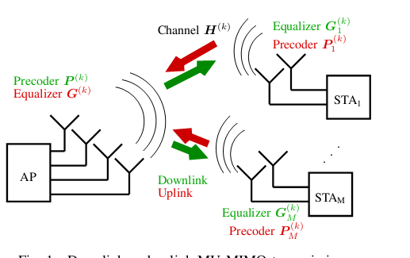
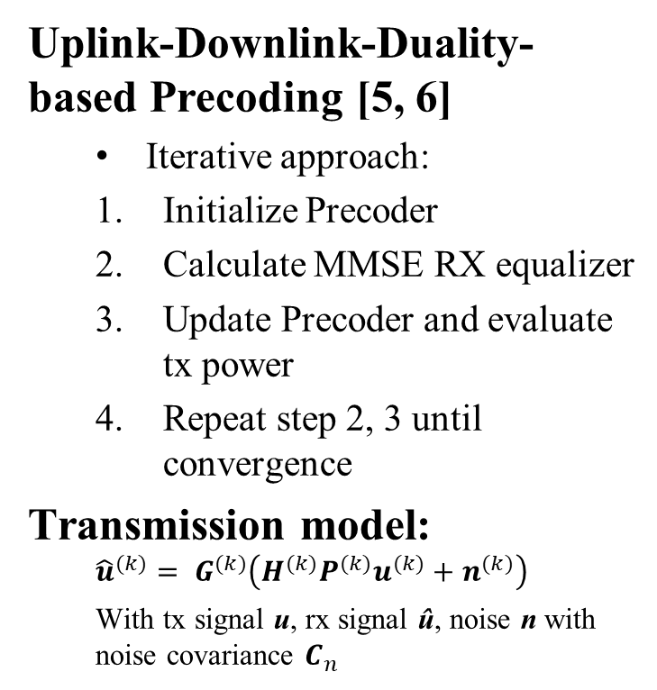
MMSE Precoder Calculation -
Introduction
Uplink-Downlink-Duality-based Precoding [5, 6]
  Iterative approach:
  Initialize Precoder
  Calculate MMSE RX equalizer
  Update Precoder and evaluate tx power
  Repeat step 2, 3 until convergence
Transmission model:
  $${\hat{u}}^{(k)}= G^{(k)}\left(H^{(k)}P^{(k)}u^{(k)}+n^{(k)}\right)$$
  With tx signal u, rx signal û, noise n with noise covariance $C_{n}$

Slide 15
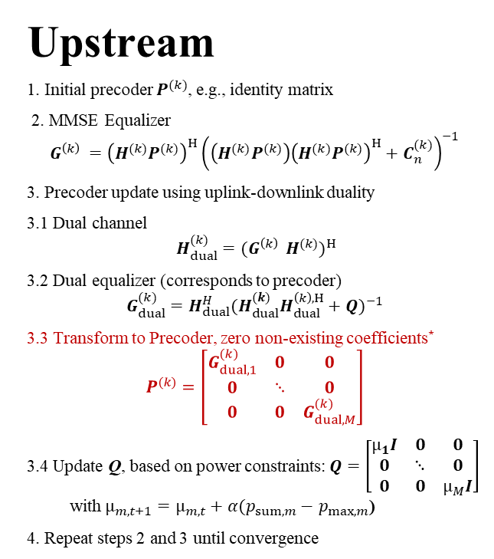
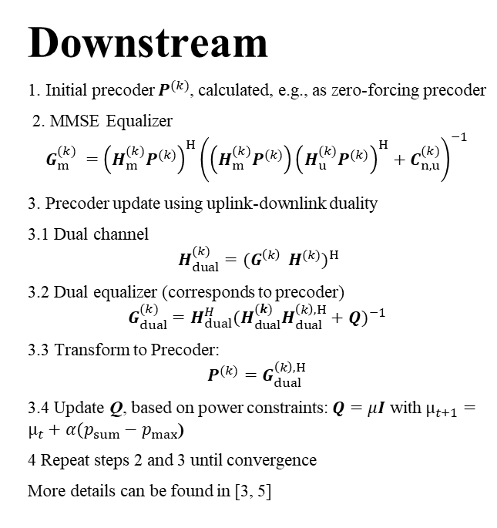
MMSE Precoder Calculation
(DL MU MIMO vs. UL MU MIMO)
Downstream
1. Initial precoder $P^{(k)}$, calculated, e.g., as zero-forcing precoder
2. MMSE Equalizer
$${G_{m}^{(k)}}^{ }={\left(H_{m}^{(k)}P^{(k)}\right)}^{H}{\left(\left(H_{m}^{(k)}P^{(k)}\right){\left(H_{u}^{(k)}P^{(k)}\right)}^{H}+C_{n,u}^{(k)}\right)}^{−1}$$
3. Precoder update using uplink-downlink duality
3.1 Dual channel
$$H_{dual}^{(k)}={(G^{\left(k\right) } H^{(k)})}^{H}$$
3.2 Dual equalizer (corresponds to precoder)
$$G_{dual}^{(k)}=H_{dual}^{H}{(H_{dual}^{(k)}H_{dual}^{\left(k\right),H}+Q)}^{−1}$$
3.3 Transform to Precoder:
$$P^{(k)}=G_{dual}^{\left(k\right),H}$$
3.4 Update Q, based on power constraints: $Q=μI$ with $µ_{t+1}=µ_{t}+α(p_{sum}−$ $p_{max}$)
4 Repeat steps 2 and 3 until convergence
More details can be found in [3, 5]
Upstream
1. Initial precoder $P^{(k)}$, e.g., identity matrix
2. MMSE Equalizer
$$G^{\left(k\right) }={\left(H^{(k)}P^{(k)}\right)}^{H}{\left(\left(H^{(k)}P^{(k)}\right){\left(H^{(k)}P^{(k)}\right)}^{H}+C_{n}^{(k)}\right)}^{−1}$$
3. Precoder update using uplink-downlink duality
3.1 Dual channel
$$H_{dual}^{(k)}={(G^{\left(k\right) } H^{(k)})}^{H}$$
3.2 Dual equalizer (corresponds to precoder)
$$G_{dual}^{(k)}=H_{dual}^{H}{(H_{dual}^{(k)}H_{dual}^{\left(k\right),H}+Q)}^{−1}$$
3.3 Transform to Precoder, zero non-existing coefficients*
$$P^{(k)}=\left[\begin{matrix}G_{dual,1}^{(k)} & 0 & 0 \\ 0 & ⋱ & 0 \\ 0 & 0 & G_{dual,M}^{(k)}\end{matrix}\right]$$
3.4 Update Q, based on power constraints: $Q=\left[\begin{matrix}µ_{1}I & 0 & 0 \\ 0 & ⋱ & 0 \\ 0 & 0 & µ_{M}I\end{matrix}\right]$ with $µ_{m,t+1}=µ_{m,t}+α(p_{sum,m}−$ $p_{max,m}$)
4. Repeat steps 2 and 3 until convergence
*Additional computation step for uplink precoder vs. downlink precoder is marked in red

Slide 16
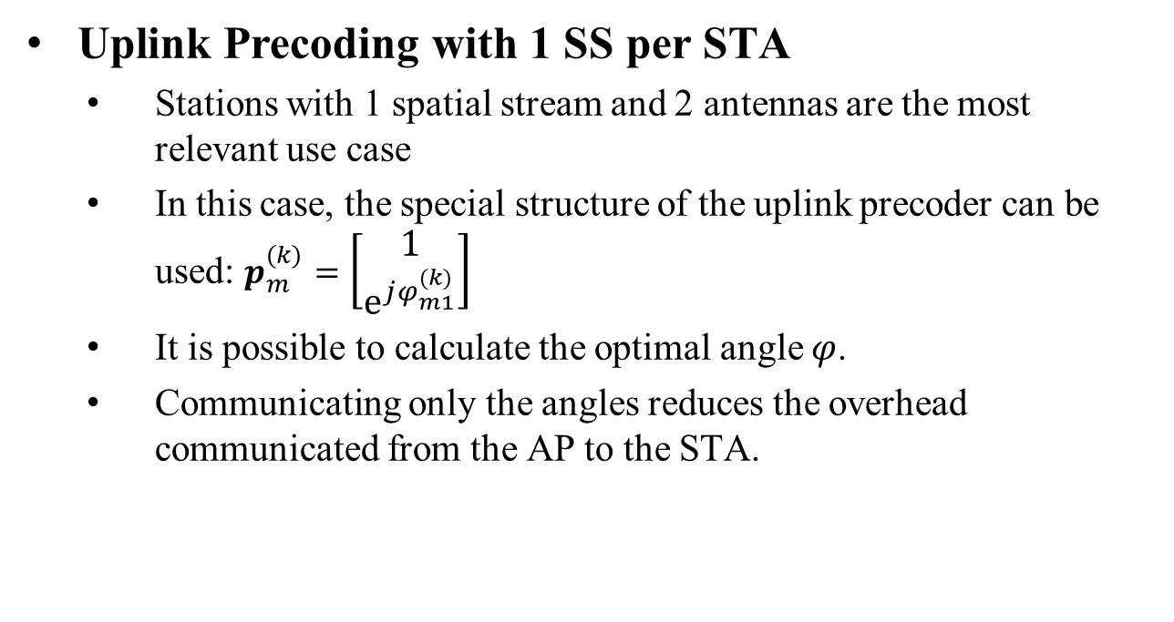
Uplink Precoder Calculation
- 1 SS special case
Uplink Precoding with 1 SS per STA
  Stations with 1 spatial stream and 2 antennas are the most relevant use case
  In this case, the special structure of the uplink precoder can be used: $p_{m}^{(k)}=\left[\begin{matrix}1 \\ {\text{e}}^{jφ_{m1}^{(k)}}\end{matrix}\right]$
  It is possible to calculate the optimal angle $φ$.
  Communicating only the angles reduces the overhead communicated from the AP to the STA.

Slide 17
Conclusion
Performance gain vs. overhead
  The performance increase of precoding is substantially higher than the overhead in all tested cases
Beamforming vs. Precoding
  Coordinated precoding outperforms beamforming
  The uplink sounding procedure for UHR shall support both, precoding and beamforming
More simulations
  ~8dB gain on LOS and NLOS channels (4 STA, 2 antennas, 1 SS per STA, linear receiver)
  With 3 STAs or nonlinear receiver, gains are lower, but still justify uplink precoding/beamforming to be used

Slide 18
References
[1] IEEE 802.11-23/0027r1, “Uplink MU MIMO Improvements”, 2023-01-17
[2] Vinko Erceg et.al., “IEEE P802.11 Wireless LANs TGn Channel
Models,” 2004, Contribution IEEE 802.11-03/940r4
[3] IEEE 802.11-22/1392r0, “Beamforming Improvement for UHR”, 2022-09-02
[4] IEEE 802.11-23/0263r0, “Triggered Beamforming in UHR”, 2023-02-20
[5] Strobel, Rainer, Andreas Barthelme, and Wolfgang Utschick. "Zero-Forcing and MMSE Precoding for G. fast." 2015 IEEE Global Communications Conference (GLOBECOM). IEEE, 2015.
[6] – Lanneer, Wouter, et al. "Linear and nonlinear precoding based dynamic spectrum management for downstream vectored G. fast transmission." IEEE Transactions on Communications 65.3 (2016): 1247-1259.

Slide 19
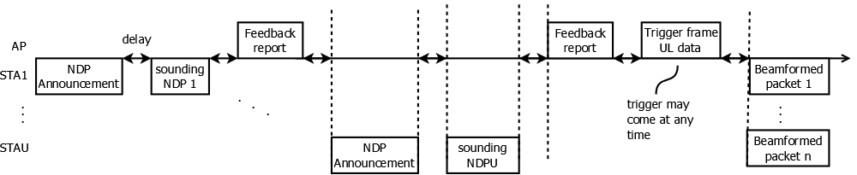
MAC Overhead - Beamforming
Protocol (see figure)
  4x NDP announcement (64µs, each)
  4x NDP (64µs, each)
  4x individual feedback, 48µs+3920 byte
  13 SIFS, 16µs =208µs
Sounding is repeated every 100ms, as beamforming is not sensitive to aging
Collisions are not considered

