Slide 1
Follow up on the enhanced link adaptations
Date: 04/25/23
Authors | Affiliations | Address | Email
Xiaogang Chen | ZEKU | 2479 E Bayshore Road, Suite 260. Palo Alto, CA | Xiaogang.chen@zeku.com
Bolton Shen
Chunlin Zhang
Wen Song
Ivan Yu

Slide 2
Outline
Clarifications, simulations and discussions on the beamforming feedback.
Discussions on the closed loop rate adaptations.

Slide 3
Recap of the issue on the Bfing feedback (1/2)
The average SNR gap between two SS in Bfed data could be as large as more than 10dB with an average of ~7.5dB [1];
11be uses only one MCS for data transmission. One MCS needs to adapt to 2SS with a large gap in post-SNR.
Considerable gains is demonstrated in [1] by feeding back the rotated Bfing matrix:
Instead of feeding back
$SVD\left(H\right)→V_{BF}=\left[\begin{matrix}V_{1} & V_{2}\end{matrix}\right],$
Feed back
$V_{rot}=$ $V_{BF}∗R, where R=\left[\begin{matrix}\cos{θ} & \sin{θ} \\ \sin{θ} & −cos{θ}\end{matrix}\right]$.

Slide 4
Recap of the issue on the Bfing feedback (2/2)
Issue is STA with two chains always feedback two SS and may optimize the feedback assuming two SS by feedback $V_{rot}$ instead of $V_{BF}$ (SVD)
Currently AP has no knowledge on STA’s optimization and may chose the 1st column of $V_{rot}$ and the postSNR degrades:
$H_{eff_SVD}=U∗S∗{\left[V_{1} V_{2}\right]}^{H}∗V_{1}=U_{1}∗s_{1}→{PostSNR}_{svd}=\frac{s_{1}^{2}}{N_{0}}$
$H_{eff_rot}=U∗S∗{\left[V_{1} V_{2}\right]}^{H}∗{(V}_{1}∗\cos{θ}+V_{2}∗\sin{θ)=U∗S∗\left[\begin{matrix}\cos{θ} \\ \sin{θ}\end{matrix}\right] }→{PostSNR}_{rot}= \frac{s_{1}^{2}\cos^{2}{θ+s_{2}^{2}\sin^{2}{θ}}}{N_{0}}$
${PostSNR}_{rot}$ <= ${PostSNR}_{svd}(baseline)$. “=” is true only If $θ=0$.
Considerable loss was demonstrated that align with the analysis [1].

Slide 5
Discussions and clarifications (1/4)
Where the gain comes from?
Rotated Bfing vector is not the optimal vector to maximize channel capacity;
Rotation also introduces inter-stream interference;
However, after rotation, the post SNR could be the same for the two spatial streams. Given single MCS is used for two SS, rotation provides gain.
Clarifications for other questions
Leveraging the average SNR to recommend/force AP do nSS selection?
The average SNR in CBF may not be used for rate adaptation since the sounding frequency could be once per tens or hundred of ms.
[1] already showed that different nSS was selected within one sounding instance.

Slide 6
Discussions and clarifications (2/4)
Not much gain was observed when rotation is applied in some simulation.
When rotation is applied, ML equalizer demonstrates more gain than MMSE due to the robustness to inter-stream interferences (table on the left).
If ML receiver is used, is there any gain comparing Bfed with rotation vs. non-Bfed (table on the right)?
SVD vs Rotation, 4x2x2, ChB, 20MHz, EHT 4x LTF, LDPC, MMSE
MCS | Gain(dB) MMSE
0 | 1.2
1 | 0.3
2 | 0.8
3 | -1.5
4 | 0.2
5 | -0.9
6 | -0.3
7 | 0.2
8 | -0.7
9 | -0.1
Bfed vs non-Bfed 4x2x2, ChB, 20MHz, EHT 4x LTF, LDPC, MLD
MCS | Sensitivity Bfed (dB) | Sensitivity non-Bfed (dB) | Gain(dB)
0 | 6.1 | 6.7 | 0.6
1 | 9.1 | 9.9 | 0.8
2 | 12.1 | 13.7 | 1.6
3 | 15.8 | 18.1 | 2.3
4 | 19.3 | 21.9 | 2.6
5 | 24.2 | 27.4 | 3.2
6 | 25.5 | 29.0 | 3.5
7 | 27.1 | 30.9 | 3.8
8 | 31.3 | 35.3 | 4.0
9 | 32.8 | 37.1 | 4.3

Slide 7
Discussions and clarifications (3/4)
Duplicated feature with Unequal Modulation (UEQM)?
Not really.
UEQM
Is a substantial feature to maximize capacity in theory given a proper rate adaptation is conducted by transmitter.
Needs standardization efforts to chose the proper MCS.
Needs fine turn on Tx given that a new dimension (spatial stream) is added for MCS adjustment.
Fully controlled by Tx, may need time to deploy in the field.
Rotation:
Spec transparent;
Existing rate adaptation can be reused;
Could be adopted in the field in short term.
Both schemes can be developed together for short-term and long-term deployment respectively.

Slide 8
Discussions and clarifications (4/4)
Other work around:
Rule of thumb: a feature that solely rely on transmitter is hard to guarantee without certification.
Rely on AP to rotate or do power allocation -> basically nothing will be implemented.
In the non-TB CBF frame, BFee recommend nSS to BFer or BFer indicate nSS to BFee:
Could be a solution but nSS may still be overwrite by Bfer’s rate adaptation algorithm
Way forward:
Alt. 1: Feedback both 1ss and 2ss
Overhead: given a STA with 2 chains always feedback 2ss in CBF already, the extra overhead is the 1ss CBF.
946/1883 Bytes for 80/160MHz respectively in every 50/100ms;
1-2ms (non-HT-DUP 6Mbps) or 0.2ms (MCS0 EHT) -> marginal extra overhead in reality.
Implementation impacts:
SU Bfee: Optional. Bfee may chose to optimize or not.
SU Bfer: Mandatory to
Parsing the MIMO control field and the CBF with nSS = “1+2”;
Save the Bfing vectors for both 1ss and 2ss respectively and apply the vectors to the SU-Bfed data.
Alt.2: Recommend nSS (Nc) in non-TB CBF, to align the nSS in CBF with Bfed data.
may be overwrite by Bfer’s rate adaptation algorithm.

Slide 9
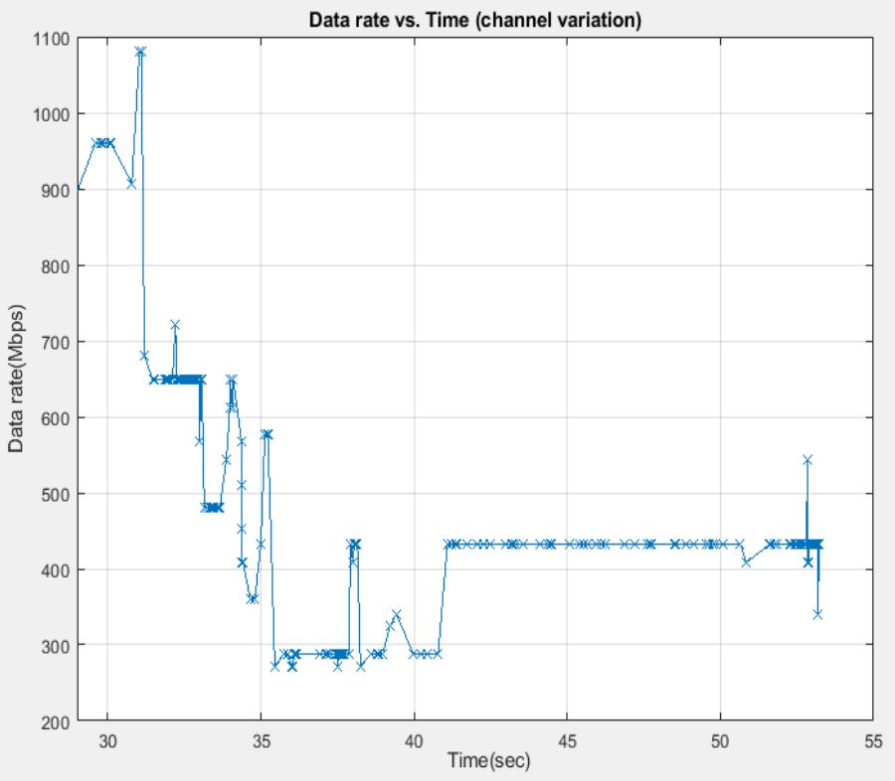
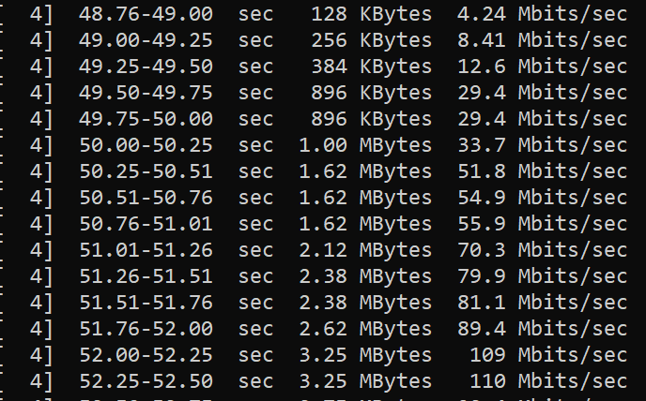
Recap of the observations in [1] for rate adaptation
Transmitter try to maintain higher rate when channel degrades -> Retransition is triggered frequently (left figure and [1])
Transmitter is conservative to increase rate when channel condition recovers (right figure copied from [1]).

Slide 10
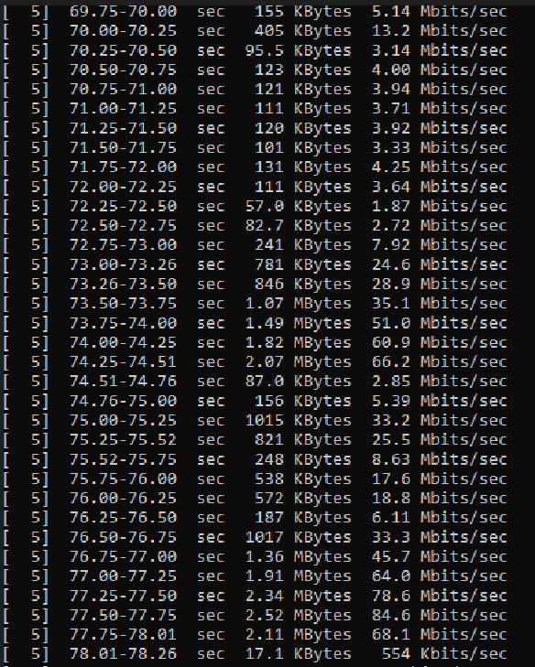
Emulating the come&go of ACI
Rx settles on a rate with the presence of the ACI.
ACI could be in-band Bluetooth working in FDD with Wi-Fi;
ACI Setup is the same as [1].
For a period of time (on the order of seconds or even longer), the Rx cannot work on the highest MCS that it indicated to support in the capability due to the presence of ACI.
It’s better to inform the Tx a MCS cap within this duration to avoid the MCS climbing/dropping back and force which introduces too many retries.
ACI is not present.
ACI is present.
ACI is not present.
ACI is present.
ACI is not present.
ACI is present.
ACI is not present.

Slide 11
Thoughts on the feedback (1/2)
What information need to feedback?
The presence of interferences;
May report next level of details such as:
Time (expected duration to determine long term or short term);
Frequency for punctured transmission (some in-device information is only available to Rx. E.g. restrict the BT hopping within a narrow band).
MCS Cap recommendation for long term;
MCS recommendation for short term??
How the transmitter leverage the feedback?
Link switch depends on the predicted duration of the interference and link availability;
Maximum supported MCS adjustment;
Short term MCS fine tune.

Slide 12
Thoughts on the feedback (2/2)
Where those information can be carried?
BA for fastest response
OMI for long term
A-Control? Not widely implemented so far.
Certification will help the technology adoption.
Link adaptation focused certification has been done for other technologies;
Throughput comparison was also used during the test of many other features in the certification of 11ax/11be.
Link adaptation focused certification in 11bn should not be difficult to conduct and demonstrate gain.

Slide 13
Summary
The benefit of rotated beamforming feedback is further explained;
Standing out questions have been clarified with further simulations.
Feedback to aid rate adaptation is further discussed;
In-device coex will be a beneficiary if proper information is fed back.
Can potentially help other use cases if certification can be enforced.

Slide 14
Reference
[1] 11-23-0011-00uhr On the enhanced link adaptation.

Slide 15
Backup
 |  |  |  |  | Sensitivity(dB@10% PER) |  |  | Gap (dB) ChDNLoS
Nrx | Ntx | Bw(MHz) | MCS | Nss | SVD | Rot A | Rot B | Rot A-SVD | Rot B-SVD
2 | 2 | 20 | 0 | 2 | 15.577 | 10.488 | 10.421 | -5.089 | -5.156
2 | 2 | 20 | 4 | 2 | 28.996 | 23.342 | 25.048 | -5.654 | -3.948
2 | 2 | 20 | 7 | 2 | 37.109 | 33.399 | 34.715 | -3.71 | -2.394
2 | 2 | 20 | 9 | 2 | 41.577 | 38.743 | 41.030 | -2.834 | -0.547
2 | 2 | 20 | 11 | 2 | 47.637 | 45.756 | 47.617 | -1.881 | -0.02
2 | 4 | 80 | 0 | 2 | 7.984 | 4.737 | 4.850 | -3.247 | -3.134
2 | 4 | 80 | 4 | 2 | 20.886 | 17.361 | 18.488 | -3.525 | -2.398
2 | 4 | 80 | 7 | 2 | 28.716 | 25.383 | 26.473 | -3.333 | -2.243
2 | 4 | 80 | 9 | 2 | 32.771 | 30.966 | 32.094 | -1.805 | -0.677
2 | 4 | 80 | 11 | 2 | 38.266 | 36.805 | 37.863 | -1.461 | -0.403
2 | 8 | 160 | 0 | 2 | 3.468 | 1.641 | 1.862 | -1.827 | -1.606
2 | 8 | 160 | 4 | 2 | 15.414 | 12.796 | 13.440 | -2.618 | -1.974
2 | 8 | 160 | 7 | 2 | 22.963 | 20.491 | 21.643 | -2.472 | -1.32
2 | 8 | 160 | 9 | 2 | 27.520 | 26.229 | 26.879 | -1.291 | -0.641
2 | 8 | 160 | 11 | 2 | 33.028 | 32.348 | 32.927 | -0.68 | -0.101
 |  | Sensitivity(dB@10% PER) |  |  | Gap (dB) ChDNLoS
MCS | Nss | SVD | Rot A | Rot B | Rot A- SVD | Rot B-SVD
0 | 1 | 1.512 | 2.991 | 1.676 | 1.479 | 0.164
1 | 1 | 1.641 | 5.049 | 2.604 | 3.408 | 0.963
2 | 1 | 3.065 | 7.896 | 4.891 | 4.831 | 1.826
3 | 1 | 4.853 | 10.149 | 6.941 | 5.296 | 2.088
4 | 1 | 8.267 | 13.769 | 10.648 | 5.502 | 2.381
5 | 1 | 11.549 | 17.298 | 14.007 | 5.749 | 2.458
6 | 1 | 13.210 | 18.879 | 15.598 | 5.669 | 2.388
7 | 1 | 15.168 | 20.823 | 17.577 | 5.655 | 2.409
8 | 1 | 18.369 | 24.652 | 20.842 | 6.283 | 2.473
9 | 1 | 20.476 | 26.705 | 22.940 | 6.229 | 2.464
10 | 1 | 23.711 | 29.277 | 25.989 | 5.566 | 2.278
11 | 1 | 26.280 | 32.144 | 28.425 | 5.864 | 2.145

