Slide 1
A non-collocated AP MLD framework for UHR

Slide 2
Introduction
Per the UHR PAR, the UHR group intends to improve latency performance of mobile clients
  “at least one mode of operation capable of improving the tail of the latency distribution and jitter compared to Extremely High Throughput MAC/PHY operation, with mobility between BSSs”
Quite a few UHR SG contributions have already talked about this
  [2] proposes a new non-collocated AP MLD framework within which context of a client is transferred from one physical AP to another when the setup links move from one physical AP to another physical AP.
  [3] proposes a non-collocated affiliated APs coordination framework with the MLD high MAC as the coordinator and each affiliated AP as the coordinated AP
In this contribution, we talk about similar approach with the objective to have a solution that not only targets “hitless roaming” but that is also able to provide high number of links for non-AP MLDs with AP MLDs that have only few Wi-Fi radios

Slide 3
Possible mismatch between high end non-AP MLDs and basic AP MLDs
High-end non-AP MLDs are expected to emerge in the market with at least three links operating in 2.4 GHz, 5 GHz and 6 GHz
At the same time, we can expect dual radio APs to be common at least in residential market
Could we find a solution with which number of radios in AP MLDs don’t limit number of simultaneous links in those non-AP MLDs that can run high number of links?
  The following slides talk about one possible approach

Slide 4
High level of the proposed solution
One possible solution is to have the UHR to address case of links that are setup to non-collocated APs
  We acknowledge that nothing in the 802.11be draft prevents APs affiliated to an AP MLD to be collocated, but it assumes that
Our proposal is that the UHR group further develops the AP MLD concept and specifies all the required means to
  Discover non-collocated APs to which links may be setup,
  Setup links to non-collocated APs, and
  Maintain links to non-collocated APs
All this considering both static and mobile non-AP devices which may all experience situations that need changes in setup links

Slide 5
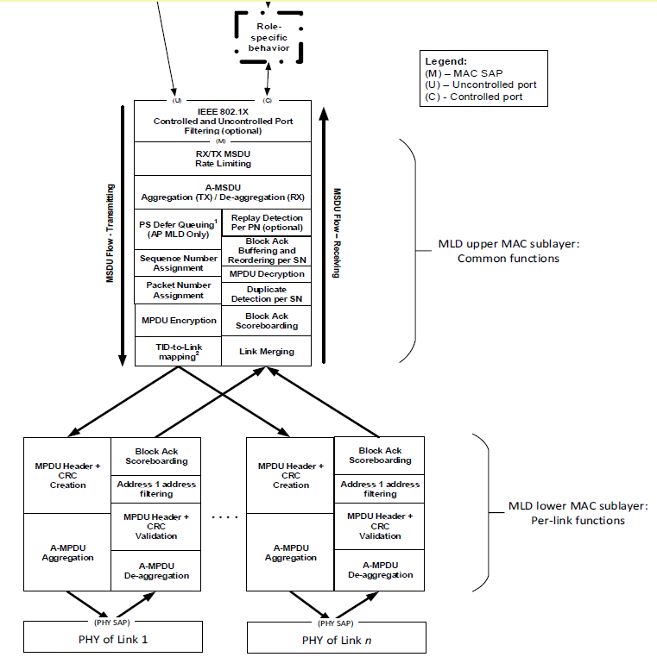
Proposed solution in reference model
The 802.11be reference model (figure on the right) has the MLD upper MAC and MLD lower MAC specified as functionality split without any service interface
The proposal to have UHR to develop solution which allows links to be setup to non-collocated APs means that the MLD upper MAC and the MLD lower MAC of a “UHR AP” may be in different physical devices and no longer collocated
The UHR reference model looks very similar to the 802.11be reference model
The main difference is that the interface between the MLD upper MAC and the MLD lower MAC should be specified while maintaining flexibility for different implementations

Slide 6


One implementation and deployment example for consideration
Physical AP1
MLD upper MAC
Three AP devices which each have two radios but with shared MLD upper MAC in one of the AP devices they can provide three links to a high-end mobile device
Backhaul implements the service interface between the MLD upper MAC and the MLD lower MAC and it may be wireline or wireless
backhaul
AP1.1
2.4 GHz
AP1.2
6 GHz
backhaul
Physical AP2
Physical AP3
AP2.1
5 GHz
AP2.2
6 GHz
AP3.1
5 GHz
AP3.2
6 GHz

Slide 7
Another implementation and deployment example for consideration
MLD upper MAC
AP1(2.4GHz)
AP1(5GHz)
AP1(5GHz)
AP1(2.4GHz)
AP1(5GHz)
AP1(2.4GHz)
AP2(6GHz)
AP2(6GHz)
AP2(6GHz)
AP2(6GHz)
AP2(6GHz)
Physical AP1
Physical AP2
Physical AP3
Physical AP4
Physical AP5
Physical AP6
High number of AP devices with few radios
MLD upper MAC may be even a controller like entity which interfaces with the MLD lower MACs of AP devices over selected media
2.4 & 5 & 6GHz

Slide 8

Third implementation and deployment example for consideration
The solution could be applied also to an example implementation of a UHR AP which has three radio modules connected to a network processor via PCIE interface
  The network processor implements the MLD upper MAC
  Each radio module implements the MLD lower MAC
Even though this is not related to non-collocated APs which provides links under control of common MLD upper MAC, this is an example of deploying media independent but detailed specification of interface between the MLD upper MAC and two or more MLD lower MACs
Network processor
PCIE-1
Wireless module1
（2.4GHz）
PCIE-2
Wireless module2
(5GHz)
PCIE-3
Wireless module3
(6GHz)

Slide 9
MLD upper MAC – MLD lower MAC interface
Our proposal is to specify the interface so that the MLD upper MAC and MLD lower MAC may be from different vendors
  The interface should be an exposed interface
Different physical media can be used to implement the interface
  The UHR group should not specify media dependent details but provide interface specification which is detailed enough for interoperable implementations
One possible approach is to specify virtual communication port between MLD upper MAC and MLD lower MAC so that they can communicate with each other via various medium connection

Slide 10
THANK YOU ☺

Slide 11
reference
[1] 11-23-0480-00-0uhr-uhr-proposed-par.pdf
[2] 11-22-1910-03-0uhr-seamless-roaming-for-uhr.pptx
[3] 11-22-1512-00-0uhr-multi-ap-coordination-for-uhr.pptx

