Slide 1
Low Latency QoS based on L4S
Date: 2023-06-05
Authors:
Name | Affiliation | Address | Phone | Email
Lili Hervieu | CableLabs |  |  | l.hervieu@cablelabs.com
Greg White | CableLabs |  |  | g.white@cablelabs.com
Luther Smith | CableLabs
Darshak Thakore | CableLabs
Allen Huotari | Comcast
Trilok Mutyala | Comcast
Teddy El-Rashidy | Comcast
Maulik Vaidya | Charter
Nima Namvar | Charter
Carol Ansley | Cox
Matthew Chappell | Cox

Slide 2
Introduction
UHR PAR includes in its scope the reduction of tail latency [1]
Different mechanisms have been proposed to reduce latency
  Including preemptible PPDU [2], EDCA variant [3], AIML [4], etc.…
  Need to address latency and jitter due to implementation of large buffers filled by classic congestion control traffic (e.g., TCP/QUIC Reno/Cubic)
Network/application developer's industry moving toward new efficient technologies to support end-to-end low latency
  Especially for low latency and high throughput applications such as XR or cloud gaming
  Support needed in WLAN for end-to-end low latency
  Proposed in [5][6]
This contribution addresses
  Main cause of latency in many networks
  How the network industry is solving for end-to-end low latency
  How can UHR support end-to-end low latency

Slide 3
Source of Latency in Wi-Fi Networks
Different causes of latency in WLANs have been and are being addressed
  Channel access
  Steering, roaming, etc.…
  Dense environments
A much-overlooked cause of latency is the queueing delay
  Queueing delay is present at bottleneck links in the network
  Due to the way that applications currently interact with the network (e.g., TCP/QUIC w/ Reno/Cubic)
  Exacerbated by the use of large buffers to enable high throughput
  The largest, solvable, source of latency and latency variation on the Internet
  For WLAN, queueing delay is observed on APs (downlink), non-AP STAs (uplink) and Multi-APs (downlink/uplink)
This submission is addressing the queueing delay from the time MSDU enters the MAC to the time contention starts
  “Queuing Delay” does not include Media Access Delay (contention resolution, retransmissions, etc.)

Slide 4



Queuing Delay in Networks
TCP Reno sending data for this capacity
Delay increases
Buffer overflows, and packets drop
Buffer
Packets dropped
Real capacity
Classical congestion control traffic TCP/QUIC (Reno, Cubic) leads to large buffer occupancy
Packets waiting in queues for transmission add latency and latency variation
Note: Reducing buffer size reduces throughput of Reno/Cubic based flows

Slide 5
Queuing Delay in Networks
End-to-end problem arising from network and application interaction
  At each bottleneck, including WLAN links
  Requires an end-to-end solution involving both application and network aspects
Low-Latency, Low-Loss Scalable Throughput (L4S) Architecture has been developed by IETF to solve this problem
  Developed and supported by networking industry and application providers
  Support is needed at bottleneck links including WLAN to send signals to applications
  Support is needed in applications - new sending behavior and response to network signals

Slide 6
How the Network Industry Solves Queuing Delays due to Congestion
Low-Latency Low-Loss Scalable Throughput (L4S) Architecture
RFC [7][8][9]
New (L4S) congestion-controlled protocols
Explicit Congestion Notification (ECN)
Dual queue (AQM) implementation
Specifications (RFCs) published January 2023
New congestion-controlled protocols solve the root cause of queuing delay due to applications creating large queues
Make use of ECN field in the IP header to notify the client that congestion is experienced
Dual Queue AQM (Active Queue Management) to support L4S and legacy traffic

Slide 7
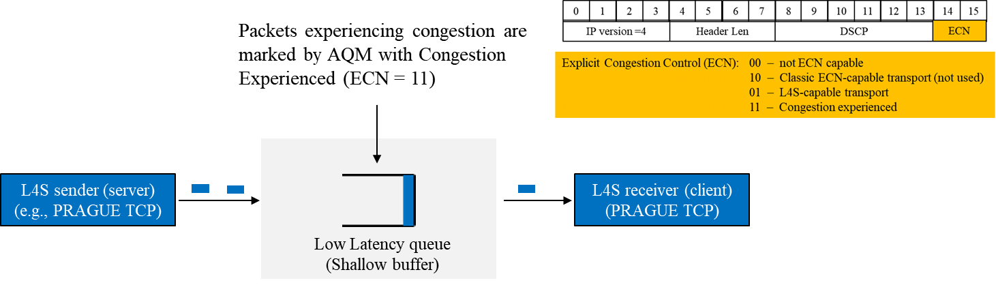
L4S Technology - ECN & Scalable Congestion Control Protocols
L4S Explicit Congestion Notification (ECN) is an end-to-end notification of network congestion without dropping packets
  Sender marks its packet as “L4S capable”
  Network sends early congestion signal by marking IP packet with a Congestion-experienced code (CE)
    Fine grained congestion notification
  Receiver send congestion feedback to the sender in layer 4 (fine grained congestion feedback)
Sender implements L4S “scalable” congestion control algorithm
  Adjusts sending rate dynamically based on fine grained feedback

Slide 8
L4S Technology – Dual Queue AQM
Congested Network (e.g., AP downlink)
Low Latency (LL) queue
ECN/CE marking
L4S sender
(PRAGUE TCP)
L4S receiver
(PRAGUE TCP)
ECN classifier
Classic (legacy) sender
(TCP Reno)
Classic receiver
(TCP Reno)
Classic queue
Packets dropped
Dual queue AQM
Dual queue implementation enables L4S flows and 'Classic' flows to coexist
  Classic queue for legacy TCP/QUIC flows like video streaming, downloads, bulk data
  Low Latency queue (shallow buffer) for L4S flows like AR/VR, HQ video conferencing, cloud gaming
Solely for isolation, not prioritization (no winners & losers)
  Solution still works when 100% of applications adopt L4S!
If an L4S flow increases latency in the Low Latency queue, it is moved to the classic queue (queue protection)
  No benefit for “cheaters” to mark traffic as L4S

Slide 9
Why Not Just Use Prioritization?
Latency optimization has been historically addressed with prioritization
  Prioritization can give privileged access to the link, and can reduce media access delay in certain cases
  But doesn’t work when the majority (or all) traffic would like low latency
  Traffic prioritization also doesn’t solve the root cause of queueing delays at bottleneck links – the lack of congestion feedback
  And, in many cases, it results in bandwidth disparity (lower priority classes can be starved by higher classes)
In WLAN, scheduled channel access and EDCA can’t effectively reduce queueing delay due to congestion
  Especially for low latency high throughput flows

Slide 10
Proposed L4S Support in UHR
End-to-end low latency provided for L4S traffic in three ACs (BE, VI, VO)
  AC_BE & AC_VI support Dual-Queue AQM
    AC_BE for normal priority traffic
    AC_VI for high priority traffic
  No low latency queue needed for AC_BK
    Single classic queue is sufficient
  No classic queue needed for AC_VO
    Voice queue is already a shallow queue – add support for L4S ECN
End-to-end low latency can be supported even in environments where all traffic uses AC_BE
  e.g., Operator residential AP deployments where DSCP is bleached due to network policy / network neutrality concerns
Queue | DSCP+ECN Field | Description | EDCA AC
1 | 001***** 010***** | Background Classic queue (deep buffer) | AC_BK
2-A | 000****0 011****0 | Best Effort Classic queue (deep buffer) | AC_BE
2-B | 000****1 011****1 | Best Effort L4S queue (shallow buffer) | AC_BE
3-A | 10*****0 | Video Classic queue (deep buffer) | AC_VI
3-B | 10*****1 | Video L4S queue (shallow buffer) | AC_VI
4 | 11****** | Voice/L4S queue (shallow buffer) | AC_VO
DSCP mapping shown as example

Slide 11
L4S Benefits
L4S technology enables L4S traffic to achieve low latency, low packet loss and high throughput
  Coexists with classic traffic
  ECN is not bleached in (most) networks
  In WLAN, EDCA can still be used to give priority
Allows for safe and incremental deployment over Internet
Supported in Linux & MacOS/iOS and application providers (e.g., cloud gaming / video conferencing)
Implemented in DOCSIS and an active Work Item in 5G RAN
Multiple interoperability events have been held over the past year

Slide 12
Summary
Queueing delays are experienced at network bottlenecks
  Due to “classic” application behaviors and the implementation of large buffers to support them
    Implementation of smaller buffers reduces the throughput of these classic flows
Traffic prioritization doesn’t solve the problem
L4S architecture supports end-to-end low latency while not reducing throughput
  New L4S protocols (e.g., TCP/QUIC/RTP PRAGUE) make use of the ECN field in the IP header to adapt to the network conditions
    No packet drop, finer granularity
  Dual queue AQM at network bottlenecks supports incremental deployments and coexistence with classic congestion-controlled protocols.
  Supported by network industry and application providers
L4S should be supported in UHR to achieve end-to-end low latency

Slide 13
Straw Poll
Do you support UHR studying L4S implementation to support end-to-end low latency ?

Slide 14
References
[1] Proposed UHR PAR
[2] Thoughts on Beyond 802.11be
[3] Latency and Reliability enhancements for UHR
[4] Requirements of Low Latency in UHR
[5] A Perspective on UHR Features for Operator Residential Deployments
[6] QoS Re-visited
[7] Low Latency Low Loss Scalable Throughput (L4S) Deployments (RFC9330)
[8] The Explicit Congestion Notification (ECN) Protocol for Low Latency, Low Loss, and Scalable Throughput (L4S) (RFC9331)
[9] Dual-Queue Coupled Active Queue Management (AQM) for Low Latency, Low Loss, and Scalable Throughput (L4S) (RFC9332)

Slide 15
Appendix

Slide 16
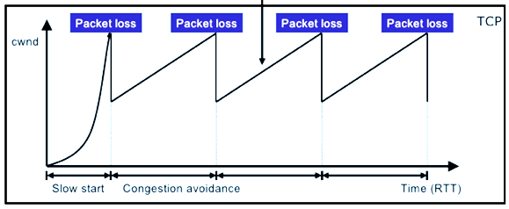
Queuing Delay in Congested Networks
Delays happen at any point of congestion in networks where ingress capacity > egress capacity
  Routers, Cable modems, APs…
Networks implement large buffers to support and optimize legacy TCP/QUIC (Reno/Cubic based) traffic
  At each node in the network where congestion is experienced
Reno/Cubic congestion control algorithms try to utilize the full capacity of the network.
  Use packet loss as congestion signal
  Introduce significant latency, latency variation and packet loss as a result

Slide 17
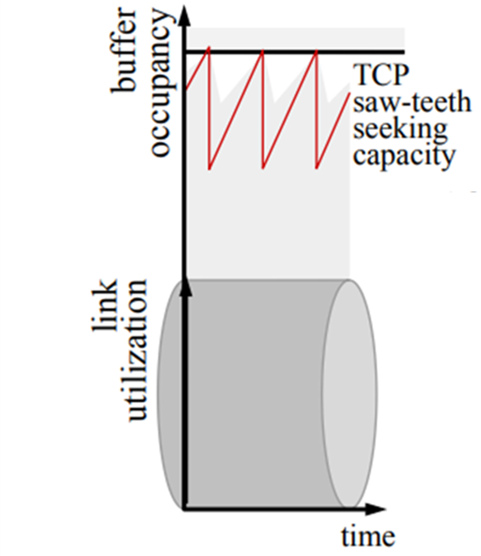
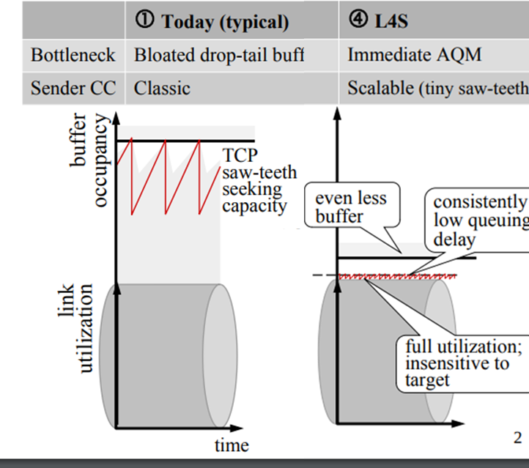
Classic vs L4S Scalable Congestion Control
Classic TCP flow
L4S congestion protocol flows
Classic congestion control
L4S scalable congestion control
L4S leads to consistently low queuing delay while enabling full link utilization

