Slide 1
Revisiting of the LDPC rate matching
Date: 04/24/23
Authors | Affiliations | Address | Email
Xiaogang Chen | ZEKU | 2479 E Bayshore Road, Suite 260. Palo Alto, CA | Xiaogang.chen@zeku.com
Xin Len
Bolton Shen
Guorun Ai
Wei Wen
Hao Li

Slide 2
Outline
Preliminaries
  Distribution of the packet size in the field;
  Scheduler of the transmitter;
  Background of PHY/MAC padding.
Three issues on the LDPC rate matching:
  Performance loss of 11ac/ax/be vs 11n;
  Higher power consumptions in LDPC decoding/encoding;
  Over puncturing.

Slide 3
Preliminaries - distribution of the packet size in the field
Laptop for daily use: email, documents, remote desktop, etc.
Topic / Item | Average | Min Val | Max Val | Percent
Packet Lengths | 280.72 | 154 | 2042 | 100%
40-79 | - | - | - | 0.00%
80-159 | 154 | 154 | 154 | 0.04%
160-319 | 204.57 | 160 | 319 | 88.89%
320-639 | 424.35 | 320 | 638 | 4.69%
640-1279 | 1119.83 | 641 | 1274 | 4.81%
1280-2559 | 1591.25 | 1284 | 2042 | 1.57%
>=2560 | - | - | - | 0.00%
Laptop Webex
Topic / Item | Average | Min Val | Max Val | Percent
Packet Lengths | 330.6 | 154 | 1969 | 100%
40-79 | - | - | - | 0.00%
80-159 | 154 | 154 | 154 | 0.01%
160-319 | 250.42 | 160 | 318 | 57.07%
320-639 | 405.22 | 320 | 632 | 41.37%
640-1279 | 1108.72 | 640 | 1279 | 0.72%
1280-2559 | 1448.25 | 1280 | 1969 | 0.83%
>=2560 | - | - | - | 0.00%
Smart Phone: Everything except 4K video streaming
Topic / Item | Average | Min Val | Max Val | Percent
Packet Lengths | 506.28 | 164 | 2044 | 100%
80-159 | - | - | - | 0.00%
160-319 | 214.45 | 164 | 319 | 59.37%
320-639 | 433.04 | 320 | 638 | 17.98%
640-1279 | 929.73 | 641 | 1279 | 7.60%
1280-2559 | 1530.46 | 1280 | 2044 | 15.06%
>=2560 | - | - | - | 0.00%
Smart Phone: 4K Video streaming
Topic /Item | Average | Min Val | Max Val | Percent
Packet Lengths | 1339.18 | 164 | 2042 | 100%
80-159 | - | - | - | 0.00%
160-319 | 201.56 | 164 | 319 | 4.14%
320-639 | 430.95 | 322 | 636 | 1.13%
640-1279 | 872.41 | 645 | 1263 | 1.31%
1280-2559 | 1407.11 | 1283 | 2042 | 93.42%
>=2560 | - | - | - | 0.00%
  Although the max PSDU size is >15MByte in theory, the PPDU size is usually small for many applications.
          All PPDU in statistics are Qos Data coded by LDPC in 11ax PPDU.
        Every statistics are conducted based on capturing ~1 million QoS packet from different vendors.
        Chance of aggregation is low for smaller packet and high for larger packet.

Slide 4
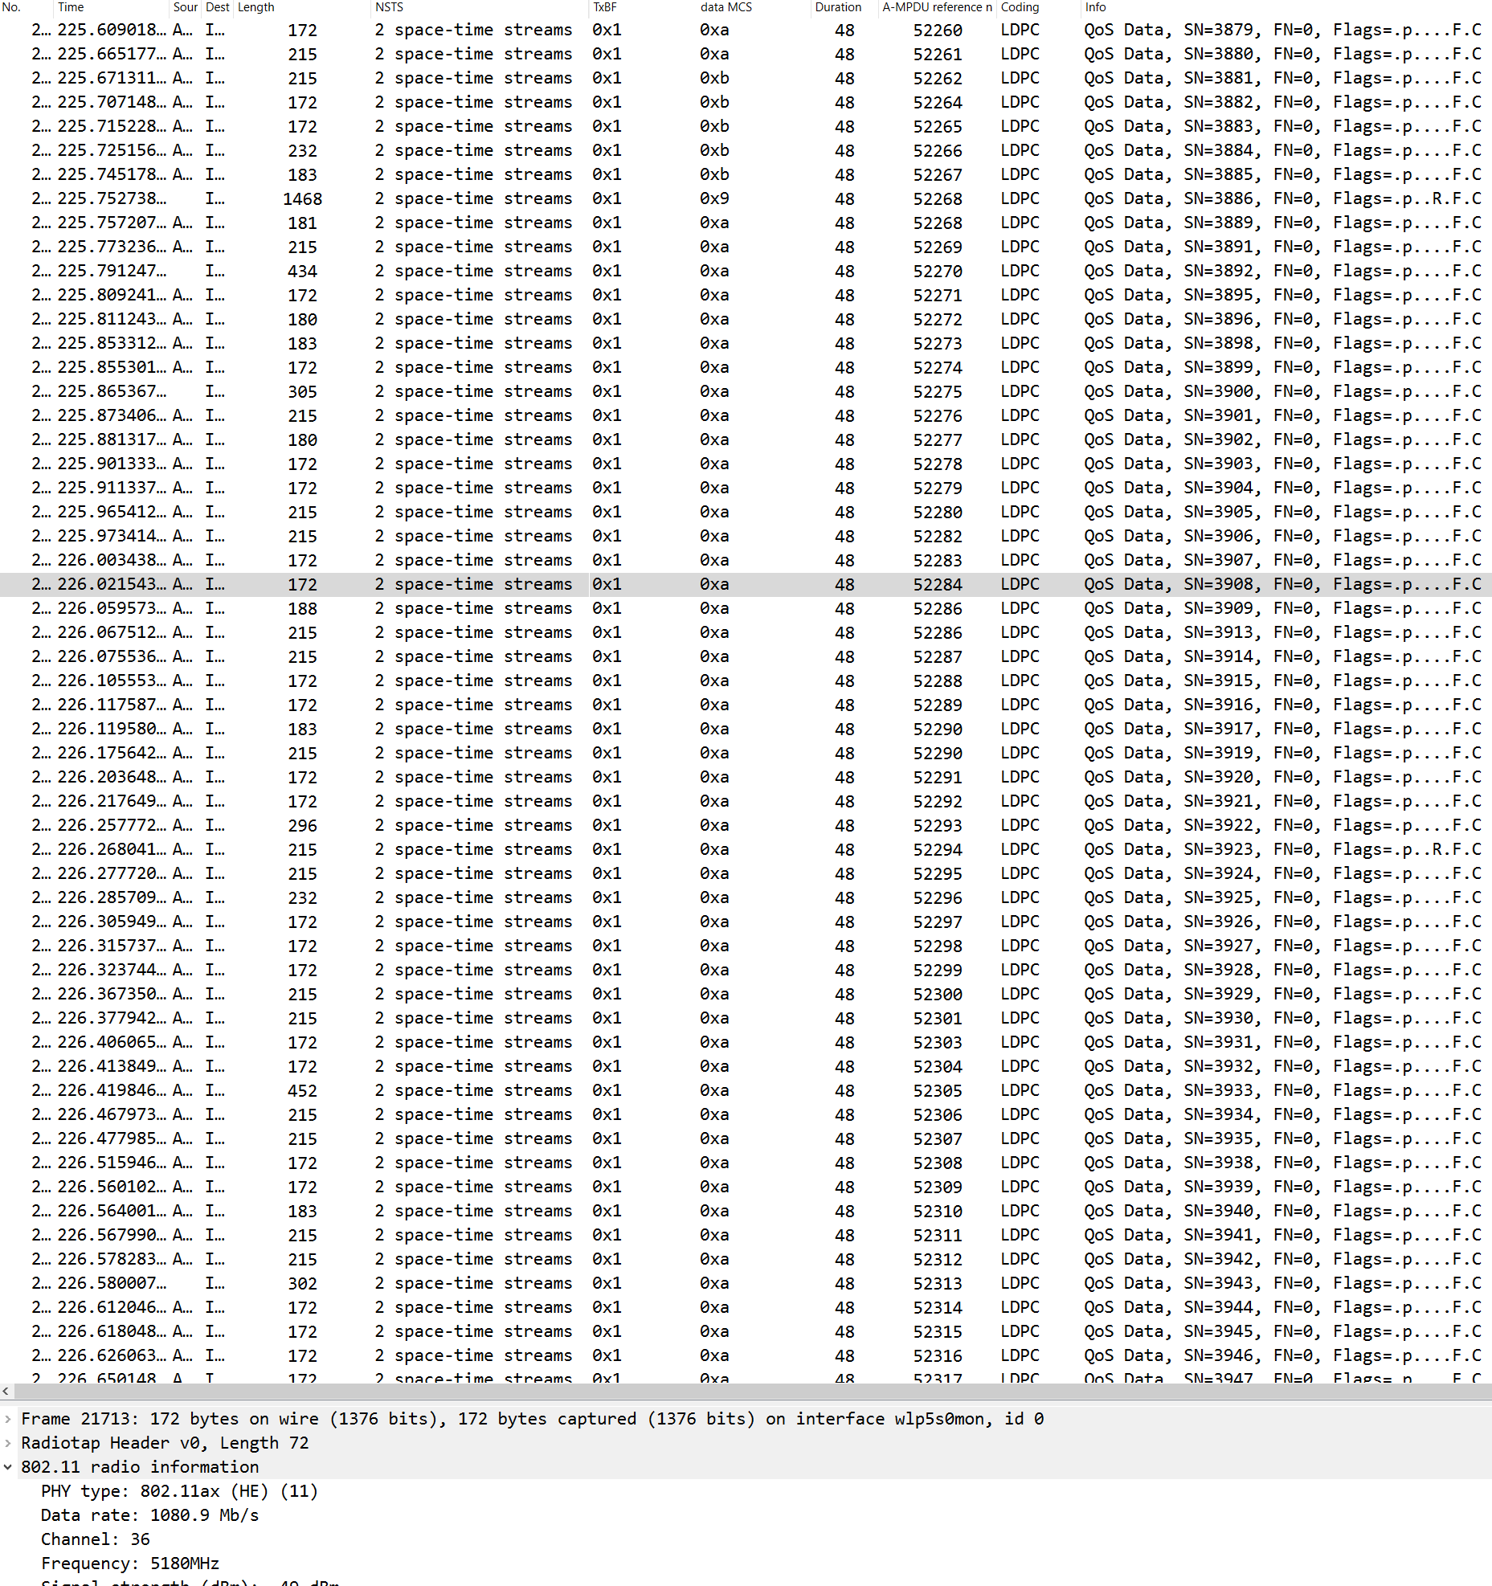
Preliminaries – AP’s scheduling behavior
Even for small packet size, transmitter always try to use highest rate, if possible, to transmit.
Highest rate means:
  Largest BW;
  Highest MCS;
  Highest nSS.
PSDU size is usually not a factor for rate selection.
  Rate is usually selected in advance;
  MPDU size is not quite predictable.

Slide 5
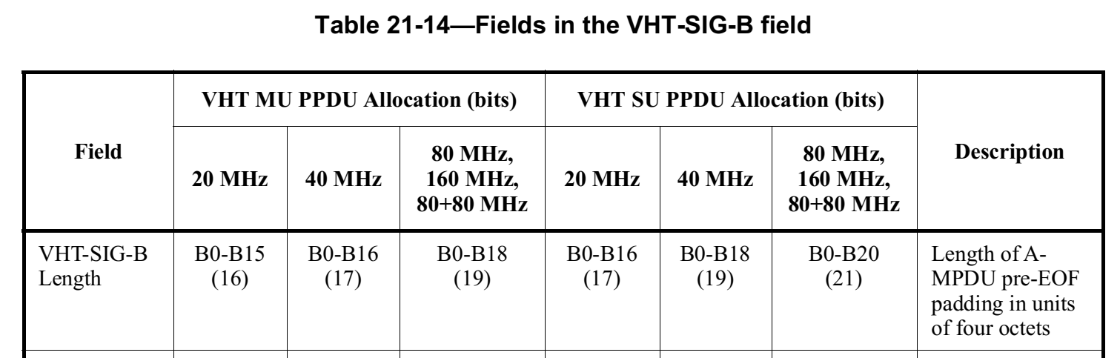
Preliminaries - pre-FEC padding/post-EOF padding
11n repeats systematic & parity bits (after encoding) to fill the OFDM symbol boundary;
  Repeated bits after FEC coding will improve performance if proper LLR combination is conducted at the receiver.
11ac/ax/be use pre-FEC bits to fill the OFDM boundary.
  Pre-FEC bits are dummy information that is transparent to PHY and waste resources.
  11ac indicates the pre-EOF payload in VHT-SIGB already (signaling overhead paid) but still use pre-FEC padding (doubles overhead).

Slide 6
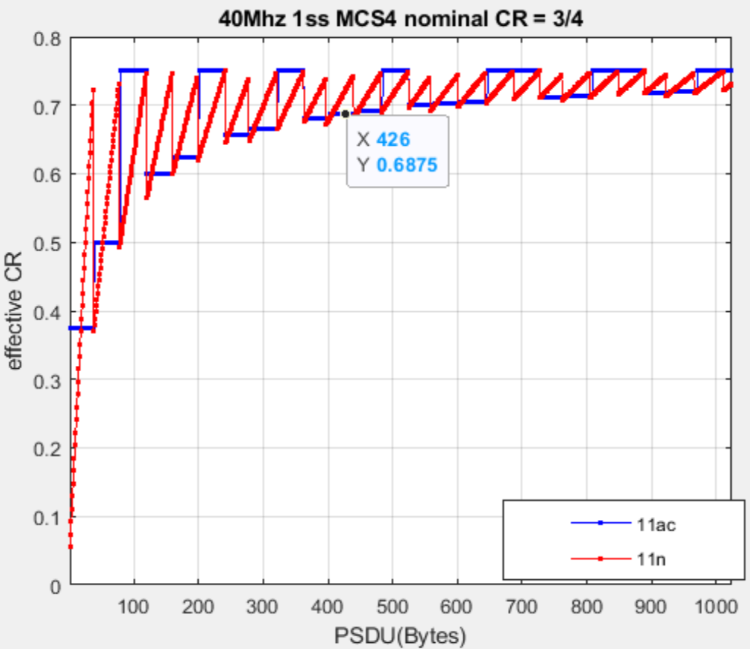
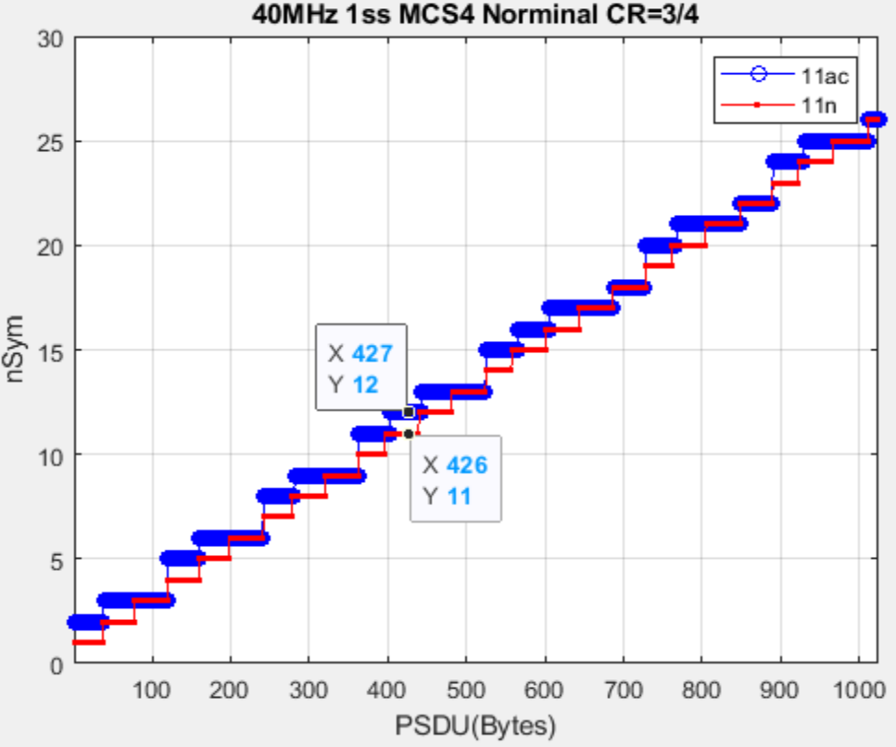
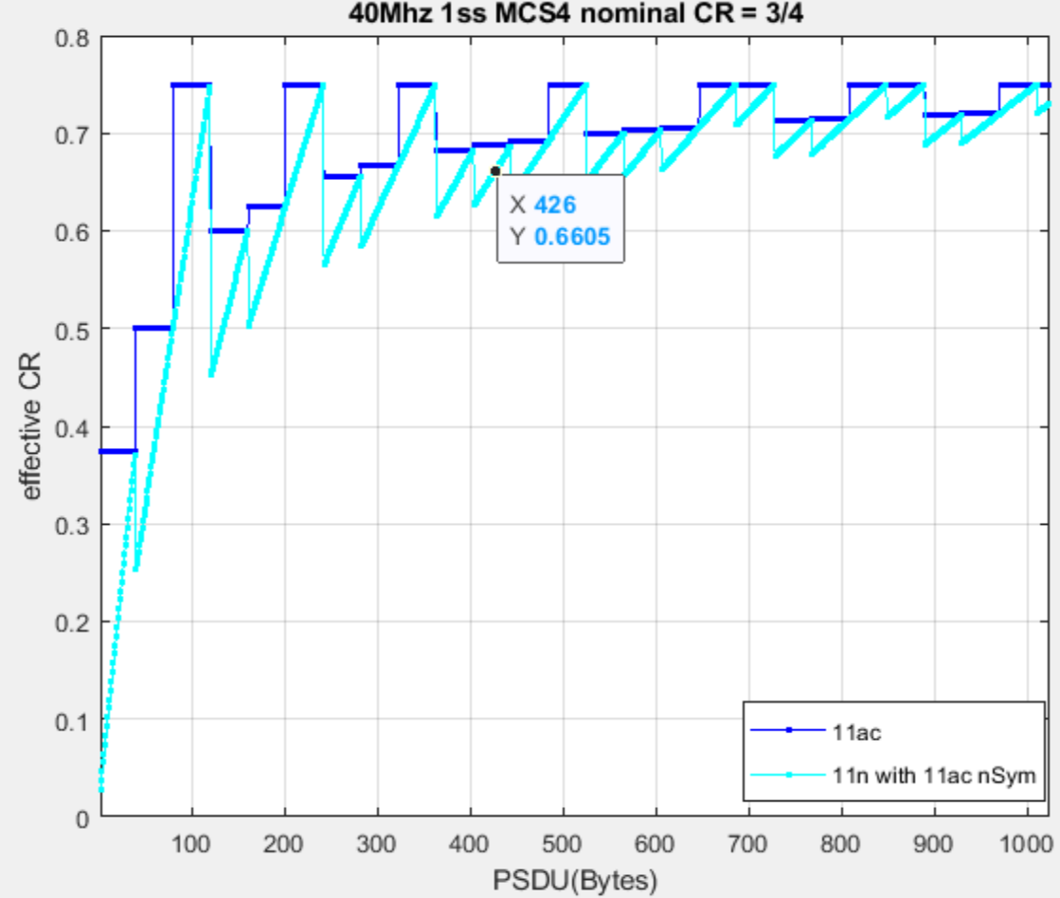
Performance degradation (the 1st issue)
Effective coding rate (eCR) dominate the sensitivity.
  eCR = nPld / (nPld + nParity - nPunc + nRep);
In many cases, 11n has lower eCR. 11ac may have lower eCR in other cases by paying extra symbol;
  The left figure is not a fair comparison for 11n…when 11ac has a lower eCR, it uses more symbol.
The curve of light blue uses 11n scheme (without pre-FEC padding) but with the 11ac overhead (nSym) for the same PSDU size
  Guaranteed lower coding rate if 11n scheme is used!
Note: the PSDU(Bytes) is counted for 11n as fair comparison. 11ac will add dummy bits as pre-FEC. The true PSDU will be larger due to the dummy padding.

Slide 7
How the effective coding rate affects sensitivity?
Sims assumptions:
ChD NLoS. 1x1x1 (left), 4x2x1(right), BW 40MHz, MCS4/7.
  Sensitivity is simulated between 11ac and 11n.
Similar gaps are observed for other MCS/BW/Pld combinations.
 |  | Sensitivity(dB@10% PER) |  | Gap (dB) ChDNLoS
MCS | nBytes | 11n | 11ac | 11n-11ac
4 | 201 | 15.00 | 17.22 | -2.22
4 | 323 | 16.19 | 17.52 | -1.33
4 | 687 | 16.99 | 17.40 | -0.42
4 | 849 | 17.06 | 17.58 | -0.53
4 | 1011 | 17.13 | 17.54 | -0.42
7 | 201 | 21.17 | 25.24 | -4.07
7 | 336 | 23.23 | 25.36 | -2.13
7 | 539 | 23.99 | 25.20 | -1.21
7 | 741 | 24.3 | 25.26 | -0.94
7 | 944 | 24.8 | 25.28 | -0.52
 |  | Sensitivity(dB@10% PER) |  | Gap (dB) ChDNLoS
MCS | nBytes | 11n | 11ac | 11n-11ac
4 | 201 | 13.309 | 15.337 | -2.03
4 | 323 | 14.339 | 15.360 | -1.02
4 | 687 | 15.213 | 15.400 | -0.19
4 | 849 | 15.170 | 15.670 | -0.5
4 | 1011 | 15.253 | 15.685 | -0.43
7 | 201 | 18.933 | 23.006 | -4.07
7 | 336 | 21.195 | 23.038 | -1.84
7 | 539 | 21.719 | 23.218 | -1.5
7 | 741 | 22.516 | 23.152 | -0.64
7 | 944 | 22.887 | 23.158 | -0.27

Slide 8
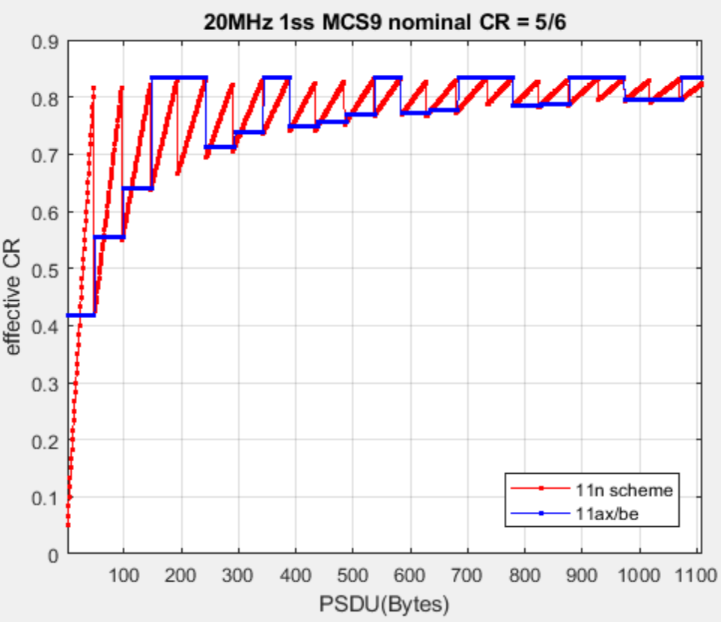
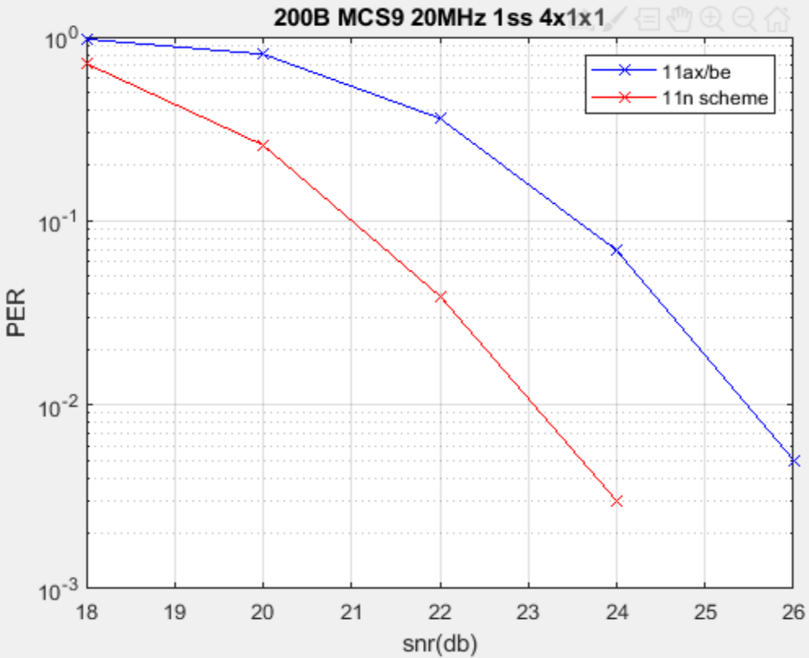
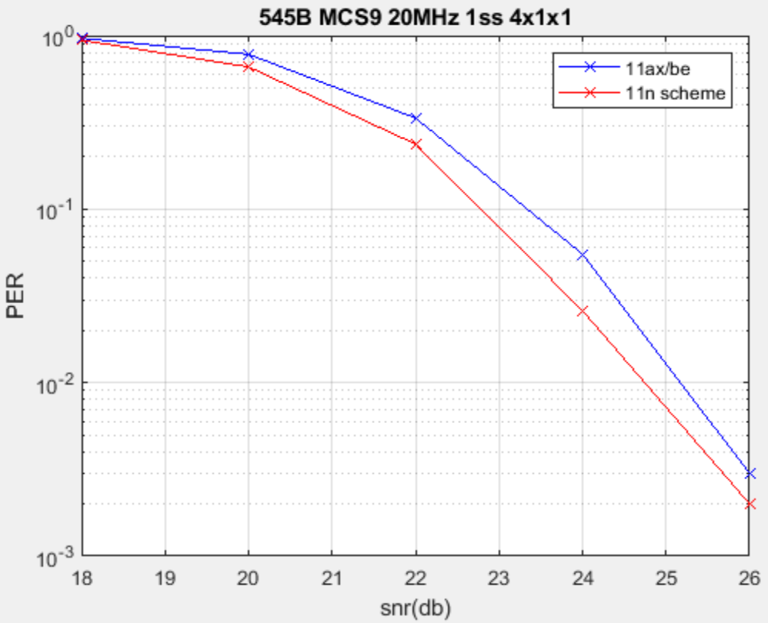
Performance gap of 11be vs. 11n scheme
Similar gap is observed.
Note: 11n scheme means pre-FEC padding is not added (Pld size is indicated) and everything else is the same as 11ax/be.

Slide 9
Power consumption (the 2nd issue)
nCW per symbol impacts the scheduling of the LDPC decoder ( also encoder) cores
Input to the scheduler: data rate (nCW/Symbol), timing of turn around, etc;
Output of the schedule: n_Iterations (performance), n_Decoders to power on / clock (power consumption), etc.
Fewer codewords per symbol means
  more iterations can be scheduled for each codeword;
  Less decoders can be powered on;
  Lower clock can be used.
nCW in the last symbol can also impacts the trade off between decoding performance and timing.
  nIteration may be reduced to meet the timing.

Slide 10
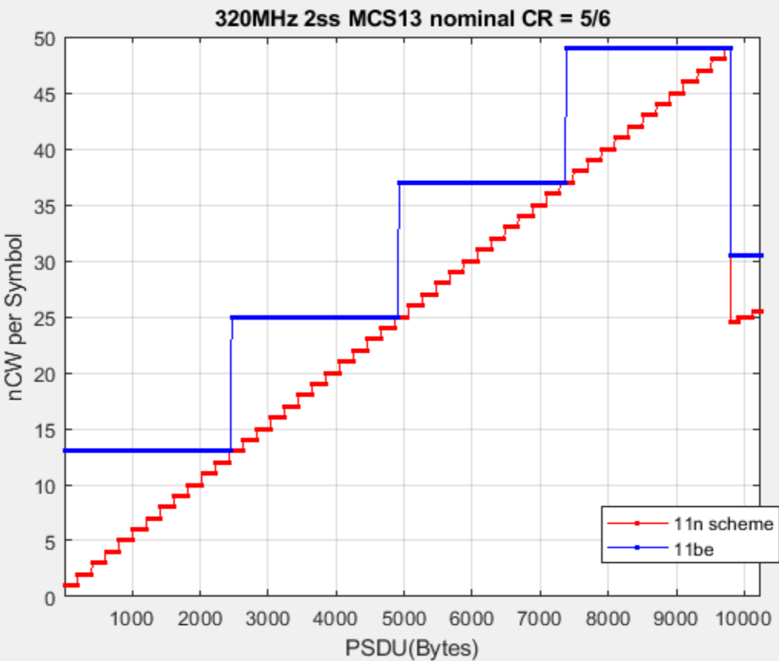
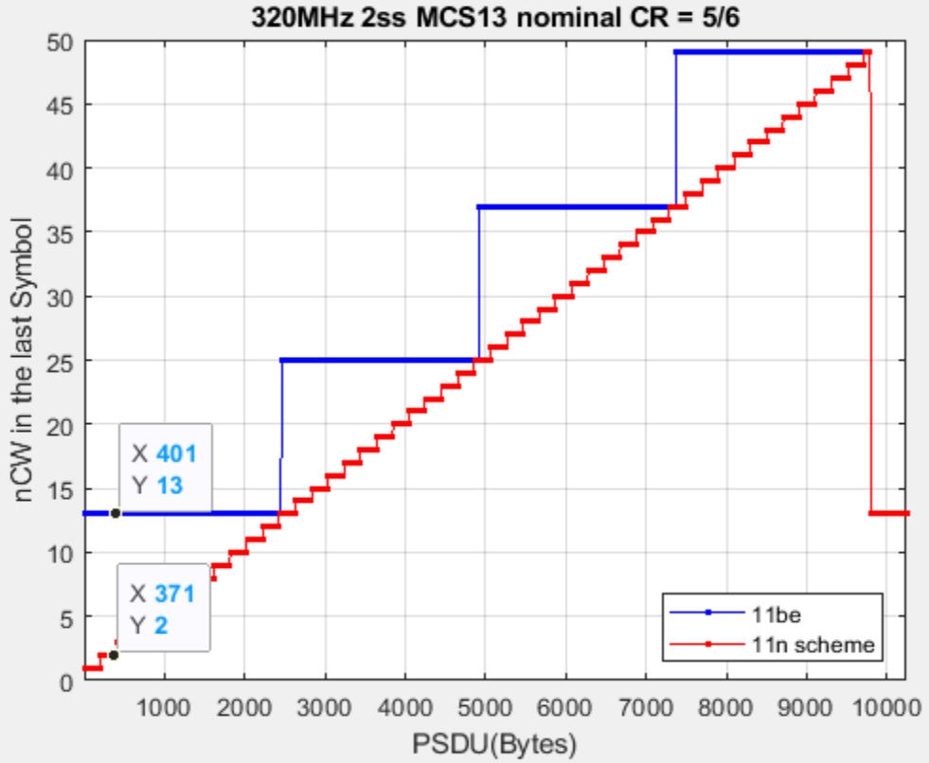
nCW per symbol for high data rate (1/2)
The difference of nCW/Symbol could be significant: 2 vs. 11 or 13; 2 vs. 6 or 7
  Dummy padding adds extra dummy codewords for PHY.
  E.g.: With 11n scheme receiver needs to decode 2 CWs but needs to decode 13 CWs in 11be…
So does the power consumption.
This is true for most of the payload size (not only for small payloads).

Slide 11
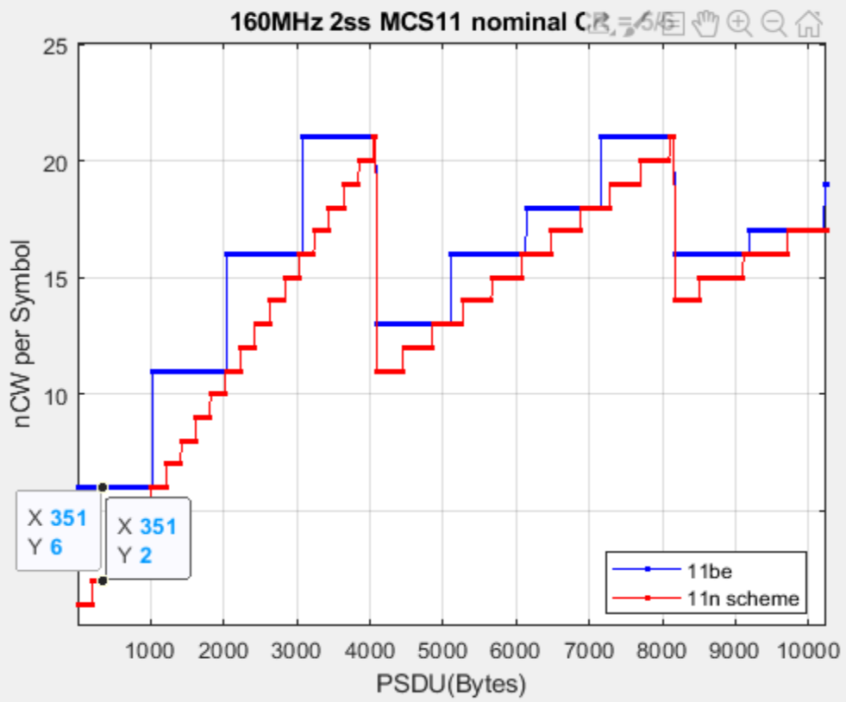
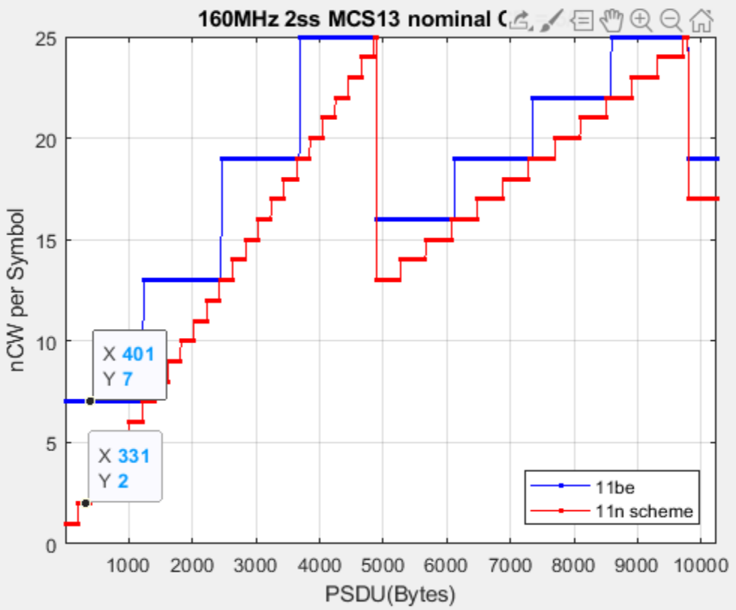
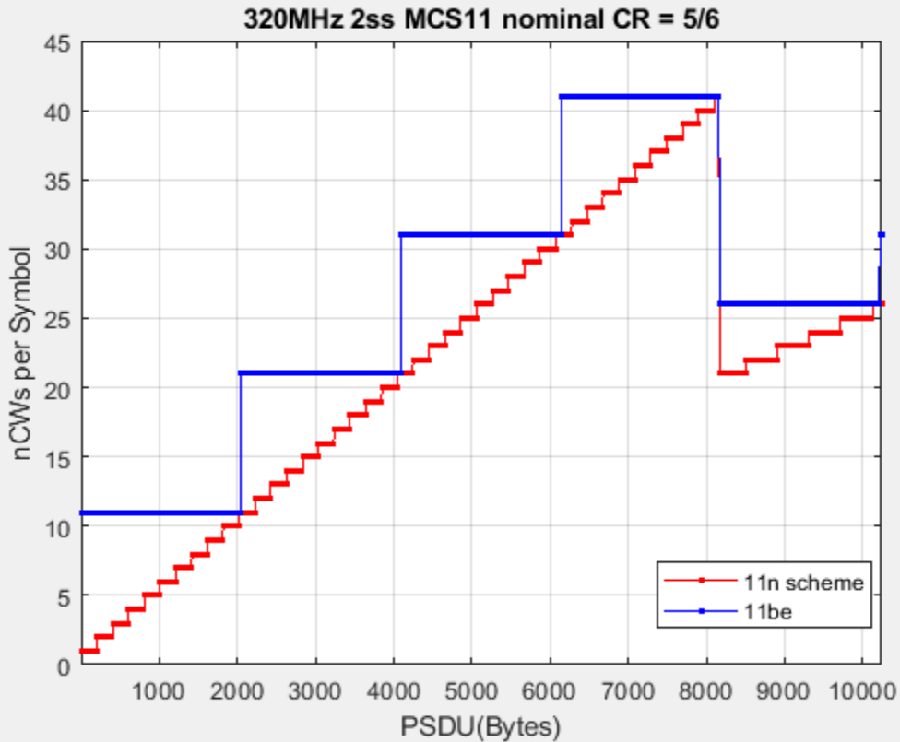
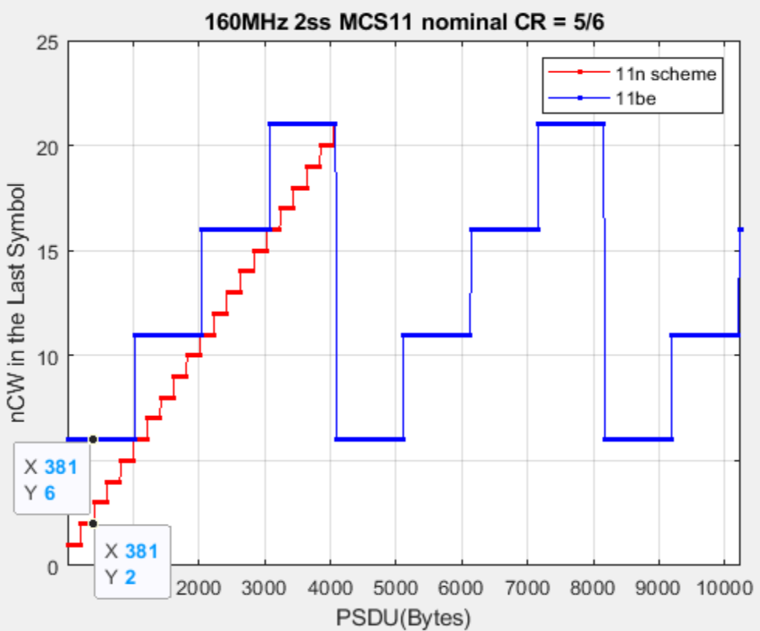
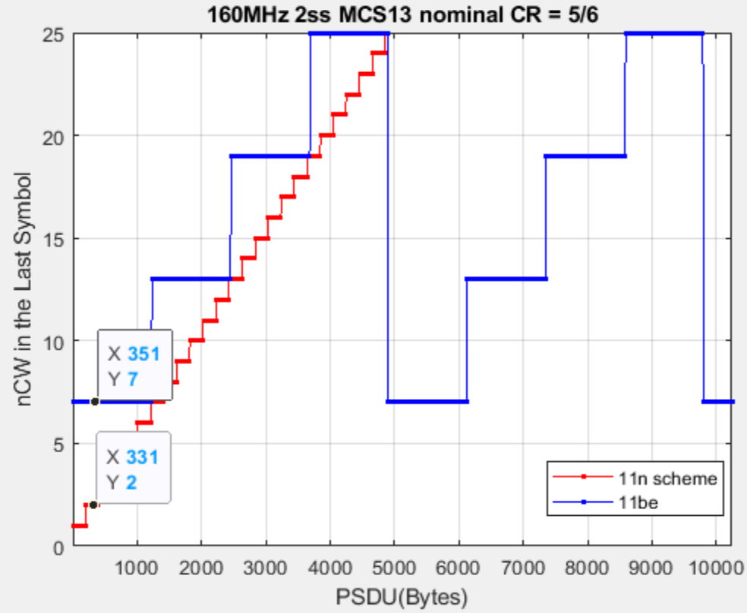
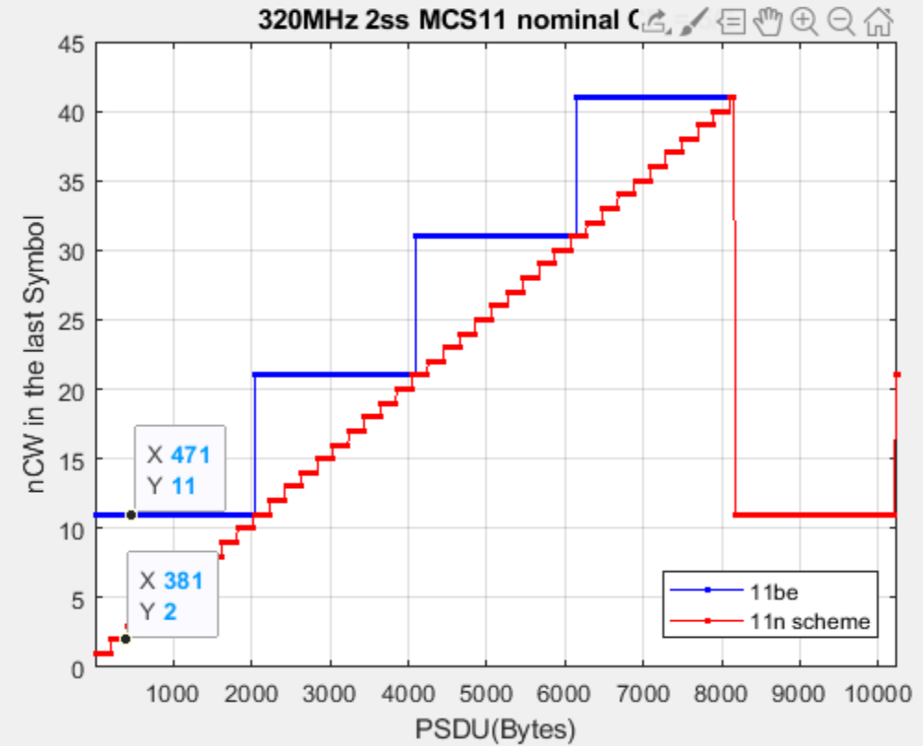
nCW per symbol for high data rate (2/2)

Slide 12
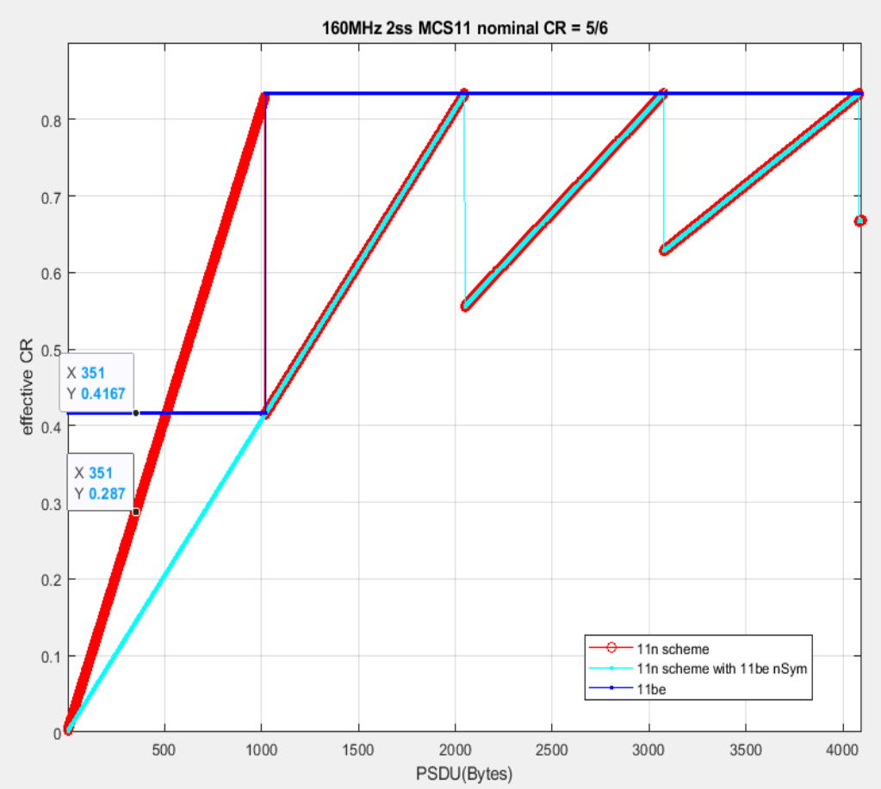
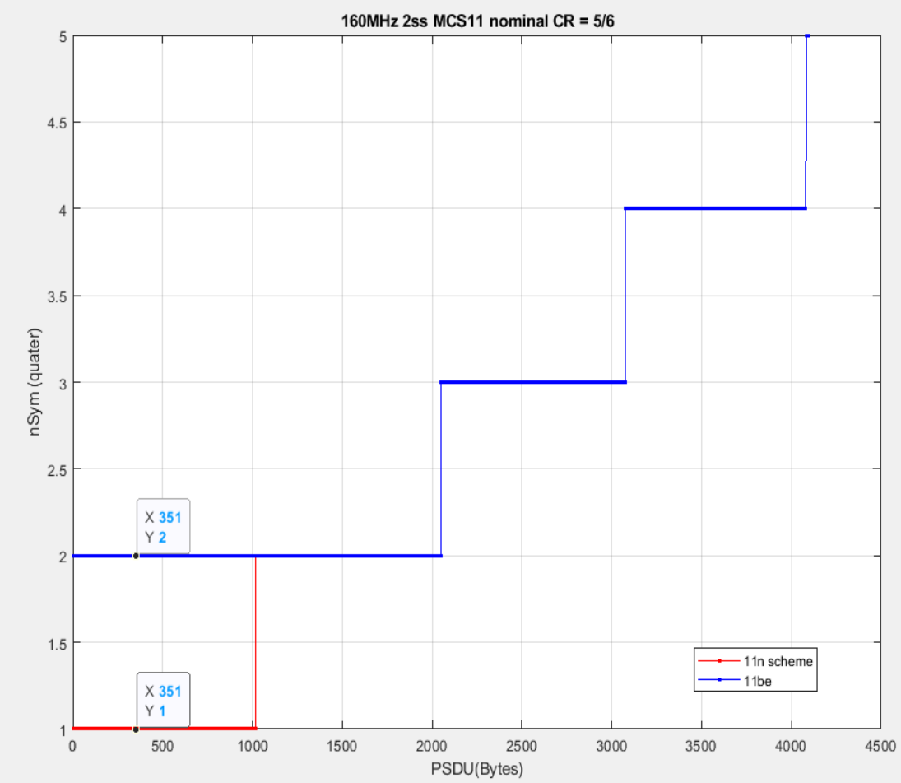
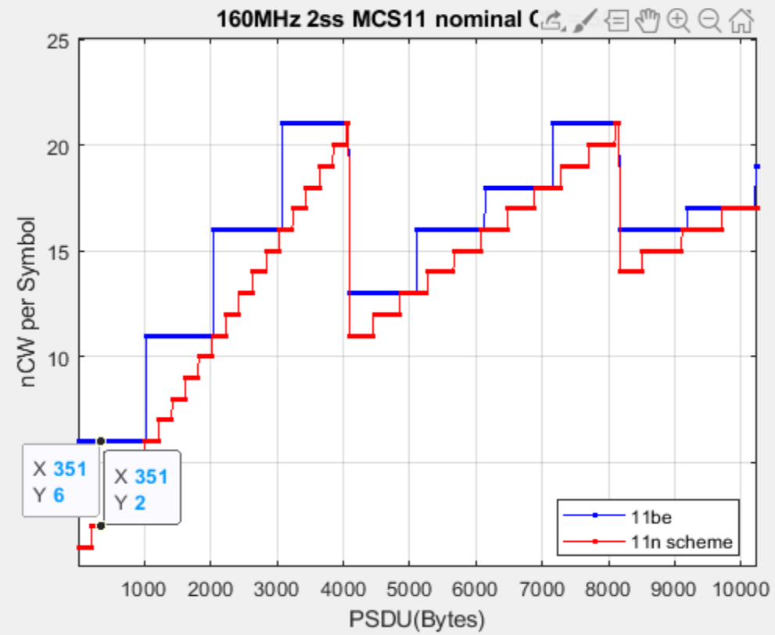
Cases even more illogical…
There are even illogical cases that has:
Higher eCR -> worse performance;
More symbols in a PPDU -> more air-time;
More nCW/Symbol -> higher power consumption.

Slide 13
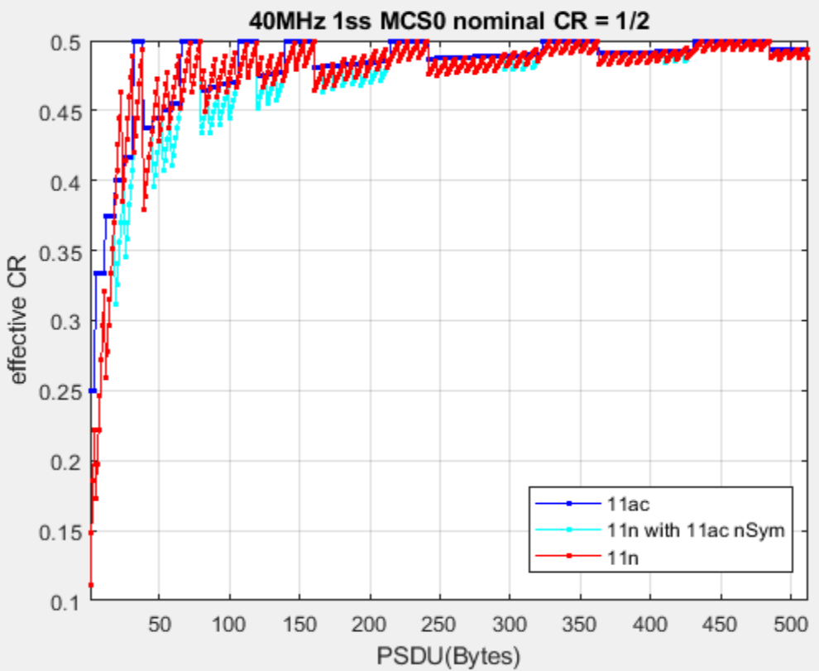
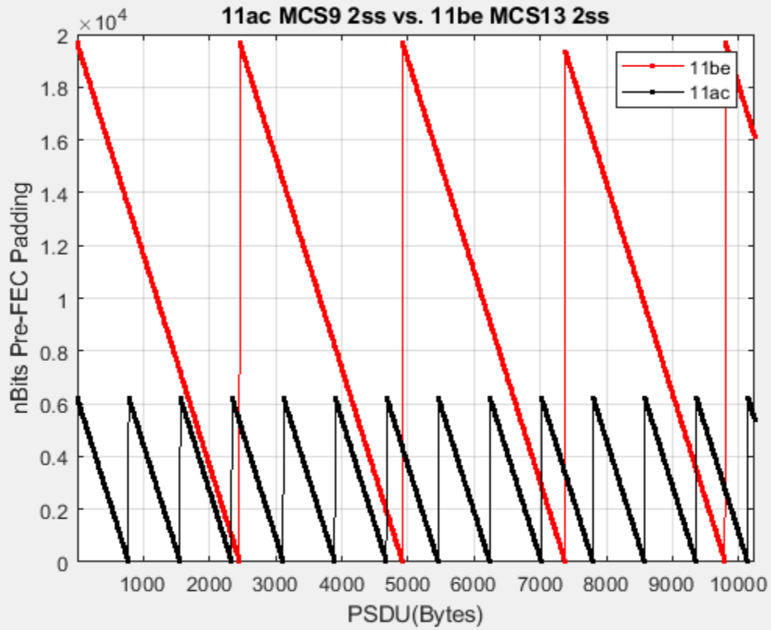
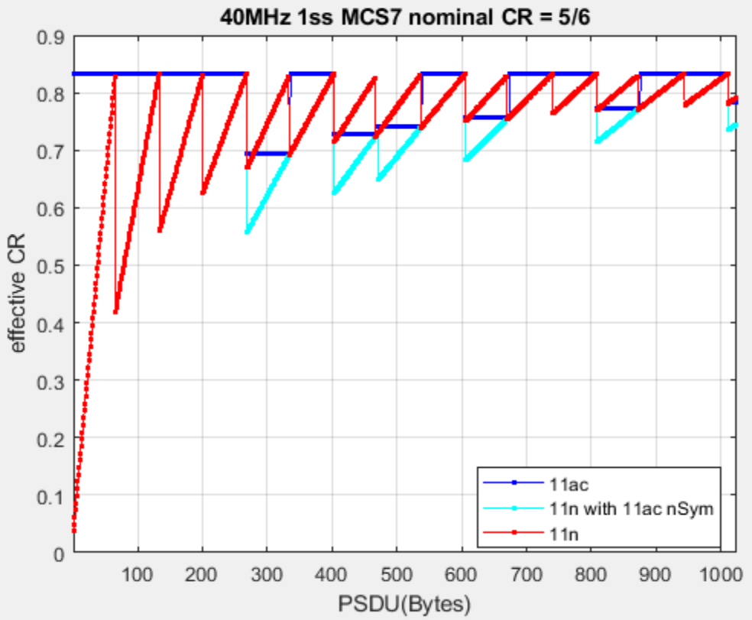
More information…
11be has 3x more dummy bits padded comparing with 11ac even with the introduction of a factor.
If larger BW is introduced in 11bn and the current rate matching scheme is still in service, 4x, 5x more dummy bits padding can be expected...
The gap of eCR ( 11n scheme vs. 11be scheme) will increase if a packet is transmitted with:
A larger nDBPS -> Large BW, higher MCS/nSS (generally be used in an area with good coverage).
A smaller Payload size -> most applications in daily usage.

Slide 14
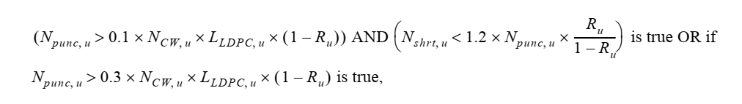
Over-Puncturing (the 3rd issue)
The criteria below are used to avoid over-puncturing in LDPC.
  30% puncturing is set as one criteria;
  10% puncturing is set as another criteria together with a threshold of nbits_short.
Extra symbol (n_SD_short) is added only once if either criteria is “TRUE”.
New RU size and MCS introduced in 11be are leaving this mechanism more broken.

Slide 15
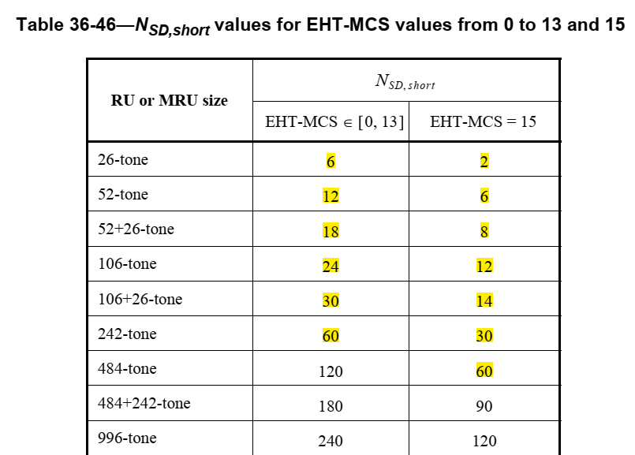
Over-Puncturing – the reason
  The number of data tone in one extra symbol (N_SD) for 11n/ac is 52/108/234/468 for BW of 20/40/80/160MHz respectively.
  The number of data tone with one extra quarter symbol (N_SD_Short) for 11be could be much less than 11n/ac…especially with the MCS 14/15.
    Since extra symbol is only applied one time, the number of cases of over-puncturing in 11be could be significantly higher than 11n/ac. (5000 cases 11be vs 50 cases 11n/ac)
All the combinations violating the rule of over-puncturing are included in the excel attached. Note that:
  Over-puncturing impacts the modes of low-rate (<20Mbps)
    Smaller RU size;
    Lower MCS.
  For those cases, one extra symbol has already been applied.
  Unreasonable small packet size has been removed from the list

Slide 16
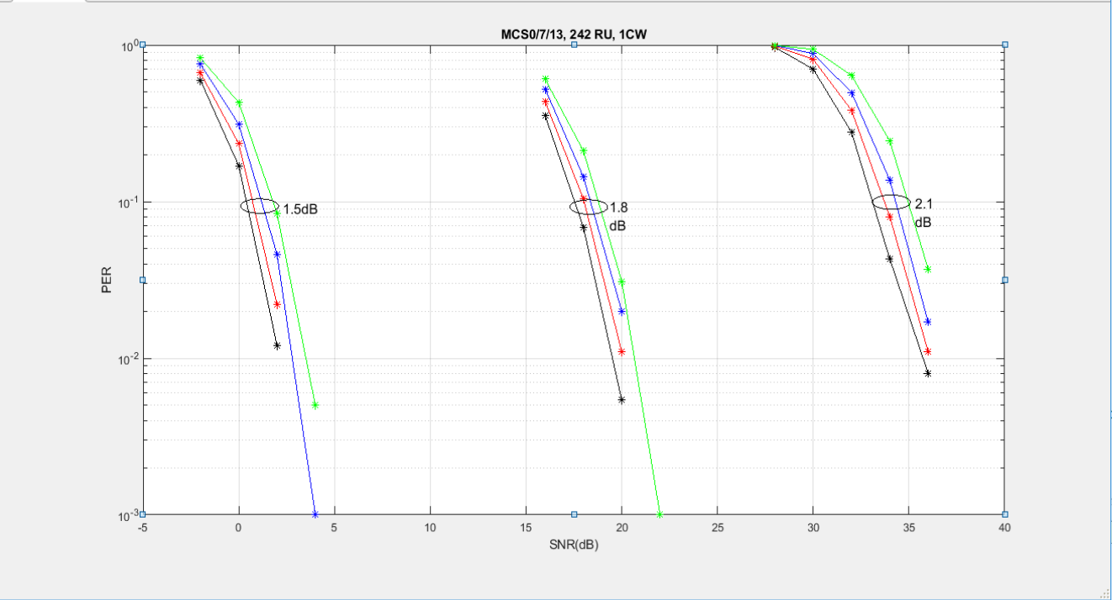
Over-Puncturing – the impacts
In short, the impacts are not quite simple to evaluate without extensive simulations…
  Puncturing itself may introduce 0.5~2dB loss depends on puncturing ratio (10%-30%)
    Blk: 0% Punc; Red: 10% Punc; Blue: 20% Punc; Green: 30% Punc.
    Note: sims is for 1 CW (1944) in ChDNLoS 4x2x1.
  Shortening may offset the performance loss due to puncturing.
One example of 20MHz MCS0 1ss
Pld 361B has punc ratio~23%.
Pld 360B has punc ratio~2%.
Sensitivity loss is ~0.4dB with over-puncturing and shortening.

Slide 17
Solutions & Summary
11n scheme needs 20-ish bits to indicate the PSDU size
  For SU transmission, 20-ish bits needs only one extra 1x-symbol (4us);
  For MU transmission, e.g. 80Mhz PPDU addressing to 4STAs, only two extra 1x-symbols are required (8us).
    Overhead may be a concern only if a large number of STAs are scheduled in one PPDU.
  Well worth the extra signaling overhead considering the gain from performance and power consumptions.
    The overhead increase due to 11be scheme (pre-FEC padding) could be one extra 4x-symbol due to the 16us PE.
Other rate matching scheme can also be developed if similar goal as 11n can be achieved.
  5GNR uses similar rate matching in LDPC but has 90+ candidates of payload size to avoid over padding.
Regarding over-puncturing, suggest to
  respect the existing rule and patch the bug (preferred);
  or redo the evaluation and define new criteria.
Bottom line: Considering the new RU/MRU size and MCS introduced, the current LDPC rate matching (still reusing the one developed in 11n) needs a refresh.

