Slide 1
QoS Revisited
Date: 2023-04-14
Authors:
Name | Affiliations | Address | Phone | Email
Maulik Vaidya | Charter Communications, Inc. |  |  | maulik.vaidya@ieee.org
Nima Namvar |  |  |  | c-nima.namvar@charter.com

Slide 2
Abstract
The purpose of this proposal is two-fold:
One is to highlight the shortcomings of traffic classification (under QoS facility) and corresponding treatment of uplink / downlink traffic in present day 802.11 specifications especially in relation to identification and treatment of low-latency traffic.
Secondly, to highlight shortcomings of current EDCA mode with respect to handling of congestion of the wireless medium and corresponding mechanisms in place to mitigate said congestion.
Furthermore, high-level solutions are proposed as potential candidates to address said shortcomings.

Slide 3
Introduction
The UHR SG finalized the PAR and CSD in the March meeting. The agreed upon KPIs compared to EHT are as follows:
Throughput enhancement at different SINR levels (rate-vs-range)
Improvement to the tail of the latency distribution and jitter
Improved efficient use of wireless medium (WM)
Enhanced power save for both AP and non-AP STAs
Throughput, latency, and efficient use of wireless medium are tightly intertwined.
Various UHR contributions have been discussed for latency improvement, including Preemption [1-2], AI/ML [3], multi-AP coordination [4-5], and scheduling of LL traffic [6].
This study focuses on enhancing the QoS facility to meet the demands of interactive, high-rate, and latency-critical applications such as online gaming, AR/VR, and web conferencing. The proposed improvements aim to provide optimal support for these applications while ensuring efficient use of network resources.

Slide 4
Key Contributors to Latency
While achieving higher TPUTs seems plausible, it is quite challenging to guarantee high TPUT and low latency at the same time.
Ensuring low latency is not easy, especially in a loaded WiFi network. The factors that make it difficult to keep low latency are congestion, retransmission (due to packet loss) and queue delay.
Conventional congestion control techniques work on the premise of reducing transmission rate, leading to severe decrease in TPUT and thereby highlighting the seemingly unresolvable tradeoff between low latency and high TPUT performance.
We need a non-compromising congestion control protocol atop of QoS facility in SME to enable low latency high TPUT performance.
Low Latency Low Loss Scalable Throughput (L4S) is a (IETF) technology intended to ensure low delay and low packet loss rate for Internet flows, without affecting TPUT performance [9].

Slide 5
Key Contributors to Latency (cont’d…)
Another contributing factor to the latency of WiFi network is the lack of sufficient granularity to classify the traffic streams.
802.11e amendment (2002-2005) defined 4 priority levels, called access categories (ACs):AC_BE (Best Effort), AC_BK (Background), AC_VI (Video), AC_VO (Voice) which are still in use after almost 20 years! [7]
These access classes were well reflective of traffic prevalent over a decade or two ago. However, consumer needs and data consumptions have come a long way since and the current classification granularity is no more sufficient to meet the latency demands.
A total of only 8 UPs for received MSDUs which are then mapped to only 4 ACs for MPDU transmission over WM (very low resolution)
With such low resolution, different TSs with varying latency requirements are blurred into a single AC, resulting in the loss of valuable info necessary for prioritizing the latency-sensitive TSs.
Let us review how other other technologies operating over various mediums (wireless and wireline) have accommodated the needs of growing traffic diversity needs.

Slide 6
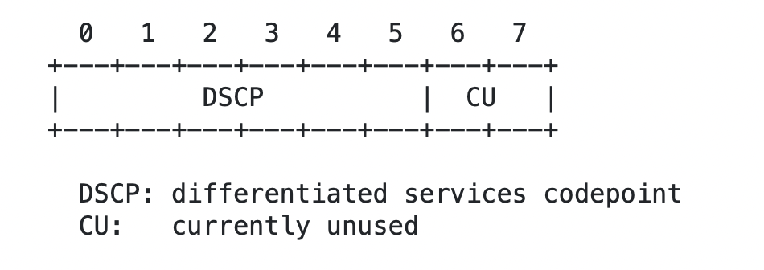
What have other technologies done? (1/4)
IETF defined DSCP (Differentiated Services Code Point) as a method of classifying and managing network traffic in the IP layer [8].
DSCP enables network administrators to differentiate and prioritize network traffic by assigning a specific value to the IP header of a packet, which is used by routers to make decisions on how to handle the packet.
The DSCP values have a range of 0 to 63, with two unused bits currently available. These bits can be utilized to achieve even more refined traffic classification, potentially allowing up to 256 levels in the future.

Slide 7
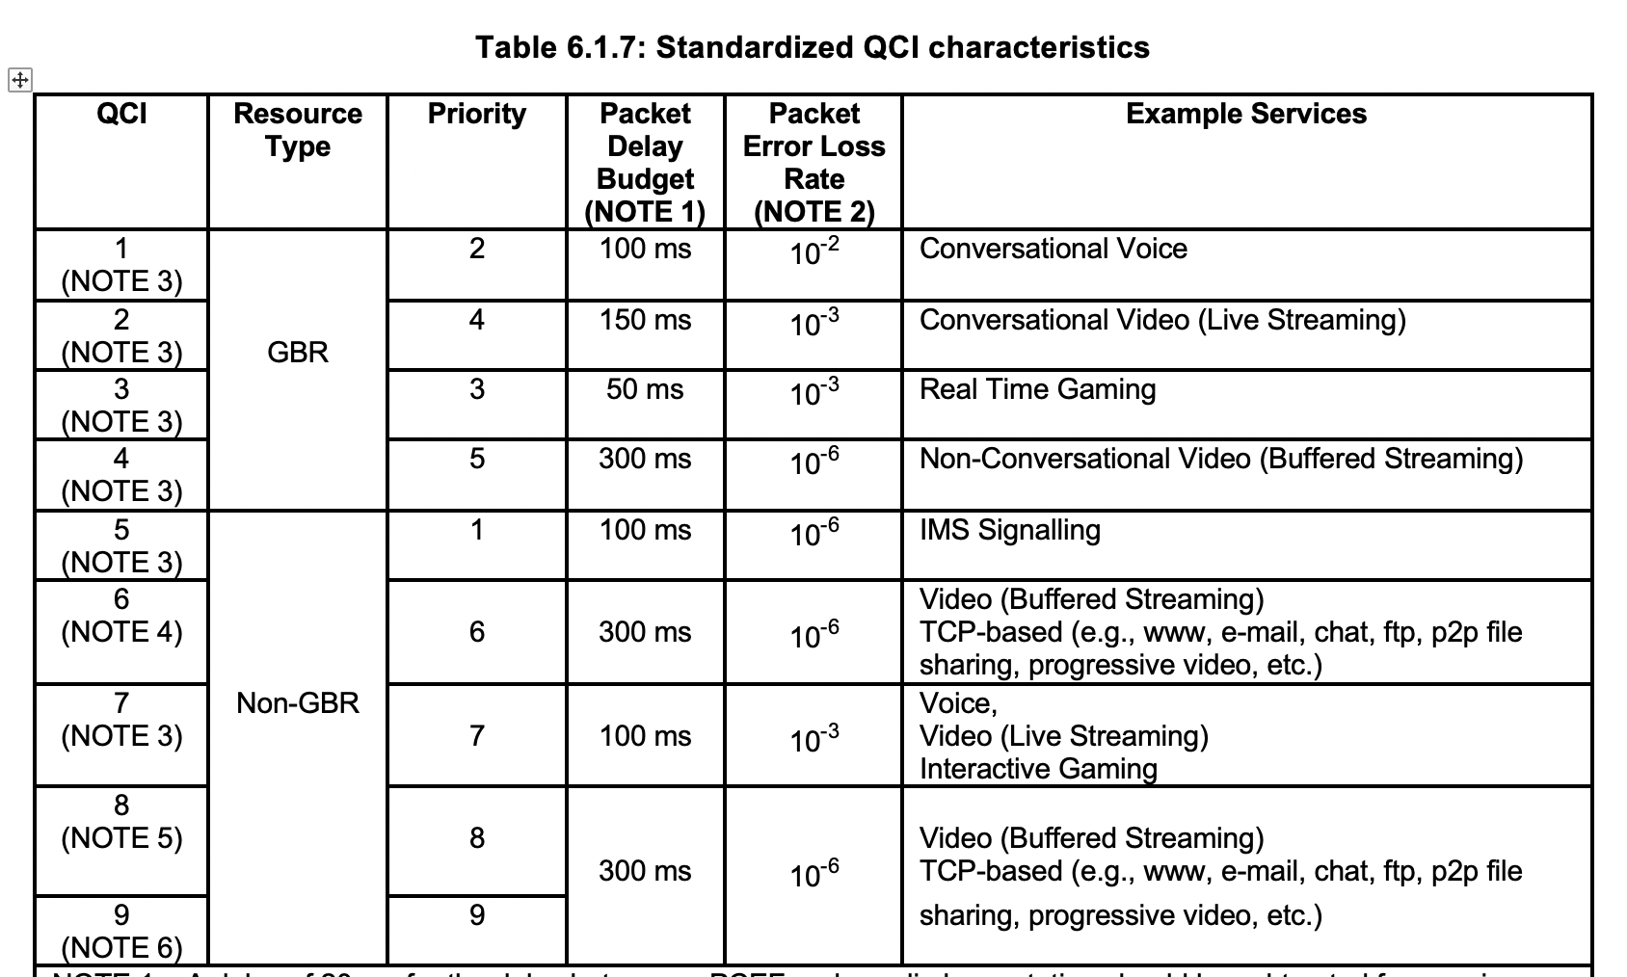
What have other technologies done? (2/4)
Back in early days of 4G LTE, 3GPP defined nine classes, each with its own set of QoS parameters such as packet delay, packet loss, and data rate [11].
The 3GPP classification is commonly used in cellular networks, specifically for LTE and 5G networks.

Slide 8
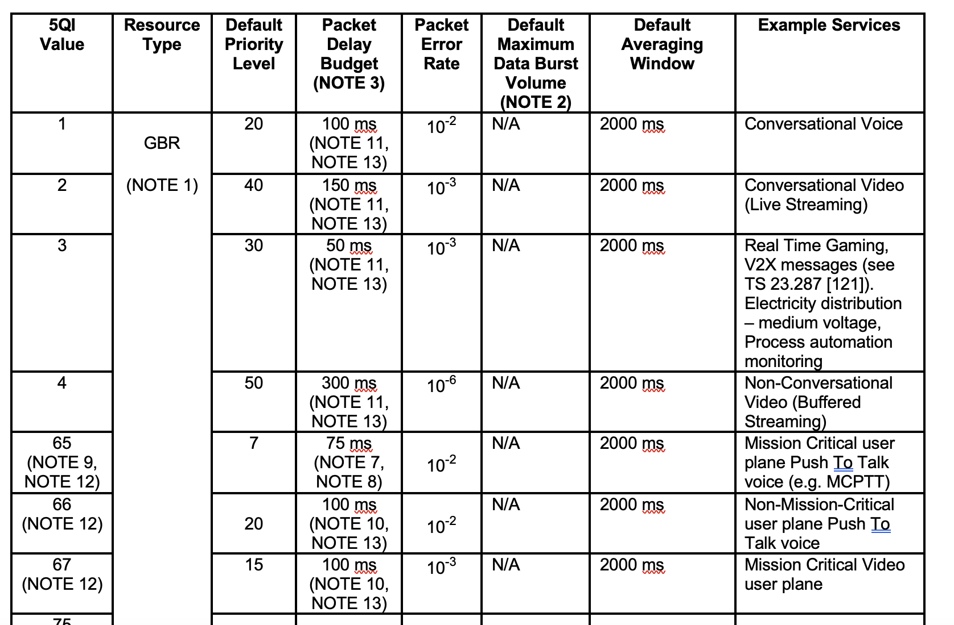
What have other technologies done? (3/4)
As of today (2023), 3GPP defined traffic types [12] have grown to over 25.
Fine-grained qualifications for traffic affords for better traffic treatment due to better resource allocation and utilization strategies

Slide 9
Medium Congestion and Possible Remedies
Wireless medium congestion can occur due to various reasons; chief amongst which being the inability of transmitting entities to clear buffered data over wireless medium
Arguably, two main mechanisms are touted to provide relief:
EDCA (under IEEE purview)
Application-level buffer management (e.g. TCP congestion control)
In subsequent slides, the authors propose high-level solutions to address the former
By prioritizing low latency, low loss traffic over other traffic in the network (similar to L4S [8]), the user experience can be improved for real-time applications, even for when a wireless medium is congested.
It is the authors’ opinion that solution(s) proposed in [6] address a similar problem but do not consider the standardized IETF L4S framework. Hence, authors propose a new solution (in slide 11) to address this issue.

Slide 10
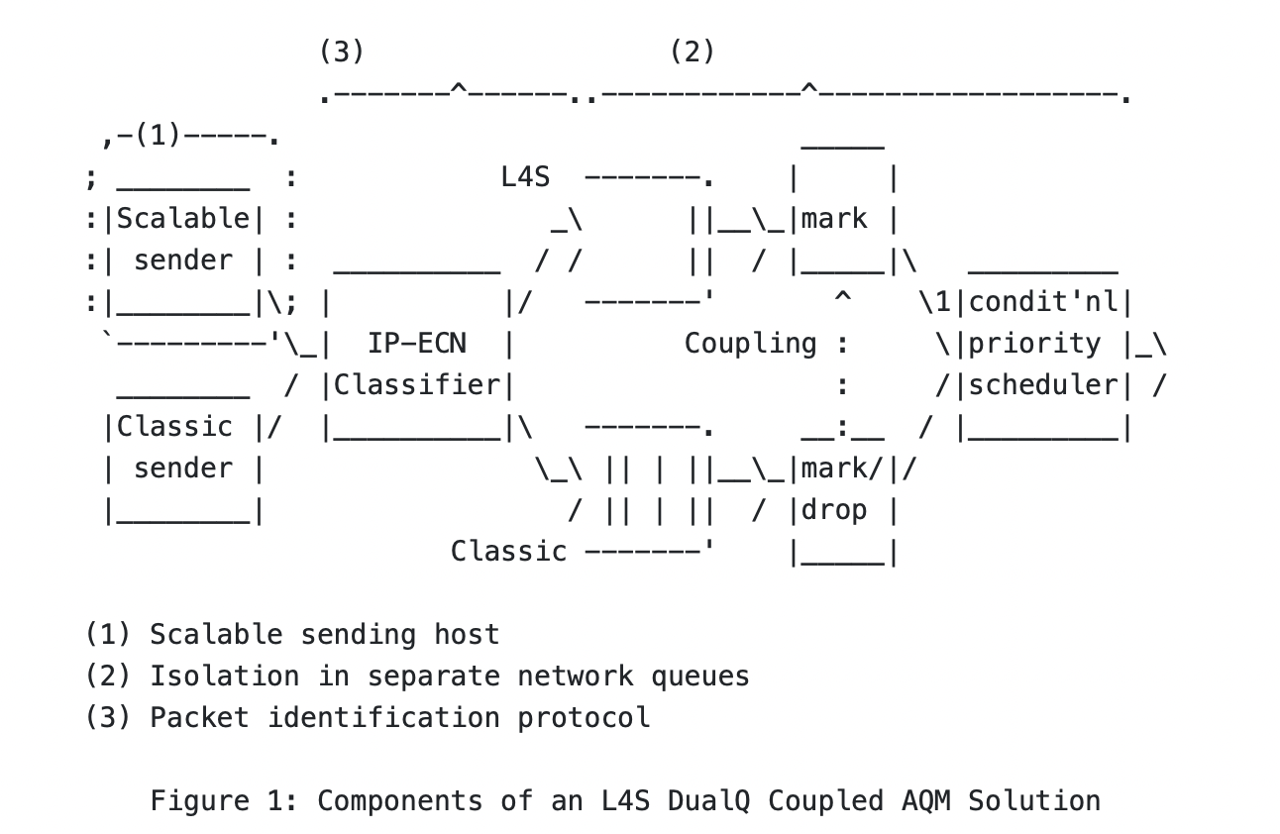
Low Latency Low Loss Scalable Throughput (L4S)
Now, not only has the need for different traffic types been further qualified, but also the need for treatment of given traffic type(s) under different network conditions.
L4S [9] standardizes a dual queue implementation to allow differentiated handling based on network congestion.
The L4S architecture is composed if 3 components [10]:
network support to isolate L4S traffic from Classic traffic (either higher layers or 802.11 MAC SAP itself);
protocol features that allow network elements to identify L4S traffic; (double queue implementation in 802.11)
and host support for L4S congestion controls (improvements to 802.11 QoS facility)

Slide 11
Proposed Solution #1
6
L4S marked packet
packet arrival @ MAC
5
4
Each upper-layer packet arriving at MAC layer, within a given AC, can be divided into two sub-queues
One sub-queue (denoted by AC_i_q1) keeps non L4S marked packets
Second sub-queue keeps L4S marked ([9]) packets
Within a given AC, packets in second sub-queue (denoted by AC_i_q1) are prioritized for transmission prior to those in first sub-queue (denoted by AC_i_q2)
Various prioritization schemes can be implemented and be considered outside the scope of specification e.g.
Empty AC_i_q1 prior to scheduling AC_i_q2
For every packet in AC_i_q2 schedule 5 packets in AC_i_q1 first
3
No L4S marking on packet
2
1
AC_i_qN
AC_i_q1
…
AC_i_q2
i = 1,2,3,4
6
AC_i_q1
AC_i_q2
2
4
5
1
3
AC_i Scheduler
…
3
5
6
TXOP
4
2
1

Slide 12
Proposed Solution #2
(MSDU, UP)
Mapping to AC
Increasing the Number of ACs for Improved Traffic Management:
The baseline standard defines four ACs, each with a different priority level and contention window size. However, this may not be enough to handle the increasing diversity of traffic types in modern networks.
ACs are determined via the UPs and thus, the maximum number of ACs that can be used is 8. Extending the range for UPs requires some modification on the higher layers to support the assignment
Having a one-to-one mapping between UPs and ACs allows better classification of the traffic. However, it needs 4 more EDCAF assigned to each new AC with different CW and AIFS parameters (needs more discussion)
The additional ACs allow for optimized IFS and CW size to accommodate the LL traffic.
AC₇
AC₆
AC₅
AC₄
AC₃
AC₂
AC₁
AC₀
Transmit Queues for ACs
Mapping to transmit
queue and access
category
EDCA Functions with internal collision resolution
…
LL: More frequent access Less TXOP duration
Non-LL: Less frequent access More TXOP duration
TXOP

Slide 13
Proposed Solution #3: Enhanced-EDCA
We propose to include a SUPPORTED_CLASS subfield in the QoS information element, comprising of 8 bits with potential for fine grained TS classification up to 256 levels.
Some bits can be left as “reserved” for future use
Via a capability exchange (e.g. during association), AP and STA exchange support for Extended EDCA (EEDCA)
If both AP and STA support EEDCA, then both AP and STA can employ additional Access Classes
Maximum allowed Access Classes is indicated by 8 bits (➔ total # of allowed AC = 2^8)
For each AC, values of resulting EDCA parameters (e.g. Cw min, max, TXOP etc) are kept between the least and most restrictive parameters of present-day AC parameter values ➔ fair coex with legacy devices
The additional ACs allow for optimized IFs and CW size to accommodate the LL traffic
The proposed SUPPORTED_CLASS subfield enables a direct 1-to-1 mapping between DSCP traffic and 802.11 ACs, allowing much finer transition of IP traffic to the end users (i.e., STAs)

Slide 14
Proposed Solution#4
Combination of the proposed solutions 1 and 2 allows for
Much finer traffic categorization
Better support for LL traffic
Capability for congestion control thanks to L4S tagging
Refined EDCA with more resolution as well as intra-AC MSDU prioritization.
Support for up to 16 different TSs
AC Mapper and L4S to sub-queue assignment
…
(MSDU, UP)
AC₇
AC₀
L4S
L4S
Transmit Queues for ACs
…
EDCA Functions with internal collision resolution
…
TXOP

Slide 15
Straw Poll 1
Do you support the following feature in UHR:
Enhancements (e.g. via Solution# 2, 3,4) to the QoS facility to accommodate fine-grained traffic type distinction to enable better identification of low-latency traffic.
Note, all feasible solutions are expected be explored during resulting work.
Y/N/A

Slide 16
Straw Poll 2
Do you support the following feature in UHR:
Enhancements to the QoS facility by enabling congestion control mechanisms required to handle low-latency traffic (e.g. Solution#1).
Note, all feasible solutions should be explored during resulting work.
Y/N/A

Slide 17
References
11-22/1393, Latency Reduction Scheme for UHR
11-22/1880, Latency and Reliability enhancements for UHR
11-22/1519, Requirements of Low Latency in UHR
11-22/1530, Multi AP coordination for next-generation Wi-Fi
11-22/1556, Multi-AP Coordination for Low Latency Traffic Delivery
11-22/0069r1, Considerations on latency improvement
802.11me draft 2.1
IETF RFC 2474
IETF RFC 9330
IETF RFC 9331
3GPP TS 23.203 v8.15.0
3GPP TS 23.501 v18.0.0

