Slide 1

IEEE P802.11bc – Enhancements for Broadcast Services
IEEE Computer Society Webinar series – May 2023
Presenter: Marc Emmelmann, IEEE 802.11 Task Group bc Chair
(emmelmann@ieee.org)
Coauthors: Carol Ansley, Stephen McCann, Hiroshi Mano, Hitoshi Morioka, Antonio de la Oliva, Abhishek Patil, Xiaofei Wang
“At lectures, symposia, seminars, or educational courses, an individual presenting information on IEEE standards shall make it clear that his or her views should be considered the personal views of that individual rather than the formal position, explanation, or interpretation of the IEEE.” IEEE-SA Standards Board Operation Manual (subclause 5.9.3)

Slide 2
IEEE P802.11bc enhanced broadcast services (eBCS)
The standard in a nutshell – three things to remember
Key features
P802.11bc Draft D7.0 final – pending publication
IEEE P802.11bc defines enhanced broadcast service (eBCS) enhancement for downlink and uplink data transmission
IEEE P802.11bc services enable
  an efficient distribution of content to a large number of consumers in the local neighborhood
  a power-efficient, zero-config scheme for delivering data to a remote destination
  support for unassociated and associated client stations
IEEE P802.11bc is scoped to MAC-only changes
  No changes to existing chipsets (silicon)
  Can be immediately rolled out on legacy devices via firmware updates

Slide 3


Downlink broadcast use cases
Support for associated and unassociated stations
Video streaming at a stadium
  Highlight replay
  Video from different angles of the game
  Videos of different sport activities that take place in parallel
Timetable distribution at a station and an airport
Multilingual audio service at a museum
Emergency instruction at a shopping mall
  Although ETWS on 3GPP can warn earthquake or tsunami, it is only for large area.
  Wi-Fi Broadcast can warn local information.
Intelligent Transportation Broadcast

Slide 4
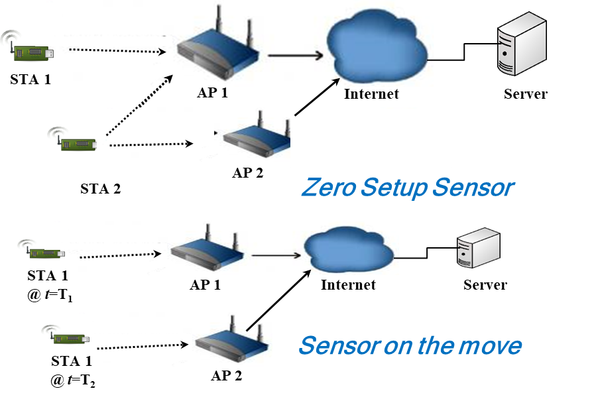
Uplink broadcast use cases
Focus on unassociated stations
Asset tracking
  Inexpensive, low-power mobile tracker sends ping to a cloud server
    Baggage tracking at airports
    Inventory tracking in a warehouse
    Parcel tracking
  No association between tracker and serving AP(s)
Zero-config, low-power sensors
  sends data to a remote server
  Headless IoT device
  Zero setup (no association)

Slide 5
Stakeholders
Representing a potential market of 20 billion connected devices for sensor and broadcast deployments with associated services with an estimated worth of $2 trillion
Infrastructure operators:
Stadium operators
Museums
schools, universities
Device vendors and manufacturers:
IoT devices
Mobile phones
Sensors
Tracking devices
Access points
Service providers
Broadcasters
Emergency management agencies/local governments
IoT operators and service providers
Tracking services
Service Consumers
Private end-users
Commercial end users (e.g., cargo companies)
Event organizers

Slide 6
802.11bc – Key Technical features

Slide 7
Service discovery negotiation and termination
Enable finding broadcast services with and without access restrictions
Service Discovery/Announcement
  ANQP-element
  EBCS Info Frame
Service Negotiation
  Associated
    EBCS Content Request/Response
  Un-associated
    EBCS Content Request/Response
    ANQP-element
Service Termination
  Termination Notice frame
Optimization mechanisms to reduce waiting times
  Reduced Neighbor Report
Public announcement of services
w/ access requirements
Supports content w/ access restrictions
Supports content publicly accessible
Automatic stop of services
Power saving
Enables easy change of tx AP

Slide 8
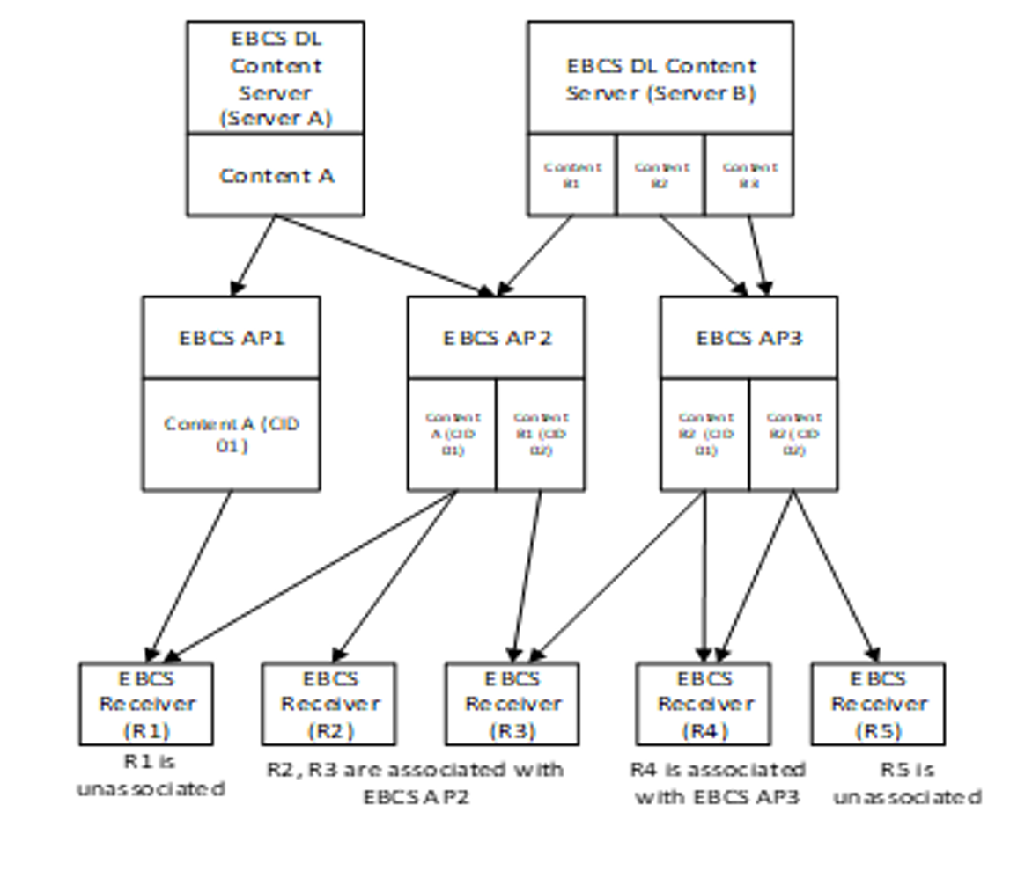
Downlink Broadcasting with Content Origin Authentication
Support for associated and unassociated stations
Content server
  May be located externally, e.g., in the cloud
  Originator of an identified (e.g., tagged) content stream
Access point(s)
  Request content stream from server (out of scope of the standard)
  Operator of AP decides, which services are broadcast
  Broadcast stream to associated / unassociated STAs
  map specific content stream to a content ID used to build a special multicast address
STAs may employ MAC-address-based filtering to decide which information to receive

Slide 9
Specific MAC Group Addressing
Distinguish between downlink streams and identify receiving APs in the uplink
EBCS uses special MAC addresses (EBCS content MAC address) to
  identify the content stream
  filter desired/undesired content stream easily.
EBCS content MAC address
  Address format: 01-0F-AC-xx-yy-zz
    00-0F-AC is the OUI for IEEE 802.11.
    The bit 0 of the first octet equal 1 means it is a group MAC address (multicast).
  For EBCS Downlink: The EBCS content MAC address is used as the receiver address.
    xx-yy specifies the EBCS AP group ID that identifies the group the AP belongs to.
    zz identifies the content ID of the content stream.
  For EBCS Uplink: The EBCS content MAC address is used as BSSID.
    xx-yy-zz identifies the UL stream.
One more special MAC address, EBCS info MAC address, is used to identify the EBCS AP group for EBCS Info frame, a kind of management frame, that is used for EBCS downlink.
  Address format: 01-0F-AC-xx-yy-00
  xx-yy identifies the EBCS AP group ID.
OUI for IEEE 802.11
01-0F-AC-xx-yy-zz
EBCS
AP Group ID
Downlink
Content
stream ID
Uplink
BSSID ID

Slide 10
EBCS Content origin authentication preventing fake AP attacks
3 types of one-way frame authentication mechanisms not requiring key negotiation
PKFA (Public Key Frame Authentication)
PKFA uses a public key algorithm to authenticate frames.
Each frame contains the certificate and the signature to enable receiver to authenticate the frame.
It is good for small data and time sensitive data.
HCFA (Hash Chain Frame Authentication)
HCFA uses a public key algorithm and one-way key chain.
One-way key chain is a light-weight frame authentication algorithm that requires just hash value calculations.
It is good for streaming data.
HLSA (Higher Layer Source Authentication)
HLSA does not provide any frame authentication in IEEE 802.11 layer.
Higher layer is responsible for source authentication.

Slide 11
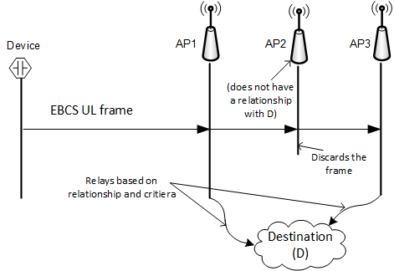
Uplink (UL) Relaying Service
The UL relaying service provides a means for a device to send short data to a cloud service without having to join an AP’s network
  The frame carrying the data is broadcasted by the device and includes the address of the destination, security parameters and ID of the device.
The relaying service is best effort and is targeted to serve low-power low-cost devices
  The transmitting device is not required to spend power in monitoring the wireless medium to determine if it is in range of any AP that can relay its data
  In addition, a relay AP might not forward if the criteria for relaying are not met

Slide 12
Agreements for Uplink Relaying
An AP (or the AP’s operator) needs to have an agreement with the specified destination to support relaying of the data to that destination.
To reduce the possibility of a DoS attack, the agreement can specify the rules for relaying.
  The criteria can include authenticating the transmitter, checking for replay and limiting the amount or frequency of data sent to the cloud service.
  Deployments can have a centralized controller sitting behind multiple APs at the location perform the above checks and deliver a single copy to the intended destination if the criteria are met.
Based on the agreement, an AP can embed additional information (such as date, time, location etc).

Slide 13
Examples of UL Relaying service
Tracking services:
Ex 1: An operator at an airport establishes an agreement with a baggage tracking cloud service. This enables the APs at the airport to support relaying to the cloud service. The tracking service provides ultra low power Wi-Fi enabled tags which users can place in their luggage. The tags periodically broadcast their ID which is relayed by one or more APs (along with location information). The cloud service logs the reported location for each tag enabling their respective users to track their luggage.
Ex 2: APs belonging to a courier service support relaying, to the courier’s cloud server, which logs package location. An ultra low power Wi-Fi enabled tag embedded within a package periodically broadcasts its ID which is relayed to the cloud server along with the warehouse location. The service enables users to track the progress of their packages.
Headless IoT devices:
A manufacturer of a smart home appliance (such as a dishwasher) has an agreement with either the networking gear vendor (e.g., the AP vendor) or the broadband service provider (cable co., that has provided the AP) to support relaying to the manufacturer's cloud service. Such zero config, smart appliance can transmit data intended for its manufacture’s cloud service. Based on the agreement, an AP in range of the appliance (which could be neighbor’s AP) relays the data to the cloud service if it has the necessary agreement with the manufacturer. The short data can be a service request, sensor data etc.

Slide 14
Summary
P802.11bc, enhanced broadcast services (EBCS),
  advances the support of the transmission and reception of broadcast content
  Supports stations while associated or unassociated with in infrastructure basic service set (BSS)
Content can be relayed in the uplink and downlink direction to/from (external) servers hosting a broadcast service
Adds features allowing
  The access point to control the relaying process to avoid, e.g., DOS attacks
  The station to filter relevant content streams
  Origin authentication preventing fake AP attacks
New features to the MAC only (no PHY changes) thus enabling fast roll-out via firmware updates

Slide 15
P802.11bc D7.0 is available in the IEEE SA Standards Store
(final draft prepublication)
IEEE P802.11bc: IEEE Draft Standard for Information technology--Telecommunications and information exchange between systems Local and metropolitan area networks--Specific requirements - Part 11: Wireless LAN Medium Access Control (MAC) and Physical Layer (PHY) Specifications - Amendment 6: Enhanced Broadcast Service. ISBN(s):9781504495301
Number of Pages:102
See: https://www.techstreet.com/ieee/standards/ieee-p802-11bc?product_id=2241694

Slide 16
Thank you
Questions

Slide 17
References
P802.11bc CSD
https://mentor.ieee.org/802-ec/dcn/18/ec-18-0250-00-ACSD-p802-11bc.pdf
TGbc Use Case Document
https://mentor.ieee.org/802.11/documents?is_dcn=268&is_group=00bc
P802.11bd D7.0
https://www.techstreet.com/ieee/standards/ieee-p802-11bc?product_id=2241694
IEEE P802.11bc – Enhancements for Broadcast Services
https://mentor.ieee.org/802.11/documents?is_dcn=0601&is_group=00bc&is_year=2023

