Slide 1
Non-AP initiated TXOP sharing
April 2023
Date: 2023-04-14
Authors:
Name | Affiliations | Address | Phone | email
Shawn (Sanghyun) Kim | WILUS Inc. | 216 Hwangsaeul-ro, Seongnam-si, Gyeonggi-do, Korea | +82-31-712-0523 | shawn.kim@wilusgroup.com
John (Ju-Hyung) Son |  |  |  | john.son@wilusgroup.com
Jin Sam Kwak |  |  |  | jinsam.kwak@wilusgroup.com
Greg Geonjung Ko |  |  |  | greg.ko@wilusgroup.com
Sanghyun Kim (WILUS), et al.

Slide 2
Motivation
April 2023
Improving the tail of the latency distribution and jitter is one of objectives of UHR[1]
To improve latency/jitter, the AP needs to perform more flexible scheduling by taking into account the requirements of each STA
However, a challenge arises when a non-AP STA is the TXOP holder, as the AP is limited to a passive role as a TXOP responder
Moreover, the AP of a BSS where a non-AP STA is a TXOP holder is limited in participating in Multi-AP Operation, which is considered as one of the key functions of UHR
Therefore, To enhance the network manageability of the AP that is a TXOP responder, it is necessary to introduce techniques in UHR
Sanghyun Kim (WILUS), et al.

Slide 3
Candidate solutions
April 2023
Two solutions can be considered to increase the manageability of AP
Option 1: Reusing Triggered TXOP Sharing (TXS)[2]
Concept: non-AP STAs share their TXOP with the AP
Option 2: Reusing Reverse Direction (RD) protocol
Concept: non-AP STAs transmit the RDG PPDU
Reusing the TXS procedure defined in EHT could be a better starting point
As a RD responder, AP’s manageability is still limited (10.29.2 Reverse direction (RD) frame exchange sequence):
shall schedule at least one MPDU/Trigger frame for the RD initiator
shall trigger full-BW UL MU-MIMO
Sanghyun Kim (WILUS), et al.

Slide 4
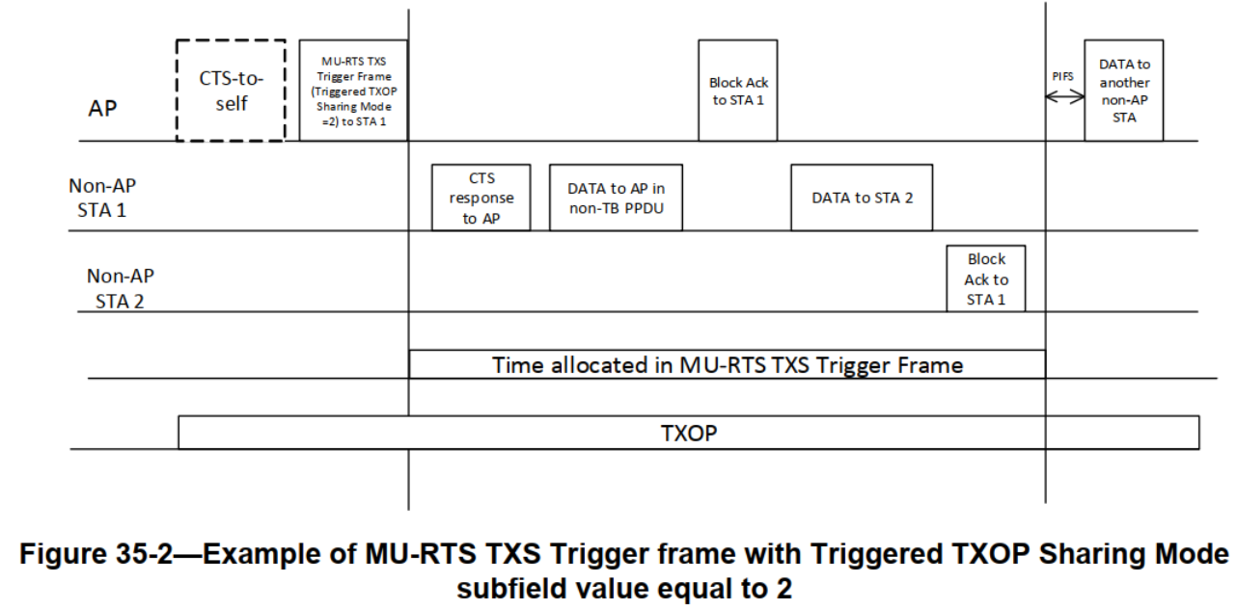
Recap: Triggered TXOP sharing procedure[3]
April 2023
The TXOP sharing procedure defined in EHT allows an AP to share its TXOP with a non-AP STA, allowing the non-AP STA to manage the frame exchange sequence
Sanghyun Kim (WILUS), et al.

Slide 5
Non-AP initiated TXOP sharing
April 2023
Reusing Triggered TXOP Sharing (TXS)
The AP can initiate MU operations for its BSS or M-AP operations during the time allocated by the non-AP STA
Coordinated operations
Shared AP
Response
(e.g., CTS, Trigger frame)
DL MU PPDU
M-AP
Ctrl frame
AP
TXOP shared by the non-AP STA1
TXOP
Non-AP STA1
Ctrl frame
(e.g., TXS)
TB PPDU
TXOP
Non-AP STA2
TB PPDU
Sanghyun Kim (WILUS), et al.

Slide 6
Remaining problems
April 2023
Problems
Inefficiency in BW utilization
BW of the shared TXOP might be limited according to the non-AP STA’s operating BW
AP cannot fully utilize its performance[4]
*Note that there could be still 20 MHz-only STA in the UHR BSS
NAV set by the non-AP STA
Some APs may not be able to participate in M-AP operation due to the NAV set by the non-AP STA that is a TXOP holder
Direction to go
The AP should become the TXOP holder, and the bandwidth should be able to expand
Sanghyun Kim (WILUS), et al.

Slide 7
Proposed enhancement for the non-AP initiated TXOP sharing
April 2023
During the shared TXOP, the AP can gain the rights to access the wider channel by invoking the backoff procedure and ignoring the NAV set by the non-AP STA
AP can determine whether to invoke the backoff procedure
*The other STAs do not contend the channel because their NAV is non-zero
*The non-AP STA can invoke backoff to perform TXOP recovery during the shared TXOP by the AP (when the TXOP sharing mode is 2)
Once the AP obtains the rights, the AP can manage the network as a TXOP holder
320 MHz PPDU
(e.g., MU-RTS)
MU & M-AP operations
IDLE
AP
Response frame (P80)
2
1
0
3
TXOP shared by the non-AP STA (P80)
TXOP
TXOP of AP (320 MHz)
Non-AP STA
Ctrl frame
(on P80)
0
TXOP
TXOP has been terminated
Sanghyun Kim (WILUS), et al.

Slide 8
Considerations
April 2023
ETSI Regulations[5]
AP's channel access for wider BW after the backoff procedure is a regulation-compliant operation (please see APPENDIX)
Fair coexistence with legacy BSS
There might be a rule for limiting the length of the TXOP for the AP
e.g., (End of the AP’s TXOP) - (Initial frame of the non-AP STA) ≤ TBD threshold
Therefore, it may be recommended for non-AP STAs to share their TXOP with the AP as soon as they acquire the TXOP
Sanghyun Kim (WILUS), et al.

Slide 9
A brief analysis of the proposed solution
April 2023
Pros
Reducing Latency/Jitter
Due to the increased manageability of AP
TPUT Increase
Due to MU/M-AP operations
Due to the extended BW
Cons
Overhead
Additional backoff procedure does introduce overhead, but benefits (extra BW & M-AP operation) seem outweigh the overhead
Sanghyun Kim (WILUS), et al.

Slide 10
Summary
April 2023
We proposed sharing the TXOP acquired by non-AP STAs with the AP
Sanghyun Kim (WILUS), et al.

Slide 11
Straw Poll 1
April 2023
Do you agree to define a procedure in UHR for a non-AP STA to share its TXOP with the associated AP?
Sanghyun Kim (WILUS), et al.

Slide 12
Straw Poll 2
April 2023
Do you agree to define a procedure in UHR that allows an AP to initiate its TXOP during the time allocated by the non-AP STA?
Sanghyun Kim (WILUS), et al.

Slide 13
References
April 2023
[1] 11-23/480r0 UHR proposed PAR (Laurent, Intel)
[2] 11-23/41r0 Considerations on Coordinated TDMA (Yanjun, Qualcomm)
[3] TGbe D3.0 (35.2.1.2 Triggered TXOP sharing procedure)
[4] 11-22/2204r0 Dynamic Subband Operation (Sindhu, Broadcom)
[5] ETSI EN 301 893v2.1.50e, 5 GHz WAS/RLAN; Harmonised Standard for access to radio spectrum https://www.ieee802.org/11/private/ETSI_documents/BRAN/05-CONTRIBUTIONS/2023/BRAN(23)118013r3_Rapporteur_s_copy_of_EN_301_893.zip
Sanghyun Kim (WILUS), et al.

Slide 14
Appendix (ETSI regulations)
April 2023
Summary (4.2.7.3.2.3 Multi-channel operation)[5]
Option 1
Device may use any combination/grouping of channels, if it satisfies the channel access requirements for an initiating device on each such operating channel
Need to separately gain the right to access each channel (per-20 MHz)
Option 2
Device that uses a combination/grouping of adjacent 20 MHz channels that is a subset of the 40/80/160 MHz channels may transmit on any of the 20 MHz channels, if:
The device has gained the right to the primary channel as defined in 4.2.7.3.2.6 and
The device performs CCA of at least 23 us immediately before the intended transmission on each of the other operating channel
*4.2.7.3.2.6 is equivalent/similar to the backoff procedure of Wi-Fi
Sanghyun Kim (WILUS), et al.

