Slide 1
ARC-SC-agenda-May-2023
Date: 2023-05-15
Authors:

Slide 2
Abstract
Agenda for:
ARC SC, May 2023 Session

Slide 3
IEEE 802.11
Architecture Standing Committee
Agenda
May 2023 Session
Chair: Mark Hamilton (Ruckus/CommScope)
Vice Chair & Sec’y: Joe Levy (InterDigital)

Slide 4
Registration for the May IEEE 802 wireless interim session
This meeting is part of the May IEEE 802 wireless interim session
You must pay the registration fee whether attending in-person or remotely
If you have not already done so, you can register here: https://web.cvent.com/event/c8c74da9-42ef-4650-bbf6-d33d40c6bedc/summary
If you do not intend to register for this session you must leave this meeting and, if you have logged attendance on IMAT, email the 802.11 chair or vice chairs to have your attendance cancelled

Slide 5
Attendance, etc.
Reminders to attendees:
  Sign in for .11 attendance credit
  Noises off (if remote connected)
  NO AUDIO CXN (if on-site connected)
  No recordings

Slide 6
Meeting Protocol
Please announce your affiliation when you first address the group during a meeting slot

Slide 7
Participants have a duty to inform the IEEE
  Participants shall inform the IEEE (or cause the IEEE to be informed) of the identity of each holder of any potential Essential Patent Claims of which they are personally aware if the claims are owned or controlled by the participant or the entity the participant is from, employed by, or otherwise represents
  Participants should inform the IEEE (or cause the IEEE to be informed) of the identity of any other holders of potential Essential Patent Claims
  Early identification of holders of potential Essential Patent Claims is encouraged

Slide 8
Ways to inform IEEE
Cause an LOA to be submitted to the IEEE-SA (patcom@ieee.org); or
Provide the chair of this group with the identity of the holder(s) of any and all such claims as soon as possible; or
Speak up now and respond to this Call for Potentially Essential Patents
If anyone in this meeting is personally aware of the holder of any patent claims that are potentially essential to implementation of the proposed standard(s) under consideration by this group and that are not already the subject of an Accepted Letter of Assurance, please respond at this time by providing relevant information to the WG Chair

Slide 9
Other guidelines for IEEE WG meetings
All IEEE-SA standards meetings shall be conducted in compliance with all applicable laws, including antitrust and competition laws.
  Don’t discuss the interpretation, validity, or essentiality of patents/patent claims.
  Don’t discuss specific license rates, terms, or conditions.
    Relative costs of different technical approaches that include relative costs of patent licensing terms may be discussed in standards development meetings.
      Technical considerations remain the primary focus
  Don’t discuss or engage in the fixing of product prices, allocation of customers, or division of sales markets.
  Don’t discuss the status or substance of ongoing or threatened litigation.
  Don’t be silent if inappropriate topics are discussed … do formally object immediately.
---------------------------------------------------------------
For more details, see IEEE-SA Standards Board Operations Manual, clause 5.3.10 and
Antitrust and Competition Policy: What You Need to Know at http://standards.ieee.org/develop/policies/antitrust.pdf

Slide 10
Patent-related information
  The patent policy and the procedures used to execute that policy are documented in the:
    IEEE-SA Standards Board Bylaws
    (http://standards.ieee.org/develop/policies/bylaws/sect6-7.html#6)
    IEEE-SA Standards Board Operations Manual (http://standards.ieee.org/develop/policies/opman/sect6.html#6.3)
  Material about the patent policy is available at
  http://standards.ieee.org/about/sasb/patcom/materials.html
  If you have questions, contact the IEEE-SA Standards Board Patent Committee Administrator at patcom@ieee.org

Slide 11
IEEE SA Copyright Policy
By participating in this activity, you agree to comply with the IEEE Code of Ethics, all applicable laws, and all IEEE policies and procedures including, but not limited to, the IEEE SA Copyright Policy.
  Previously Published material (copyright assertion indicated) shall not be presented/submitted to the Working Group nor incorporated into a Working Group draft unless permission is granted.
  Prior to presentation or submission, you shall notify the Working Group Chair of previously Published material and should assist the Chair in obtaining copyright permission acceptable to IEEE SA.
  For material that is not previously Published, IEEE is automatically granted a license to use any material that is presented or submitted.

Slide 12
IEEE SA Copyright Policy
    The IEEE SA Copyright Policy is described in the IEEE SA Standards Board Bylaws and IEEE SA Standards Board Operations Manual
      IEEE SA Copyright Policy, see
      Clause 7 of the IEEE SA Standards Board Bylaws
      https://standards.ieee.org/about/policies/bylaws/sect6-7.html#7
      Clause 6.1 of the IEEE SA Standards Board Operations Manual
      https://standards.ieee.org/about/policies/opman/sect6.html
    IEEE SA Copyright Permission
      https://standards.ieee.org/content/dam/ieee-standards/standards/web/documents/other/permissionltrs.zip
    IEEE SA Copyright FAQs
      http://standards.ieee.org/faqs/copyrights.html/
    IEEE SA Best Practices for IEEE Standards Development
      http://standards.ieee.org/develop/policies/best_practices_for_ieee_standards_development_051215.pdf
    Distribution of Draft Standards (see 6.1.3 of the SASB Operations Manual)
      https://standards.ieee.org/about/policies/opman/sect6.html

Slide 13
Participant behavior in IEEE-SA activities is guided by the IEEE Codes of Ethics & Conduct
All participants in IEEE-SA activities are expected to adhere to the core principles underlying the:
  IEEE Code of Ethics
  IEEE Code of Conduct
The core principles of the IEEE Codes of Ethics & Conduct are to:
  Uphold the highest standards of integrity, responsible behavior, and ethical and professional conduct
  Treat people fairly and with respect, to not engage in harassment, discrimination, or retaliation, and to protect people's privacy.
  Avoid injuring others, their property, reputation, or employment by false or malicious action
The most recent versions of these Codes are available at
  http://www.ieee.org/about/corporate/governance

Slide 14
Participants in the IEEE-SA “individual process” shall act independently of others, including employers
The IEEE-SA Standards Board Bylaws require that “participants in the IEEE standards development individual process shall act based on their qualifications and experience”
This means participants:
  Shall act & vote based on their personal & independent opinions derived from their expertise, knowledge, and qualifications
  Shall not act or vote based on any obligation to or any direction from any other person or organization, including an employer or client, regardless of any external commitments, agreements, contracts, or orders
  Shall not direct the actions or votes of other participants or retaliate against other participants for fulfilling their responsibility to act & vote based on their personal & independently developed opinions
By participating in standards activities using the “individual process”, you are deemed to accept these requirements; if you are unable to satisfy these requirements then you shall immediately cease any participation

Slide 15
IEEE-SA standards activities shall allow the fair & equitable consideration of all viewpoints
The IEEE-SA Standards Board Bylaws (clause 5.2.1.3) specifies that “the standards development process shall not be dominated by any single interest category, individual, or organization”
  This means no participant may exercise “authority, leadership, or influence by reason of superior leverage, strength, or representation to the exclusion of fair and equitable consideration of other viewpoints” or “to hinder the progress of the standards development activity”
This rule applies equally to those participating in a standards development project and to that project’s leadership group
Any person who reasonably suspects that dominance is occurring in a standards development project is encouraged to bring the issue to the attention of the Standards Committee or the project’s IEEE-SA Program Manager

Slide 16
ARC Agenda – 16 May 2023, 10:30 ET/
18 May 2023, 13:30ET
Two meeting slots this week, Tues 10:30 and Thurs 13:30
Attendance, noises/recording, meeting protocol reminders
Policies, duty to inform, participation rules
Approve meeting minutes (slide 18)
Contribution/discussion topics:
  IEEE Std 802 project (Tuesday)
  Annex G way forward (Thursday)
Next steps

Slide 17
ARC (Architecture) – Other
    Other items being tracked (but not actively worked unless/until contributions):
    “What is a STA?” (per REVmd discussion: 11-19/0106r0)
    Off-channel TDLS architecture
    MLME-RESET, versus MLME-JOIN, MLME-START, MLME-SCAN and MLME-END
      One aspect is how MAC address is set/controlled – related to IEEE 1609/TGbd activities
    Nendica’s/TGbe’s discussion on 802.11 in a Deterministic Network/Time-Sensitive Networking

Slide 18
Prior meeting minutes
Approve the minutes of:
  March plenary: 11-23/0215r0
  May 8 telecon: <tbd>
Moved:
Seconded:
Result:

Slide 19
IEEE Std 802 revision
IEEE Std 802 is undergoing a revision update
  Background/overview information is here: 11-23/0468r0
  802.1 is handling the official process, and is holding a Working Group letter ballot
WG11 (802.11) held a comment collection
  Results: 11-23/0282r0
Overall comments submitted/disposition: ec-23/0057r4
Does ARC have any follow-up? Check on “802.11” submitted comments’ status
Also, ARC should consider “ripple effect” and cleanup:
      Review 802.1AC mapping from ISS to 802.11 MAC SAP interface
      Consider any changes to remove 802.2/LLC terms?
      Clarifying EPD/LPD: 11-20/0174r0

Slide 20
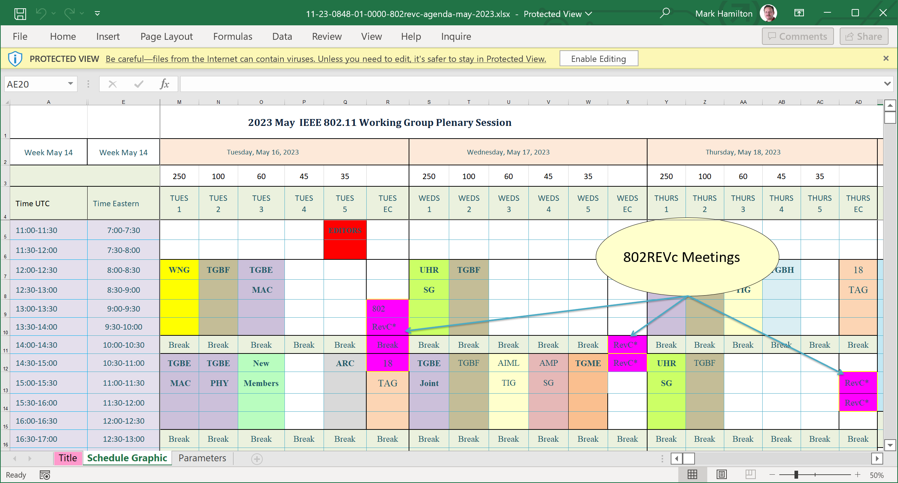
P802REVc meetings this week
(in Hibiscus)

Slide 21
Annex G way forward – Step 2
Annex G way forward:
    Consider scope/purpose for (new) Annex G – informative or normative, etc.
    Straw Poll in Jan: “Do you support deleting Annex G?” 2/6/5.
    Continue discussion on a “replacement” Annex G
      11-23/0419r0 (Harry Bims)

Slide 22
Next steps
Contributions requested/expected:
  Annex G
  Anything on 802REV before May?
July session planning
  1 or 2 slots? 2
  Topics? Annex G, 802REVc
Next Teleconference(s):
  May to July teleconference plan… Any/How many telecons?
    Conflicts to avoid: TGbe, REVme, TGbh, 802REVc
    Continue with Monday 1PM ET ?
    Dates to avoid??
  Will be coordinated with other TG chairs, and announced later

