Slide 1
Clause 6.3 new format
Date: 2023/3/31
Authors:
Name | Affiliation | Address | Phone | Email
Narengerile | Huawei Technologies Co., Ltd. |  |  | narengerile@huawei.com
Stephen McCann
Claudio da Silva | Meta Platforms, Inc.
Zhuqing Tang | Huawei Technologies Co., Ltd.

Slide 2
Introduction
This contribution presents a top level overview of the most significant changes to 11bf D1.0 Clause 6, to align with the new format used in the baseline (i.e., 802.11 REVme D2.1) [1].
The contribution also presents the plan to resolve all 82 comments under the topic of “MLME” for LB272 [2].
The goal is to convert the current subclause 6.3 in 11bf D1.0 to subclause 6.4 and 6.5 using the same format as in REVme D2.1.

Slide 3
Background ①②③
In 11bf D1.0, we have 4 subclauses in Clause 6.3:
WLAN sensing procedure
SBP procedure
DMG sensing procedure
DMG SBP procedure
Which results in 44 pages in total in Clause 6.3.
As a comparison, Clause 11 has 55 pages.
In REVme D2.1, all MLME SAP primitives are classified into 7 types, and summarized into Table 6-1 – MLME SA interface.

Slide 4
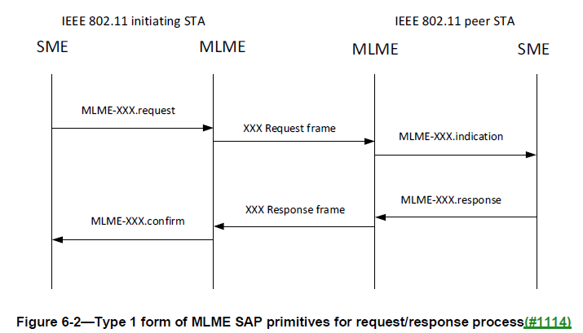
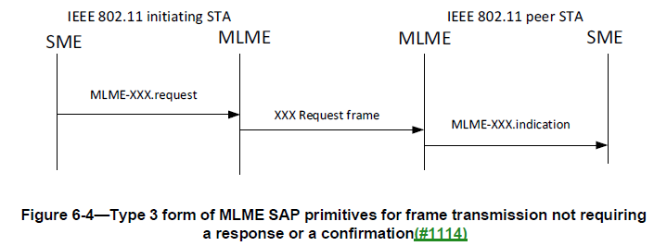
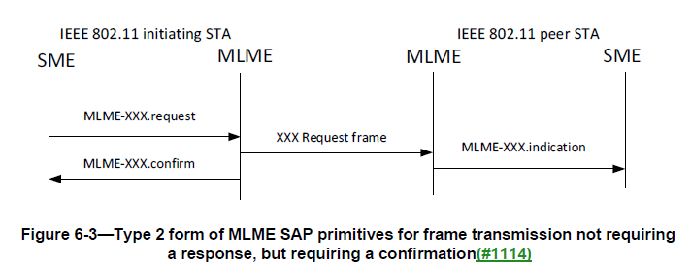
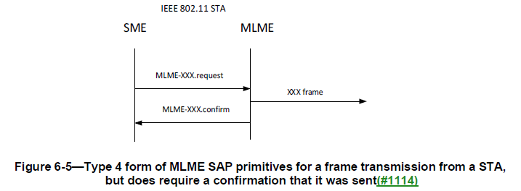
Background ①②③ MLME SAP Types

Slide 5
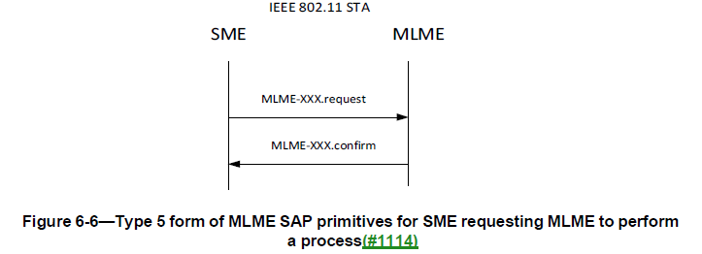
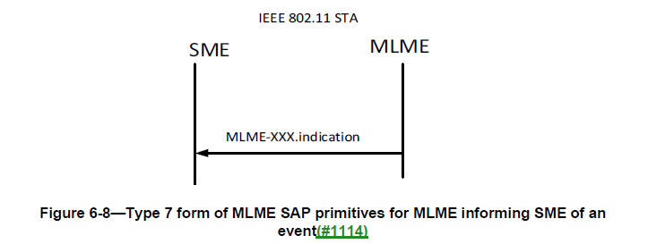
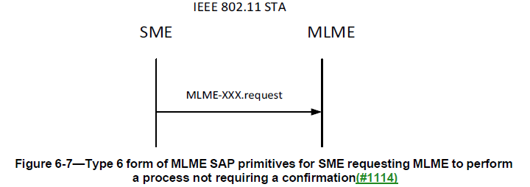
Background ①②③ MLME SAP Types

Slide 6
WLAN sensing procedure
(TB and non-TB sensing measurement setup)
The sensing measurement setup process does not differentiate from TB and non-TB.
MLME-SENSMSMTSETUP: Type 1
Type 1
Type 1

Slide 7
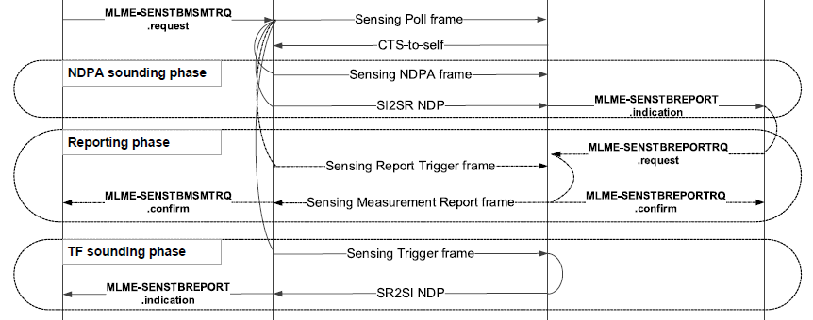
WLAN sensing procedure
(TB sensing measurement instance)
A TB sensing measurement instance with a basic reporting phase
Proposed change: replace MLME-SENSTBMSMTRQ.confirm with MLME-SENSTBREPORTRQ.indication
Reason 1: If we use .confirm, it means SME requests MLME to report the result of a requested process (e.g., a Result Code). There exists cases where the measurement report frame is not transmitted, i.e., .confirm doesn’t exist. – The process provided by MLME is not complete.
Reason 2: This primitive is report and deliver measurement reports to the SME of a sensing initiator. It should belong to the SENSTBREPORTRQ family.
Sensing initiator (AP)
Sensing responder (non-AP STA)
MLME-SENSTBREPORTRQ.indication

Slide 8
WLAN sensing procedure
(TB sensing measurement instance)
A TB sensing measurement instance with a basic reporting phase
MLME-SENSMSMTRQ: Type 6
MLME-SENSTBREPORT: Type 7
MLME-SENSTBREPORTRQ: Type 2 (when used in a basic reporting phase, see next slide)
Sensing initiator (AP)
Sensing responder (non-AP STA)
Type 6
Type 7
Type 2
MLME-SENSTBREPORTRQ
.indication
Type 7

Slide 9
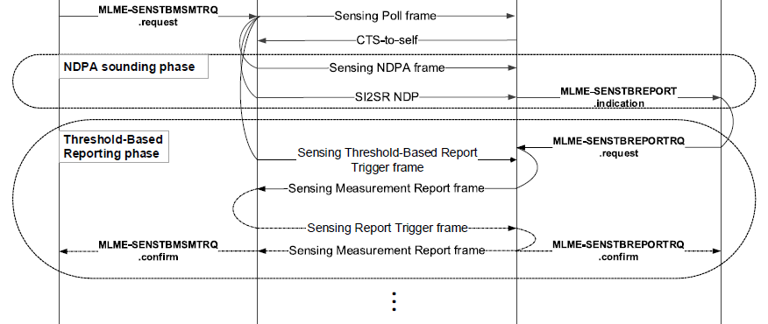
WLAN sensing procedure
(TB sensing measurement instance)
A TB sensing measurement instance with a threshold-based reporting phase
MLME-SENSTBREPORTRQ.request will deliver both CSI variation and CSI measurements to the MLME, and may initiate two transmissions of two separate Sensing Measurement Report frames.
This does NOT fit Type 2.
Since same report primitives are used in basic reporting and threshold-based reporting, the primitive type should be unified. Therefore, MLME-SENSTBREPORTRQ does NOT belong to any type when used in a threshold-based reporting phase.
N/A
MLME-SENSTBREPORTRQ
.indication

Slide 10
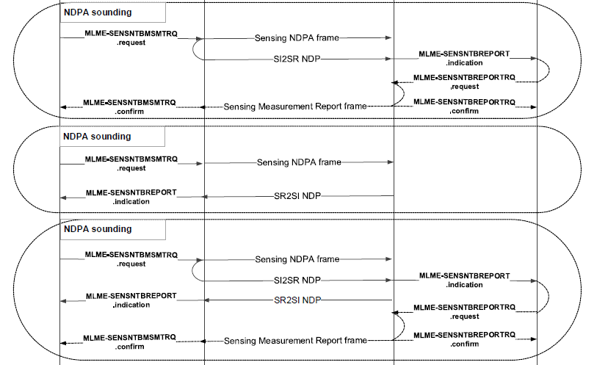
WLAN sensing procedure
(Non-TB sensing measurement instance)
Sensing initiator (non-AP STA)
Sensing responder (AP)
Type 6
Type 7
MLME-SENSTBREPORTRQ
.indication
Type 2
Type 6
Type 7
Type 6
Type 7
Type 7
MLME-SENSTBREPORTRQ
.indication
Type 2
Proposed change:
Combine SENS(N)TBREPORT into SENSREPORT
Combine SENS(N)TBREPORTRQ into SENSREPORTRQ

Slide 11
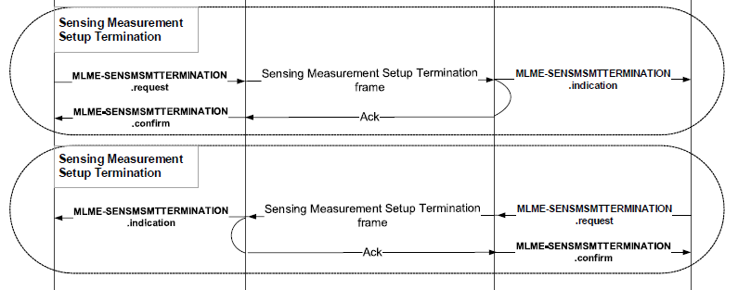
WLAN sensing procedure
(TB and non-TB sensing measurement setup termination)
The sensing measurement setup termination phase does not differentiate from TB and non-TB. Take the TB case as an example.
Type 2
Type 2

Slide 12
Table 6-1 – MLME SA interface
Service Name | MLME-XXX | Type | References | Comments
WLAN sensing procedure | SENSMSMTSETUP | 1 | 9.6.7.49 ((Protected) Sensing Measurement Setup Request frame format), 9.6.7.50 ((Protected) Sensing Measurement Setup Response frame format) | See 11.55.1.4 (Sensing measurement setup)
 | SENSMSMTTERMINATION | 2 | 9.6.7.52 ((Protected) Sensing Measurement Setup Termination frame format) | See 11.55.1.6 (Sensing measurement setup termination)
 | SENSTBMSMTRQ | 6 | 9.3.1.22.14.2 (Sensing Polling Trigger frame), 9.3.1.19.5 (Sensing NDP Announcement frame format), 9.3.1.22.14.3 (SR2SI Sounding Trigger frame), 9.3.1.22.14.6 (SR2SR Sounding Trigger frame), 9.3.1.22.14.4 (Sensing Report Trigger frame), 9.3.1.22.14.5 (Sensing Threshold-based Report Trigger frame) | See 11.55.1.5.2 (TB sensing measurement instance)
 | SENSNONTBMSMTRQ | 6 | 9.3.1.19.5 (Sensing NDP Announcement frame format), 9.3.1.22.14.4 (Sensing Report Trigger frame) | See 11.55.1.5.3 (Non-TB sensing measurement instance)
 | SENSREPORT | 7 | 9.4.1.75 (Sensing Measurement Report Container field) | See 11.55.1.5.2.6 (Reporting phase), 11.55.1.5.3.3 (Reporting phase)
 | SENSREPORTRQ | N/A | 6.5.25 (WLAN sensing procedure)

Slide 13
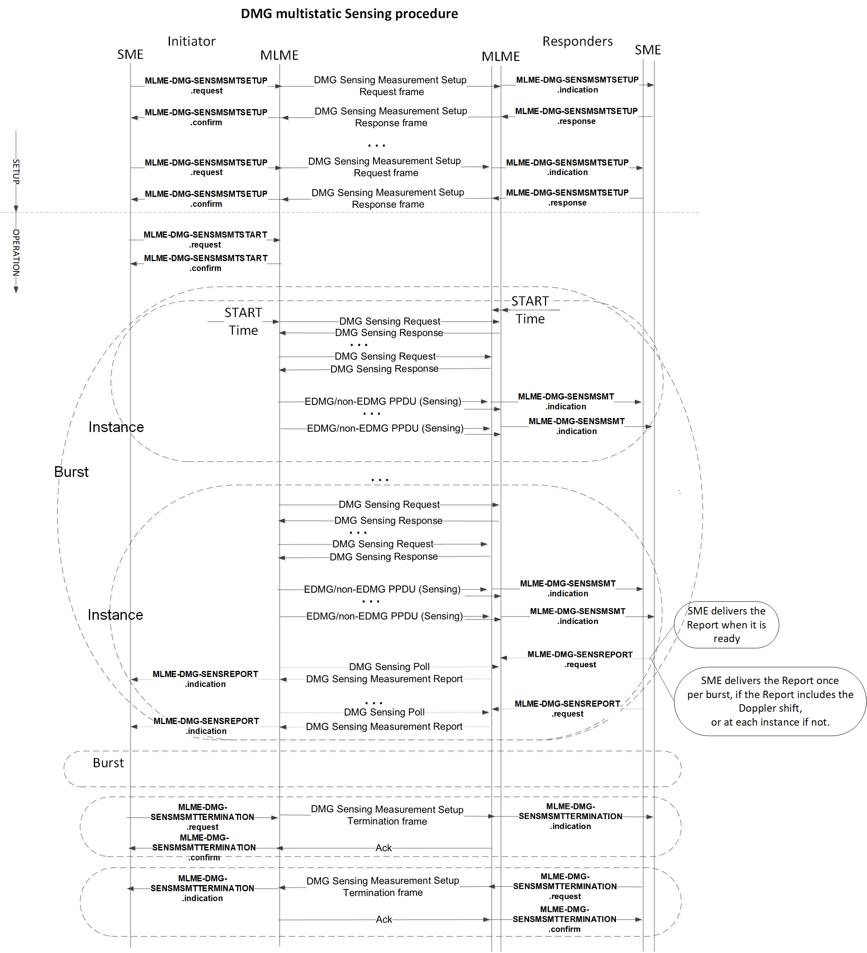
[3]
Type 1
DMG sensing procedure
Type 5
MLME-DMG-SENSMSMTSETUP: Type 1
MLME-DMG-SENSMSMTTERMINATION: Type 2
MLME-DMG-SENSREPORT: Type 3
MLME-DMG-SENSMSMTSTART: Type 5
MLME-DMG-SENSMSMT: Type 7
Type 7
Type 3
Type 2
Notes:
Length inconsistent

Slide 14
Service Name | MLME-XXX | Type | References | Comments
DMG sensing procedure | DMG-SENSMSMTSETUP | 1 | 9.6.19.24 (Protected DMG Sensing Measurement Setup Request frame format), 9.6.19.25 (Protected DMG Sensing Measurement Setup Response frame format), 9.6.21.8 (DMG Sensing Measurement Setup Request frame format), 9.6.21.9 (DMG Sensing Measurement Setup Response frame format) | See 11.55.3.4 (DMG sensing measurement setup)
 | DMG-SENSMSMTTERMINATION | 2 | 9.6.21.11 (DMG Sensing Measurement Setup Termination frame format), 9.6.36.4 (Protected DMG Sensing Measurement Setup Termination frame) | See 11.55.3.8 (DMG sensing measurement setup termination)
 | DMG-SENSMSMTSTART | 5 | 9.6.21.3 (BRP frame format), 9.3.1.25.5 (DMG Sensing Request), 9.3.1.25.7 (DMG Sensing Poll) | See 11.55.3.5 (DMG sensing burst), 11.55.3.6 (DMG sensing instance)
 | DMG-SENSMSMT | 7 | 9.6.21.10 (DMG Sensing Measurement Report frame format), 9.6.36.3 (Protected DMG Sensing Measurement Report frame) | See 11.55.3.6 (DMG sensing instance), 11.55.3.7 (DMG sensing measurement reporting)
 | DMG-SENSREPORT | 3 |  | See 11.55.3.6 (DMG sensing instance), 11.55.3.7 (DMG sensing measurement reporting)

Slide 15
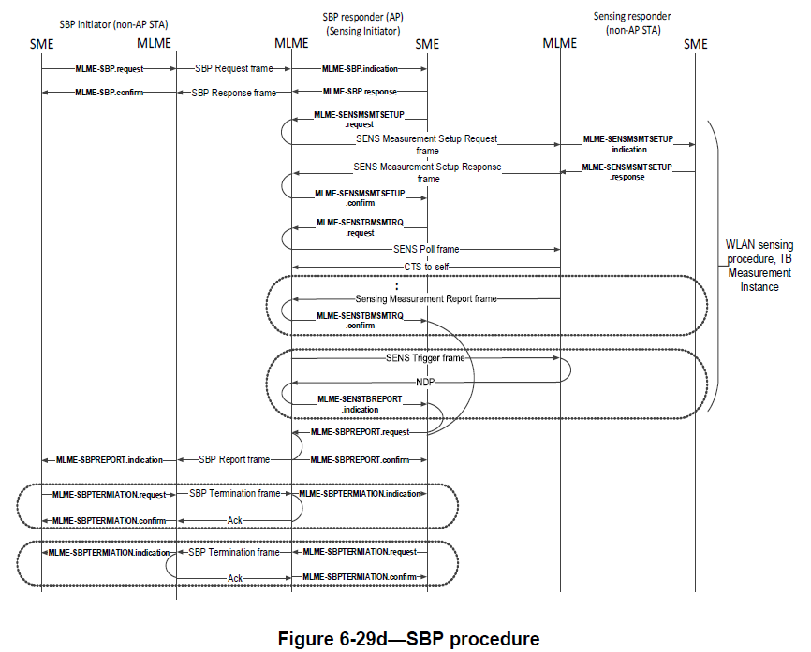
SBP procedure
Type 1
MLME-SBP: Type 1
MLME-SBPREPORT: Type 2
MLME-SBPTERMINATION: Type 2
Type 2
Type 2
Notes:
Length inconsistent

Slide 16
Service Name | MLME-XXX | Type | References | Comments
SBP procedure | SBP | 1 | 9.6.7.54 ((Protected) SBP Request frame format), 9.6.7.55 ((Protected) SBP Response frame format) | See 11.55.2 (SBP procedure)
 | SBPREPORT | 2 | 9.6.7.57 (SBP Report frame format), 9.6.36.6 (Protected SBP Report frame)
 | SBPTERMINATION | 2 | 9.6.7.56 ((Protected) SBP Termination frame format)
DMG SBP procedure | DMG-SBP | 1 | 9.6.19.26 (Protected DMG SBP Request frame format), 9.6.19.27 (Protected DMG SBP Response frame format), 9.6.21.12 (DMG SBP Request frame format), 9.6.21.13 (DMG SBP Response frame format) | See 11.55.4 (DMG SBP procedure)
 | DMG-SBPREPORT | 2 | 9.6.19.28 (Protected DMG SBP Report frame format), 9.6.21.14 (DMG SBP Report frame format)
 | DMG-SBPTERMINTION | 2 | 9.6.21.15 (DMG SBP Termination frame format), 9.6.36.5 (Protected DMG SBP Termination frame)

Slide 17
A summary of proposed changes
Technical changes:
Replace MLME-SENSTBMSMTRQ.confirm with MLME-SENSTBREPORTRQ.indication
Combine SENS(N)TBREPORT into SENSREPORT
Combine SENS(N)TBREPORTRQ into SENSREPORTRQ
Editorial changes:
SENSNTBMSMTRQ -> SENSNONTBMSMTRQ
The whole subclause 6.3 in 11bf D1.0 will be reformatted into subclause 6.4 and 6.5, according to the primitive tables given in this contribution.
The primitives related to SENSREPORTRQ will be specified in subclause 6.5.

Slide 18
Plan for CR
Step 1: Categorise and summarise all existing primitives into Table 6-1 in subclause 6.4 (0512r1)
Step 2: Present the proposed draft text (PDT) of subclauses 6.4 and 6.5 to TGbf
Close corresponding comments ($≈$95%)
Step 3: Check the remaining comments that need to be resolved and may provide another contribution

Slide 19
Reference
[1] https://www.ieee802.org/11/private/Draft_Standards/11me/Draft%20P802.11REVme_D2.1.pdf
[2] https://mentor.ieee.org/802.11/dcn/23/11-23-0314-03-00bf-lb272-comments-and-approved-resolutions.xlsx
[3] https://mentor.ieee.org/802.11/dcn/22/11-22-1751-01-00bf-dmg-mlme-primitives-introduction.pptx

