Slide 1
Wi-Fi deferral for NB signals
Author:
Name | Affiliation | Address | Phone | Email
Menzo Wentink | Qualcomm | Utrecht, The Netherlands | +31-65-183-6231 | mwentink qti.qualcomm.com
Richard van Nee | Qualcomm | Utrecht, The Netherlands

Slide 2
Introduction
These slides describe a cabled experiment in which a continuous NB signal is provided to a Wi-Fi access point at -62 dBm/20 MHz
the NB signal is a continuous wave (CW) signal tuned in the primary channel of the AP
the AP has its primary channel at center frequency 5 300 MHz
the CW signal is tuned at 5 305 MHz
the test setup is similar to the setup used for ETSI ED testing, cabled
The expectation is that the Wi-Fi AP defers for the NB signal based on its energy detect (ED) CCA

Slide 3
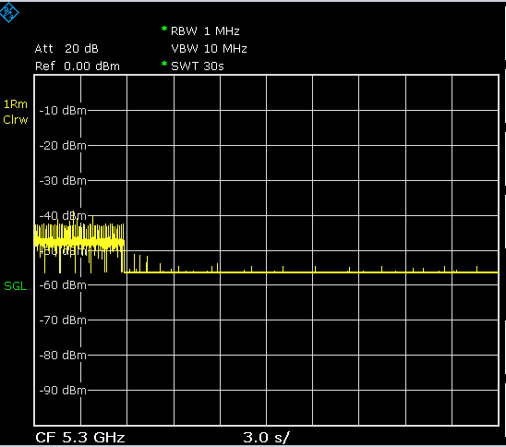
Test results
The CW signal starts here
The Wi-Fi AP defers for the CW signal
This level is the spectrum analyzer’s noise floor, which depends on resolution bandwidth and cable attenuation. The CW signal itself is not visible in this setup

Slide 4
Conclusion
The Wi-Fi AP defers for the NB signal (continuous CW) that is present at its antenna connector at -62 dBm/20 MHz

Slide 5
References
11-22-1578-01-0wng-coexistence-of-narrowband-frequency-hopping-nb-fh-systems-and-wi-fi
11-22-0998-01-0wng-clear-channel-assessment-cca-behavior-of-commerical-wi-fi-equipment

