Slide 1
TGbi – Rotating MAC Addresses for MLO and non-MLO
Date: 2023-03-11
Authors:
Name | Affiliations | Address | Phone | email
A. De la Oliva | InterDigital, UC3M | Avda. De la Universidad 30, Leganes, Madrid, Spain | +34 91 6248803 | aoliva@it.uc3m.es
J. Levy | Interdigital

Slide 2
Abstract
This document describes a solution for CCMP encapsulation/decapsulation supporting MLO and non-MLO.

Slide 3
Background
otaMAC: over the air medium access control address
Note: A temporal MAC address used in frames transmitted over the air. For individually addressed frames where the To DS bit is set to 1 and the From DS bit is set to 0, the otaMAC is transmitted as the Address 2. For individually addressed frames where the To DS bit is set to 0 and the From DS bit is set to 1, the otaMAC is transmitted as the Address 1. The purpose of the otaMAC is to keep private the aaMAC of the STA.
DSMAC: association and authentication medium access control address
Note: The aaMAC corresponds to the MAC address used for the association and authentication process between the AP and the STA and is the one indexed in the RSNA. This MAC address is used to set up the RSNA, for routing traffic to the STA on the DS network segment and it is also the one used for mobility related operations such as Fast Transition mechanisms.

Slide 4
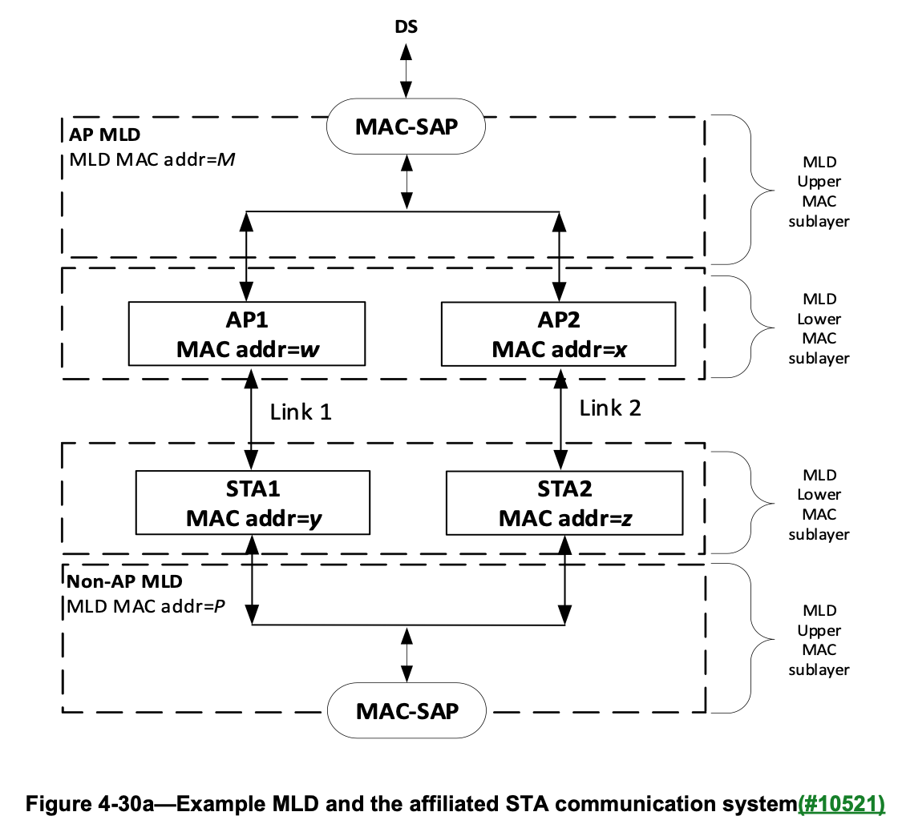
Background on MLD
Each MLD has a single MAC-SAP. Each AP affiliated with an AP MLD has a MAC address different from any other AP affiliated with the AP MLD, and each non-AP STA affiliated with a non-AP MLD has a MAC address different from any other non-AP STA affiliated with the non-AP MLD.
The MLD MAC address (M and P in Figure 4-30a (Example MLD and the affiliated STA communication system)) play the role of aaMAC addresses. Addresses w, x, y and z are considered otaMAC addresses and may change during the operation of the MLO.
DS MAC == STA’s MLD MAC
otaMAC == STA’s e.g., y, z

Slide 5
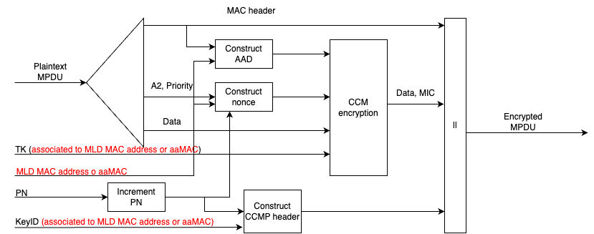
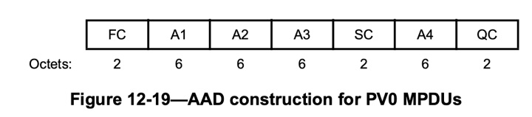
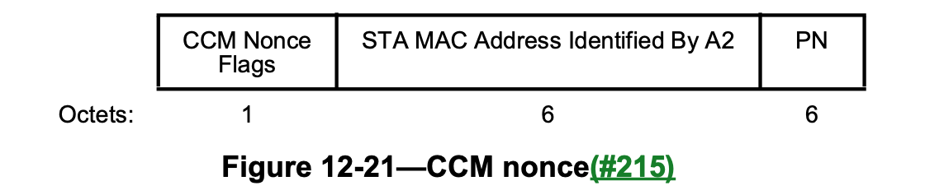
Proposal
Use, in all cases, the CCMP encapsulation defined in IEEE 802.11be. For MLD and non MLD STAs.
Rx DS MAC
Tx DS MAC
Tx DS MAC

Slide 6
Compatibility with IEEE 802.11bh IRM
IRM scheme is:
  STA provides a (random) MAC Address to the AP/ESS in each association (msg 2)
  STA uses that address in the next association.
IRM can be used as the next address to be used for association -> next DS_MAC
The mechanism is fully compatible with the concept of rotating MAC address, just use IRM as DS_MAC for next association, then rotate addresses

Slide 7
Benefits/drawbacks
Benefits
1 implementation for all, including bi
Single CCMP mechanism for MLO and non-MLO (based on mechanism already in place)
Decouples CCMP encapsulation/decapsulation from frame anonymization/de-anonymization
Drawbacks
Modified how non-MLD frames currently use CCMP encapsulation/decapsulation

Slide 8
Straw Poll (March 2023)
Do you prefer for non-MLD STA case
  Option A: AAD and Nonce based on over the air MAC addresses (slide 4)
  Option B: AAD and Nonce based on DS MAC (aaMAC) addresses (slide 6)
  Option C: More information needed
  A 0%, B 23%, C 63%

Slide 9
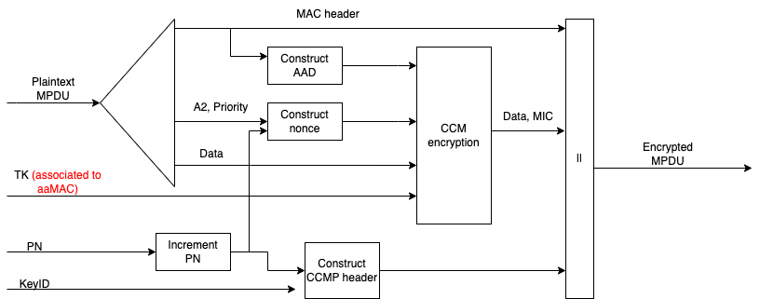
Background
DCN 2023/133r0 provided encapsulation/decapsulation mechanism which enable the MAC address rotation (A1 and/or A2) for non-MLO.
It basically works by using the key associated to the aaMAC instead of the one associated to the A1 frame.
Advantages: simple, no change required to mechanism in place
Drawback: frame arriving to CCMP encapsulation needs to be the same as the frame arriving to CCMP decapsulation (constraining position of anonymization/de- block)

