Slide 1
TGbi – Rotating MAC Addresses for MLO and non-MLO
Date: 2023-03-11
Authors:
Name | Affiliations | Address | Phone | email
A. De la Oliva | InterDigital, UC3M | Avda. De la Universidad 30, Leganes, Madrid, Spain | +34 91 6248803 | aoliva@it.uc3m.es
J. Levy | Interdigital

Slide 2
Abstract
This document describes a solution for CCMP encapsulation/decapsulation supporting MLO and non-MLO.

Slide 3
Background
otaMAC: over the air medium access control address
Note: A temporal MAC address used in frames transmitted over the air. For individually addressed frames where the To DS bit is set to 1 and the From DS bit is set to 0, the otaMAC is transmitted as the Address 2. For individually addressed frames where the To DS bit is set to 0 and the From DS bit is set to 1, the otaMAC is transmitted as the Address 1. The purpose of the otaMAC is to keep private the aaMAC of the STA.
aaMAC: association and authentication medium access control address
Note: The aaMAC corresponds to the MAC address used for the association and authentication process between the AP and the STA and is the one indexed in the RSNA. This MAC address is used to set up the RSNA, for routing traffic to the STA on the DS network segment and it is also the one used for mobility related operations such as Fast Transition mechanisms.

Slide 4
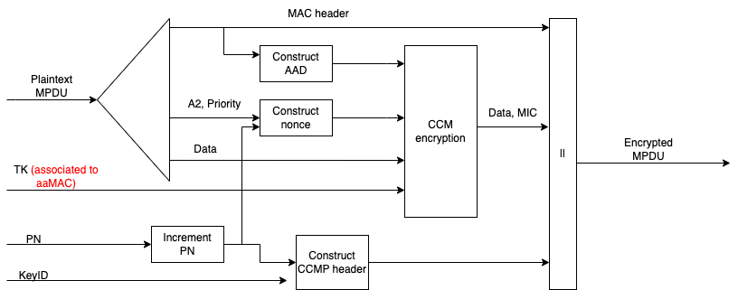
Background
DCN 2023/133r0 provided encapsulation/decapsulation mechanism which enable the MAC address rotation (A1 and/or A2) for non-MLO.
It basically works by using the key associated to the aaMAC instead of the one associated to the A1 frame.
Advantages: simple, no change required to mechanism in place
Drawback: frame arriving to CCMP encapsulation needs to be the same as the frame arriving to CCMP decapsulation (constraining position of anonymization/de- block)

Slide 5
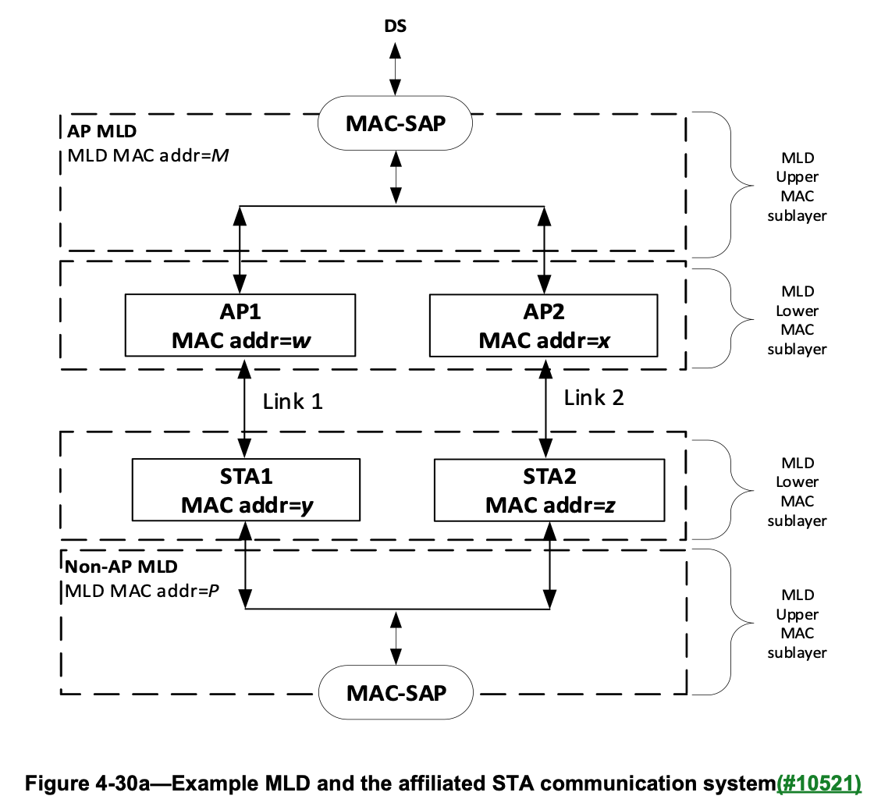
Background on MLD
Each MLD has a single MAC-SAP. Each AP affiliated with an AP MLD has a MAC address different from any other AP affiliated with the AP MLD, and each non-AP STA affiliated with a non-AP MLD has a MAC address different from any other non-AP STA affiliated with the non-AP MLD.
The MLD MAC address (M and P in Figure 4-30a (Example MLD and the affiliated STA communication system)) play the role of aaMAC addresses. Addresses w, x, y and z are considered otaMAC addresses and may change during the operation of the MLO.

Slide 6
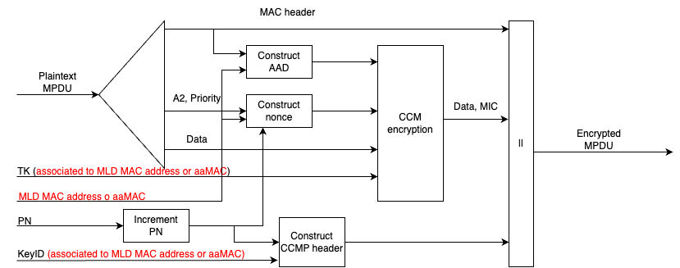
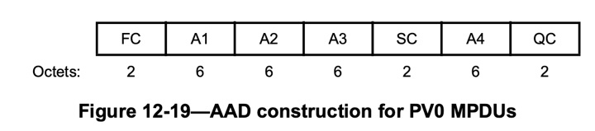
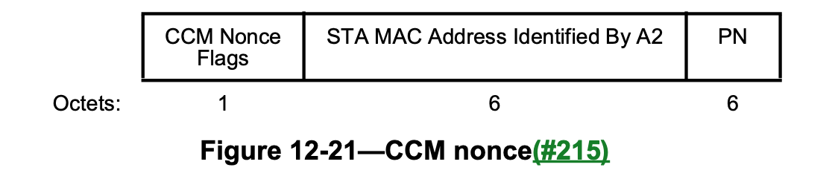
Proposal
To provide a single mechanism for MLO and non-MLO, we propose to extend the MLO CCMP encapsulation/decapsulation to non-MLO
The aaMAC of the non-MLO STA is used as MLD_MAC in the MLO case
Rx aaMAC
Tx aaMAC
Tx aaMAC

Slide 7
Benefits/drawbacks
Benefits
Single CCMP mechanism for MLO and non-MLO (based on mechanism already in place)
Decouples CCMP encapsulation/decapsulation from frame anonymization/de-anonymization
Drawbacks
Modified how non-MLD frames currently use CCMP encapsulation/decapsulation

