Slide 1
TGbi – Anonymizing frames and A1 filtering
Date: 2023-05-13
Authors:
Name | Affiliations | Address | Phone | email
A. De la Oliva | InterDigital, UC3M | Avda. De la Universidad 30, Leganes, Madrid, Spain | +34 91 6248803 | aoliva@it.uc3m.es
J. Levy | Interdigital

Slide 2
Abstract
Some works in IEEE 802.11bi propose anonymizing A1 and A2 addresses by rotating the transmitting and receiving MAC addresses.
  DCN 2021/1539r0
  DCN 2023/133r0
Such a mechanism have implications on how a STA performs A1 filtering, since the A1 may change, some challenges discussed are:
  An A1 MAC address is only used as receiver address for a period of time
  When an A1 MAC address changes, retransmissions may use the “previous” MAC address.
  How are the MAC address transitions coordinated between the transmitter and the receiver.
This document proposes a mechanism enabling A1 filtering in such a scenario
  Proposal includes discussion on the anonymization/de-anonymization block

Slide 3
Background
A1 address filtering is done right after CRC validation
  Some implementations may do Block Ack Scoreboarding right after
The process itself is not defined in the spec
It considers filtering based on:
  MAC address of the receiving STA
  dot11GroupAddressesTable

Slide 4
Current description for A1 filtering (11me D2.0)
A1 filtering described in 10.2.8 - MAC data service
  A MAC performs address filtering on the Address 1 field in each MPDU contained in a PPDU and, for non-GLK non-AP STAs, on the DA of each MSDU within an A-MSDU.
  In the case of a non-GLK STA receiver, when the Address 1 field or DA field contains a group address, address filtering is performed by comparing the value in the Address 1 field or DA field to all values in the dot11GroupAddressesTable and the broadcast address value.
  If the Address 1 field of an MPDU carrying an A-MSDU does not match any address at a receiving STA, then the entire A-MSDU is discarded.

Slide 5
Current proposals
2022/1870r0 (SRT, Graham) – Protection against Spoof AP using Probe: Requires STAs to use two MAC addresses simultaneously -> Requires list of addresses (2) for A1 filtering. There is no interim, both addresses available at same time.
2023/268r0 (Cox, Carol) - Proposal for OTA MAC Change -> Requires signaling change of MAC address, requires emptying queues, signaling in beacon, MAC addresses are generated in sequence, requires sync.
2023/328r0 (Cox, Carol) – Proposal for MLD OTA MAC Change -> similar features as previous, requires flushing queues since it assumes no simultaneous use of MAC Addresses.
2023/411r0 (Canon, Julien) – Obfuscation of Multiple CPE Parameters -> assumes simultaneous use of MAC addresses during interim.

Slide 6
Summary of background
All proposals either assume an interim where queues need to be flushed, stop transmission, recompute parameters and resume or assume simultaneous use of several addresses
The use of multiple addresses in A1 filtering is already accepted in the standard for Group Addresses

Slide 7
Proposal
Use a solution similar to what is used for dot11GroupAddressesTable
A group of the A1 and A2 addresses allows for different addresses to be used each direction of the communication
Anonymization/de-anonymization works by selecting addresses from the above sets

Slide 8
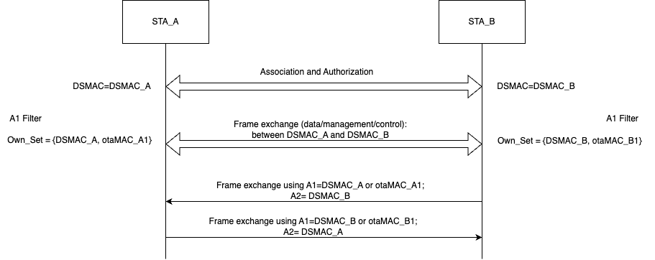
Example for A1 filtering using a group

Slide 9
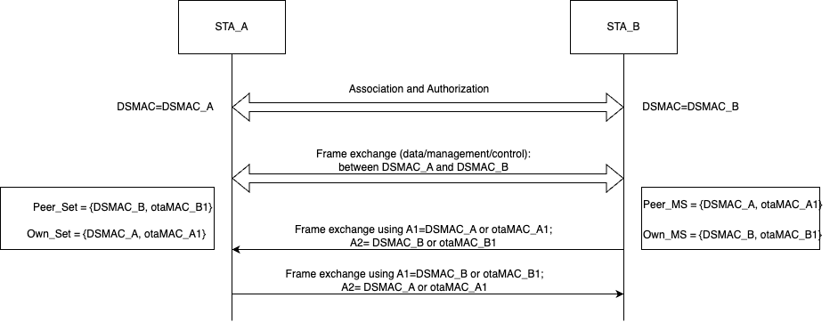
Example for A1 and A2 anonymization

Slide 10
Anonymization process (from A)
The transmitting process starts by the anonymization process of the frame, by the STA processing a MDPU to be transmitted (A).
  Frame[A1=DSMAC_B, A2=DSMAC_A]
It first finds the list of otaMACs binded to the Rx (A1, DSMAC_B) address on the MPDU (list of MAC addresses stored in the Peer_Set).
Once found, the transmitting STA may choose among all the otaMAC addresses stored in the Peer_Set (A1) and the otaMAC addresses signaled to B (Own_Set) for A2.
The MPDU is then modified, exchanging the A1 and A2 addresses by the newly selected transmitting and receiving otaMAC and MPDU processing continues using the current 802.11 process to transmit the frame.
  Frame[A1=otaMAC_B1||DSMAC_B, A2=DSMAC_A||otaMAC_A1]
Note: if this process is coupled with the CCMP encapsulation process proposed in DCN 2023/416r0. Then the anonymization process can be done decoupled from the CCMP encapsulation

Slide 11
A1 filtering/De-anonymization/reception process (from B)
The receiving process starts by the STA (B) receiving a unicast frame and performing A1 filtering.
  Frame[A1=otaMAC_B1||DSMAC_B, A2=DSMAC_A||otaMAC_A1]
The receiving STA compares the A1 address in the received frame to the list of otaMAC addresses stored in its Own_Set.
If found, processing can continue, otherwise the frame should be discarded.
After checking A1, the EP receiving STA checks for the A2 address, comparing it to the otaMAC addresses stored in the Peer_Sets.
If found, the frame is modified, exchanging the A1 address by the DSMAC of the receiving DSMAC (DSMAC_B) and the A2 by the transmitting DSMAC (DSMAC_A).
  Frame[A1=DSMAC_B, A2=DSMAC_A]
Note: if this process is coupled with the CCMP de/capsulation process proposed in DCN 2023/416r0. Then the de-anonymization process can be done decoupled from the CCMP decapsulation

Slide 12
Benefits/drawbacks of the approach
The proposal enables communication between two STAs that use anonymized MAC addresses for A1 and A2 in each direction of the communication → high level of ofuscation
Proposed use of address sets reduce the complexity of managing the addresses, it reduces non steady state periods and allows for retransmissions
  No need to empty queues, any address can be used any time
MAC addresses can be added/removed any time, retransmitions should not modify addresses, a STA can decide to stop using an address, signal its removal and actually take it out from the set considering enough time to not face problems.
May require increased memory space → this can be bounded by setting a maximum size of the sets

